Slide 1
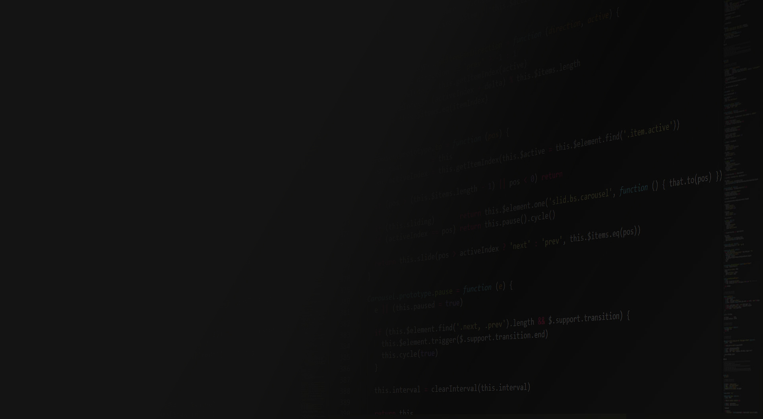


Amplitude 2017 #cashlessbanoindia

Slide 2


TechnoRocks
Executive pitch
Hackathon Theme :
Create Metadata rules platform

Slide 3
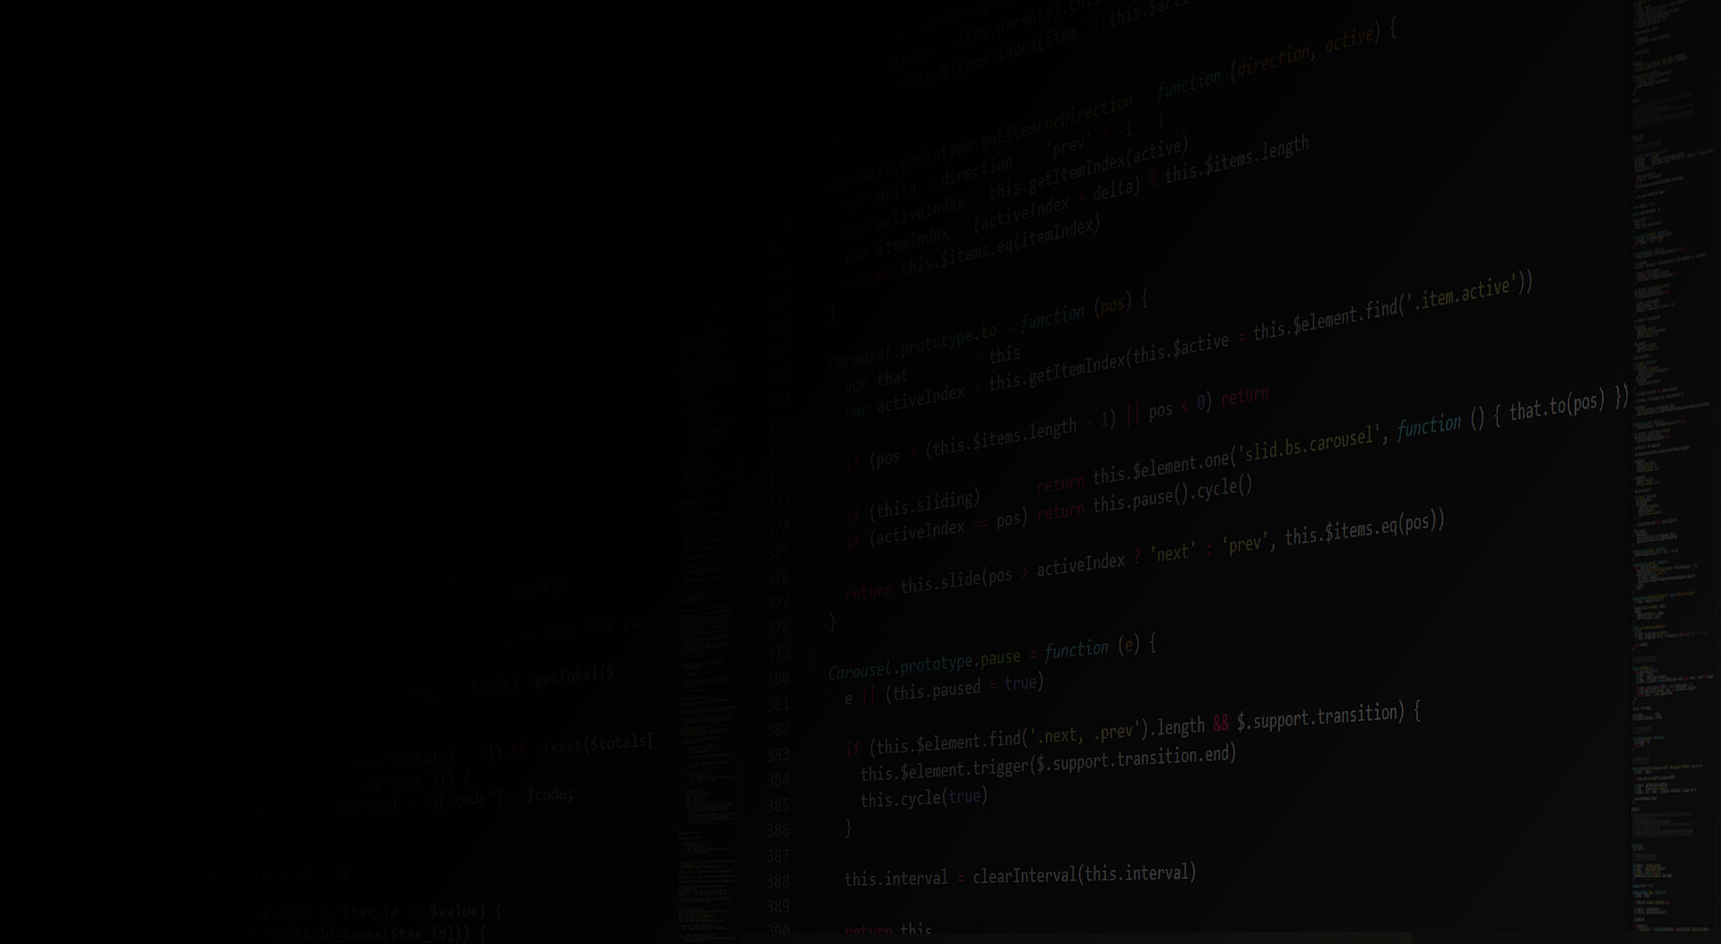

What are the Pain Point(s) addressed ?
Change rules on runtime
GUI based application to define rules
Capability to test defined rules
Set validity for rules
Scalability
Notes:
Is there a clear pain-point their idea is addressing? Does their idea clearly meet the needs of this pain point?

Slide 4

What is Your Solution to Address Pain Point(s)?
Zero Downtime
Zero Coding
Simulation using REST Service
Time-based Rules
Notes:
To what degree is the solution a viable technical solution that promotes a great user experience?

Slide 5

How to Implement Your Solution?
Define Business Rule in from GUI based tool.
Define Validity period of BusinessRule
Export Rule-based file in Web Application.
Load file on every change.
REST API call will invoke loaded file.
Application will only call REST API.

Slide 6
How to Implement Your Solution?
Define Business Rule in from GUI based tool.
Define Validity period of BusinessRule
Export Rule-based file in Web Application.
Load file on every change.
REST API call will invoke loaded file.
Application will only call REST API.

Slide 7
What are the Risks/Issues for GoToMarket ?

Slide 8
Q & A

