Slide 1
COVID19 VACCINE TWEETS
PROJECT COORDINATORS:
VIJENDAR REDDY.G
BHARATHI
PROJECT GUIDE:
DR.PRASANNA LAKSHMI.K
HOD
TEAM MEMBERS:
1)VINOD MAHESH JAIN
2)AKHIL YADAV.M
3)JAANU NAIK
4)B.SAI SANKEERTH
5)SAMUEL.A

Slide 2
INTRODUCTION
We will extract all the words from the dataset which will be categorized into positive, negative or neutral.
The extracted words will be displayed in the form of three pictures, each representing opinions of three categories - positive, negative or neutral.
We have collected a dataset on COVID-19 Vaccine Tweets to find out the opinions of people about different vaccines.

Slide 3
REQUIREMENTS
Any Operating System i.e., Windows 7/8/8.1/10 or Linux or MacOS
Anaconda navigator
A minimum of 4GB RAM

Slide 4
MODULES
fastai - It is a deep-learning library which provides practitioners with high level components that can quickly and easily provide state of the art results in standard deep learning domains and provides researchers with low-level components that can be mixed and matched to build new approaches.
Wordninja-It is a Python package which probabilistically splits concatenated words using NLP based on English Wikipedia uni-gram frequencies.
Datablock-Generic container to quickly build datasets and dataloaders.

Slide 5
TRANSFER LEARNING IN NLP
We will be making use of transfer learning to help us create a model to analyze tweet sentiment.
The idea behind transfer learning is that neural networks learn information that generalizes to new problems.
ULMFit(Universal Language Model Fine-Tuning) approach is a transfer learning technique for NLP.

Slide 6
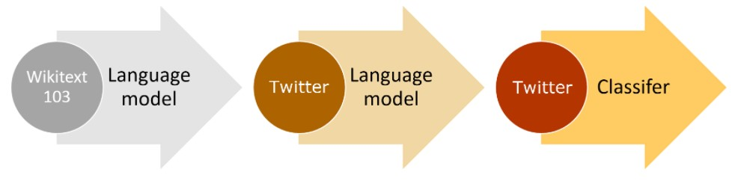
The ULMFiT approach is as follows:
Train a language model to predict the next word in a sentence. This is already done with fastai.
Fine-tune the language model to a more specific task.
Fine-tune a classification model to identify sentiment using the pre-trained language model.

Slide 7
TRAINING A LANGUAGE MODEL
To train our language model we can use self-supervised learning.
We just need to give the model some text as an independent variable and fastai will automatically preprocess it and create a dependent variable for us.
We use the DataLoaders class, which converts our input data into a DataLoader object that can be used as an input to a fastai learner.
By default, fastai uses word tokenization.

Slide 8
FINE TUNING THE LANGUAGE MODEL
The next step is to create a language model using language_model_learner.
We can find a good learning rate for training using lr_find and use that to fit our model.

Slide 9
TRAINING A SENTIMENT CLASSIFIER
To get the DataLoaders for our classifier we use the DataBlock API which is more customisable.
FINE TUNING THE CLASSIFIER
Now we can train the classifier using discriminative learning rates and gradual unfreezing, which has been found to give better results for this type of model.

Slide 10
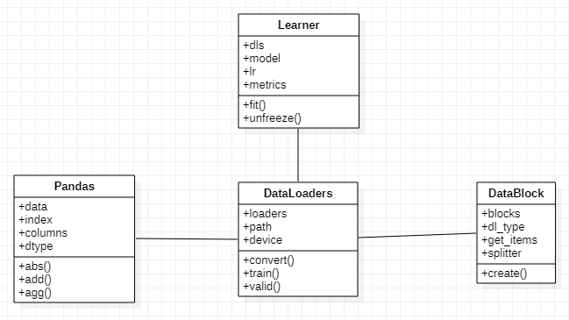
CLASS DIAGRAM

Slide 11
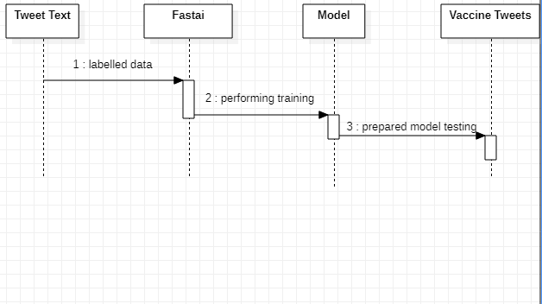
SEQUENCE DIAGRAM

Slide 12
THANK YOU!

