Slide 1

Structure of FitAB from Neisseria gonorrhoeae Bound to DNA Reveals a Tetramer of Toxin-Antitoxin Heterodimers Containing Pin Domains and Ribbon-Helix-Helix Motifs*
Kirsten Mattison, J.Scott Wilbur, Magdalene So, Richard G. Brennan
Journal of Biological Chemistry
Volume 281 Issue 49 Pages 37942-37951 (December 2006)
DOI: 10.1074/jbc.M605198200
Copyright © 2006 © 2006 ASBMB. Currently published by Elsevier Inc; originally published by American Society for Biochemistry and Molecular Biology. Terms and Conditions

Slide 2
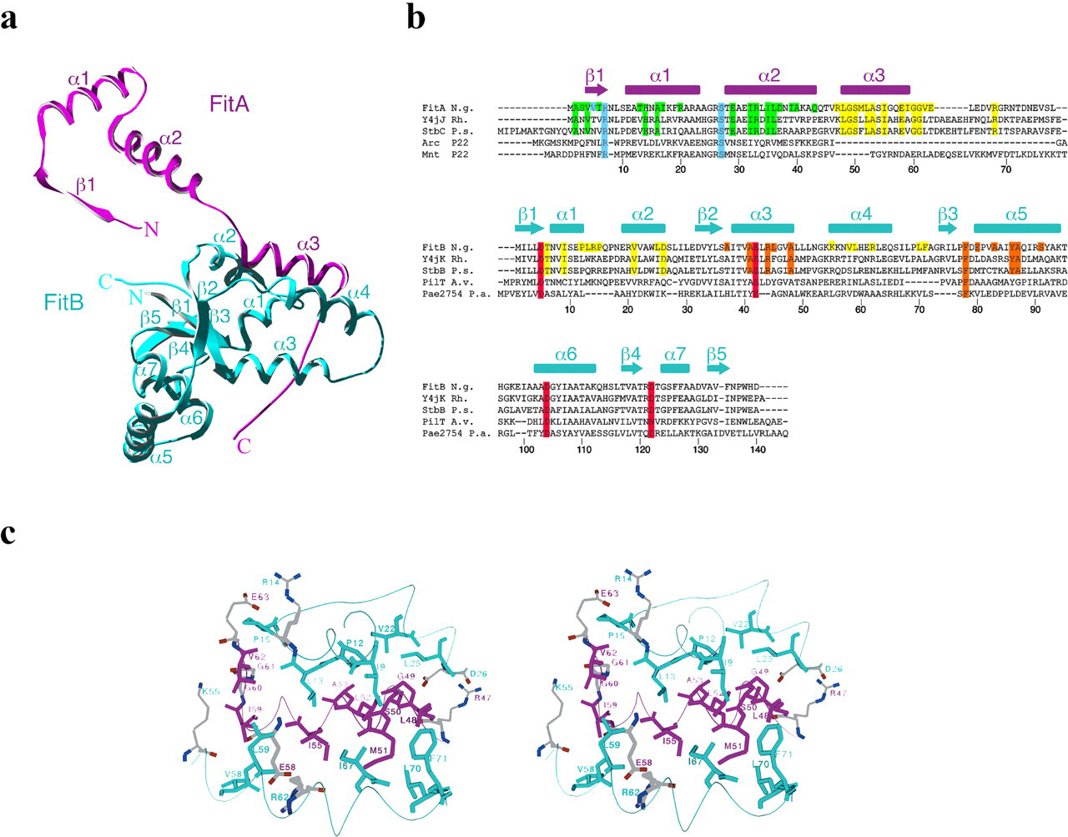
FIGURE 1
Journal of Biological Chemistry 2006 28137942-37951DOI: (10.1074/jbc.M605198200)
Copyright © 2006 © 2006 ASBMB. Currently published by Elsevier Inc; originally published by American Society for Biochemistry and Molecular Biology. Terms and Conditions
Notes:
Structure of the FitAB heterodimer. In all panels, FitA is shown in magenta and FitB is in cyan. a, ribbon diagram of the FitAB heterodimer. The α-helices and β-sheets for both proteins are labeled as are the N and C termini. b, sequence alignment of FitA and FitB proteins with homologues. Secondary structural elements of the proteins are shown above the alignment. Y4jJK from Rhizobium sp. and StbCB from Pseudomonas syringae are highly homologous to FitAB by sequence analysis but no structural data are available for either of these systems. Arc and Mnt from Enterobacteria phage P22 are ribbon-helix-helix proteins with structural homology to FitA. PilT from Azotobacter vinelandii and PAE2754 from Pyrobaculum aerophilum are PIN domain containing proteins with structural homology to FitB. Alignments were generated with ClustalW (49). Residues involved in FitA-FitB heterodimerization are highlighted in yellow, those forming the FitA-FitA dimer interface are highlighted in green, and those making up the FitB-FitB dimer interface are highlighted in orange. Conserved residues involved in specific protein-DNA contacts are highlighted in blue and the conserved acidic residues forming the putative FitB active site are highlighted in red. c, stereo view of the FitA-FitB heterodimer interface. Residues involved in ionic interactions contributing to the stability of the interface are colored according to gray (carbon), red (oxygen), and blue (nitrogen). This extensive interface buries up to 1900 Å² accessible surface area.

Slide 3
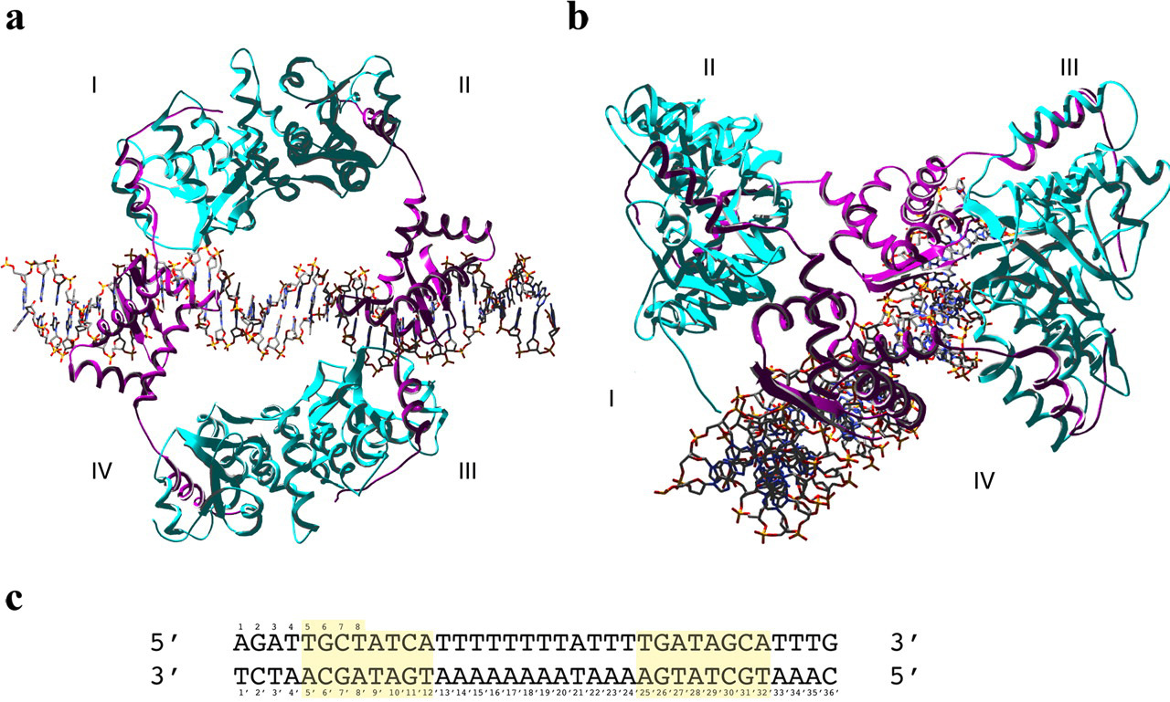
FIGURE 2
Journal of Biological Chemistry 2006 28137942-37951DOI: (10.1074/jbc.M605198200)
Copyright © 2006 © 2006 ASBMB. Currently published by Elsevier Inc; originally published by American Society for Biochemistry and Molecular Biology. Terms and Conditions
Notes:
Ribbon diagram of the structure of the FitAB-IR36 complex. a, the FitA and FitB proteins are colored magenta and cyan, respectively. DNA is colored according to gray (carbon), red (oxygen), blue (nitrogen), and yellow (phosphorus). The four FitAB heterodimers are numbered from I to IV. b, view of a rotated to demonstrate that the two FitA β sheets bind on the same face of the DNA helix. c, sequence of the 36-bp IR36 site used for crystallization. The 8-bp inverted repeat half-sites are highlighted in yellow.

Slide 4
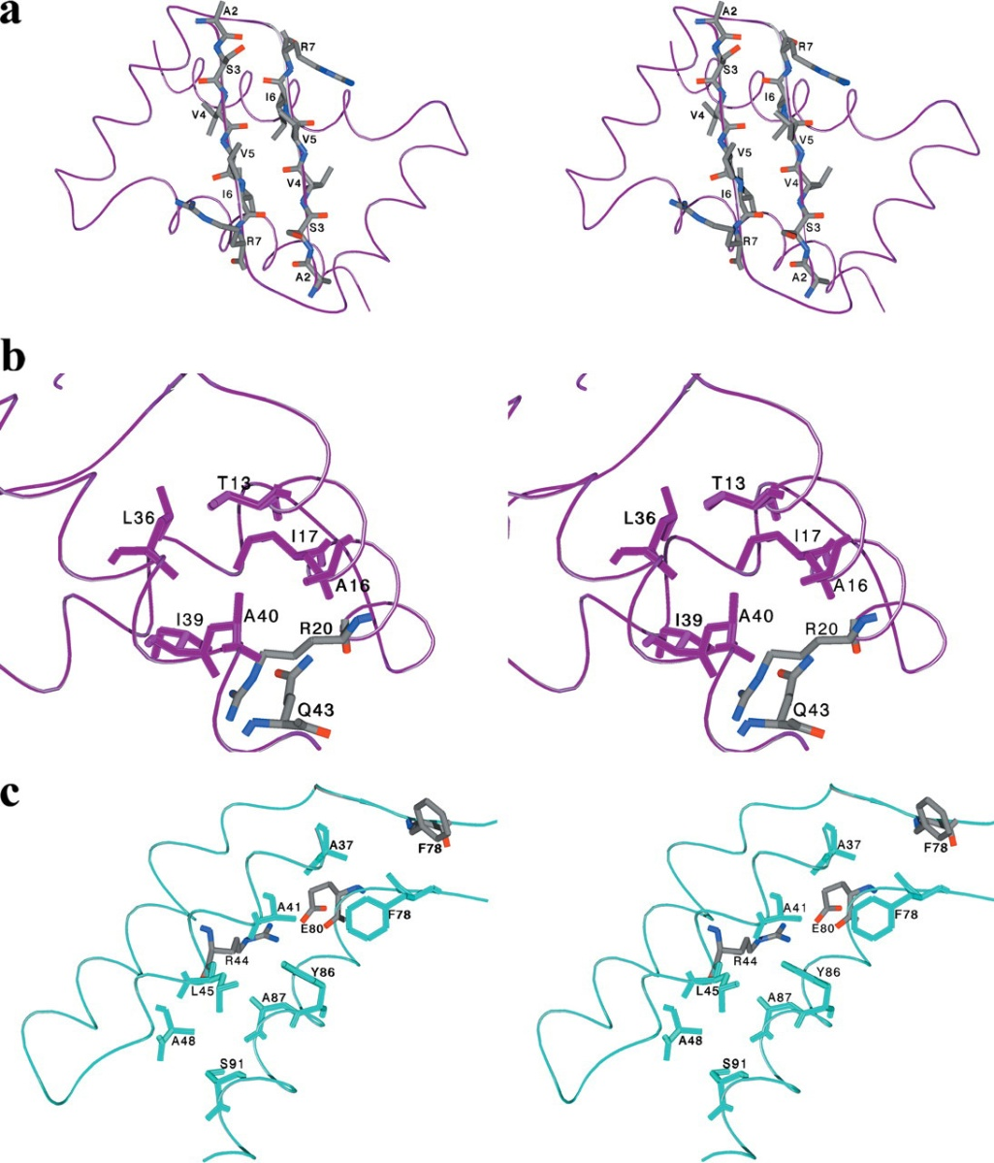
FIGURE 3
Journal of Biological Chemistry 2006 28137942-37951DOI: (10.1074/jbc.M605198200)
Copyright © 2006 © 2006 ASBMB. Currently published by Elsevier Inc; originally published by American Society for Biochemistry and Molecular Biology. Terms and Conditions
Notes:
Stereo views of the multiple oligomerization interfaces of the FitAB complex. FitA is in magenta and FitB is in cyan. Selected residues are colored according to gray (carbon), red (oxygen), and blue (nitrogen). a, FitA dimerization forms the DNA binding β sheet, with β1 from each of the FitA subunits (I and IV or II and III). b, the two FitA RHH motifs form one globular domain, with interactions between α1 of one subunit and α2of the dimer partner (I with IV and II with III). Two identical interfaces are formed in this manner per FitA dimer, which together with the β sheet stabilize the domain and bury 2850 Å² accessible surface area. c, two FitB monomers have an extensive dimerization interface (I and II or III and IV), where α3 from one subunit contacts α5 from the other subunit. Half of this interface is shown here, as there is 2-fold symmetry around residue Phe⁷⁸ (F78) in the complete interface. FitB homodimerization buries 1870 Å² accessible surface area.

Slide 5
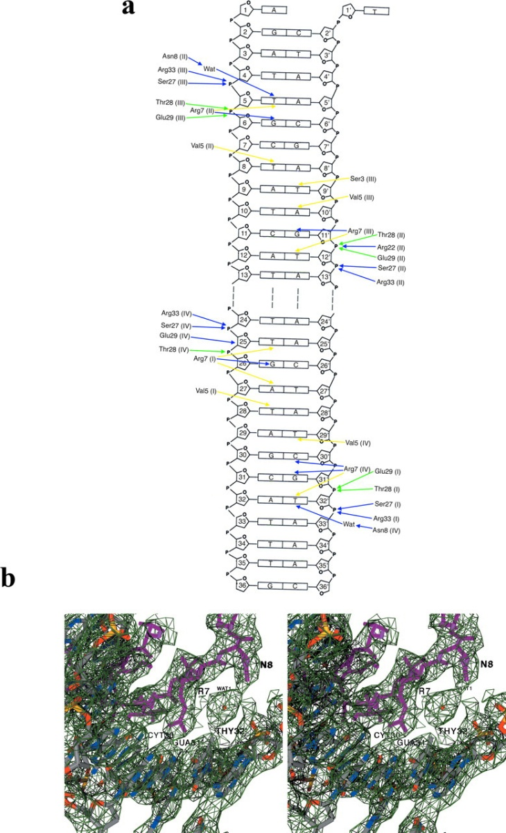
FIGURE 4
Journal of Biological Chemistry 2006 28137942-37951DOI: (10.1074/jbc.M605198200)
Copyright © 2006 © 2006 ASBMB. Currently published by Elsevier Inc; originally published by American Society for Biochemistry and Molecular Biology. Terms and Conditions
Notes:
FitA-DNA contacts. a, schematic diagram of the FitA-DNA contacts. The deoxyriboses of each nucleotide are numbered, labeled, and shown as pentagons. Side chain DNA hydrogen bonds are indicated by blue arrows, backbone amide-DNA hydrogen bonds are green arrows, and van der Waals contacts are shown as yellow arrows. Each FitA residue is from subunit I, II, III, or IV, as defined in the legend to Fig. 2. b, stereo view of the composite omit electron density map of one FitA-DNA interface contoured at 1.0 σ to 3.0 Å resolution (green mesh). The FitA protein is shown as magenta balls and sticks and the DNA is shown as balls and sticks where gray (carbon), red (oxygen), blue (nitrogen), yellow (phosphorus). Note the water (Wat1)-mediated contact between Asn⁸ and Thy^{32′}.

Slide 6
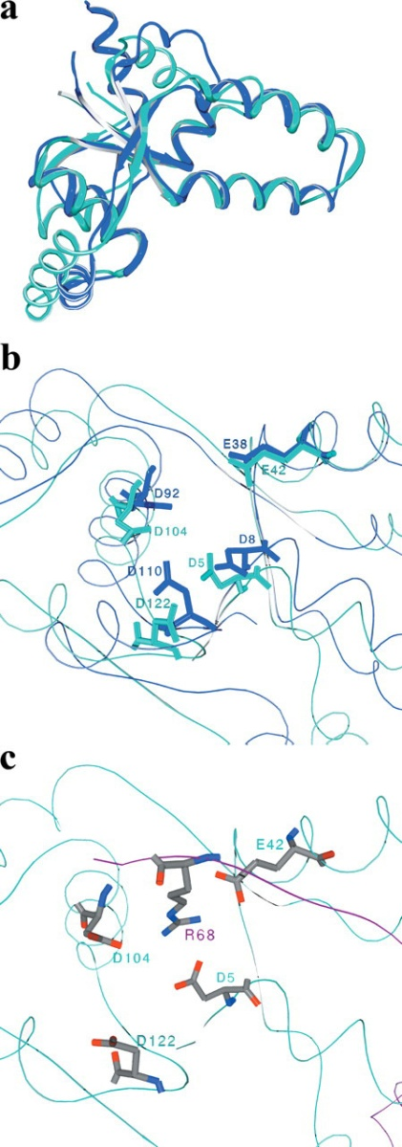
FIGURE 5
Journal of Biological Chemistry 2006 28137942-37951DOI: (10.1074/jbc.M605198200)
Copyright © 2006 © 2006 ASBMB. Currently published by Elsevier Inc; originally published by American Society for Biochemistry and Molecular Biology. Terms and Conditions
Notes:
FitB is homologous to a protein with nuclease activity. a, superimposition of the structure of FitB (cyan) and PAE2754 from Pyrobaculum aerophilum (blue) (PDB accession 1V8P). The alignment is based on optimized superimposition of 93 Cα atoms (FitB residues 1-11, 29-51, 54-71, 74-80, 99-126, 131-136), resulting in a final RMSD of 1.9 Å between the two structures. The two proteins share only 13% amino acid identity over these aligned regions. b, the conserved acidic residues that define the PIN domain cluster in a surface pocket at the C-terminal end of the central, 5-stranded β-sheet. FitB is in cyan and PAE2754 is in blue. c, in FitB, the putative active site for nuclease activity is blocked by the presence of Arg⁶⁸ from FitA. FitA is in magenta and FitB is in cyan. Residues are colored gray (carbon), red (oxygen), blue (nitrogen).

