Slide 1


Current Tasks
Doc History
My Account
(TBD)..
ID | Date | Origin | Doc Name | Meta Data Extracted | Renamed File | Success Rate | Status | Date Completed | Action
0001 | DD-MM-YY | Scan | Doc35548 | Data Extraction Ref | John-PC1234-ReturnMail | 100% | Completed | DD/MM/YY
0002 | DD-MM-YY | Email | VU, TIEN BEST JOURNEY DEC PGS 6-9-20 | Data Extraction Ref | Jane-CR1234-Email | 92% | To Be Reviewed | DD/MM/YY
0003 | DD-MM-YY | Email | …. | ….. | ….. | …. | ….. | …..
0004 | DD-MM-YY | Scan
REVOKE
Approve
Approve
1 of 1 | > | >>
(All docs approved will automatically be moved to the Doc History tab)
Notes:
Main Workscreen

Slide 2

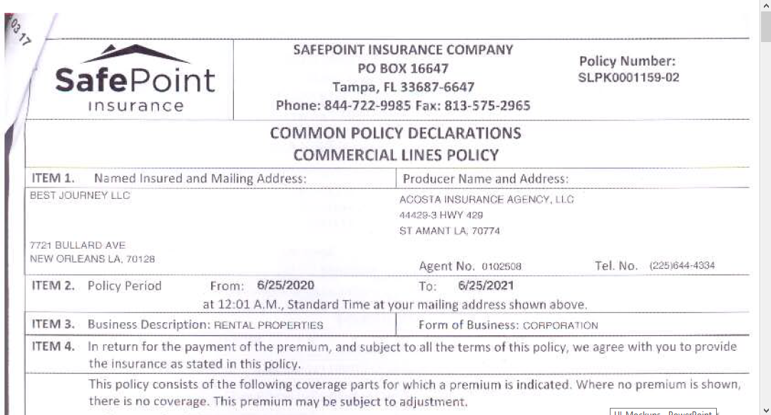

Current Tasks
Doc History
My Account
(TBD)..
Name
Doc Type
ID | Date | Origin | Doc Name | Meta Data Extracted | Renamed File | Success Rate | Status | Date Completed | Action
0001 | DD-MM-YY | Scan | Doc35548 | Data Extraction Ref | John-PC1234-ReturnMail | 100% | Completed | DD/MM/YY
0002 | DD-MM-YY | Email | VU, TIEN BEST JOURNEY DEC PGS 6-9-20 | Data Extraction Ref | Jane-CR1234-Email | 92% | To Be Reviewed | DD/MM/YY
0003 | DD-MM-YY | Email | …. | ….. | ….. | …. | ….. | …..
0004 | DD-MM-YY | Scan
Policy Number
TBD..
Approve
Approve
Approve
1 of 1 | > | >>
(All docs approved will automatically be moved to the Doc History tab)
Notes:
Document Preview

Slide 3


Current Tasks
Doc History
My Account
(TBD)..
Filter Search
From
Client Name
Doc Type
Current Status
To
Policy Number
ID | Raised Date | Approval Date | Origin | Original Doc Name | Revised Doc Name | Approved By | Current Status
0001 | DD/MM/YY | DD/MM/YY | Email | Doc35548 | John-PC123-Email | User Name | Upload Failed
0002 | DD/MM/YY | DD/MM/YY | Scan | Doc5678 | Jane-CR123-MailRebound | User Name | In FileHold
… | …. | …. | …. | …. | …. | …. | ….
1 of 1 | > | >>
Notes:
Historical Data

Slide 4
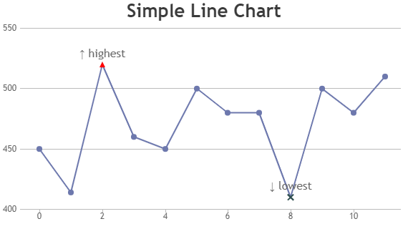



Current Tasks
Doc History
My Account
(TBD)..
Date Range
Approval Rate
This is just a sample analytics, and can be customized based on the data views needed
Notes:
My account – Insights

Slide 5
Current Tasks
Doc History
My Account
(TBD)..
User Name
Email ID
Phone Number
Change Password
Existing Password
New Password
Re-enter
Save Password
Notes:
My Account Overview

