Slide 1

Welcome

Slide 2
A Bit Introduction about my self
I’m Mahesh Kumar S G
Working as a Technical Consultant
in IBM
I work basically with Data science and
GenAI
I Graduated from MSRIT in 2020 from
ISE Branch

Slide 3
Welcome & Agenda
What is GenAI?
What are vectors and how to harness the power of vectors?
What is RAG?
Implementation of simple RAG

Slide 4
GenAI it all started with LLMS

Slide 5
LLMs
LLMS What are they?
(full form)

Slide 6
LLMs
Large Language Model
What is language model?

Slide 7
LLMs
What is language model?
A model which predicts the probability distribution of next set of words.

Slide 8
LLMs
But What is Large in large language model?

Slide 9
LLMs
Large Language Model
Large number of parameters
Large model size
Large Training dataset

Slide 10
LLM Journey started from here
Attention is all you need – 2017
A Game changer research paper that introduced the Transformer architecture

Slide 11
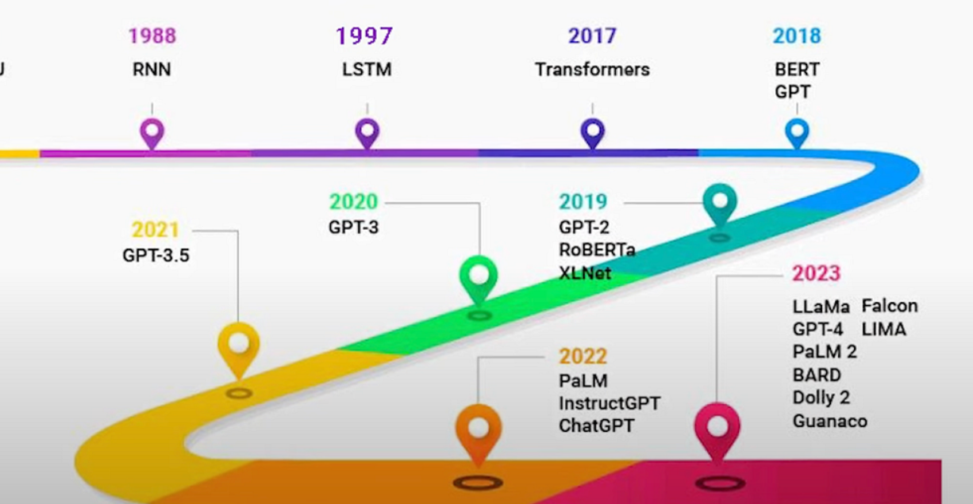
Before Transformers RNN and LSTM Existed

Slide 12
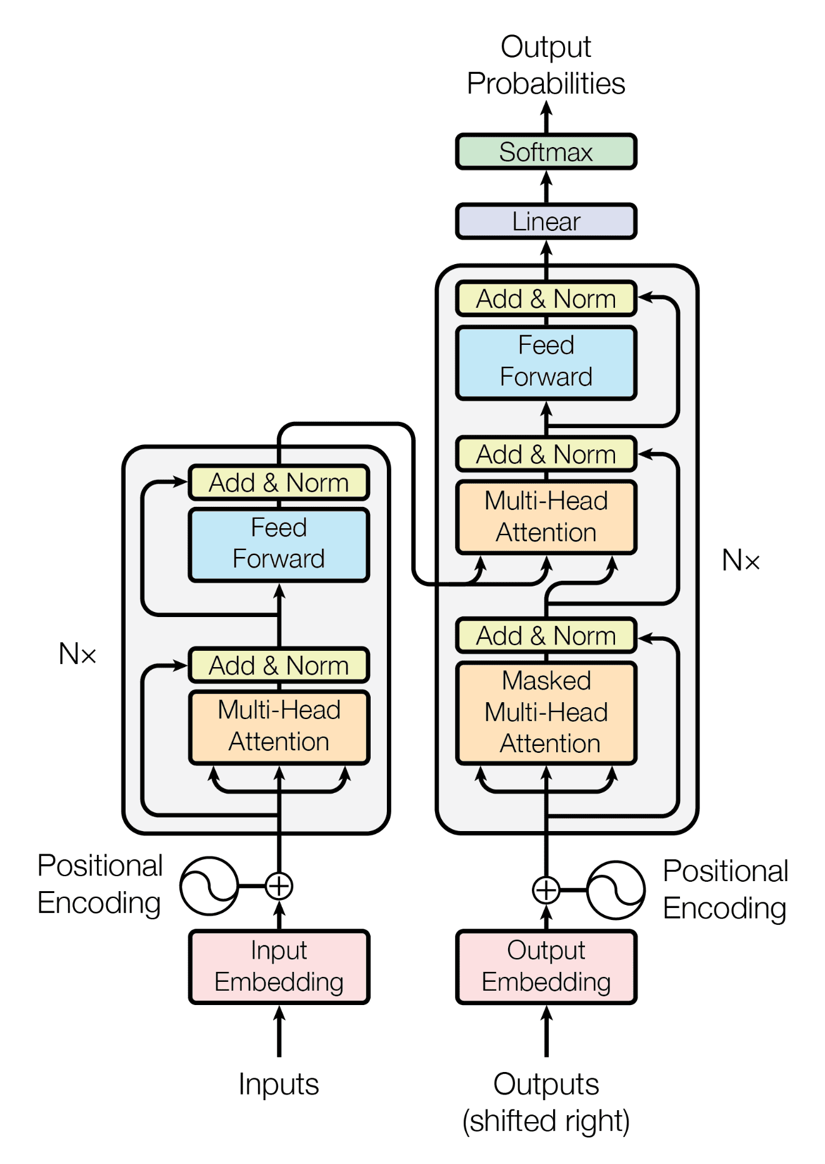
Transformer ARchitecture

Slide 13
So many unkowns which we don’t need let’s concentrate on embeddings and tokens
What are Embeddings?

Slide 14
Embeddings
Numerical representations of objects
(like words, images, or audio) that
capture their meaning and
relationships, allowing models to
understand and process data
more effectively

Slide 15
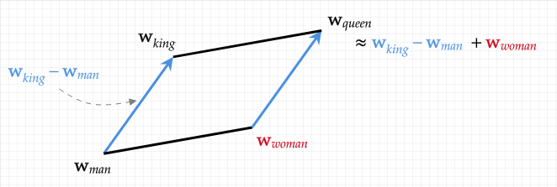
Embeddings

Slide 16
Embeddings
Types of Embeddings
Word2vec
Glove
Etc

Slide 17
Tokenization
What is tokenization?

Slide 18
Tokenization
Breaking of Sentence/Words or subject of interest into parts
Types of Tokenization:
Word based
Subword
Character based
Open AI Tokenizer: https://platform.openai.com/tokenizer

Slide 19
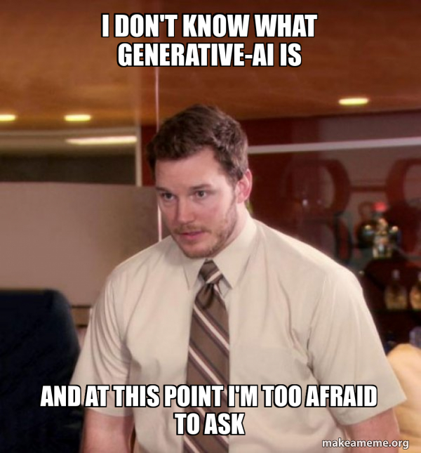
Ok Let’s talk about genai

Slide 20
Gen AI
1️⃣ Generative AI creates new content (text, images, code, music) instead of just analyzing data. 2️⃣ It uses deep learning models like Gemini and ChatGPT to generate human-like responses. 3️⃣ Works by learning patterns from large datasets and predicting the next word (token), pixel, or note. 4️⃣ Used in chatbots, image generation (e.g., DALL·E), and code writing (e.g., Copilot). 5️⃣ Helps with automation, creativity, and problem-solving in various industries.

Slide 21
WHY LEARN GEN AI

Slide 22
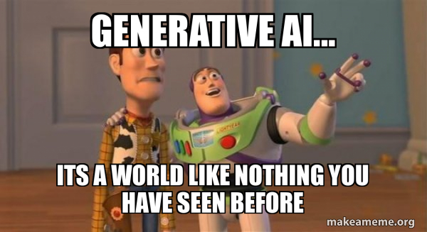
WHY LEARN GEN AI

Slide 23
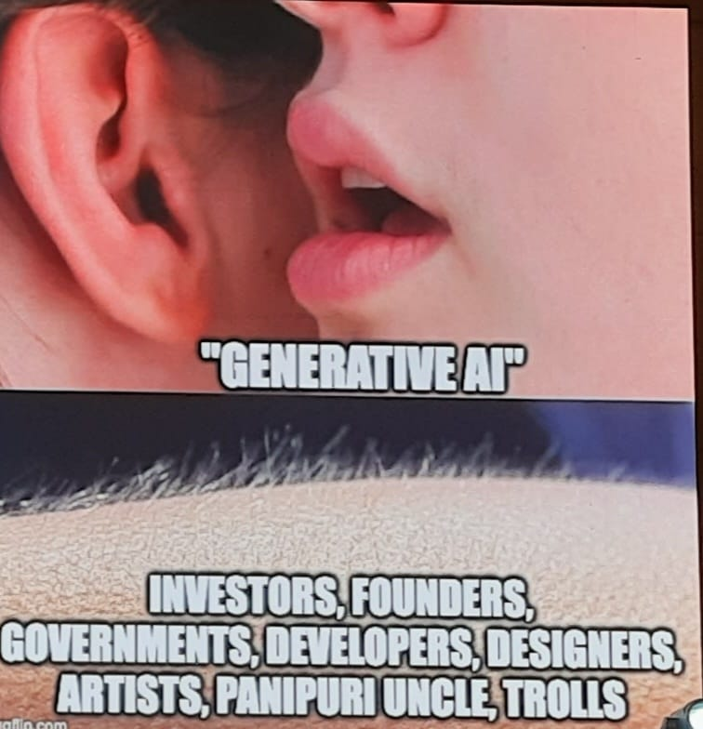
WHY LEARN GEN AI * Because its powerful * because its trending * Because it’s the future

Slide 24
Lets talk about rag
What is RAG?

Slide 25
rag
Retrieval-Augmented Generation, an AI framework

Slide 26
* Llm doesn’t know latest data * llm can’t answer about my own data * llm can’t answer domain specific questions solution: RAG

Slide 27
So what is rag basically?

Slide 28
in simpler terms Giving llm context to answer your queries is noting but rag lets see an example in chatgpt

Slide 29
Hey but wait I have a whole corpus of documents, a 20-30 page book how can I get my answers?

Slide 30
Chunk them and store them in vector database

Slide 31
Wait did you just say vector database what is it and why do we need it?

Slide 32
A vector database stores and manages data as high-dimensional vectors * Chroma * pinecone * qdrant * milvus

Slide 33
Let’s get started in building RAG
Two components of RAG
* Data ingestion
* Retrieval

Slide 34
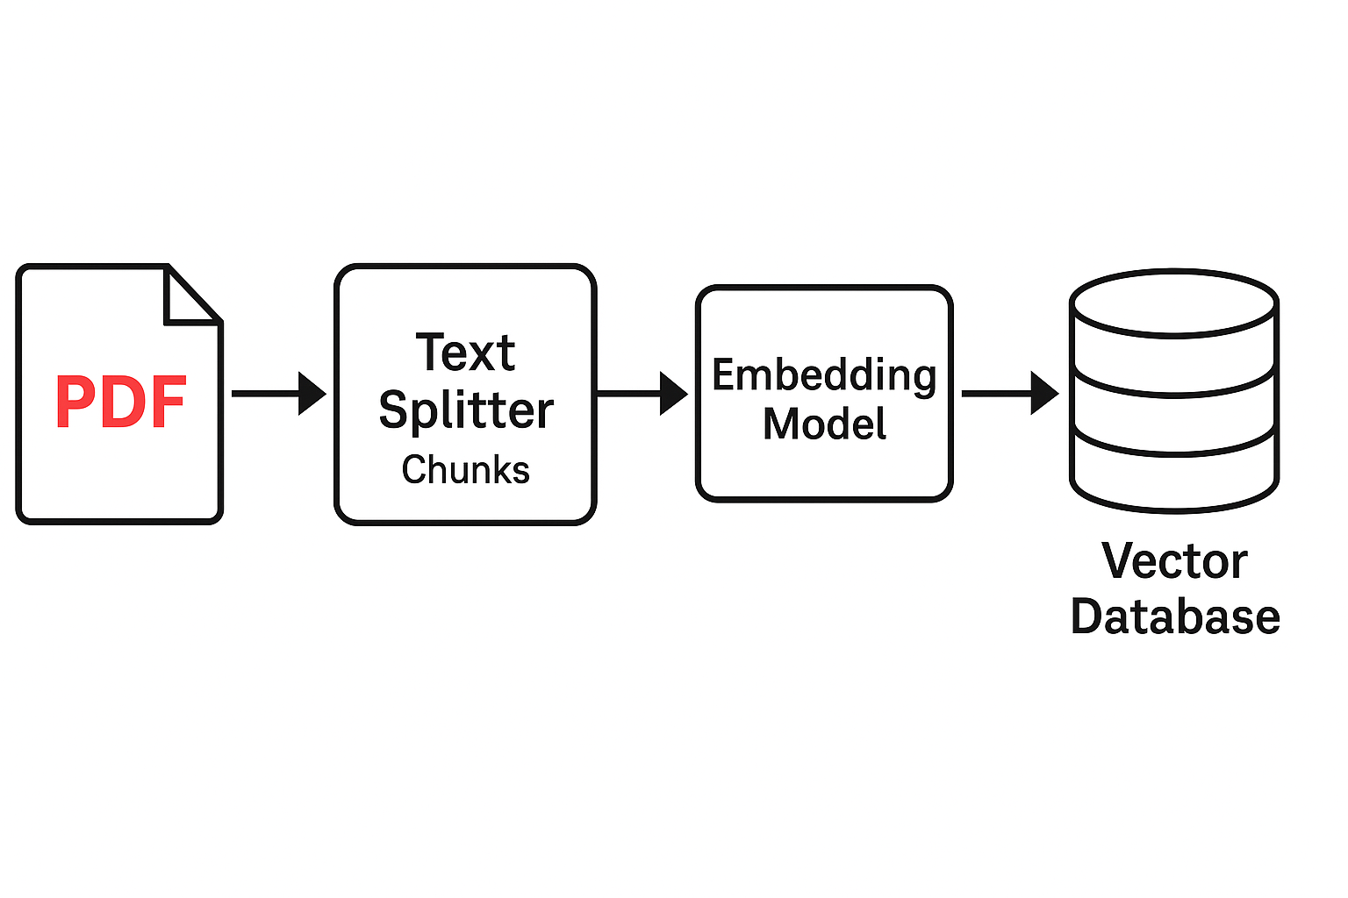
Data ingestion
Two components of RAG
* Data ingestion
* Retrieval

Slide 35
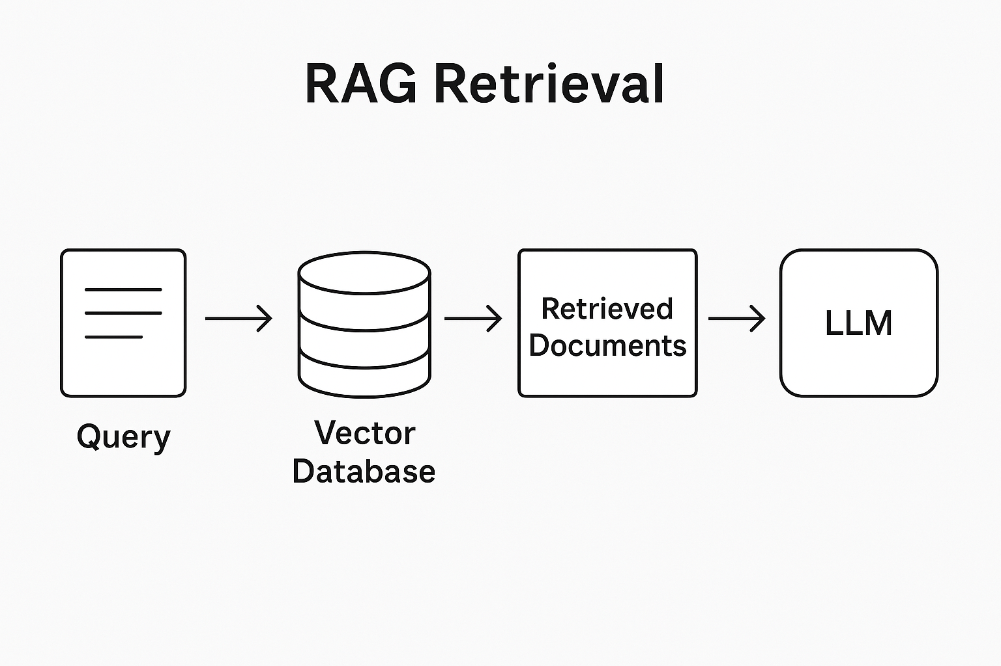
retrieval

Slide 36
let’s hop into coding
Download pdf: https://github.com/MaheshKumarsg036/bms_rag_demo

Slide 37
Q&A + Learning Resources
Further learning: www.learn.deeplearning.ai
Books: AI Engineering – Chip Huyen
Courses Roadmap: https://docs.google.com/spreadsheets/d/1mvI-tzpCPFdnAhiHSS15npVHWLaMiap-YEZxE02nbAI/edit?usp=sharing

