Slide 1

Public Transport System – Test and Validation framework for Autonomous Vehicles
www.avvc.net
Dr. Rahul Razdan

Slide 2
PolvVerif HD Scene creation

Slide 3
Steps to generate Jacksonville map and environment
Pre-requisite Software’s : Unity, Blender, Mapbox, LG Simulator
Steps for importing a particular map/route:
Setup and Open Blender in machine, create blank new project.
Download and install blender-osm plugin in Blender.
Setup and configure Mapbox account for access token for satellite view usage.
Add blender-osm and Mapbox access to the blender project for use.
In project select and import the terrain of region/map in project.
Now Import satellite image of the map using Mapbox.
Now Import the openstreetmap building and road information, It will import the 3D structure.
Now add texture and colour to the building and roads.
Once it is completed export that project in .fbx format.
Use .fbx file in unity and annotate the Jacksonville map in unity:
Add traffic signals, traffic lights, crossing, etc.
Link texture and colours in unity project which is used in blender.
Build Environment for the Simulator.
Use that environment in simulation.

Slide 4
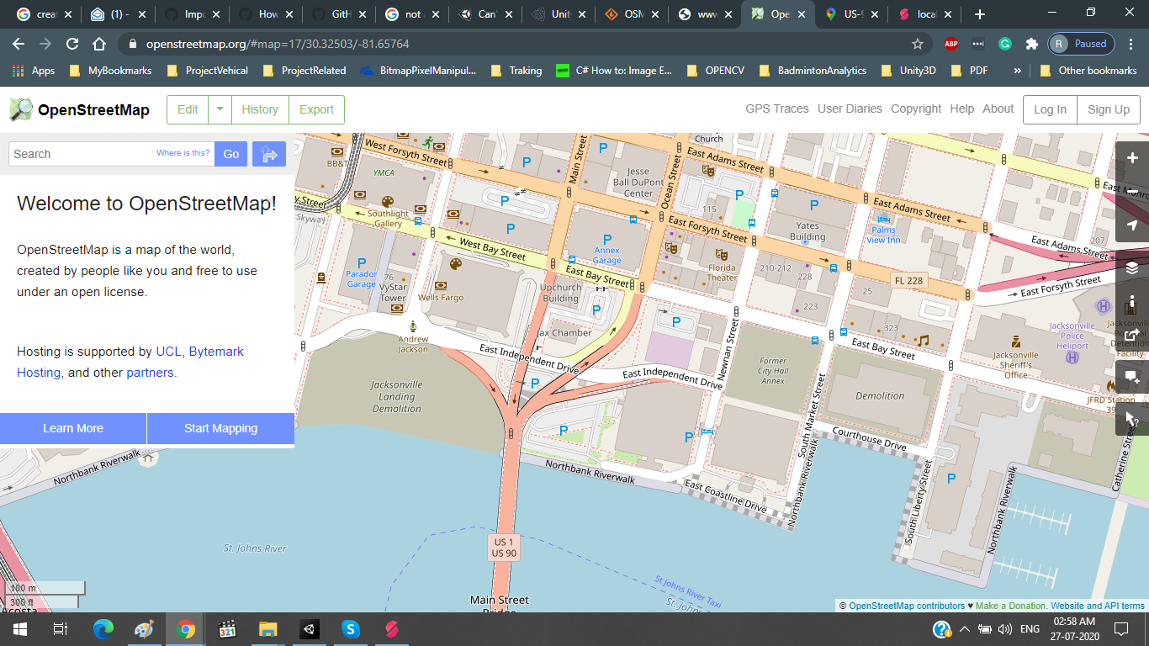
OpenStreetMap(.osm file)

Slide 5
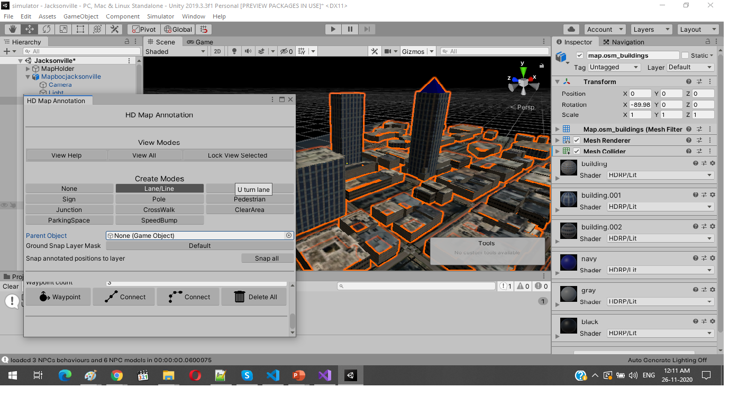
Imported 3D model (.fbx) of the Blender in LG Project

Slide 6
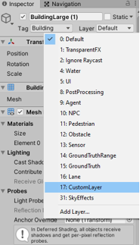
Layer added in Map 3D objects
1). Select any object from the 3D model
2). Click on the Layer
3). Add layer to the same object

Slide 7
Annotations of objects in 3D Map
Annotate all the objects in Scene using the HD Map Annotation of simulator project

Slide 8
How to fetch the position coordinates of the annotated layered object
We have added the functionality to fetch the added layered object coordinates of LG Simulator. For this we have provided an API interface to get coordinates, using PythonAPI’s
On Custom call back which will helps to fetch the added layered data from the LG Simulator.
on_custom()
Sample Python code to fetch the coordinates:
def UpdateLidarData(agent, kind, context):
if kind == "mylidar” :
objectPoints = context[" ObjectPosition "] ## This will return the object coordinates
else:
pass
a.on_custom(UpdateLidarData) ##Register user callback with the simulator

Slide 9
How to fetch and modify PointCloudData from Simulator
We have added the functionality to fetch and modify the lidar points cloud data of LG Simulator. For this we have provided an API interface to modify the lidar point cloud data frame by frame in Python and set back to the simulator which will published by the LG Simulator on ROS bridge.
API’s introduced to use and modify the lidar points cloud data
Custom call back which will helps to fetch and customize data of the LG Simulator
on_custom()
Class to interact with simulator
LidarContext
var Points
Function to apply the created object to the simulator
apply_lidar_context()

Slide 10
Sample Code
Python Script for end user:
Below is the example of how to use the API’s to modify lidar data in python script
def UpdateLidarData(agent, kind, context): # In context it will return the data
if kind == "mylidar": # Check if the context is kind of Lidar
lidarPoint = context["Points"] # Fetch the Points from the context jsonarray
y = json.loads(lidarPoint) # Get json data to use and modify
print("json data: ", y["array"]) # Print the complete data
#modify y[“array”] which have lidar point cloud data
s = lgsvl.LidarContext() # Create the LidarContext object
s.Points = y["array"] # Set modified lidar Points to the object
a.apply_lidar_context(s) # Apply updated object to the simulator
else:
pass
a.on_custom(UpdateLidarData) # Call the API’s on custom call

Slide 11
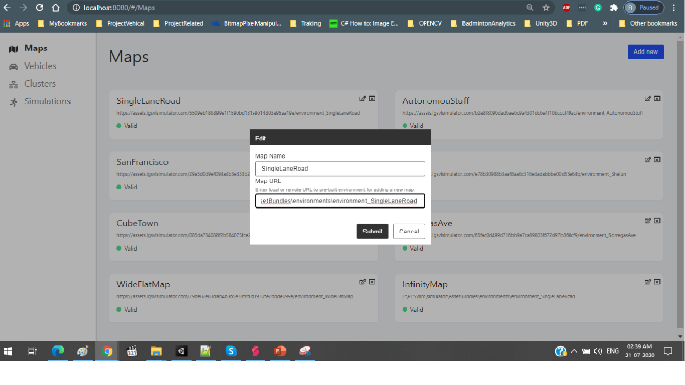
Environment setup with LG Simulator
Write map name and provide the path of the generated environment map path, like AssetBundles/Environment/environment_SingleLaneRoad, It will successfully add environment to the simulator for use.
1. Enter Name
2. Enter the path of the environment
3. Click on Submit

Slide 12
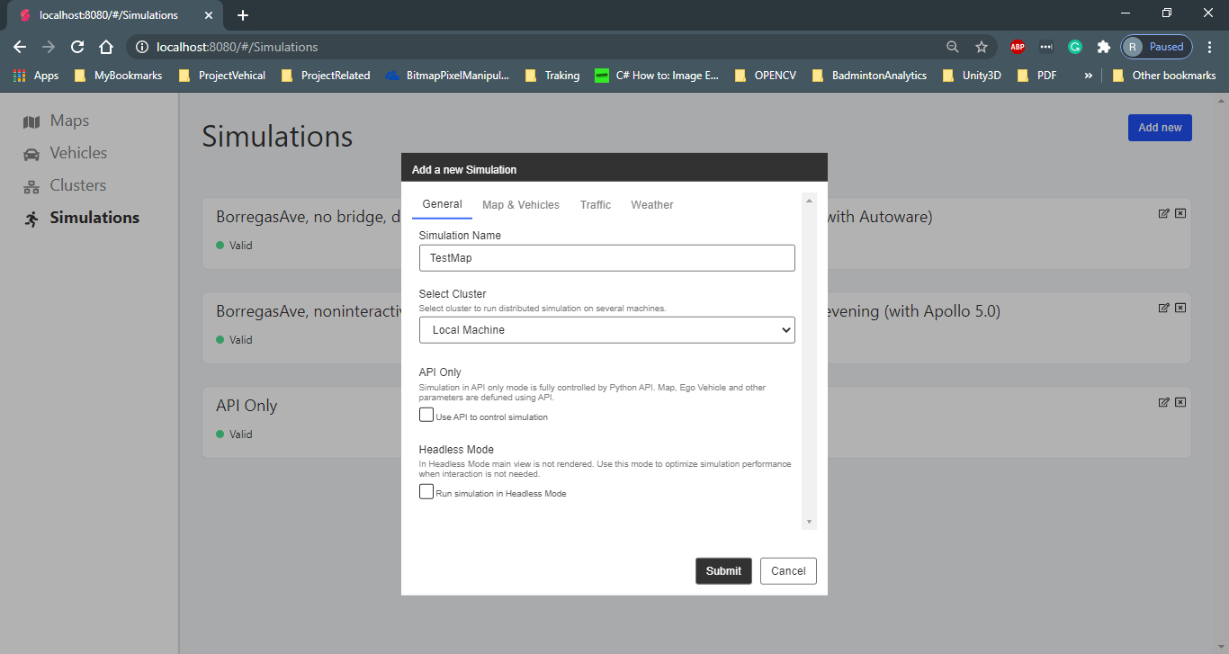
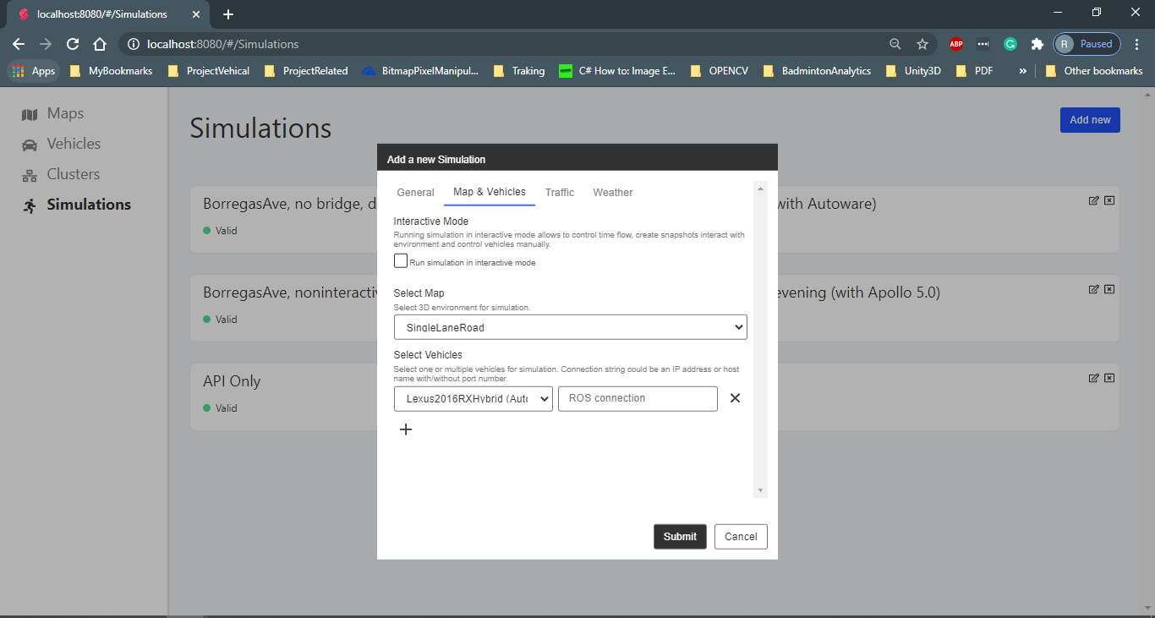
Environment setup with LG Simulator
Go to the Simulation tab and click on add new, Simulations -> Add new.
Enter Simulation name, click on map & vehicle tab. Click on the select map dropdown where you can find added map environment over there, Select it.
It will add new Simulation, select the generated simulation and click on the play button at the bottom right corner of the screen.
2. Click on Add new
4. Click on Map and vehicle tab
1. Click on Simulation
3 On General Tab, Enter Simulation name
5. Select the Map environment which we have created
6. Select Vehicle
7. Enter Bridge string
8. Click on Submit

Slide 13
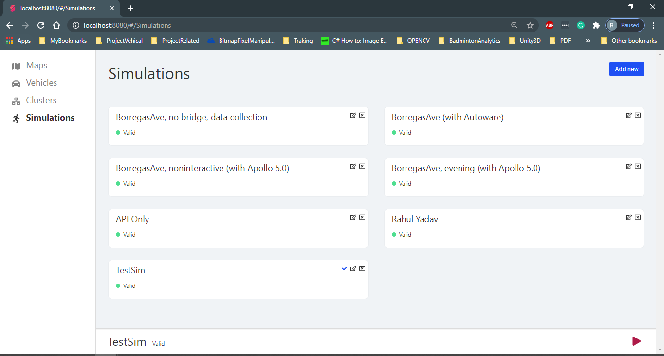
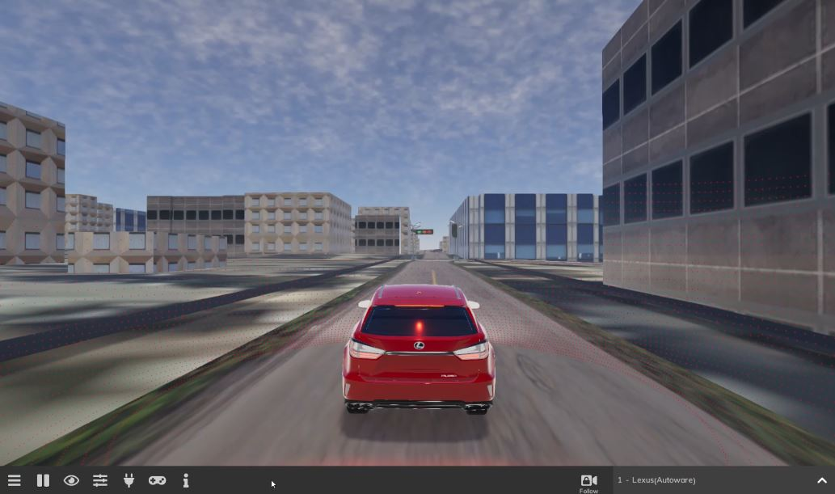
Environment setup with LG Simulator
On the Simulation tab now you can find the new added simulation with provided map environment.
Simulation of Jacksonville Map in LG Simulation
1. Click on Simulation
2. Select the newly added simulation
3. Click on play Simulation
Link of above simulation Video : https://drive.google.com/file/d/14H0hpOjVTikmqrJwyGcxcn92S6xiFrDX/view?usp=sharing

Slide 14
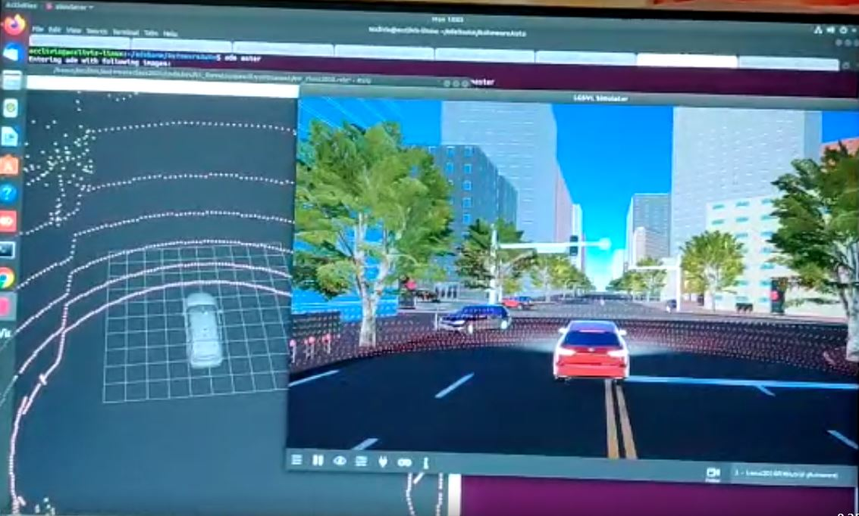
Working of LG Simulation with Autoware and Rviz Simulation
LG Simulator Window
Autoware Rviz visualizer Window
Ego Vehicle

