Slide 1
Chat app Inspired by WhatsApp (MERN + Web-Sockets)
Submitted by:
E . ARJUN : 22SS1A0512
N . MAHESH : 22SS1A0531
R . PRABHAS : 22SS1A0541
S . SRINIVAS : 22SS1A0548
Guide :
Dr . G . Priyanka jeeva karunya
Assistant professor

Slide 2
Content’s
Introduction
Existing System
Proposed System
System Requirements
Technologies Used
Architecture
Implementation
Results
References
Conclusion

Slide 3

Introduction
Real-time messaging is essential in modern communication.
Traditional systems like WhatsApp Web rely on phone number login.
This project provides a web-based WhatsApp-like app using MERN & WebSockets.
Key features include email login, friend requests, status updates, and real-time chat.

Slide 4



Existing System
WhatsApp Web requires active phone connection.
Authentication is phone number based.
No support for username/email-based friend requests.
Limited customization and extensibility.

Slide 5
Proposed System
Login and verification via Email (Node-Mailer).
1-on-1 real-time messaging (text + image) using Web-Sockets.
Send/accept friend requests via email or username.
Post/view status updates with 24hr expiration.
Edit profile; secure authentication using JWT + cookies.

Slide 6
System Requirements
SOFTWARE :
Node.js,
Express.js,
MongoDB,
React.js,
Web-Sockets,
Node-Mailer,
JWT.
HARDWARE :
4GB RAM,
Internet connection,
Modern browser.

Slide 7
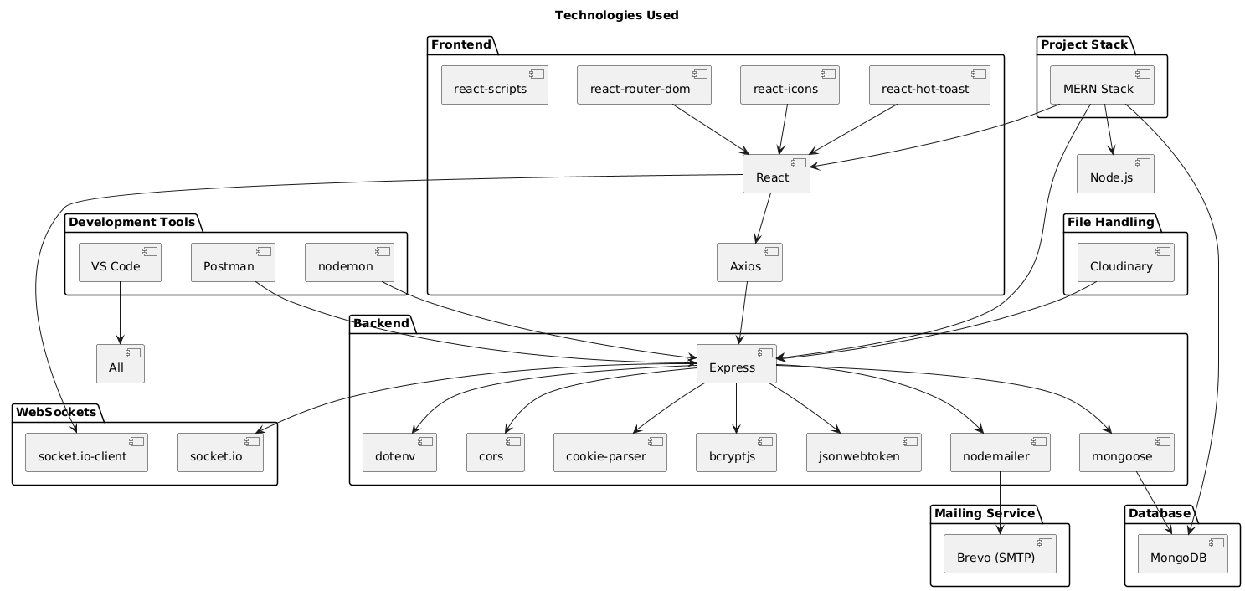
Technologies used

Slide 8





Slide 9
Architecture
Frontend : React.js (User Interface)
Backend : Node.js + Express (API + WebSocket server)
Database : MongoDB (User, Message, Status storage, Friend Request)
Authentication : JWT + Cookies
Email Verification : Node-Mailer (SMTP)

Slide 10
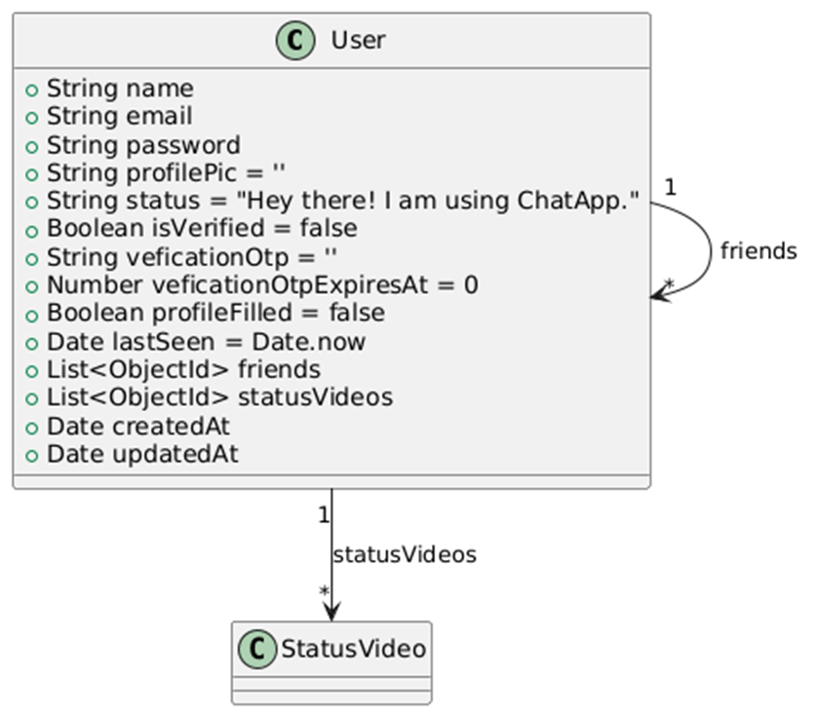
User schema

Slide 11
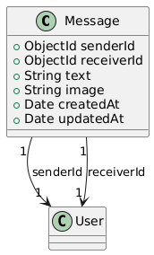
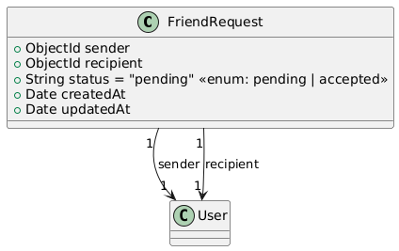
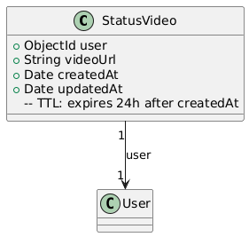
Message Schema & Friend Request Schema & Status Image Schema

Slide 12
Implementation
Email-based auth and verification system using Node-Mailer.
JWT-based session management with cookie storage.
WebSocket server for real-time chat and image sharing.
Friend system: request and accept via email/username.
Status updates: add/view/delete (expire after 24 hrs).
MongoDB stores messages, users, and status entries.

Slide 13
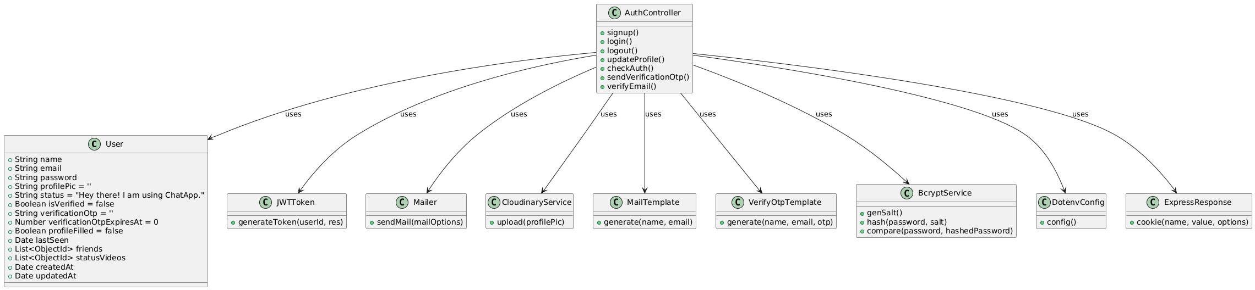
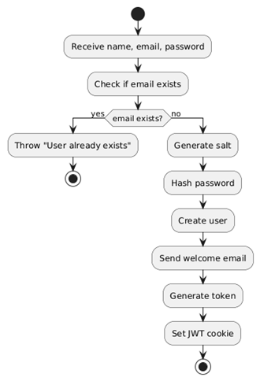
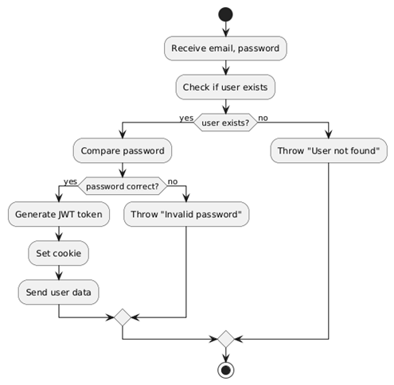
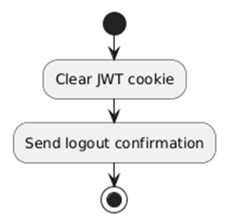
Code flow

Slide 14
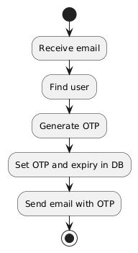
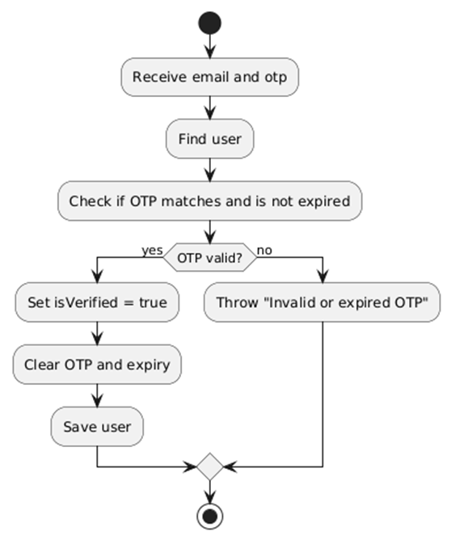
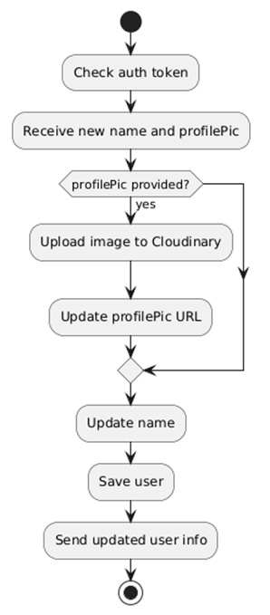
User Verification

Slide 15
Results
Successfully implemented login with email and verification.
Real-time chat with support for images.
Friend request system fully functional.
Status updates working with 24-hour expiry.
Profile edit feature tested and operational.

Slide 16
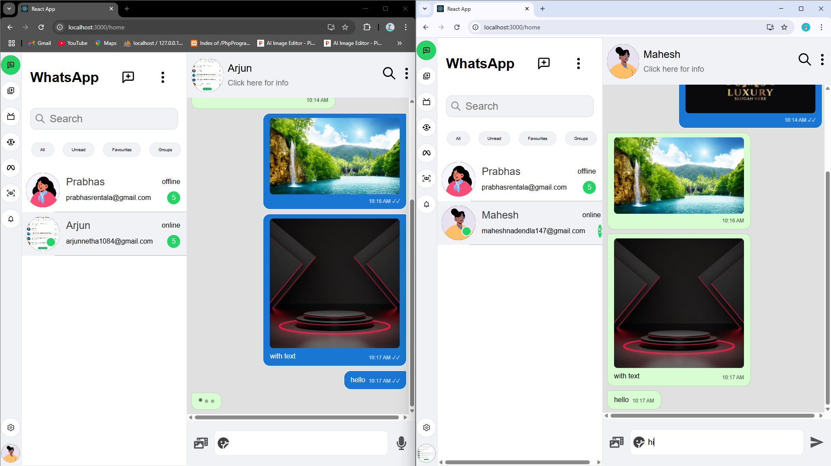
Output : Chat

Slide 17
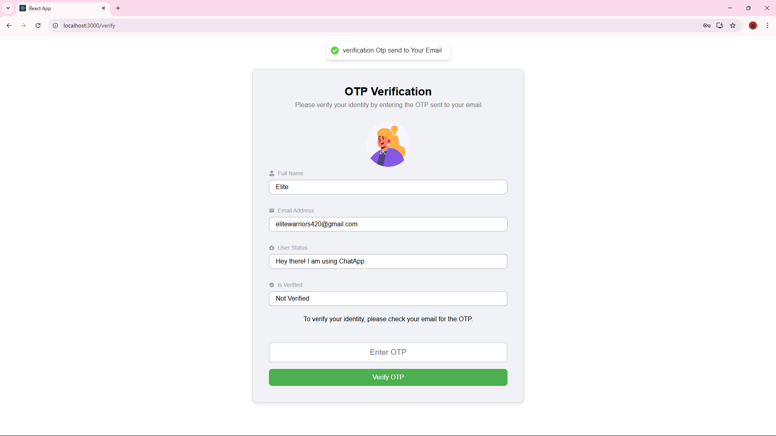
Output : otp verify

Slide 18
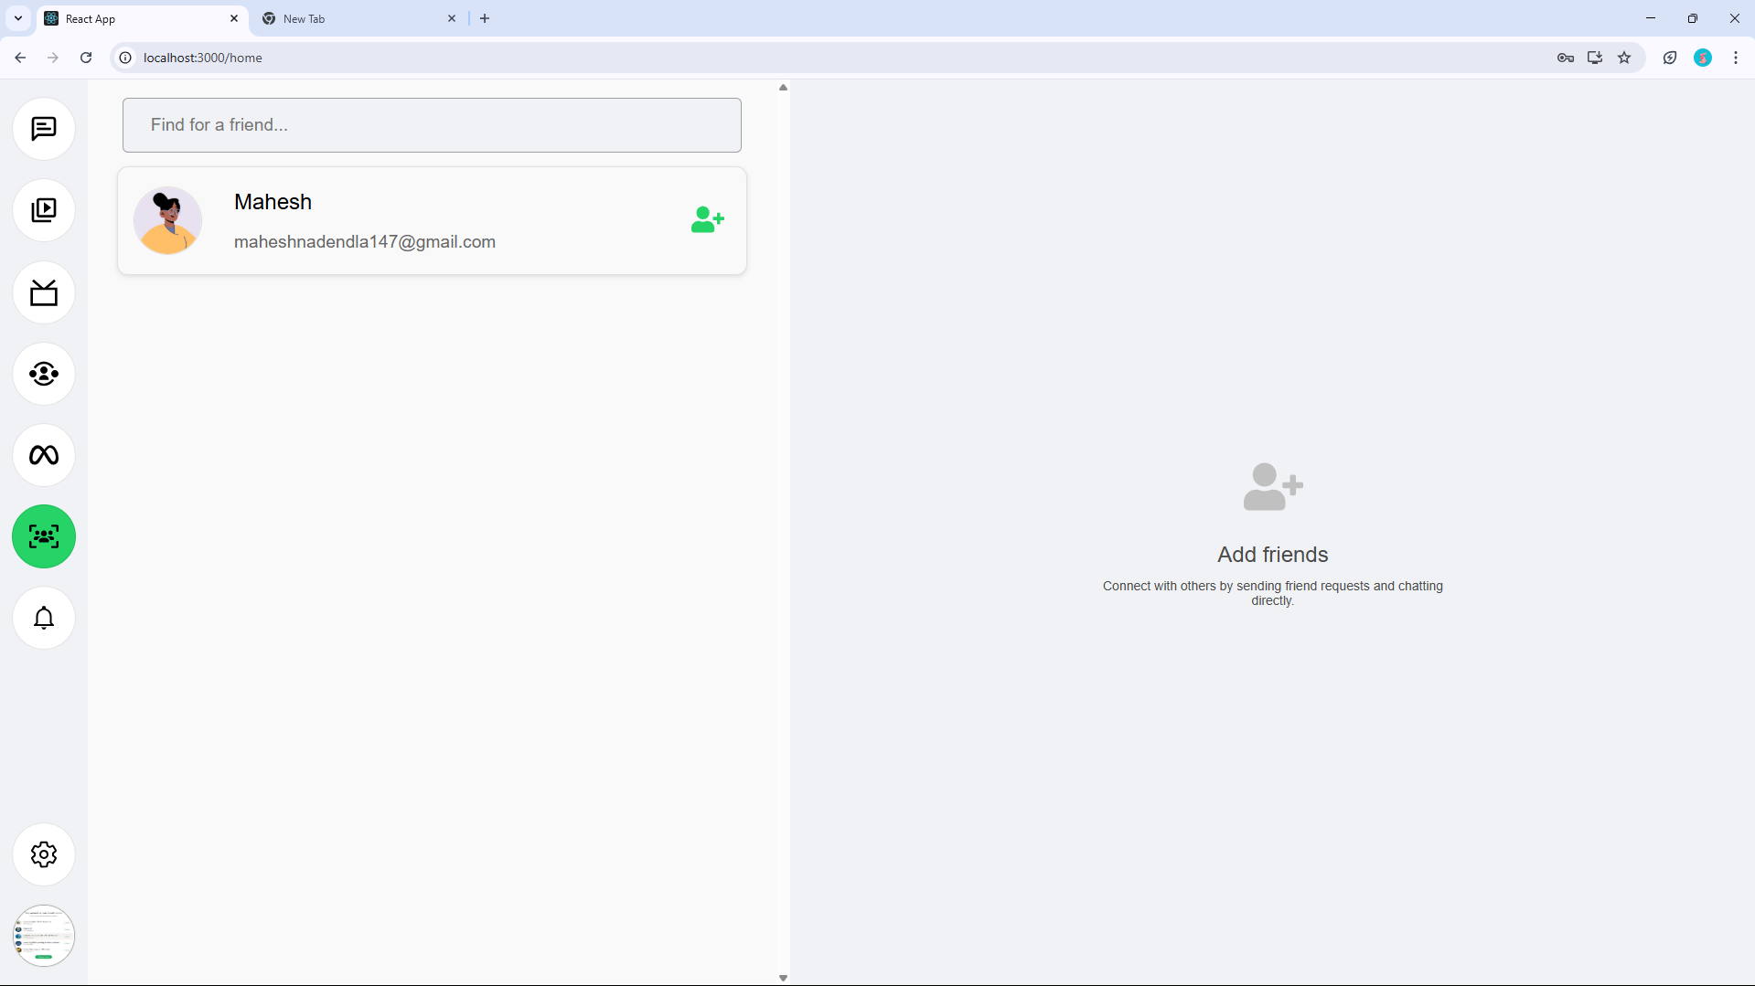
Output : add friend

Slide 19
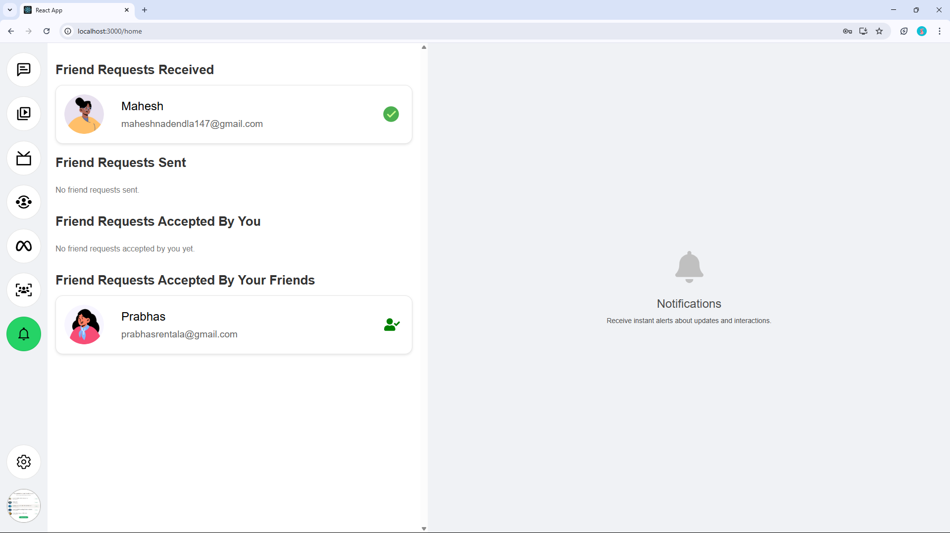
Output : notification’s

Slide 20
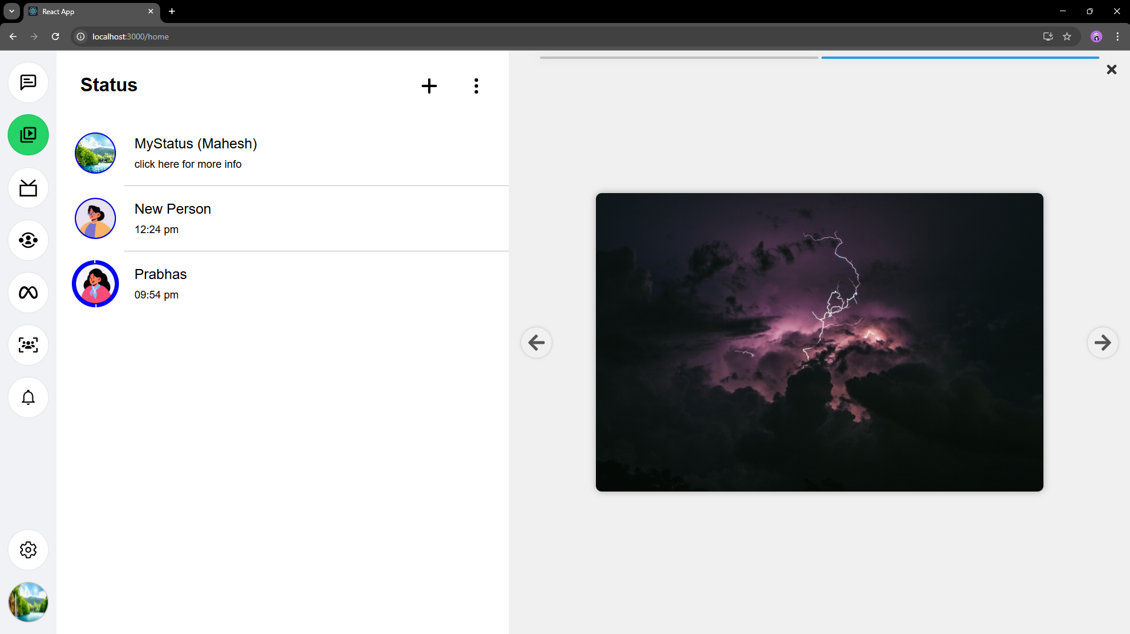
Output : status

Slide 21
Reference’s
React.js Documentation – https://reactjs.org/docs/getting-started.html
Node.js Official Docs – https://nodejs.org/en/docs
Express.js Guide –
https://expressjs.com/
MongoDB Documentation – https://www.mongodb.com/docs
Socket.IO (Client & Server) – https://socket.io/docs/v4/
Axios GitHub Repository – https://github.com/axios/axios
JWT (JSON Web Token) Guide – https://jwt.io/introduction
bcryptjs on npm – https://www.npmjs.com/package/bcryptjs
Node-Mailer Official Site – https://nodemailer.com/
Brevo SMTP Service (for sending emails) – https://www.brevo.com/free-smtp-server/
Cloudinary Documentation – https://cloudinary.com/documentation
React Hot Toast –
https://react-hot-toast.com/
React Icons Documentation –
https://react-icons.github.io/react-icons/
VS Code –
https://code.visualstudio.com/
Postman –
https://www.postman.com/
WhatsApp Web Interface (UI Inspiration) – https://web.whatsapp.com/

Slide 22
Conclusion
Developed a secure, scalable WhatsApp Web.
Extended features beyond original app (email login, web-based).
Modern UI with real-time experience using Web-Sockets.
Ready for further enhancements like group chats ,voice messages,video calls.

Slide 23
Thank You

