Slide 1
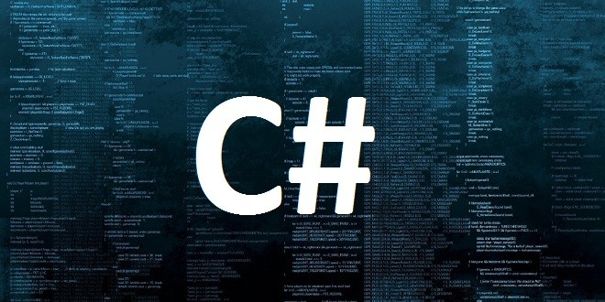

Slide 2
Basic C#
C# is Pronounced as “C-Sharp”.
ANDERS HEJLSBERG is a Founder of C# Language.
It is an Object-Oriented Programming Language Provided by Microsoft.
C# has roots from the C family, and the language is close to other popular languages like C++and Java.

Slide 3
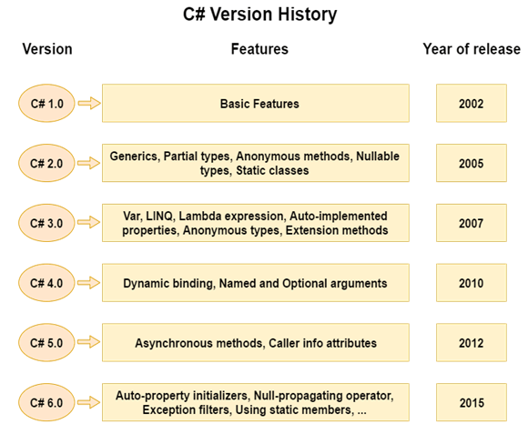

Slide 4
Features
SIMPLE & FAST
OBJECT-ORIENTED
Features
SCALABLE
STRUCTURED PROGRAMING LANGUAGE
INTEROPERABILITY

Slide 5
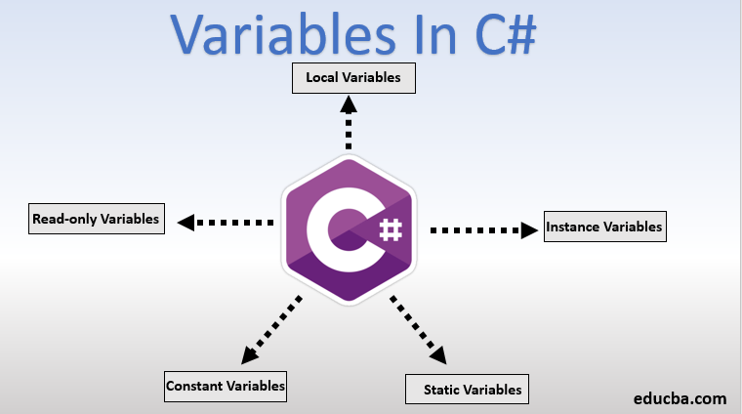

Slide 6
Rules For Variables
A Variable can have Alphabets, Digits and Underscore.
A Variable name can start with Alphabet and Underscore only.
It can’t start with Digit.
No White Spaces are allowed within variable name.
A Variable name must not be any Reserved Word or KeyWord.

Slide 7
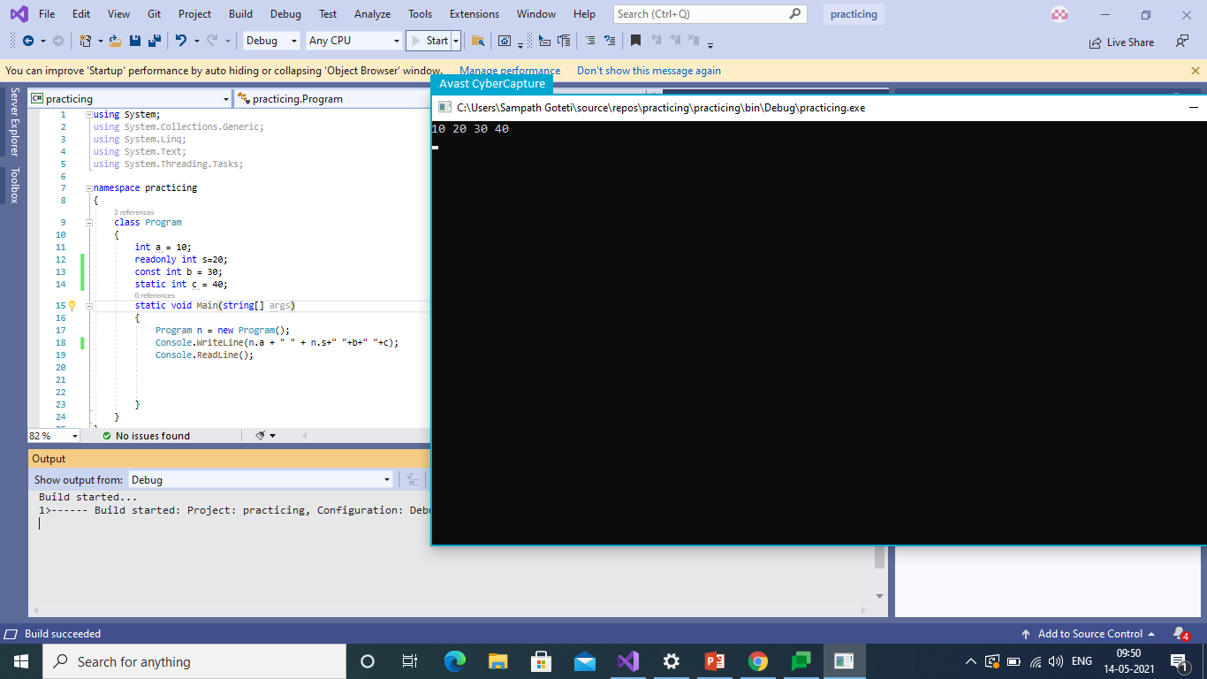
Variables in Different Manner

Slide 8
Datatypes
As the name itself indicating, Datatype means Type of Data.
While Developing any Software Application, We come across different Datatypes and values.
We have to Declare Datatype when we are going to Create variable.

Slide 9
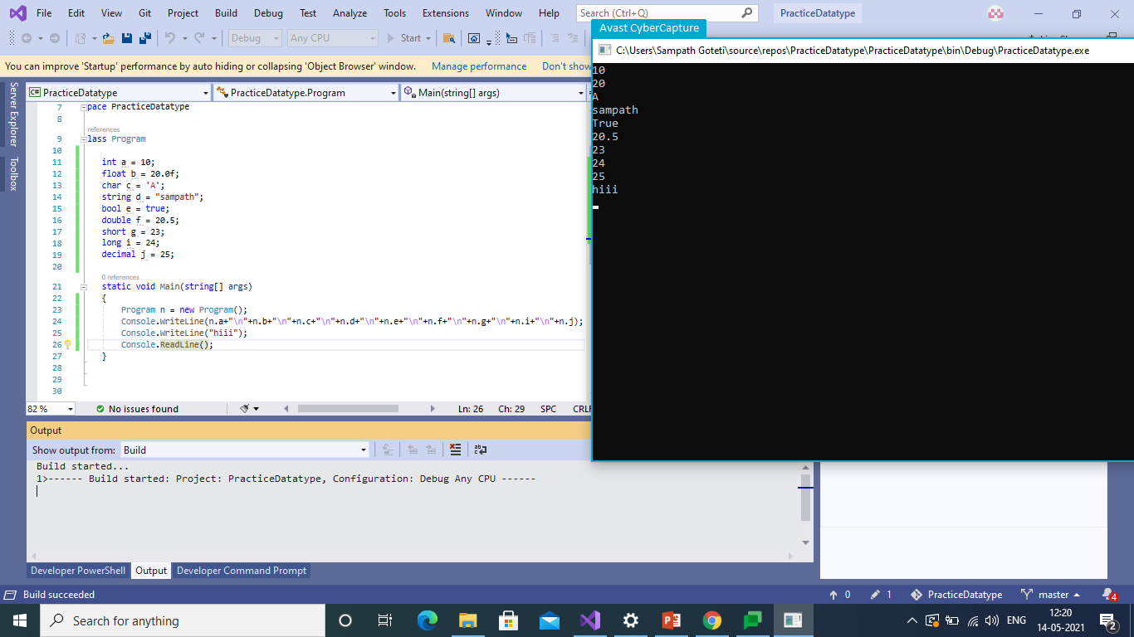
DataTypes in Different Manner

