Slide 1

Slide 1
Telecom Churn Case Study
Summary and recommendations

Slide 7
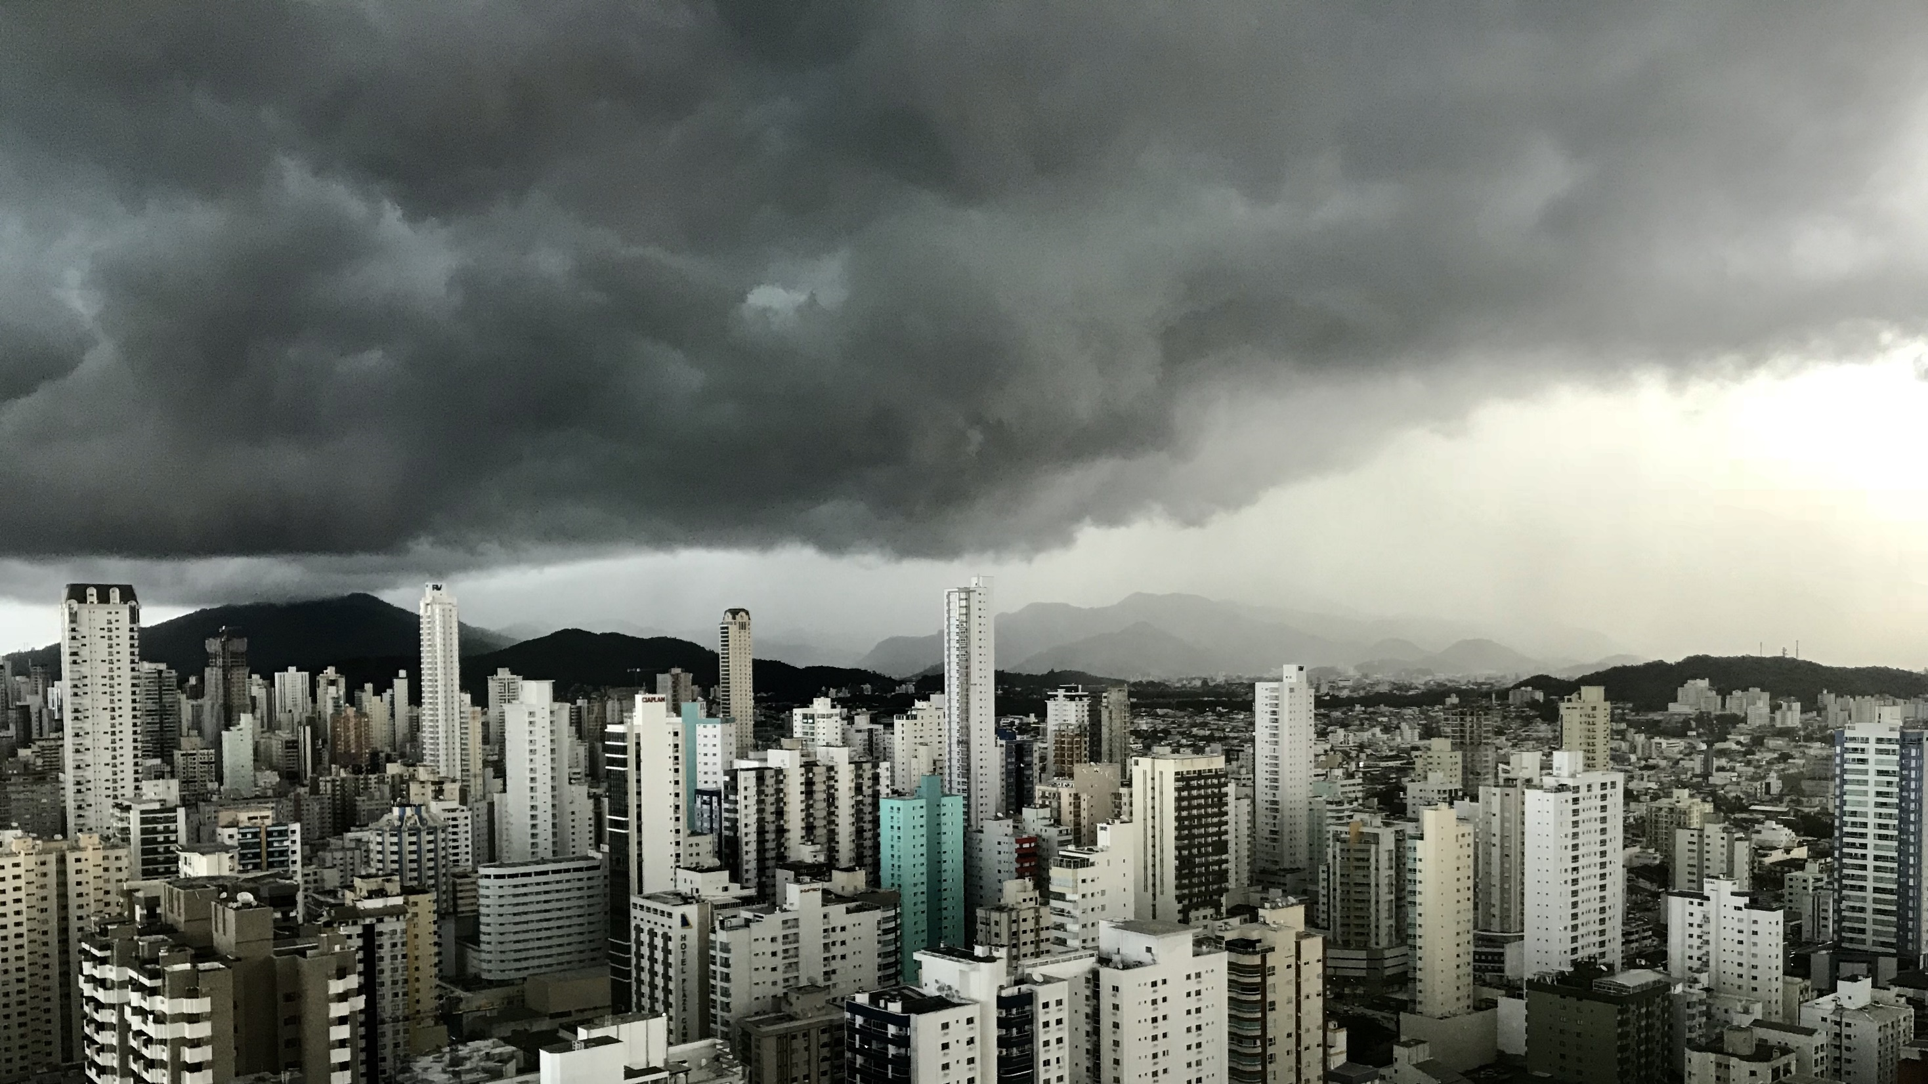
Slide 11
THANK YOU

