Slide 1


JSPM’s
Imperial College of Engineering and Research,Wagholi,Pune.
(Approved by AICTE,Delhi & Govt. of Maharashtra, affiliated to Savitribai Phule Pune University) Gat.No.720,Pune-Nagar Road,Wagholi,Pune,412207 Department of Computer Engineering
Project Review - 1
Group No.2
“E-Ration Shop - Digitizing the Public Distribution System”
Under the Guidance of Presented by
Prof. S.R. Bhandari 1) Pratik Dahale 2) Siddhesh Lamkhede 3) Mahesh Shendkar 4) Vrushali Rohokale

Slide 2
JSPM’s
Imperial College of Engineering and Research,Wagholi,Pune.
(Approved by AICTE,Delhi & Govt. of Maharashtra, affiliated to Savitribai Phule Pune University) Gat.No.720,Pune-Nagar Road,Wagholi,Pune,412207 Department of Computer Engineering
CONTENTS
Introduction
Literature Review
Problem Statement
Objective
Block Diagram and description
Result
Advantages
Applications
Software Requirement
Hardware Requirement
Conclusion
References

Slide 3
JSPM’s
Imperial College of Engineering and Research,Wagholi,Pune.
(Approved by AICTE,Delhi & Govt. of Maharashtra, affiliated to Savitribai Phule Pune University) Gat.No.720,Pune-Nagar Road,Wagholi,Pune,412207 Department of Computer Engineering
INTRODUCTION
The Public Distribution System (PDS) is India’s food security mechanism that provides subsidized food grains to ration card holders through Fair Price Shops (FPS). Despite its reach, the system faces inefficiencies, manual processes, and widespread corruption. The proposed e-Ration Shop is an online platform that enables ration card holders to order items directly from FPSs. The goal is to make the process transparent, efficient, and user-friendly by leveraging digital technology.

Slide 4
JSPM’s
Imperial College of Engineering and Research,Wagholi,Pune.
(Approved by AICTE,Delhi & Govt. of Maharashtra, affiliated to Savitribai Phule Pune University) Gat.No.720,Pune-Nagar Road,Wagholi,Pune,412207 Department of Computer Engineering
LITERATURE REVIEW
SR.No | Title | Content | Author name | Description
1. | Role of ICT in Public Distribution System | Explains the impact of digital tools like biometric authentication, SMS alerts, and online tracking in improving PDS delivery. | Dr. R. Meenakshi | Highlights the positive effects of digitization in reducing corruption and improving transparency.
2. | Smart Ration Card Using IoT and AI | Describes how smart ration cards linked with biometrics and AI-based monitoring can reduce manual errors. | Priya Sharma et al. | Proposes a smart, automated, and tamper-proof ration delivery system.

Slide 5
JSPM’s
Imperial College of Engineering and Research,Wagholi,Pune.
(Approved by AICTE,Delhi & Govt. of Maharashtra, affiliated to Savitribai Phule Pune University) Gat.No.720,Pune-Nagar Road,Wagholi,Pune,412207 Department of Computer Engineering
LITERATURE REVIEW
SR.No | Title | Content | Author name | Description
3. | Automation in Fair Price Shops | Focuses on automating Fair Price Shops using touch screens, fingerprint devices, and ePOS machines. | K. Rajkumar & D. Karthikeyan | Demonstrates the efficiency of automation in reducing pilferage and human dependency.
4. | Digital India and PDS Reforms | Studies how Digital India initiatives can revolutionize the public distribution system using Aadhaar and DBT. | NITI Aayog Report | Highlights the scope of nationwide digital infrastructure in strengthening PDS.

Slide 6
JSPM’s
Imperial College of Engineering and Research,Wagholi,Pune.
(Approved by AICTE,Delhi & Govt. of Maharashtra, affiliated to Savitribai Phule Pune University) Gat.No.720,Pune-Nagar Road,Wagholi,Pune,412207 Department of Computer Engineering
LITERATURE REVIEW
SR.No | Title | Content | Author name | Description
5. | Machine Learning in Supply Chain Forecasting | Explains the role of machine learning in demand prediction and inventory management in food supply chains. | Aniket Ghosh & Rahul Sinha | Shows how AI helps optimize grain allocation based on population and past data.
6. | e-Governance for Ration Distribution | Describes the use of online platforms to bring transparency, tracking, and accountability in ration delivery. | Ministry of Consumer Affairs | Advocates for web-based portals to reduce fake ration cards and manual errors.

Slide 7
JSPM’s
Imperial College of Engineering and Research,Wagholi,Pune.
(Approved by AICTE,Delhi & Govt. of Maharashtra, affiliated to Savitribai Phule Pune University) Gat.No.720,Pune-Nagar Road,Wagholi,Pune,412207 Department of Computer Engineering
PROBLEM STATEMENT
The current PDS is plagued by urban bias, fake ration cards, and malpractice by FPS dealers. Beneficiaries often receive less than their entitled share, and there is little recourse for complaints. Due to lack of automation and monitoring, corruption and diversion of food grains are common. A digital solution is needed to ensure fair and accountable distribution.

Slide 8
JSPM’s
Imperial College of Engineering and Research,Wagholi,Pune.
(Approved by AICTE,Delhi & Govt. of Maharashtra, affiliated to Savitribai Phule Pune University) Gat.No.720,Pune-Nagar Road,Wagholi,Pune,412207 Department of Computer Engineering
OBJECTIVE
Develop an online e-Ration platform to:
Prevent corruption and reduce manual errors.
Provide real-time stock visibility and transparency.
Ensure rightful entitlements reach beneficiaries.
Empower users with grievance redressal tools.

Slide 9
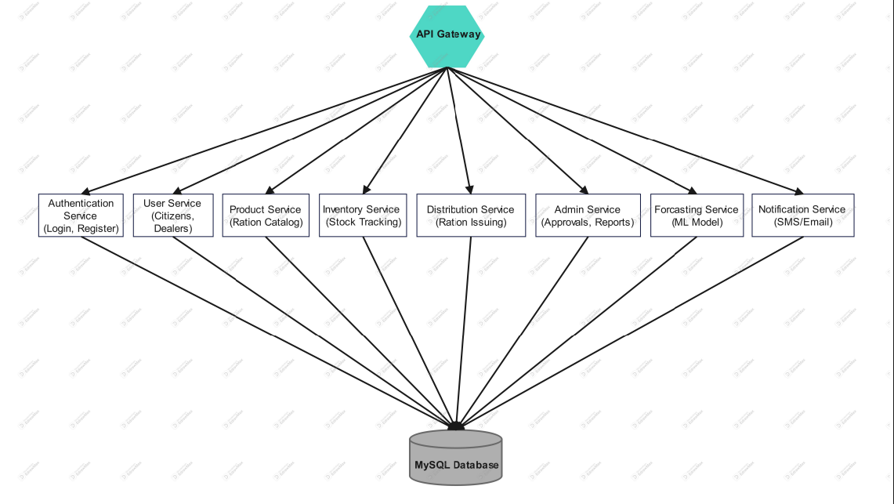
JSPM’s
Imperial College of Engineering and Research,Wagholi,Pune.
(Approved by AICTE,Delhi & Govt. of Maharashtra, affiliated to Savitribai Phule Pune University) Gat.No.720,Pune-Nagar Road,Wagholi,Pune,412207 Department of Computer Engineering
MICROSERVICES ARCHITECTURE

Slide 10
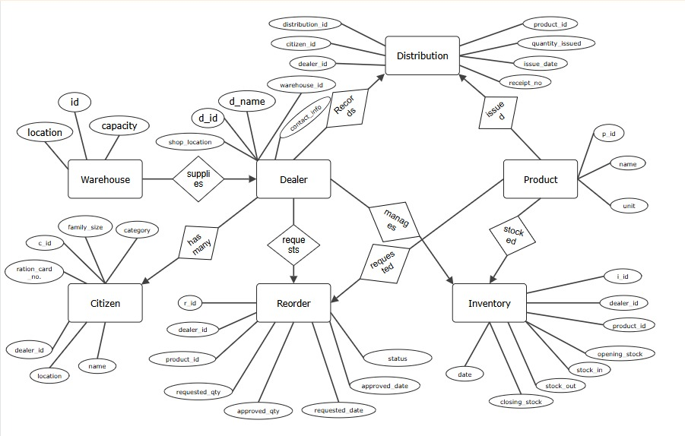
JSPM’s
Imperial College of Engineering and Research,Wagholi,Pune.
(Approved by AICTE,Delhi & Govt. of Maharashtra, affiliated to Savitribai Phule Pune University) Gat.No.720,Pune-Nagar Road,Wagholi,Pune,412207 Department of Computer Engineering
ER DIAGRAM

Slide 11
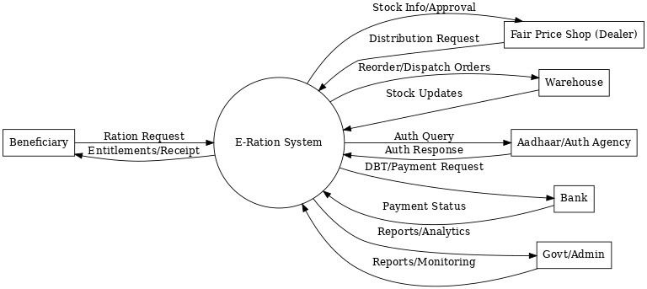
JSPM’s
Imperial College of Engineering and Research,Wagholi,Pune.
(Approved by AICTE,Delhi & Govt. of Maharashtra, affiliated to Savitribai Phule Pune University) Gat.No.720,Pune-Nagar Road,Wagholi,Pune,412207 Department of Computer Engineering
DFD DIAGRAM

Slide 12
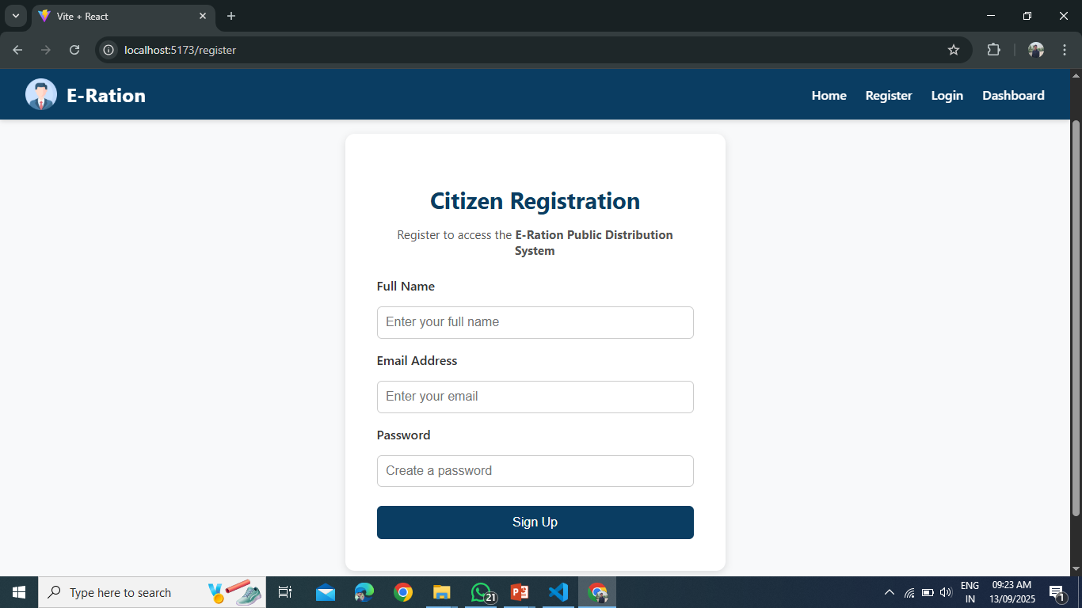
JSPM’s
Imperial College of Engineering and Research,Wagholi,Pune.
(Approved by AICTE,Delhi & Govt. of Maharashtra, affiliated to Savitribai Phule Pune University) Gat.No.720,Pune-Nagar Road,Wagholi,Pune,412207 Department of Computer Engineering
RESULTS

Slide 13
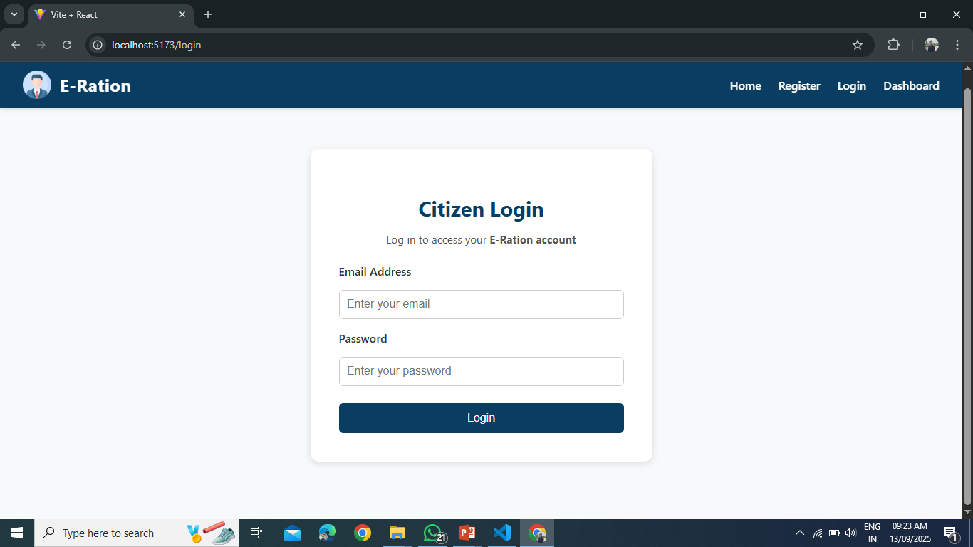
JSPM’s
Imperial College of Engineering and Research,Wagholi,Pune.
(Approved by AICTE,Delhi & Govt. of Maharashtra, affiliated to Savitribai Phule Pune University) Gat.No.720,Pune-Nagar Road,Wagholi,Pune,412207 Department of Computer Engineering
RESULTS

Slide 14
JSPM’s
Imperial College of Engineering and Research,Wagholi,Pune.
(Approved by AICTE,Delhi & Govt. of Maharashtra, affiliated to Savitribai Phule Pune University) Gat.No.720,Pune-Nagar Road,Wagholi,Pune,412207 Department of Computer Engineering
RESULTS

Slide 15
JSPM’s
Imperial College of Engineering and Research,Wagholi,Pune.
(Approved by AICTE,Delhi & Govt. of Maharashtra, affiliated to Savitribai Phule Pune University) Gat.No.720,Pune-Nagar Road,Wagholi,Pune,412207 Department of Computer Engineering
ADVANTAGES
Reduces corruption, ensures only genuine users benefit.
Minimizes manual record-keeping and human error.
Citizens track quotas and receipts anytime.
Dealers manage stock faster, less paperwork.
Admins get real-time monitoring and alerts.
Secure login and encrypted citizen data.
Smart inventory forecasting prevents stock issues.

Slide 16
JSPM’s
Imperial College of Engineering and Research,Wagholi,Pune.
(Approved by AICTE,Delhi & Govt. of Maharashtra, affiliated to Savitribai Phule Pune University) Gat.No.720,Pune-Nagar Road,Wagholi,Pune,412207 Department of Computer Engineering
APPLICATIONS
Public Distribution System (PDS): Fair and transparent ration distribution.
Smart Inventory Control: Forecasting demand for food grains and essentials.
Citizen Self-Service: Check quota, collect receipts, view history online.
Dealer Support: Easy stock tracking, ration issue, and replenishment requests.
Government Monitoring: Real-time dashboards for policy decisions.

Slide 17
JSPM’s
Imperial College of Engineering and Research,Wagholi,Pune.
(Approved by AICTE,Delhi & Govt. of Maharashtra, affiliated to Savitribai Phule Pune University) Gat.No.720,Pune-Nagar Road,Wagholi,Pune,412207 Department of Computer Engineering
HARDWARE INTERFACES
Processor :- Intel 5th Generation or above (i5, i7, or higher recommended for decent CPU performance for handling multiple requests and threads efficiently.).
Memory :- 8 GB or above (crucial to run the Java Virtual Machine (JVM), database (e.g., MySQL/PostgreSQL), and application server concurrently without performance lags.).
Hard Disk :- 500 GB SSD(helps in faster application boot-up, logging, data storage, and file serving (images, reports, etc.).

Slide 18
JSPM’s
Imperial College of Engineering and Research,Wagholi,Pune.
(Approved by AICTE,Delhi & Govt. of Maharashtra, affiliated to Savitribai Phule Pune University) Gat.No.720,Pune-Nagar Road,Wagholi,Pune,412207 Department of Computer Engineering
SOFTWARE REQUIREMENT
Programming Language: Java (Server), React(Frontend)
Libraries:
Spring Web for REST APIs,
Spring Data JPA for Database Operations
Spring Security for Authentication/Authorization.
Operating System: Cross-platform (Windows, Linux, macOS)
Development Environment: VS Code, Eclipse, Spring Tool Suite, or any of choice.

Slide 19
JSPM’s
Imperial College of Engineering and Research,Wagholi,Pune.
(Approved by AICTE,Delhi & Govt. of Maharashtra, affiliated to Savitribai Phule Pune University) Gat.No.720,Pune-Nagar Road,Wagholi,Pune,412207 Department of Computer Engineering
CONCLUSION
The e-Ration Shop aims to transform PDS by ensuring fair, transparent, and digital access to essential goods. It reduces corruption, improves user access, and supports government goals under Digital India. This system can play a vital role in making food security more reliable and citizen-focused.

Slide 20
JSPM’s
Imperial College of Engineering and Research,Wagholi,Pune.
(Approved by AICTE,Delhi & Govt. of Maharashtra, affiliated to Savitribai Phule Pune University) Gat.No.720,Pune-Nagar Road,Wagholi,Pune,412207 Department of Computer Engineering
REFERENCES
Vikram Singh; Vellanki Aamani; Booreddy Mounika (April 2013): Smart Ration Card. Journal of Global Research in Computer Science, Volume 4, No. 4.
A.N.Madur; Sham Nayse (July 2013): Automation in rationing system using ARM7 and RFID. International journal of innovative research in electrical, electronics, instrumentation and control engineering, Volume 1
Kashinath Wakade; Chidrawar Pankaj; Aitwade Dinesh (April 2015): Smart Ration Distribution Partition and Power Controlling. International Journal of Scientific and Research Inventor Publication, Volume 5, Issue 4.
Yogesh Kumar Sharma; Dr. K. B. Shivakumar; Srinidhi G. (March 2015): Biometric Device using PDS. IRF International Conference.
E-Rationing Management System Prajakta Shinde1 , Kautubhi Shukla 2 , Shraddha Zagade3 , V. S. Kumbhar4

Slide 21
JSPM’s
Imperial College of Engineering and Research,Wagholi,Pune.
(Approved by AICTE,Delhi & Govt. of Maharashtra, affiliated to Savitribai Phule Pune University) Gat.No.720,Pune-Nagar Road,Wagholi,Pune,412207 Department of Computer Engineering
Thank You

