Slide 1
Contents
Overview
Module
Aim of the Project
System specification
ER Diagram
DFD
Snapshots
Features and advantage
Future perspective

Slide 2
Overview
The e - commerce website specializes in selling plants at an affordable price of Rs. 99.
The website is user-friendly with easy navigation to provide a seamless shopping experience for customers.
The website offers a diverse range of plants to cater to different customer preferences and requirements.
The website provides a secure payment gateway and reliable delivery services to ensure customer satisfaction.
The project aims to provide a convenient and cost-effective solution for customers to purchase plants online.

Slide 3
Module
Home
Products
Category
Deal
Contact us
Login
Sign up
Cart
Whishlist

Slide 4
Aim of the Project
The primary aim of the project is to establish an e-commerce website that specializes in selling a wide range of plants at an affordable price.
The project aims to promote the benefits of having indoor plants and encourage people to adopt a greener lifestyle.
The website aims to offer a diverse range of plants that cater to different types of plants for offices and indoor .
The project aims to provide reliable delivery services like categories, , deals every week and images to select products.

Slide 5
System specification
H/W SPECIFICATION
1. RAM : 1 GB of RAM
2. Hard-disk : 10 GB of available hard disk space
3. Processor : 1.6 GHz or faster processor
S/W SPECIFICATION
1.Operating System : Windows 7/Windows 10
2.Language : ColdFusion
3.Backend : Sql Server

Slide 6
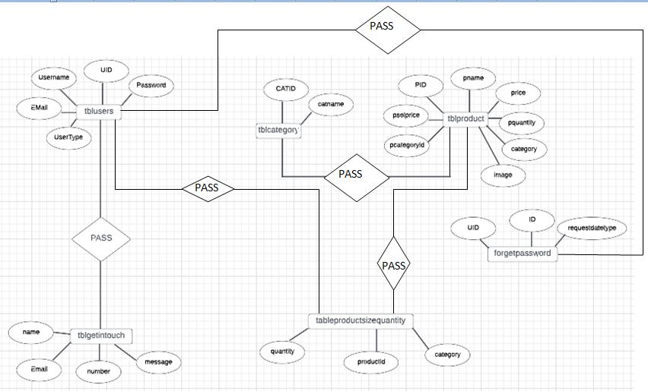
ER Diagram

Slide 7
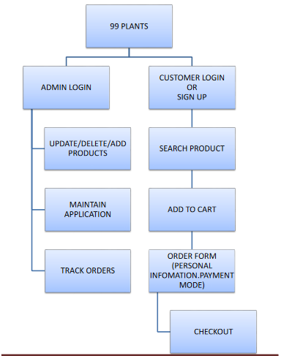
DFD

Slide 8
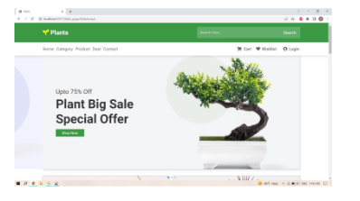
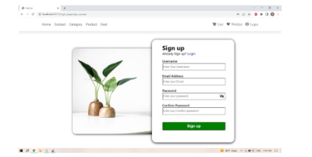
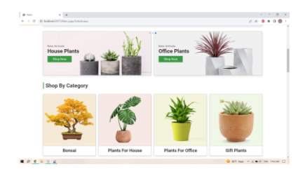
Snapshots

Slide 9
Features and advantage
User-friendly interface to allow customers to easily update their profiles, track orders, access customer support and admin to handle website.
Option to subscribe to email or push notifications for new plant arrivals, promotions, and updates on order status.
Access to informative and educational resources on plant care and maintenance.
Convenient option to download materials and certificates related to plant care and gardening.

Slide 10
Advantages
Customers can easily update their preferences and order history without the need to visit a physical store or customer service center.
Notifications help customers stay informed and up-to-date on the latest offerings and promotions on directly mail.
Access to materials helps customers make informed purchasing decisions and learn more about plant care and new types of plants.
More features like queries, feedback, comment on query facilities making it User- Friendly.

Slide 11
Conclusion
Unique feature of the project e-commerce website of plants that sells plants at Rs. 99 could be a personalized plant recommendation system based on customer preferences and environmental factors. This system could ask customers questions about their plant care experience, lighting and temperature conditions in their home, and personal preferences such as size, of plants, and maintenance level. The system could then suggest a range of plants that are suitable for the customer's unique circumstances and preferences. This would provide a highly personalized and tailored shopping experience for customers and help ensure the success of their plant care journey.

Slide 12
Thank you …..

