Slide 1
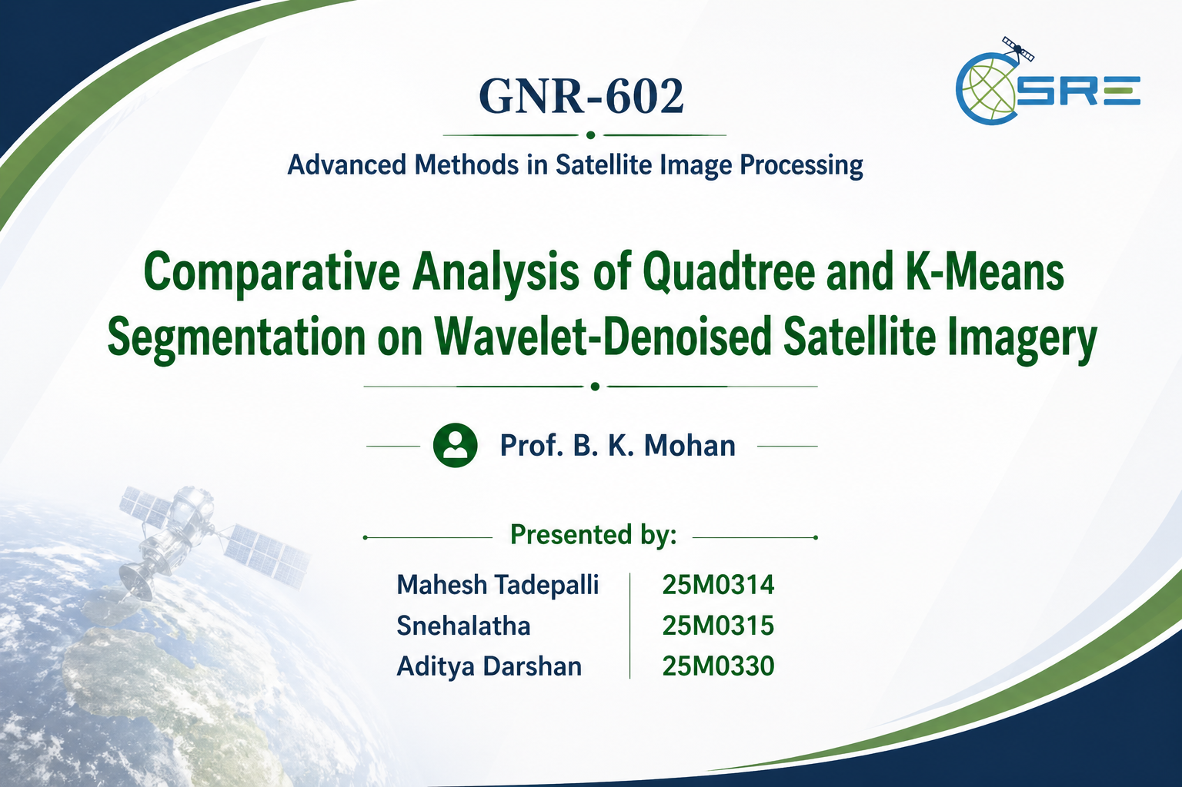

Slide 2
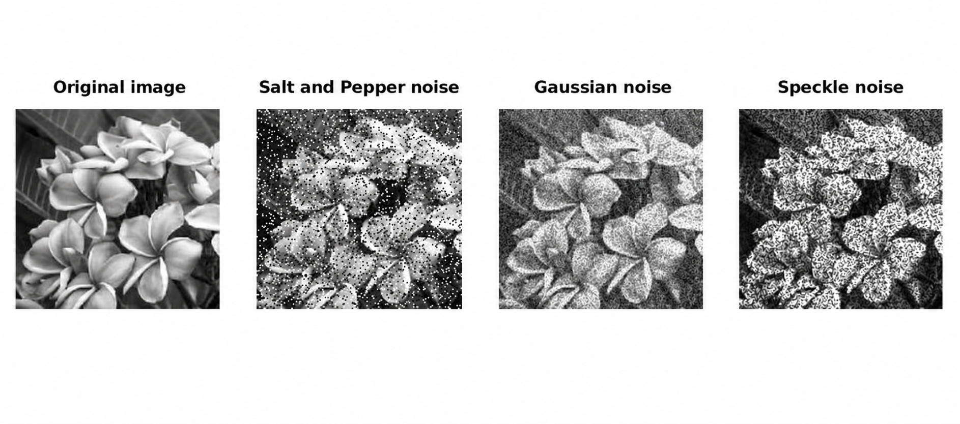
Problem Statement
“ Noise degrades segmentation accuracy, and conventional methods fail to capture spatial structure. This project addresses the need for combining smoothing with segmentation for better region extraction.”

Slide 3
Objectives
• Use Daubechies wavelets (db4 and db6) for image smoothing. • Reduce noise while preserving image details and structures. • Perform quadtree-based segmentation using homogeneity criteria. • Compare segmentation performance with K-means clustering. • Evaluate results using standard segmentation metrics.

Slide 4
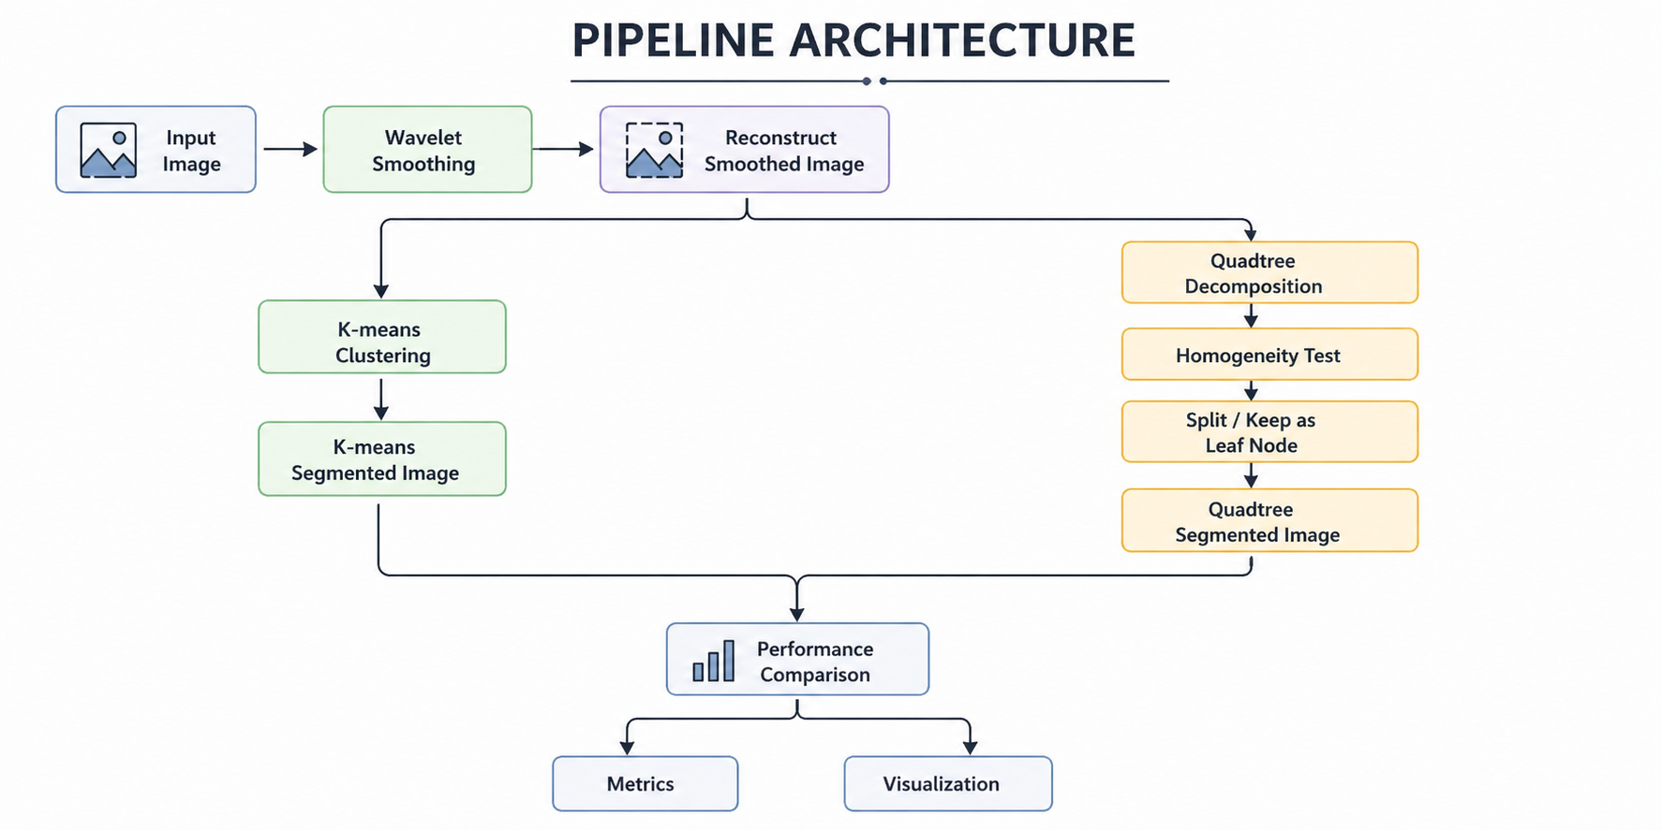

Slide 5
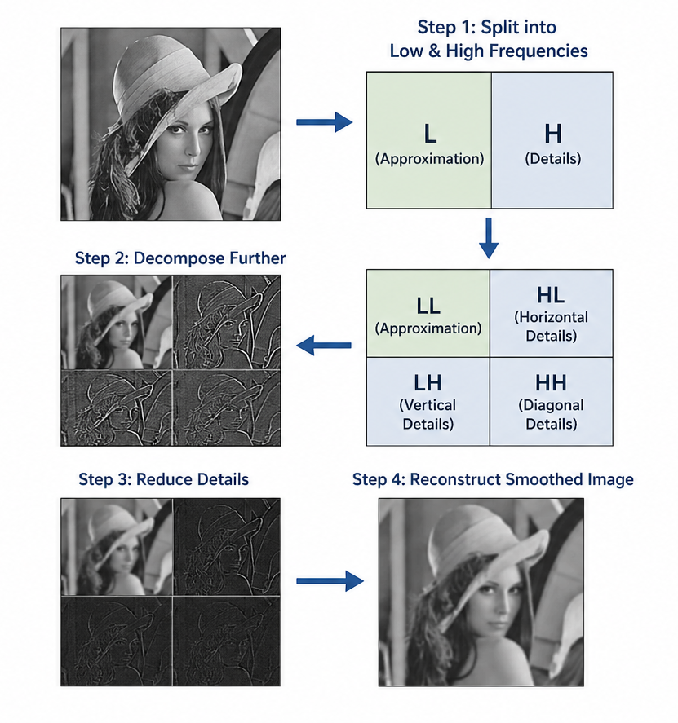
Wavelet Smoothing
Image is split using Daubechies wavelets (db4 / db6)
Decomposition separates image into two parts:
Approximation (low frequency
Details (high frequency
Approximation part is kept unchanged
Detail coefficients are scaled down (reduced)
db4 = moderate smoothing, db6 = more smoother result
Reducing details removes noise but preserves structure
Final image becomes smoother and cleaner for segmentation

Slide 6
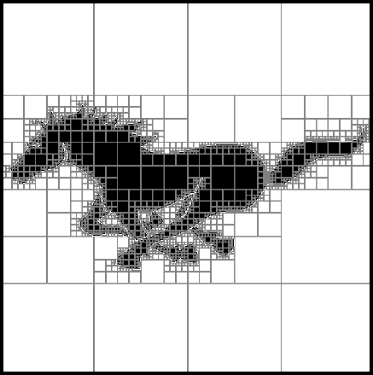
Quadtree Segmentation
Image is divided into square regions based on pixel similarity
Start with the entire image and check homogeneity
Non-uniform regions are recursively split into 4 parts
Process continues until regions become uniform or reach minimum size
Final blocks represent segmented regions of the image
Large blocks indicate smooth areas, small blocks indicate detailed regions

Slide 7
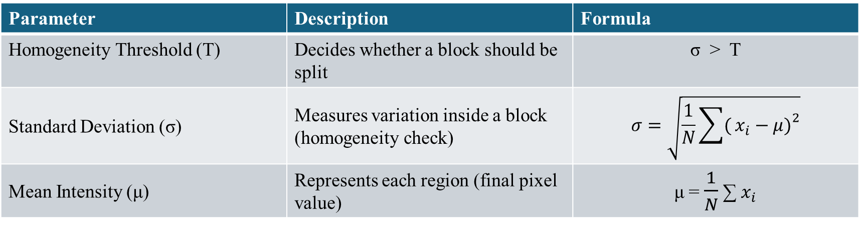
Quadtree Segmented Image Construction:
Use the final leaf blocks (homogeneous regions)
Compute mean intensity for each block
Assign this value to all pixels within the block
This directly forms the segmented image
key parameters:
Parameter | Description | Formula
Homogeneity Threshold (T) | Decides whether a block should be split | σ > T
Standard Deviation (σ) | Measures variation inside a block (homogeneity check) | $$σ=\sqrt{\frac{1}{N}\sum{(}\left.x_{i}−μ{\left.)\right.}^{2}\right.}$$
Mean Intensity (μ) | Represents each region (final pixel value) | μ = $\frac{1}{N}$ ∑ $x_{i}$​

Slide 8
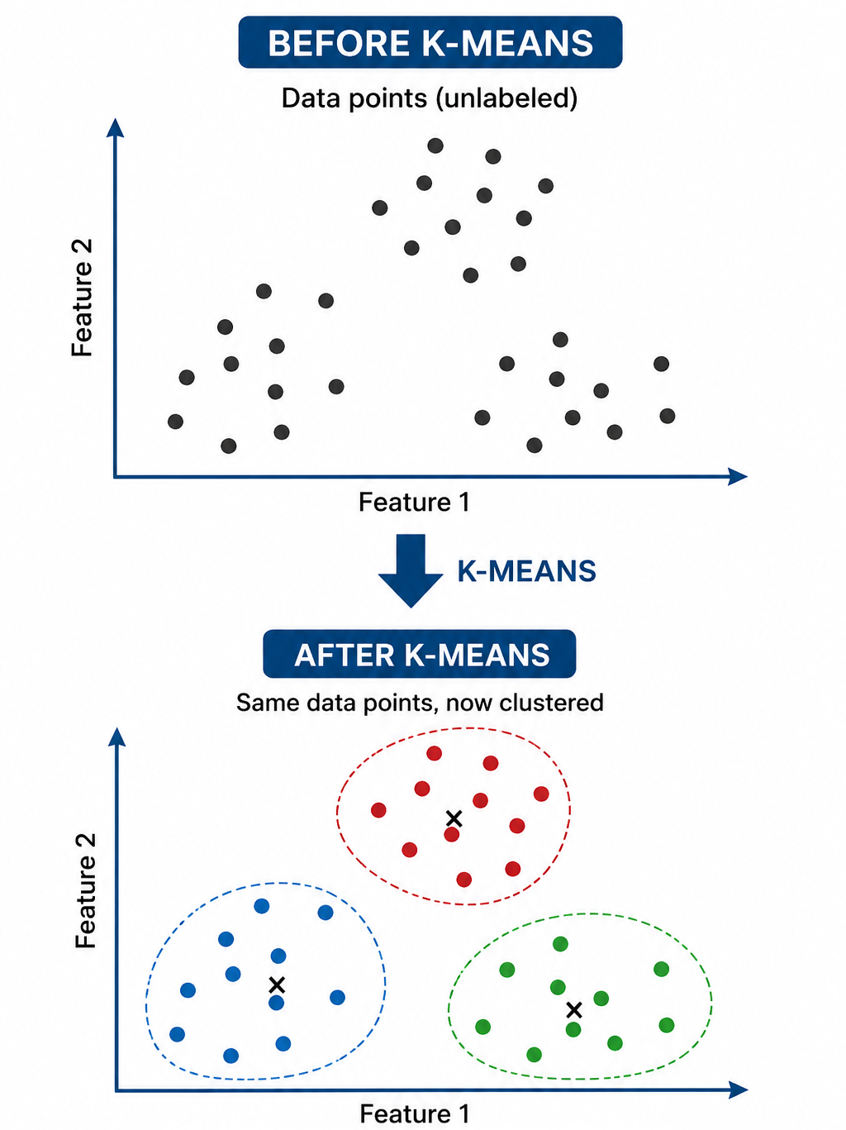
K-Means Segmentation
Groups pixels based on intensity similarity
Number of clusters (K) is predefined
Each pixel assigned to nearest cluster center
Cluster centers updated iteratively
Produces segmented image with K regions

Slide 9
Parameters(k-means):
Parameter | Description | Formula
Number of Clusters (K) | Number of regions to segment the image into | --
Cluster Centers (μₖ) | Representative intensity of each cluster | μk = (1 / Nk) * Σ xi
Distance Metric | Assigns pixel to nearest cluster center | d = √[(x − μk)²]
Objective Function (Loss) | Minimizes intra-cluster variance | J = Σ (x − μk)²
Initialization | random | --

Slide 10
Metrics
Metric | Describes | Formula
MSE (Mean Squared Error) | Difference between original and segmented image | MSE = (1/N) * Σ (I − Î)²
Intra-region Variance | Variation within each segment (homogeneity) | σ² = (1/N) * Σ (x − μ)²
Number of Regions | Total segments formed | --
Difference Map | Visual difference between methods | --
“Lower MSE → better reconstruction”
“Lower variance → more uniform regions”

Slide 11
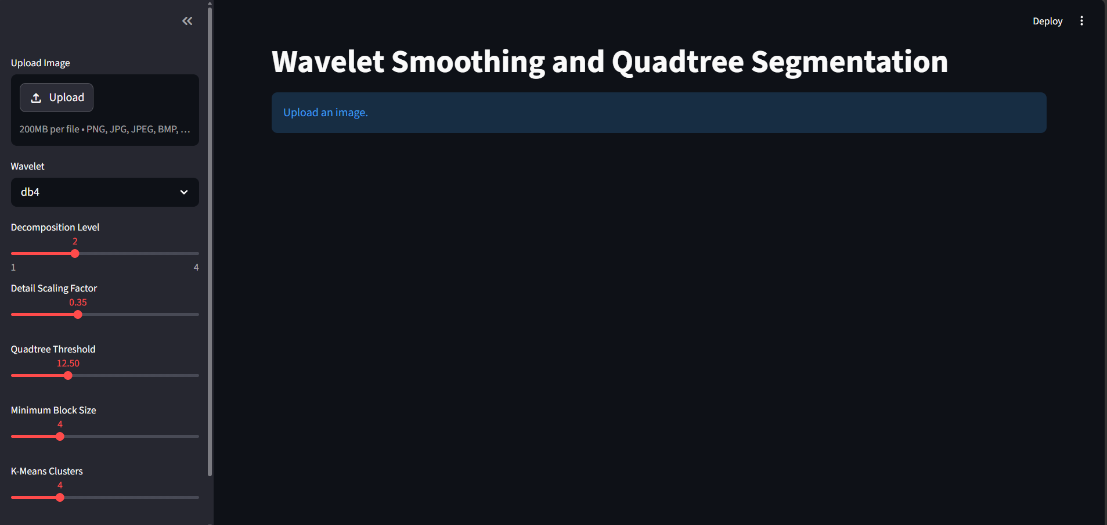
UI - Streamlit

Slide 12
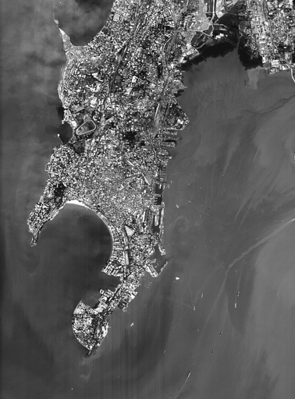

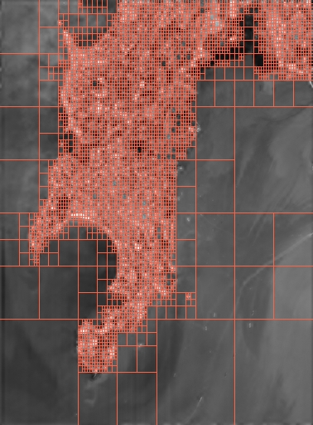
Results
Original Image
Wavelet Smoothed Image
Quadtree segmentation

Slide 13
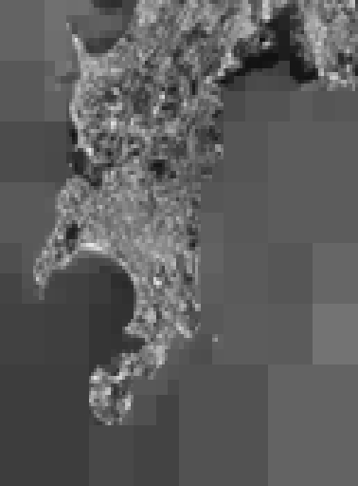
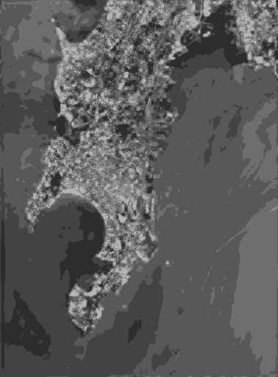
Comparison b/w Quadtree & K-means Segmented Images:
Quadtree Segmented Image
K-means Segmented Image

Slide 14
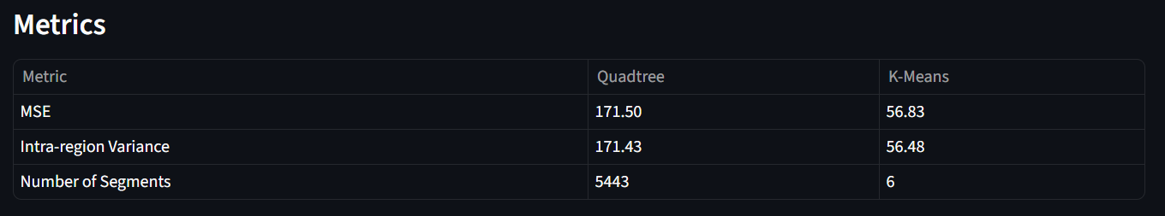
Metrics: Quadtree vs K-means

Slide 15
Observations:
Wavelet smoothing reduces noise while preserving key structures
Quadtree adapts to image content → large blocks (smooth), small blocks (detailed)
Quadtree segmentation captures spatial structure effectively but often leads to over-segmentation, especially in high-detail areas
K-means produces coarse, uniform regions with fixed clusters
K-means does not consider spatial information, so distant but similar pixels may be grouped together
Quadtree boundaries follow image structure, K-means boundaries are less aligned
Difference map highlights variations in complex regions

Slide 16
Thank you

