Slide 1
BLOCK-CHAIN BASED CERTIFICATION VALIDATION
PIP104 PROFESSIONAL PRACTICE-II
VIVA-VOCE
Batch Number:
Roll Number | Student Name
20201CCS0016 | Maddi Shanmukha Mahesh Babu
20201CCS0091 | Nagubandi Viswesh
20201CCS0125 | Lakku Rohith kumar Reddy
Under the Supervision of,
Dr. Syed Siraj Ahmed
Professor / Associate Professor
School of Computer Science & Engineering
Presidency University

Slide 2
Introduction
Conventional techniques for verifying certificates that rely on central databases are vulnerable to manipulation, fraud, and unapproved access. This makes verifying the legitimacy and authenticity of certificates from academic institutions and professional associations extremely difficult.
Blockchain technology shows promise as a remedy for these problems. The technique provides tamper-proof verification by digitally signing and storing certificates on a blockchain, each with a distinct cryptographic hash.
However, the lack of a globally accepted and standardized blockchain-based certificate verification system now in place makes it difficult to build a technique that is both universally safe and trustworthy, which affects the integrity of credential validation in a variety of industries and organizations.

Slide 3
Literature Review
1.” An Overview of Blockchain Technology: Architecture, Consensus, and Future Trends” by Zibin Zheng. (2017).
An Overview of Blockchain Technology by Zibin Zheng offered comprehensive information on blockchain. It developed several technical phrases related to this technology, the most significant of which is the term "smart contract." The Blockchain creates a lengthy chain of nodes by storing the data's hash in the block before it. When data is tampered with, its hash changes and doesn't match the hash value saved in the previous block, alerting us to the change.
2. "Certificate Transparency Using Blockchain," by D.S.V.Madala.(2018)
The Hyper Ledger Fabric blockchain platform was utilized by Madala et al. [3]. In this system, Certificate Transparency (CT), a Google invention, requires domain owners' agreement before CAs can issue certificates. The goal is to stop SSL/TLS CAs from providing certificates for a domain without the domain owner's knowledge. However, there were fewer transactions and poor scalability.

Slide 4
Literature Review
3. “Blockchain Based Identity Verification Model”, by Gunit Malik.(2019)
"Blockchain-Based Identity Verification Model," by Gunit Malik [4].Their system was composed of an issuing authority that created the document, a hashing algorithm that processed it, and a storage unit that held its value. They used asymmetric encryption to boost security because other systems used public hash keys.
4. "Decentralized Digital Certificate Revocation System Based on Blockchain”, by Aisong Zhang.(2018)
Aisong Zhang and colleagues [5] developed a blockchain-based consortium framework. They employed a covert sharing plan. It has the ability to verify the digital certificate in order to safeguard user data and property. The CAs have worked together on the digital certificate revocation lists. When compared to the traditional approach, the CRL (Certificate Revocation List) is more trustworthy and dependable. The user simply needs to utilize the public key to decrypt the signature in order to validate the certificate.

Slide 5
Literature Review
5. "Blockchain-Based Certificate Verification System for Internet of Things" by V. Vignesh et al. (2019).
The existing system discussed in the paper focuses on the challenges faced in verifying certificates in the context of the Internet of Things (IoT). Traditional certificate verification systems rely on centralized authorities, such as Certificate Authorities (CAs), which can be prone to various security vulnerabilities and single points of failure. These limitations make traditional systems less suitable for the decentralized and dynamic nature of IoT environments.
The paper proposes a block chain-based certificate verification system for IoT, which leverages the distributed ledger technology to address the limitations of the existing systems. The proposed system aims to provide a secure, transparent, and decentralized mechanism for certificate verification in IoT environments. It utilizes the immutability and consensus features of block chain to ensure the integrity and authenticity of certificates.

Slide 6
Research Gaps Identified
1. Certificate Creation: The certificate issuer generates a digital certificate containing relevant information, such as the identity of the certificate holder, issuer, and any additional metadata. The certificate may also include a digital signature from the issuer to ensure its authenticity.
2. Certificate Hashing: A cryptographic hash function is applied to the certificate, generating a unique digital fingerprint called a hash. The hash serves as a compact representation of the certificate's data.
3. Certificate Anchoring: The certificate's hash is then anchored or stored on the block chain. This process involves creating a transaction on the blockchain that includes the certificate's hash as part of its data.
4. Consensus Mechanism: The blockchain network reaches a consensus on the validity of the transaction and adds it to the block chain. This consensus is typically achieved through mechanisms such as Proof of Work (PoW), Proof of Stake (PoS), or other consensus algorithms employed by the block chain network.
5. Certificate Verification: To verify a certificate, the verifier retrieves the certificate's hash from the blockchain. The verifier can independently compute the hash of the certificate they possess and compare it with the hash stored on the block chain.

Slide 7
Proposed Methodology
The proposed method of certificate verification and validation using blockchain introduces a decentralized and transparent approach. Certificates are generated and stored on the blockchain, leveraging its immutability and consensus mechanisms.
Smart contracts are utilized to automate the verification process, enabling self-executing and tamper-resistant transactions. Verifiers can independently retrieve certificate data from the blockchain and validate their authenticity using cryptographic techniques.
The distributed nature of the blockchain ensures transparency and auditability, reducing reliance on centralized authorities. This method enhances the security, trustworthiness, and efficiency of certificate verification, addressing the limitations of traditional systems and providing a robust solution for various domains, including supply chain, and identity management

Slide 8
Proposed Methodology
1. Enhanced Security: Blockchain technology provides a high level of security by leveraging cryptographic techniques and consensus mechanisms. The immutability and tamper-resistant nature of the blockchain ensure the integrity and authenticity of certificates, reducing the risk of fraud or unauthorized modifications.
2. Decentralization and Trust: The decentralized nature of blockchain eliminates the need for a central authority, such as a certificate authority, making the verification process more transparent and resilient to single points of failure. This distributed trust model enhances trust among participants, as certificate verification can be performed by multiple nodes in the block chain network.
3. Transparency and Auditability: The transparent nature of blockchain allows anyone to access and verify certificates stored on the blockchain. The entire transaction history, including the issuance and verification process, is recorded on the blockchain, providing an auditable and transparent trail for certificate validation.

Slide 9
Proposed Methodology
4. Efficiency and Cost Savings: Blockchain-based certificate verification systems automate and streamline the verification process, reducing the need for manual interventions and paperwork. This improves efficiency, saves time, and reduces costs associated with traditional verification methods.
5. Interoperability and Standardization: Blockchain-based certificate verification systems have the potential to promote interoperability and standardization across different industries and domains. The use of common blockchain protocols and standards can facilitate seamless integration and compatibility between various certification systems.
6. Privacy and Data Ownership: Block chain technology allows for selective disclosure of certificate information, ensuring privacy while maintaining the ability to verify the validity of certificates. Users have control over their own certificate data and can choose when and how much information to disclose.

Slide 10
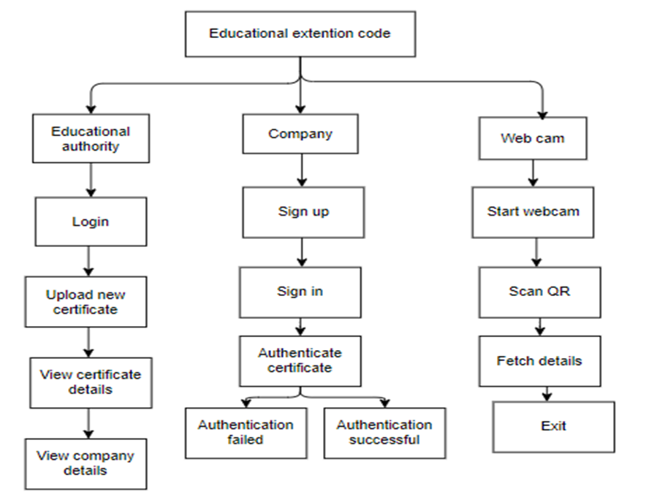
Block Diagram

Slide 11
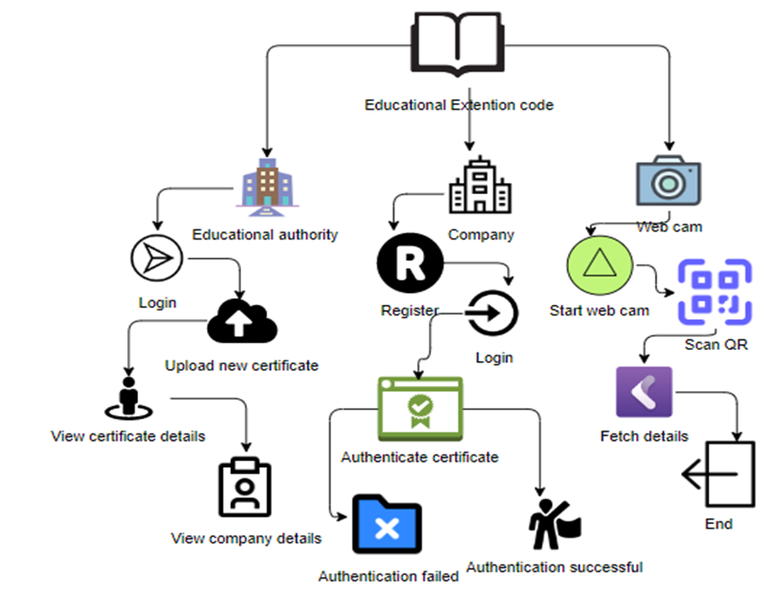
Architecture

Slide 12
Objectives
Objectives for a project to store certificates in a decentralized way using blockchain:
Secure and efficient storage and verification of educational certificates: To provide a secure and efficient way for individuals to store their educational certificates and for organizations to verify their authenticity.
Decentralized storage: To store certificates on a decentralized blockchain network, eliminating the need for a central authority and reducing the risk of data breaches or tampering.
Digital signature and access control: To allow individuals to sign their certificates digitally and control access to them by using multi-signature technology, requiring the consent of the individual and authorized organizations for access.
Shareability: To enable individuals to easily share their certificates with authorized organizations for verification purposes.

Slide 13
Objectives
Reduced workload for organizations: To streamline the verification process for organizations by providing them with a secure and tamper-proof way to access and verify certificates.
Increased transparency and trust: To increase transparency and trust in the certificate verification process by providing a secure and auditable record of all certificate transactions.
Reduced costs: By eliminating the need for paper certificates and manual verification processes, the solution could potentially reduce costs for both individuals and organizations.
Improved accessibility: The solution could make it easier for individuals to access and share their certificates, regardless of their location.
Enhanced security: The use of blockchain technology could provide an additional layer of security for educational certificates, making them more resistant to fraud and forgery.

Slide 14
System Design & Implementation
Input Design:
The raw data that is used to create output in an information system is called input. The input devices, such as PC, MICR, OMR, etc., must be taken into account by the developers throughout the input design.
As a result, the system's output quality is determined by the quality of its intake. The following characteristics of well-designed input forms and screens are present:
• It should efficiently fulfill a certain goal, such as saving, recording, and retrieving information.
• It guarantees accurate and correct completion.
• It should be simple to fill out and easy to understand.
• Its main goals should be simplicity, consistency, and user attention.
• All of these are attained by applying an understanding of fundamental design concepts.

Slide 15
System Design & Implementation
Objectives for Input Design:
The objectives of input design are −
• Designing data entry and input procedures.
• Lowering the volume of input; designing other ways of data capture.
• Designing source documents for data capture.
• Creating data entry screens, user interface screens, etc.
• Employing validation checks; and creating efficient input controls.
Output Design:
The most crucial duty in every system is output design. Developers determine the necessary output types, prototype report layouts, and output controls during output design

Slide 16
System Design & Implementation
Objectives of Output Design:
The objectives of output design are:
To create output designs that fulfill requirements and prevent undesirable output from being produced.
To create an output design that satisfies the needs of the final user.
To provide the right amount of output.
To prepare the output in the proper format and send it to the correct individual.
To provide timely access to the output so that wise decisions can be made.

Slide 17
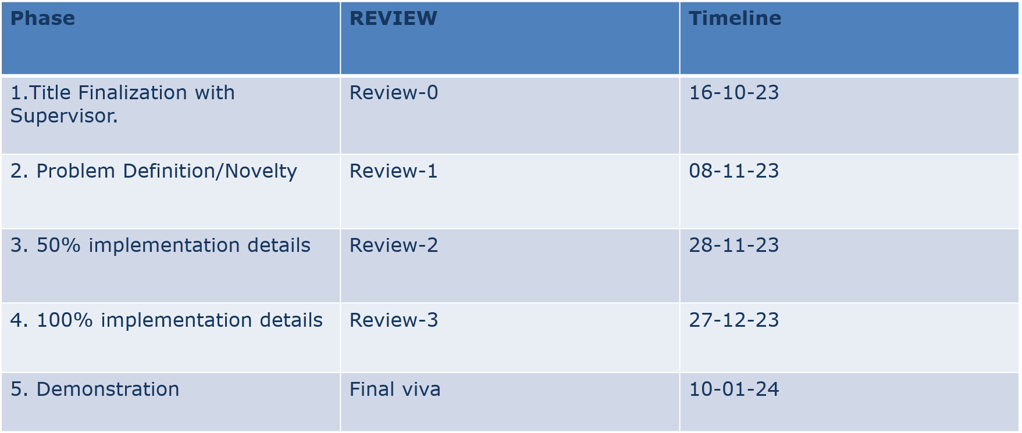
Timeline of Project

Slide 18
Outcomes / Results Obtained
Increased security and authenticity: Blockchain technology is highly secure and tamper-proof, making it ideal for storing important documents such as school/university/board certificates. Digital signatures ensure that the certificates are authentic and have not been tampered with.
Reduced workload for organizations: Institutions will no longer need to manually verify the authenticity of certificates, as this can be done automatically using blockchain technology. This will free up staff time and resources to focus on other tasks.
Improved efficiency: Students and graduates will be able to easily share their certificates with organizations or institutions with their consent, without having to worry about the security or authenticity of their documents. This can help to speed up the application process and reduce the risk of errors.
Increased transparency: Blockchain technology is transparent and public, which means that anyone can verify the authenticity of a certificate without having to contact the issuing institution. This can help to reduce fraud and increase trust in the system.

Slide 19
Outcomes / Results Obtained
Simplified sharing: Sharing certificates with authorized organizations would be faster and easier, requiring only consent and no paperwork.
Reduced costs: Eliminating manual verification processes could lower operational costs for organizations.
Reduced fraud: The decentralized nature of the blockchain would make it difficult to forge or manipulate certificates.
However, the overall goal is to create a more secure, efficient, and user-friendly system for storing and verifying educational certificates, offering advantages for both individuals and organizations.

Slide 20
Conclusion
In conclusion, the way certificates are validated might be completely changed by incorporating blockchain technology into the validation and verification procedures. This would guarantee increased security, openness, and confidence.
The suggested approach offers a solid framework for putting into practice blockchain-based certificate verification systems while addressing the drawbacks of conventional techniques.
Additionally, there is not much chance that students would misplace their certificates. The actual document will be saved in the InterPlanetary File System (IPFS), but the hash of the certificate is stored on the blockchain, reducing the amount of data that is tampered with by utilizing an additional hashing technique.
By doing this, we can maintain the data and foster transparency. Further research and development in this area can lead to widespread adoption and standardization of blockchain technology for certificate verification across various industries and sectors.

Slide 21
References
1. Zibin Zheng , Shaoan Xie, Hong-Ning Dai, Xiangping Chen , ” An Overview of Blockchain Technology: Architecture, Consensus, and Future Trends”, IEEE 6th International Congress on Big Data, 2017.
2. Jiin-Chiou, Narn-Yih Lee, Chien Chi, YI-Hua Chen, “Blockchain and Smart Contract for Digital Certificate,” Proceedings of IEEE International Conference on Applied System Innovation 2018.
3. D. S. V. Madala, M. P. Jhanwar, and A. Chattopadhyay, "Certificate Transparency Using Blockchain," 2018 IEEE International Conference on Data Mining Workshops (ICDMW), Singapore, Singapore, 2018, pp. 71-80, doi: 10.1109/ICDMW.2018.00018.
4. Gunit Malik, Kshitij Parasrampuria, Sai Prasanth Reddy, Dr. Seema Shah, “Blockchain Based Identity Verification Model”, International Conference on Vision Towards Emerging Trends in Communication and Networking (ViTECoN), 2019.
5. Ali, A., et al. (2021). Blockchain-Based Certification Systems: A Systematic Literature Review. Sensors, 21(4), 1233.

Slide 22
References
6. Vignesh, V., et al. (2019). Blockchain-Based Certificate Verification System for Internet of Things. In 2019 10th International Conference on Computing, Communication and Networking Technologies (ICCCNT) (pp. 1-5). IEEE.
7. Stukach, V., et al. (2019). Decentralized Blockchain-Based Certificate Validation for Learning Objects. In 2019 International Conference on Information Technology and Systems (ICITS) (pp. 1-6). IEEE.
8. Alam, M. M., et al. (2019). A Blockchain-Based Secure Certificate Verification System. In 2019 4th International Conference on Networking, Systems and Security (NSysS) (pp. 1-6). IEEE.
9. Bello, R. A., et al. (2019). Blockchain-Based Certification System for the Internet of Things. In 2019 IEEE 7th International Conference on Future Internet of Things and Cloud (FiCloud) (pp. 47-52). IEEE.

Slide 23

Thank You

