Slide 1
FitPlate
FIRST REVIEW · CAPSTONE PROJECT
AI Fitness & Nutrition Platform
Know what to eat, how to train, and whether it’s working.
PRESENTED BY
GUIDE
DEPARTMENT
Mahesh Dasi · 2303A54021
Udayan Duddukuri · 2303A54017
Dr. S. Jamalaiah
CSE, SR University
Notes:
Good morning. We are Mahesh and Udayan, guided by Dr. S. Jamalaiah. Our capstone is FitPlate, an AI fitness and nutrition platform. In this first review we’ll explain the problem we are solving, why existing tools don’t solve it well, how FitPlate is different, and then show a short live demo.

Slide 2
THE PROBLEM
People trying to get fit are given numbers, not guidance.
Apps tell you how many calories you ate. They rarely tell you what to eat next, how to train today, or whether it is actually working.
Notes:
The core problem in one line. Most people who start a fitness journey can get a calorie number from any calculator, but turning that number into daily decisions, what to eat for dinner, how much to lift, is where they get stuck and give up.

Slide 3
Why it matters in India
24%
22.9%
Rising in both
The numbers are going the wrong way, and most people manage weight on their own, without a dietitian or a coach.
of women are overweight or obese, up from 20.6% in the previous survey
of men are overweight or obese, up from 18.9% in the previous survey
Source: National Family Health Survey (NFHS-5, 2019 to 21) vs NFHS-4 (2015 to 16), as reported by Down To Earth
Notes:
According to NFHS-5, the national family health survey, 24 percent of women and 22.9 percent of men are overweight or obese, and both went up since NFHS-4. Most people deal with this on their own, so tools that guide them well matter.

Slide 4
Where today’s tools fall short
Calorie counters
Workout loggers
Record what you ate, but don’t suggest the next meal. Units are grams and cups, not katori or roti.
Track sets well, but don’t know what you eat, so training and food never inform each other.
Generic AI chatbots
Fixed diet charts
Answer anything, but don’t know your targets or allergies, and can give unsafe health advice.
One plan for everyone. They don’t adapt to what you ate today or how your week went.
Notes:
Four kinds of tools people use today, and the gap in each. These are general categories, not specific products. The common thread: each solves one piece, and the user has to connect the pieces in their head.

Slide 5
Problem statement
To design and build a web platform that turns a person’s body data, goal, diet and allergies into daily calorie and macro targets, meal and workout recommendations, progress predictions and weekly insights, with an assistant that answers questions from the user’s own data and refuses unsafe medical advice.
Personalised
Explainable
Safe
Built for Indian food
Notes:
This is the formal problem statement for the project. The four words at the bottom are the design goals we hold every feature to.

Slide 6
Objectives
Personal targets: daily calories, macros and water from body data and goal
Meal recommendations that fit what is left today, the diet type and allergies
1
2
Workout plans for the user’s level and split, tracked set by set with progression
Progress prediction: forecast the weight trend and explain the week
3
4
A safe assistant that answers from the user’s own data and declines medical advice
A secure, tested web app that is deployed and usable by anyone
5
6
Notes:
These are the six objectives of the project. The first five are the features a user sees; the sixth is about building it properly: secure login, input validation, automated tests and a live deployment.

Slide 7
OUR SOLUTION
FitPlate connects every step into one loop
1 · Profile
2 · Targets
3 · Eat
4 · Train
5 · Learn
Body, goal, diet, allergies
Calories, protein, carbs, fat, water
Meal ideas that fit what is left today
Weekly plan, set-by-set tracker
Progress forecast, weekly insights
An AI assistant sits across all five, answering questions from the user’s own targets, food log and workout plan.
AI
Notes:
FitPlate is one connected loop. The profile drives the targets; the targets drive meal suggestions based on what is left today; the training plan and tracker sit alongside; progress and weekly insights close the loop by showing whether it is working. The assistant can answer questions about any of it.

Slide 8
How FitPlate compares
What the user needs | Calorie counter | Workout logger | Generic AI chat | FitPlate
Personal calorie and macro targets | Yes | No | If asked | Yes
Next-meal suggestions that respect diet and allergies | Rarely | No | Generic | Yes, ranked
Indian foods in katori, roti, tbsp, ml | Partly | No | No log | Yes
Set-by-set training with progression targets | No | Yes | No | Yes
Food and training in one place | No | No | No | Yes
Answers using your own data | No | No | No | Yes
Explains why it recommends something | No | Partly | Partly | Yes, with reasons
Columns describe typical tools in each category, not one specific product.
Notes:
This table is the heart of the review. Each existing category does one or two of these well. FitPlate is designed so all seven work together for the same user. We are describing categories in general, not any specific app.

Slide 9
Five things that make FitPlate different
1
One connected loop. Food, training and progress share the same data.
2
Built for Indian food. 79 foods in katori, cups, tbsp, ml or pieces.
3
Explainable ML. Every suggestion shows a match score and its reasons.
4
Coaches like a trainer. Shows last session and when to add weight.
5
Safe, grounded AI. Uses your data, declines medical advice, works offline.
Notes:
If the panel remembers only one slide, it should be this one. One: everything shares one data model. Two: Indian foods and household units. Three: recommendations come with reasons, not a black box. Four: the workout tracker coaches progression. Five: the assistant is grounded in the user’s data with a safety rule, and still works without internet.

Slide 10
The intelligence behind it
Feature | Technique | Type
Calorie and macro targets | Mifflin-St Jeor BMR × activity, goal-based macros | Formula
Meal recommendations | TF-IDF + cosine similarity, portion scaling | Content-based ML
Exercise selection | Feature vectors + cosine similarity + MMR | ML
Next workout target | Double progression, Epley one-rep max | Rule + formula
Weight forecast | Linear regression on recent weigh-ins | ML
Habit pattern | K-Means clustering (k = 4) | ML
Assistant | Intent classifier offline; LLM with user data online | ML + LLM
Notes:
Each feature uses the simplest technique that does the job, and the ML results are explained to the user. The assistant uses a logistic regression intent classifier when offline, and a large language model given the user’s own data when an API key is configured.

Slide 11
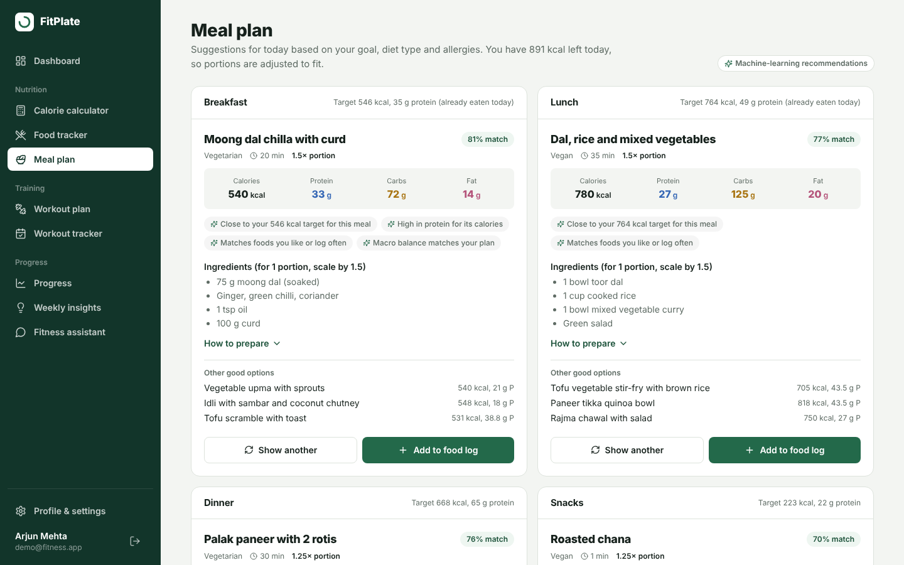
IN THE APP
Meals that fit what’s left today
Each slot gets a ranked pick with a match score, the reasons, macros, ingredients and portion size, plus three alternatives.
Notes:
This is the meal plan page. Moong dal chilla is suggested for breakfast with an 81 percent match, and the reasons are listed: close to the calorie target, high in protein, matches foods the user logs often. Portions are scaled so the day adds up.

Slide 12
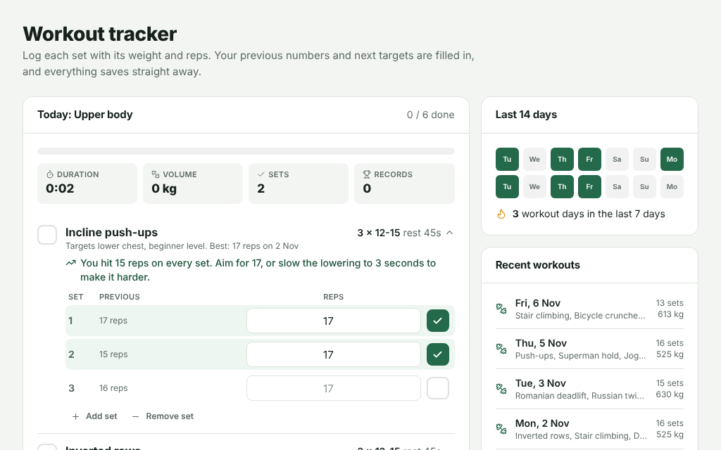
IN THE APP
Training that coaches progression
Log each set. Last session is shown beside it, the next target is suggested, a rest timer starts, and records are marked.
Notes:
This is the workout tracker. For incline push-ups the user hit 15 reps on every set last time, so FitPlate suggests aiming for 17. Previous numbers sit next to each set, and the stats at the top show duration, volume, sets and personal records.

Slide 13
What the demo will show
1
Sign up and profile: 5 quick steps
5
Workout tracker: sets, rest timer, PRs
2
Dashboard: targets and what is left
6
Progress: weight trend and forecast
3
Food tracker: 2 katori dal, 250 ml milk
7
Weekly insights: patterns and tips
4
Meal plan: ranked picks with reasons
8
Assistant: “I don’t have peanut butter”
Live at fitplate-0xeo.onrender.com · demo login demo@fitness.app
Notes:
Demo order. Start with the demo account so data is already there. Show the dashboard, log food in household units, open the meal plan and point out the reasons, tick a few sets in the workout tracker to show the rest timer and target, then progress, weekly insights, and finish with the assistant handling a follow-up like “I don’t have peanut butter”.

Slide 14
Next steps before the final review
User testing
Bigger food database
Have classmates use it for a week and measure how often they log and follow suggestions.
Add more regional dishes from the Indian Food Composition Tables, plus barcode search.
Assistant actions
Reminders and mobile
Let the assistant log a meal or change the split after the user confirms.
Meal, water and workout reminders, and a mobile app on the same API.
Notes:
These are the planned additions before the final review. We welcome the panel’s suggestions on which to prioritise.

Slide 15
References
[1] Mifflin, M. D., St Jeor, S. T., et al. A new predictive equation for resting energy expenditure in healthy individuals. Am. J. Clin. Nutr., 51(2), 241–247, 1990.
[6] Salton, G., Buckley, C. Term-weighting approaches in automatic text retrieval. Information Processing & Management, 24(5), 513–523, 1988.
[2] Jäger, R., et al. ISSN position stand: protein and exercise. J. Int. Soc. Sports Nutr., 14, 20, 2017.
[7] Carbonell, J., Goldstein, J. The use of MMR, diversity-based reranking for reordering documents and producing summaries. Proc. ACM SIGIR, 335–336, 1998.
[3] American College of Sports Medicine. Progression models in resistance training for healthy adults. Med. Sci. Sports Exerc., 41(3), 687–708, 2009.
[8] Pedregosa, F., et al. Scikit-learn: Machine learning in Python. J. Mach. Learn. Res., 12, 2825–2830, 2011.
[4] Longvah, T., et al. Indian Food Composition Tables 2017. ICMR-National Institute of Nutrition, Hyderabad, 2017.
[9] International Institute for Population Sciences and ICF. National Family Health Survey (NFHS-5), 2019–21: India. IIPS, Mumbai, 2021.
[5] ICMR-National Institute of Nutrition. Dietary Guidelines for Indians. Hyderabad, 2024.
[10] Epley, B. Poundage Chart. Boyd Epley Workout, Lincoln, NE, 1985.
Notes:
These are the main sources behind the formulas and models. Mifflin-St Jeor gives the calorie targets, the ISSN position stand guides protein, ACSM guides resistance-training progression, the Indian food tables and dietary guidelines inform the food data, TF-IDF and MMR come from information retrieval, scikit-learn is the ML library, NFHS-5 is the source of the statistics, and Epley gives the one-rep max estimate.

Slide 16
Thank you
Questions, and on to the live demo.
github.com/Maheshdasi/FitPlate
fitplate-0xeo.onrender.com
Notes:
Thank you. We’re happy to take questions, and then we’ll walk through the live demo.

