Slide 1


Eventing in the Azure with queues, grids, and hubs: when to use which and for what scenarios
Maheshkumar R, Microsoft
MahesKBlr

Slide 2



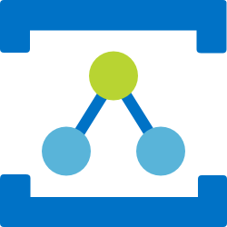

Azure Messaging Services
Storage Queues
Service Bus
Event Hubs
Relay
Event Grid
Simple task queues
Enterprise messaging
Big data streaming
Secure sockets without changes to your network
Cross-cloud reactive eventing

Slide 3
Storage Queues
Simple Queues

Slide 4
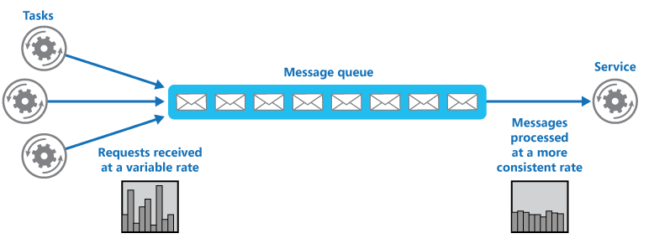
Storage queues are task queues
Tasks queues coordinate work across compute (VMs, Functions, etc.)
The messages in a queue are generally homogeneous
Low cost & Easy to use
Rich client libraries for .NET, Java, Android, C++, Node.js, PHP, Ruby, and Python
Popular use cases: , Queue-based load leveling

Slide 5
A simple queue
Sender sends message to queue
Queue ACKs receipt
Receiver connects to queue & retrieves message
Receiver ACKs complete (or other action)
Sender
Receiver

Slide 6
Service Bus
Enterprise Messaging

Slide 7
Enterprise Messaging as a Service
Queues & Topics
Reliable asynchronous communication
Rich features for temporal control
Message headers
Routing and filtering
Convoys & Sessions (related messages with state)

Slide 8
Features of Service Bus
Scheduled delivery
Time To Live
ForwardTo
Defer
Sessions
Batching
Ordering
Auto-delete on idle
OnMessage
Duplicate detection
Filters
Actions
Transactions
Poison message handling

Slide 9
Topics & Subscriptions
Sender only knows about Topic
Receivers only know about Subscriptions
Filters and Actions exist on Subscriptions
type=order
Filter
Subscription 1
“type” = “order”
type=quote
Topic
“type” = “quote”
Filter
Subscription 2

Slide 10
Event Hubs
Distributed log streaming

Slide 11



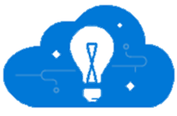
Where Big Data Streaming fits in
Event producers
Collection
Ingress
Stream Processing
Long-term storage
Presentation / action
Fast Data
Service bus
PowerBI Dashboards
Applications
Event hubs
Azure DBs
Legacy IOT (custom protocols)
Stream processing
Search and query
Cloud gateways (web APIs)
HDInsight
Devices
Slow Data
Azure Storage
Cortana Analytics
IP-capable devices (Windows/Linux)
Azure Data Lake
Low-power devices (RTOS)
Field gateways
Devices to take action

Slide 12

How Event Hubs is different from queues
Records a stream
Recording moves forward only
You can plan the tape repeatedly
A cassette tape has Left and Right channels
When you press record, they both record
But the data on each channel is different
The left and right speakers each play one channel
Event Hubs calls these partitions

Slide 13
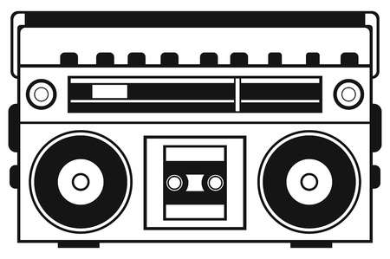
Event Hubs is like a tape deck
Can play from anywhere on the tape
FastFwd or Rewind then Play
Each partition gets a speaker
Client-side cursor
Non-destructive reads

Slide 14
Event Hubs conceptual architecture
Azure Event Hub
Consumer Group
Partition 1
Kafka
HTTP
AMQP
Partition 2
Event Receivers
Partition 3
Consumer Group 2
Event Producers
Partition 4
AMQP

Slide 15
Event Hubs Capture: batch on stream
Policy based push to your own storage
Uses Avro format
Raises Event Grid events – connect to Functions, ACI, or whatever you like
Does not impact throughput
Offloads batch processing from your real-time stream

Slide 16
Azure Event Hubs for Apache Kafka™
Kafka 1.0 compatible endpoint backed by Event Hubs
Use your existing Kafka application & tools with Event Hubs
Only need to change your connection string
All defaults supported
No additional cost
Kafka Ecosystem (Kafka Connect, Mirror Maker)
Compatible at a wire level

Slide 17
Common Use Cases
Logging and telemetry
Application and service logging
Performance
Dashboards
Real time processing
Anomaly detection (fraud detection, alerts)
Archiving
Batch processing

Slide 18
Event Grid
Push based intelligent event routing with publish-subscribe semantics

Slide 19











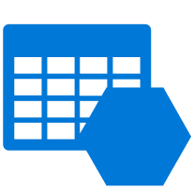

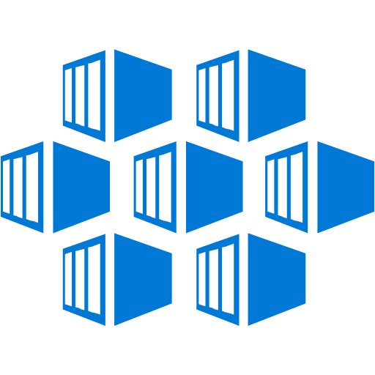
IoT Hub
Azure Functions
Blob Storage
Logic Apps
Azure Subscriptions
Azure Automation
Resource Groups
WebHooks
Event Hubs
Event Hubs
Custom Topics
Storage Queues
Storage (GPv2)
Datalake Store
Container Registry

Slide 20



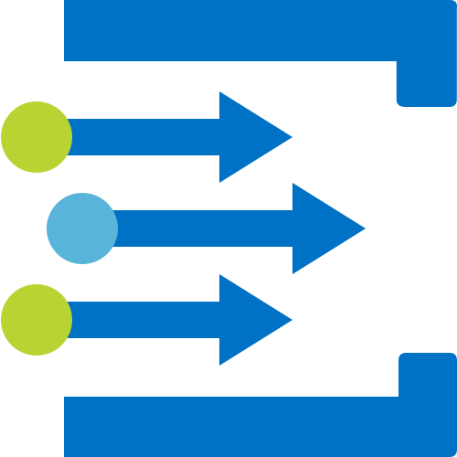

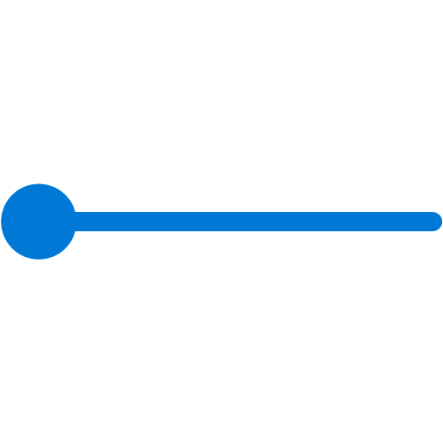
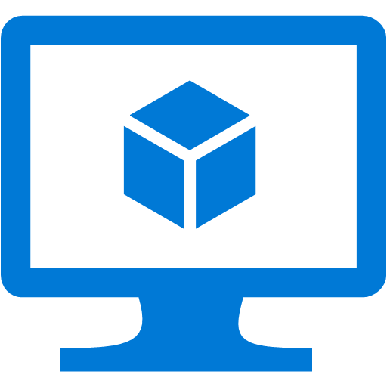
What is Event Grid For?
Serverless apps
Ops automation
Third-party integration
Trigger a function to run Cognitive API when a file is added to storage
Use a function to run a compliance check on each newly created SQL database
Use custom “drive start” and “drive end” events to log vehicle performance metrics
Tag newly provisioned VMs with Azure Automation and add to metadata store

Slide 21
Event Schema
[{
"topic": "/subscriptions/{subscription-id}/resourceGroups/rg1/providers/Microsoft.Storage/storageAccounts/socalazure",
"subject": "/blobServices/default/containers/sample/blobs/grid.jpg",
"eventType": "Microsoft.Storage.BlobCreated",
"eventTime": "2018-03-08T02:32:32.3138466Z",
"id": "60b827dd-701e-010a-2e85-b6ba5f0618c4",
"data": {
"api": "PutBlockList",
"clientRequestId": "580ebc71-0b38-4e13-9c3e-5db169ad2032",
"requestId": "60b827dd-701e-010a-2e85-b6ba5f000000",
"eTag": "0x8D5849CD8572590",
"contentType": "image/jpeg",
"contentLength": 687245,
"blobType": "BlockBlob",
"url": "https://socalazure.blob.core.windows.net/sample/grid.jpg",
"sequencer": "0000000000000000000000000000043C00000000004b90e3",
"storageDiagnostics": {
"batchId": "11c2a1b3-013f-4c7a-a31e-cf455a2c7d3f"
}
},
"dataVersion": "",
"metadataVersion": "1"
}]
Properties specific to the publisher
https://docs.microsoft.com/en-us/azure/event-grid/event-schema

Slide 22

Cloud Events Schema Cloud Native Compute Foundation (CDCF)
{
"cloudEventsVersion" : "0.1",
"eventType" : “Zohan.NewEmployee",
"eventTypeVersion" : "",
"source" : "/subscriptions/{subscription-id}/resourceGroups/{resource-group}/providers/Microsoft.Storage/
storageAccounts/{storage-account}#blobServices/default/containers/{storage-container}/blobs/{new-file}",
"eventID" : "173d9985-401e-0075-2497-de268c06ff25",
"eventTime" : "2018-04-28T02:18:47.1281675Z",
"data" : {
“name": “Frank Rizzo",
“employeeId": "6d79dbfb-0e37-4fc4-981f-442c9ca65760",
}
}
Properties specific to the publisher

Slide 23
Event Domains
Multitenant events at scale
Publish events just like Azure
Backed by RBAC
Sender sets topic
Single endpoint for events
Partitioning
Event Domain
sub1
mytopic1
sub2
Publisher
sub1
mytopic2
sub2
Publisher
mydomain
sub1
mytopic3
Publisher
sub2
sub1
mytopic4
sub2

Slide 24
Event Grid Considerations
Events are independent
Always available
Near real-time event delivery
At least once delivery
Dynamic scale
Platform and language agnostic

Slide 25
Relay & Hybrid Connections
Cloud relayed sockets

Slide 26
Cloud relayed communication
Hybrid Connections & Relay
Securely connect to on premises data and services from anywhere
Load balance multiple sites behind a single endpoint
Protect internal services by projecting a cloud endpoint (ex: DDoS)
Does not require any network changes

Slide 27
Where does Relay fit in?
When you have scenarios that are too complex or costly for VPN
When you have to keep your data where it is

Slide 28
Segmentation of the cloud messaging services
Segment | Simple Queuing | Eventing PubSub | Big Data Streaming | Enterprise Messaging | Cloud Socket
Product | Storage Queues | Event Grid | Event Hubs | Service Bus | Relay & HC
What you care about | Communication within an app Individual message Queue (polling) semantics Easy to use Pay as you go | Communication between apps / orgs Individual message Push semantics Filtering and routing Pay as you go Fan out | Many messages in a Stream (think in MBs) Ease of use and operation Low cost Fan in Strict ordering Works with other tools | Instantaneous consistency Strict ordering JMS Non-repudiation & Security Geo-Replication & Availability Rich features (de-dupe, scheduling, etc.) | Raw TCP socket that can traverse firewalls Load balanced live traffic
What you care less about | Ordering of messaging Instantaneous consistency | Ordering of messaging Instantaneous consistency | Individual message semantics Server-side cursor Only Once | Cost Simplicity | Buffered messaging Queue semantics
Primary Objective | Single partition lightweight queue | Reliable fan out push at massive scale | High scale distributed log | Highly indexed full featured message broker | High density TCP tunneling
Serverless
Big Data
Enterprise
Hybrid

Slide 29
Demos

Slide 30




Logical Architecture
A
B
C
D
Fleets
Ingest
Analyze
Publish
Companies

Slide 31


Physical Architecture
Topic
Logic App
Application
Event Hubs
Function
Event Domain
Topic
Webhook
Topic
Function

Slide 32
Session resources
Useful documentation
https://aka.ms/servicebus
https://aka.ms/azureeventgrid
https://aka.ms/servicebusrelay
https://aka.ms/eventhubs https://aka.ms/messagingdemo
https://aka.ms/messagingdemo
Azure Service bus explorer
https://github.com/paolosalvatori/ServiceBusExplorer
Service Bus plugins
https://github.com/Azure/azure-service-bus-dotnet-plugins

Slide 33
Demo references
Event Hub Demo
---------------
Simulator app sending messages -> EH -> ASA -> PowerBi (high recommend to try)
https://docs.microsoft.com/en-us/azure/stream-analytics/stream-analytics-real-time-fraud-detection#create-an-azure-event-hubs-to-ingest-events
https://twitter.com/MahesKBlr/status/930810723495657472
https://github.com/Azure/azure-stream-analytics/tree/master/Samples/TelcoDatGeneratorUI ( Load Generator )
Azure Event Grid
-----------------
https://docs.microsoft.com/en-us/azure/storage/blobs/storage-blob-event-quickstart?toc=%2Fazure%2Fevent-grid%2Ftoc.json#subscribe-to-your-storage-account
Azure Relay
------------
https://docs.microsoft.com/en-us/azure/service-bus-relay/relay-what-is-it
Azure Storage Queues and load-load-leveling
-------------------------------------------
https://docs.microsoft.com/en-us/azure/architecture/patterns/queue-based-load-leveling
https://docs.microsoft.com/en-us/azure/storage/common/storage-samples-dotnet
https://github.com/Azure-Samples/storage-queue-dotnet-getting-started
https://madeofstrings.com/2019/01/09/scaling-azure-functions-to-make-500000-requests-to-weather-com-in-under-3-minutes/

Slide 34
Q&A
MahesKBlr

