Slide 1

Quantum-Optimized Supply Chain for Essentials
Where quantum intelligence meets last-mile logistics — delivering essentials faster, smarter, and at scale.
PITCH DECK 2026

Slide 2
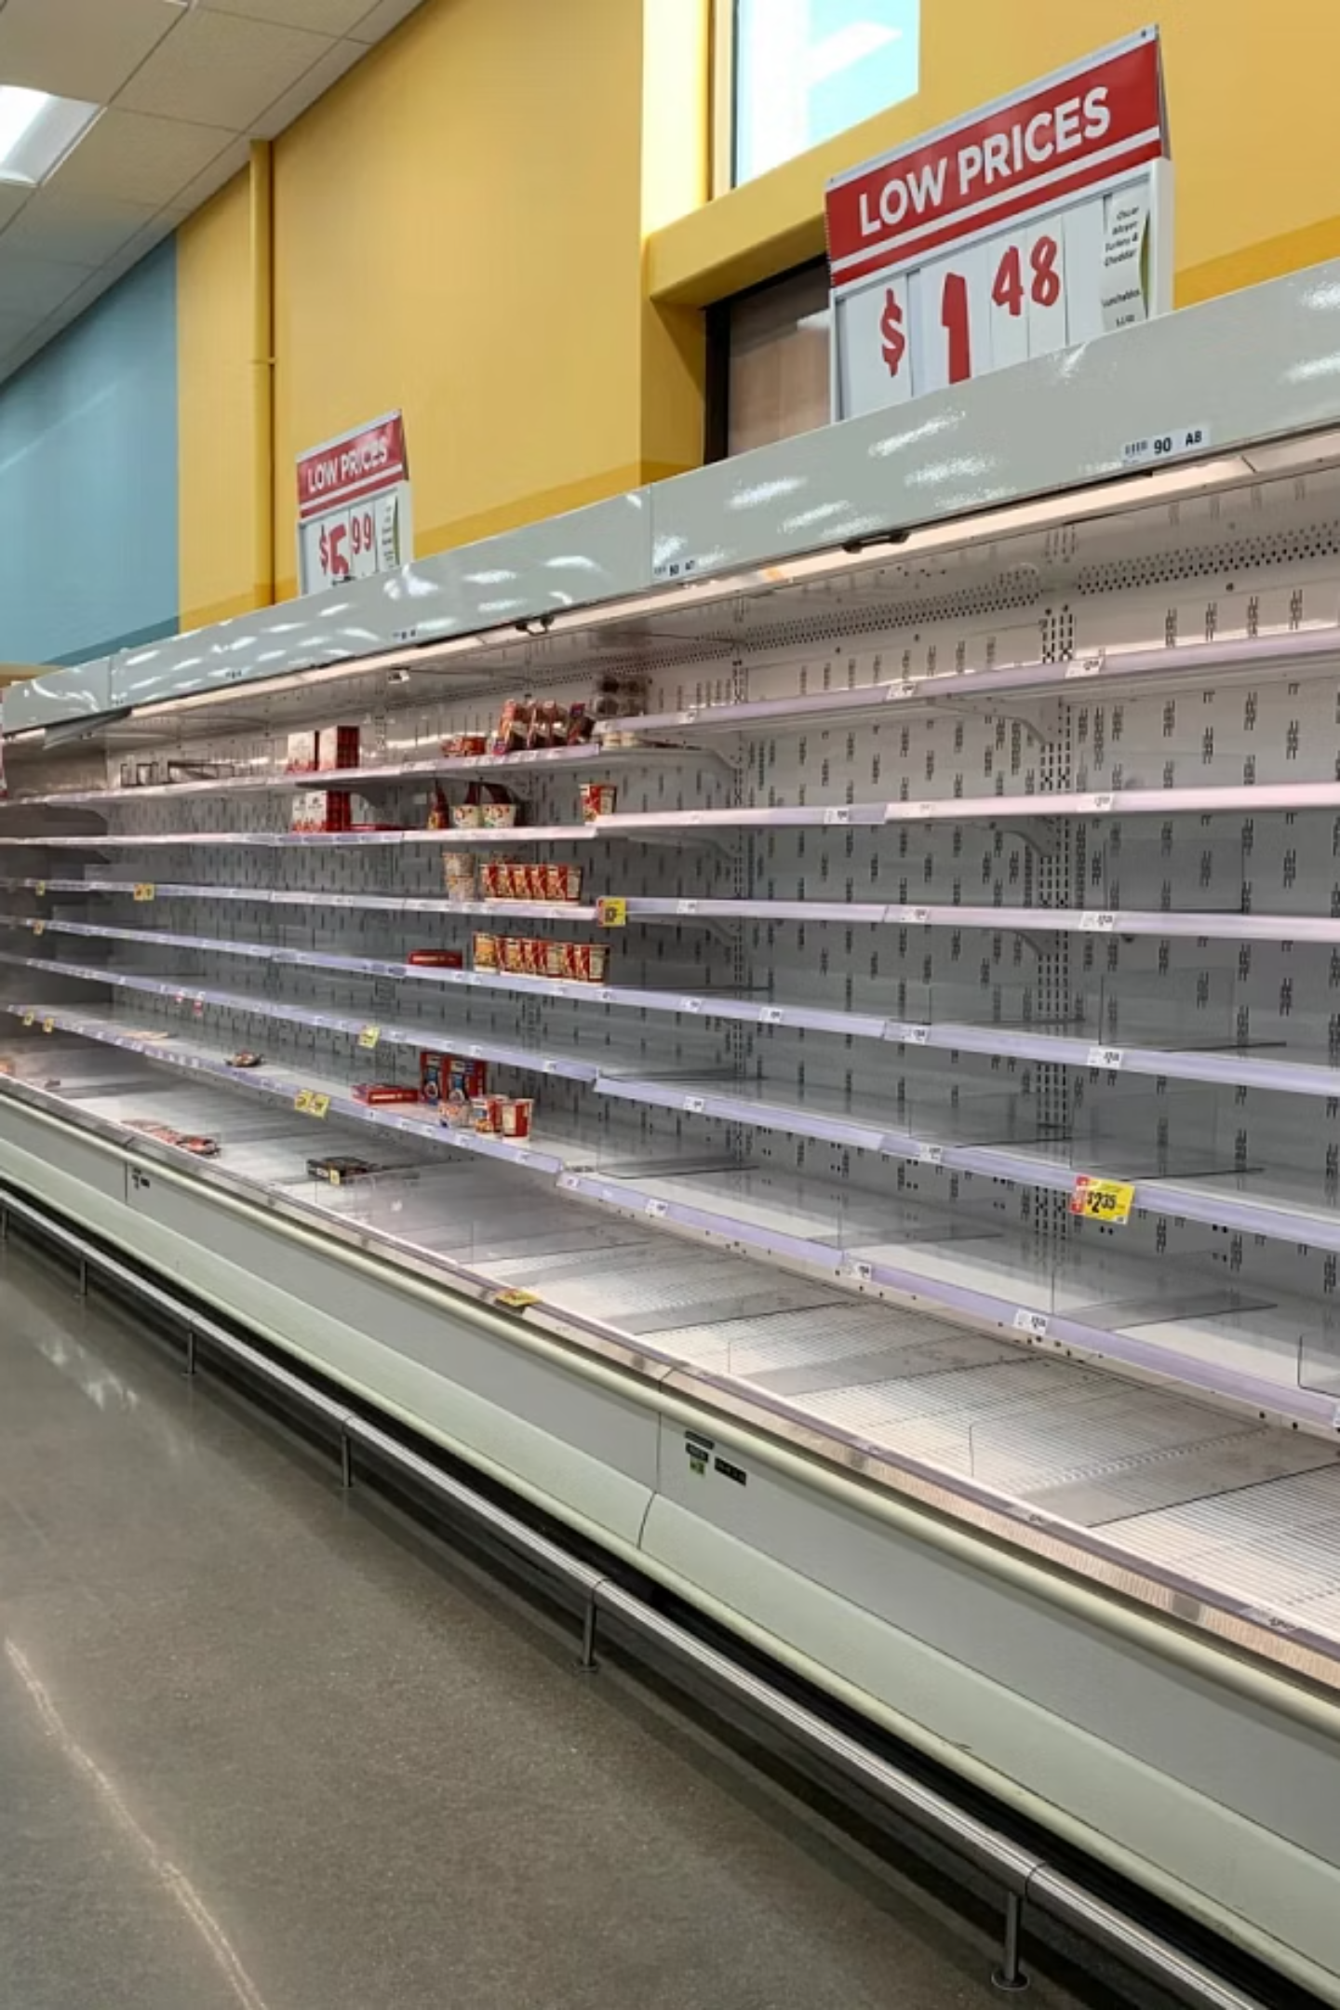
The Problem We're Solving
🚛 Inefficient Routing
📦 Demand Volatility
Classical algorithms fail at scale — millions of routes, zero optimal solutions
Unpredictable spikes in essential goods leave supply chains reactive, not proactive
💸 Cost Explosion
Suboptimal logistics inflate costs by 20–30% across the essentials sector

Slide 3
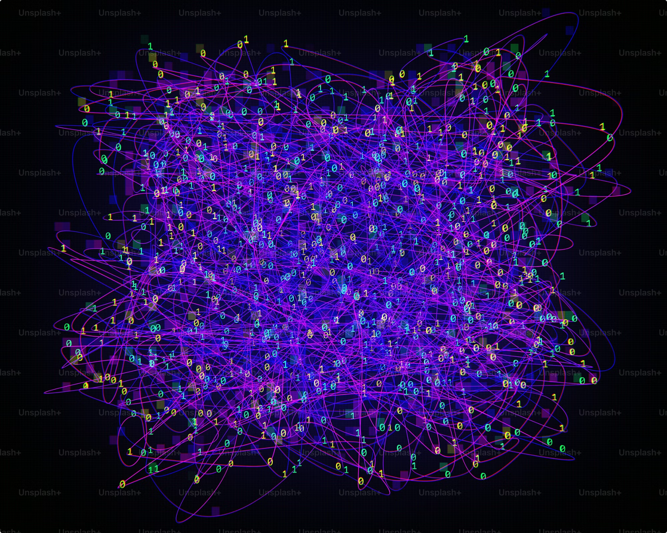
Our Quantum-First Approach
Simulated Quantum Annealing
We harness quantum-inspired optimization to solve combinatorial routing problems that classical systems cannot.
Encode supply networks as QUBO models
Anneal toward global optimum routes
Re-optimize in real-time as conditions shift

Slide 4
Technology Stack
Backend & API
Frontend Interface
Quantum Optimization
FastAPI · Uvicorn · Pydantic · Streamlit
HTML5 · Vanilla CSS3 · JavaScript
Simulated Quantum Annealing · NumPy · NetworkX
GIS & Geo Visuals
Predictive AI Engine
Folium · Streamlit-Folium · Plotly
Scikit-learn · Pandas

Slide 5

How It All Works Together
Data Ingestion
Quantum Routing
AI Forecasting
Geo-Visual Dashboard
End-to-end intelligence — from raw data to optimized delivery routes in seconds.

Slide 6
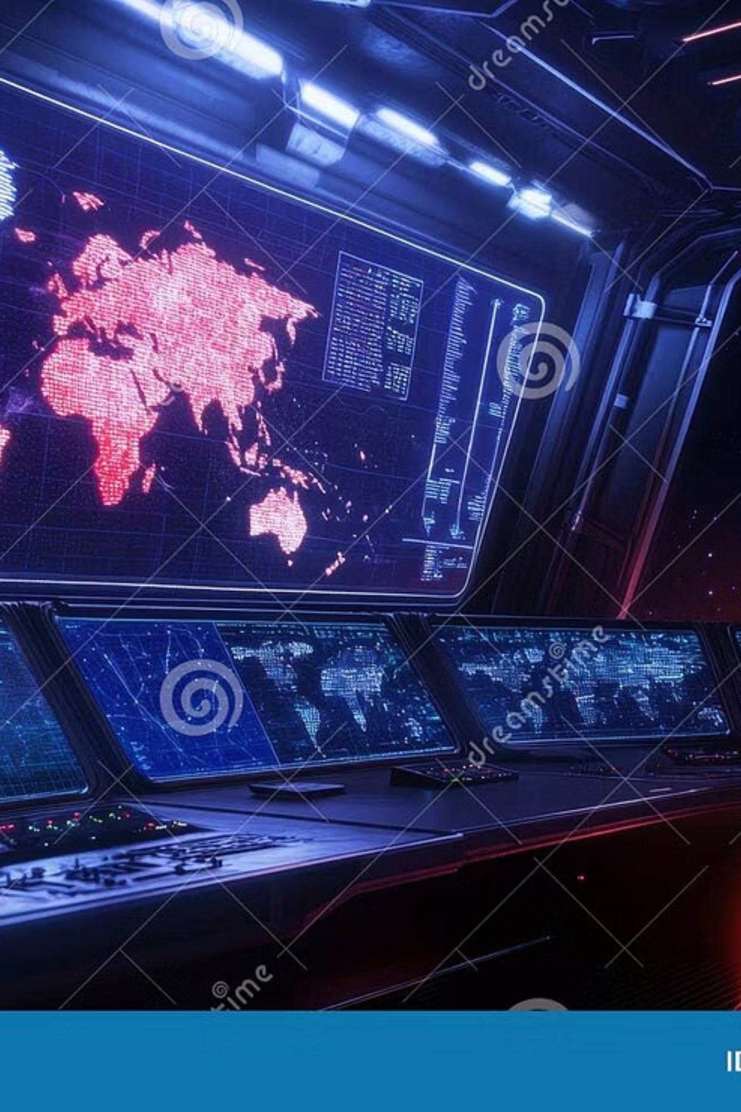
Unique Selling Points
⚡ Quantum Speed Advantage
10× faster route convergence vs. classical solvers at 500+ node networks
🌐 Zero-Dependency Frontend
Pure HTML/CSS/JS — lightweight, deployable anywhere, no framework lock-in
🔮 Predictive + Prescriptive AI
Not just optimization — we forecast demand before it happens
📍 Live Geo Intelligence
Interactive Folium maps with real-time route overlays and heatmaps

Slide 7
Impact by the Numbers
10×
30%
Faster Optimization
Cost Reduction
vs. classical routing algorithms
in logistics overhead for essentials
500+
~0ms
Nodes Solved
Re-optimization Latency
in a single quantum annealing pass
real-time route adaptation

Slide 8

Thank You
We're building the quantum-powered backbone of essential supply chains — resilient, intelligent, and built for scale.

