Slide 1

CAPSTONE PROJECT CP-302
DESIGN OF AN HDH SYSTEM FOR WATER DESALINATION USING SOLAR ENERGY
Under The Guidance of
Dr Navin Gopinathan
Maheshwar Pratap Singh
2020CHB1044

Slide 2
PROBLEM STATEMENT
Access to clean drinking water is a concern due to the high cost and non-renewable energy usage in conventional desalination techniques.
A sustainable and affordable technology is needed for desalinating saltwater using solar energy.
The project's objective is to create a system that effectively produces potable water using solar energy

Slide 3
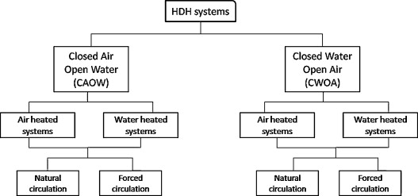
LITERATURE SURVEY
Fig1. Classification of typical HDH processes (based on cycle configuration)[2].

Slide 4
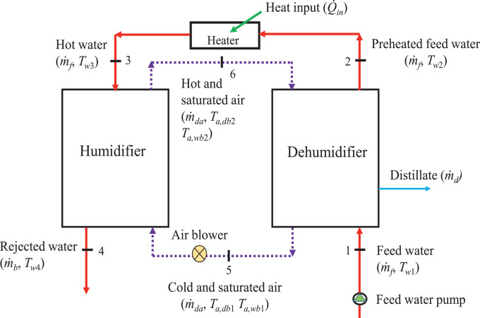
CAOW –WATER HEATED SYSTEM
Fig. 2. Schematic of the closed-air open-water (CAOW) and water-heated HDH desalination cycle.[1]

Slide 5
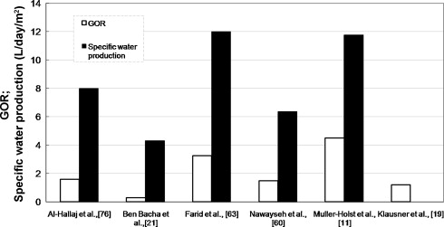
GOR DATA FOR VARIOUS WORK
The low value of GOR achieved by Ben-Bacha et al. was because they did not recover the latent heat of condensation
The higher value of GOR achieved by Müller-Holst et al. was because of high heat recovery.
These results tell us the importance of enhanced latent heat recovery to minimize the energy consumption and the cost of CAOW water-heated system
Fig.3. Performance parameters for various works on water-heated CAOW HDH cycle [2].

Slide 6
Scope of the Problem
HDH desalination systems aim to address the issue of water scarcity caused by the growing population and climate change.
HDH desalination systems can help provide clean water in areas where traditional water sources are not sufficient or have become contaminated due to pollution or climate change.
Traditional desalination methods require a significant amount of energy, which can be costly and may not be sustainable in the long run.

Slide 7
Scope of the Problem
The use of renewable energy sources in HDH desalination systems helps to reduce energy consumption and costs, making it a more sustainable and affordable solution.
The environmental impact of the HDH desalination system should be carefully considered, including waste disposal and potential impact on local ecosystems.

Slide 8
Results and Discussion
Given feed conditions - Tw1(inlet feed Temperature) = 25°C
Effectiveness for both humidifier and dehumidifier = 0.85
Saline water salinity = 45000 ppm or 45g/kg
Feed flow rate(m_{f}) = 1 kg/s
Mass flow rate ratio =1
Area of Humidifier = 12 m²
Height of packing = 1 m
Dry bulb temperature (T_{adb1})= 30 °C
Wet bulb Temperature (T_{awb1})= 25°C
Top Brine temperature (T_{w3})= 50 °C

Slide 9
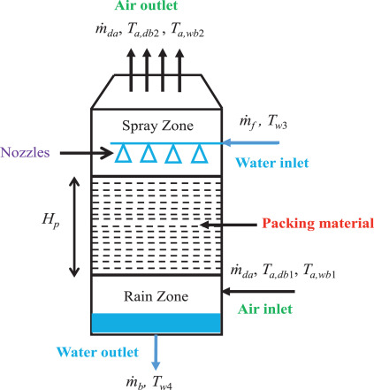
Results and Discussions
Mass and Energy balance on the humidifier
m_{f *}h_{w3} − m_{b*}h_{w4} = m_{da*}(h_{ma2} −h_{ma1})
m_{b} = m_{f} − m_{da*}(W₂ − W₁)
h_{w} – specific enthalpy of water
W - Humidity ratio
h_{ma} – specific enthalpy of the air
Fig. 4. Schematic of the packed-bed humidifier used for CAOW and water-heated HDH desalination cycle.[1]

Slide 10
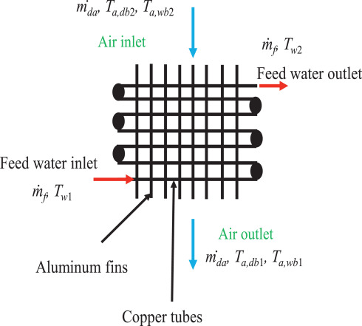
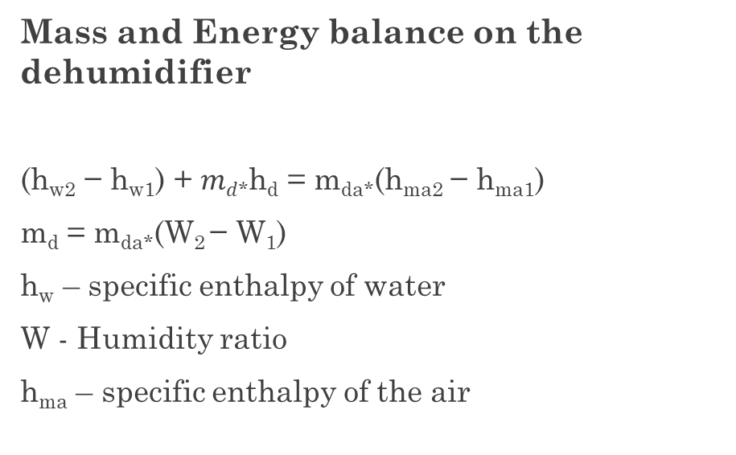
Results and Discussions
Mass and Energy balance on the dehumidifier
(h_{w2} − h_{w1}) + $md$*h_{d} = m_{da*}(h_{ma2} − h_{ma1})
m_{d} = m_{da*}(W₂ − W₁)
h_{w} – specific enthalpy of water
W - Humidity ratio
h_{ma} – specific enthalpy of the air
Fig. 5. Schematic of the plate fin and tube dehumidifier (finned-tube heat exchanger) used in CAOW and water-heated HDH desalination cycle.[1]

Slide 11
Results and Discussion
Our main aim is to calculate RR(Recovery Rate) and GOR(Gain output ratio).
Absolute humidity or humidity ratio can be calculated by using the formula at a given temperature.
Specific enthalpy of water (hw) can be calculated by using the formula at a certain temperature.
Specific enthalpy of air (ha) can be calculated by using the formula at a certain temperature.
By using the formula We can calculate Qin which further can be used to calculate the GOR.

Slide 12
Results and Discussion
On the basis of the mass and energy balance calculation RR= 0.051,
GOR = 1.21 and Q_{in} = 95.94 kJ/s
Here if we use a mass flow ratio greater than 1 and then if the top brine temperature increases then we will see the increase in GOR and also the recovery ratio will increase till a particular point. So by using MATLAB simulation, we can calculate the maximum RR and GOR by using suitable parameters.

Slide 13
Conclusions
HDH desalination systems are a promising solution to address the growing issue of water scarcity.
The use of renewable energy sources in HDH desalination systems, such as solar or waste heat, can make them more energy-efficient and sustainable.
The GOR and RR parameters are important factors to consider when designing an HDH desalination system, after my calculation I got GOR is 1.21 and RR is 0.051.
Overall, HDH desalination systems have the potential to provide a sustainable and affordable source of clean water in areas where traditional water sources are limited or contaminated.

Slide 14
Future Scope
We can use Multi-effect closed air open water–water heated system to increase the higher heat recovery from the dehumidifier.
I can use MATLAB simulation to enhance the Recovery rate and also to enhance the GOR.

Slide 15
Resources used
Kapil Garg, Sarit K. Das, Himanshu Tyagi, Thermal design of a humidification-dehumidification desalination cycle consisting of packed-bed humidifier and finned-tube dehumidifier Volume 183, Part B, February 2022,122153 https://www.sciencedirect.com/science/article/pii/S001793102101259X
G.Prakash Narayan, Mostafa H. Sharqawy, Edward k. summers, John H.Lienhard, Syed M. Zubair, M.A. Antar, The potential of solar-driven humidification–dehumidification desalination for small-scale decentralized water production Volume 14, Issue 4, May 2010 https://www.sciencedirect.com/science/article/pii/S1364032109002767?via%3Dihub#fig6

Slide 16
THANK YOU

