Slide 1
Fundamentals of Data Engineering (24DEA3101)
Real-Time Hospital Data Engineering Pipeline
Team members
K. Maheshwar Reddy – 2420090020
M. Sai Shashank – 2420030210
P. Venkata Sai Charan – 2420030339
Group Number:15 Section: 7
Under the guidance of
Dr. N. Shirisha

Slide 2

Objectives
Centralized Data Storage: Integrate healthcare data from multiple hospital departments — patient registration, laboratory, pharmacy, billing, and appointments — into a single data warehouse.
Data Consistency: Remove duplicate records and standardize healthcare data using ETL (Extract, Transform, Load) processes.
Improved Decision Making: Enable hospital administrators to generate reports for better operational and financial decisions.
Efficient Data Analysis: Support analytical queries for patient statistics, doctor performance, hospital occupancy, and revenue analysis.
Historical Data Management: Store historical healthcare data to support trend analysis and future planning.
Faster Query Performance: Design the warehouse using a Star Schema to improve query execution and reporting speed.
Business Intelligence Support: Provide reliable data for dashboards, visualization, and healthcare analytics.

Slide 3
Literature Survey
Authors | Title of the Paper | Inferences | Drawbacks | Proposed Future Solution
Zhou et al. [3] | Development of traditional Chinese medicine clinical data warehouse for medical knowledge discovery and decision support, Artificial Intelligence in Medicine, 2010 | Integrated 20,000 inpatient and 20,000 outpatient records; produced 400+ OLAP reports and supported clinical knowledge discovery. | Focused on Traditional Chinese Medicine, so the design is specialized rather than a general multi-department hospital pipeline. | Generalize the pipeline to registration, laboratory, pharmacy, billing and appointments using common ETL and Star Schema.
Bocquet et al. [2] | The Challenges of Implementing Comprehensive Clinical Data Warehouses in Hospitals, IJERPH, 2022 | DW improves research and quality evaluation; governance is critical. | Implementation is resource-intensive and needs sustained support. | Build a lightweight, modular pipeline using Python, MySQL and automated ETL.
Knezevic Ivanovski et al. [3] | Building a Healthcare Data Warehouse: Considerations, Opportunities, and Challenges, Frontiers in Digital Health, 2025 | Centralization and robust ETL support analytics and BI. | No quantitative benchmark of a specific implementation. | Implement the warehouse and measure ETL time, query speed, data quality and scalability.

Slide 4
Literature Survey (contd.)
Authors | Title of the Paper | Inferences | Drawbacks | Proposed Future Solution
Denney et al. [4] | Validating the Extract, Transform, Load Process Used to Populate a Large Clinical Research Database, International Journal of Medical Informatics, 2016 | Compared 498 observations; after resolving apparent discrepancies, the repository was found 100% accurate relative to its source EHR systems. | Validation used a limited sample and focused on ETL correctness rather than continuous real-time processing. | Validate larger multi-department datasets and add continuous/near-real-time ingestion with performance and latency measurements.
Visweswaran et al. [5] | An atomic approach to the design and implementation of a research data warehouse, Journal of the American Medical Informatics Association, 2022 | Neptune integrated longitudinal data for more than 5 million patients from EHRs, health plans and research studies. | Designed primarily for research data reuse; it is not a complete real-time operational hospital pipeline. | Extend the architecture for operational hospital departments and add real-time event ingestion for faster analytics and reporting.
Johns et al. [6] | Tracking provenance in clinical data warehouses for quality management, International Journal of Medical Informatics, 2025 | The dashboard identified recurring error patterns and traced them to source data and ETL steps, supporting continuous quality management. | Provenance tracking increased ETL loading time, and evaluation covered three ETL processes in an i2b2 setting. | Optimize provenance overhead and evaluate the approach across larger, multi-department real-time pipelines.

Slide 5
Literature Survey (contd.)
Authors | Title of the Paper | Inferences | Drawbacks | Proposed Future Solution
Lamer et al. [7] | Development and Usage of an Anesthesia Data Warehouse: Lessons Learnt from a 10-Year Project, J. Clinical Monitoring and Computing, 2022 | Large-scale data integration and OMOP mapping supported reuse. | Single-institution results may not generalize to smaller hospitals. | Design a scalable architecture that can work across different hospital sizes.
Evans et al. [8] | Clinical Use of an Enterprise Data Warehouse, AMIA Annual Symposium Proceedings, 2012 | Supported strategic and patient-specific decision support. | Based on one large health system. | Develop a simpler, lower-cost version suitable for small and medium hospitals.
Ngon [9] | Healthcare Data Integration Through Enterprise Data Warehousing: Architecture, Conformance Pipeline, and Experimental Validation for Readmission Analytics, IJITCSA, 2026 | Improved data quality; warehouse data was analytics-ready. | Validated mainly for one readmission use case. | Extend analytics to occupancy, billing, pharmacy, laboratory and doctor performance.

Slide 6
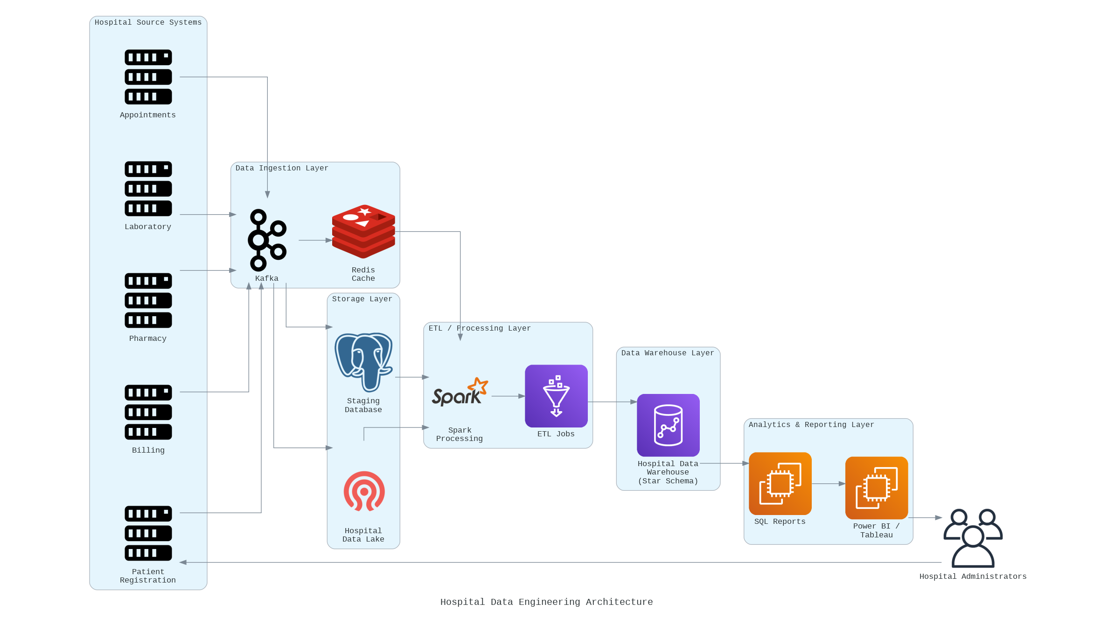

Slide 7
Proposed Method
Data Collection: Gather healthcare data from patient registration, laboratory, pharmacy, billing, and appointment systems across hospital departments.
Extraction: Extract operational data from these different source databases into a staging area.
Cleaning & Transformation: Clean inconsistent records, remove duplicate entries, handle missing values, and transform data into a standardized format using ETL techniques.
Loading: Load the transformed data into the centralized Hospital Data Warehouse.
Dimensional Modeling: Design the warehouse using a Star Schema consisting of Fact tables (patient visits, billing, lab tests, pharmacy sales) and Dimension tables (patient, doctor, department, time, disease, medication, hospital branch).
Analysis & Reporting: Execute SQL queries on the warehouse to generate reports and analytical insights for hospital administrators.
Flow: Hospital Systems → Extract → Clean & Transform (ETL) → Star Schema Warehouse → SQL Queries / Reports → Decision Making

