Slide 1
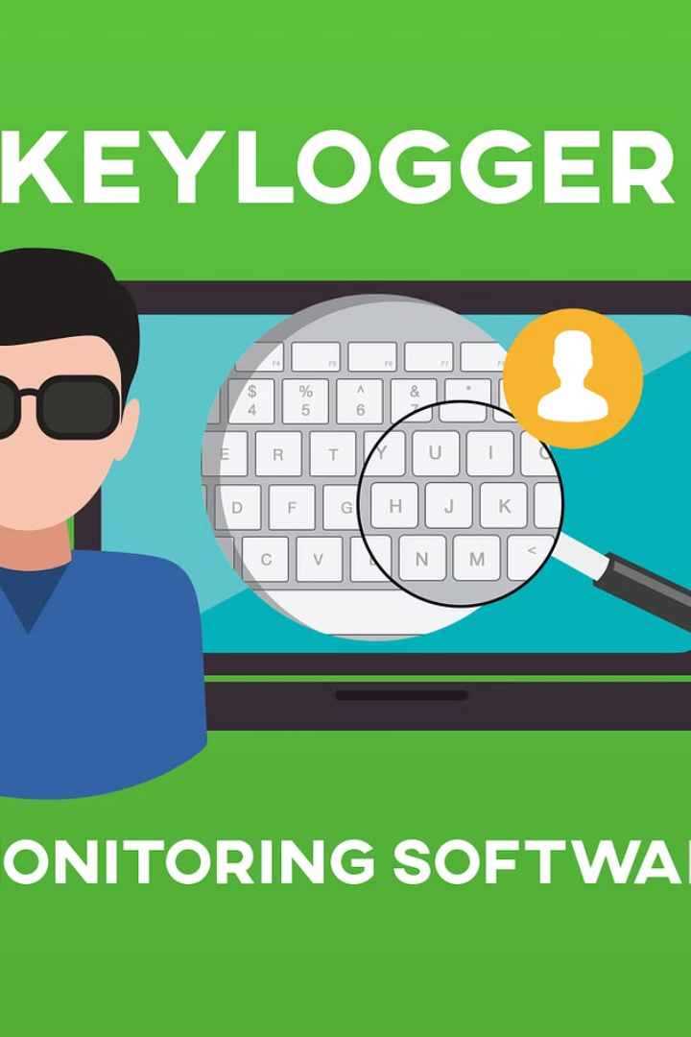
Keyloggers: The Hidden Trackers
Keyloggers are software programs or hardware devices that surreptitiously record every keystroke made on a computer, including passwords, credit card numbers, and other sensitive information. They provide a way for cybercriminals to steal data and compromise user privacy.
Maheshwaran. S
au820421104041
Anjalai Ammal Mahalingam Engineering College
Kovilvenni-3

Slide 2
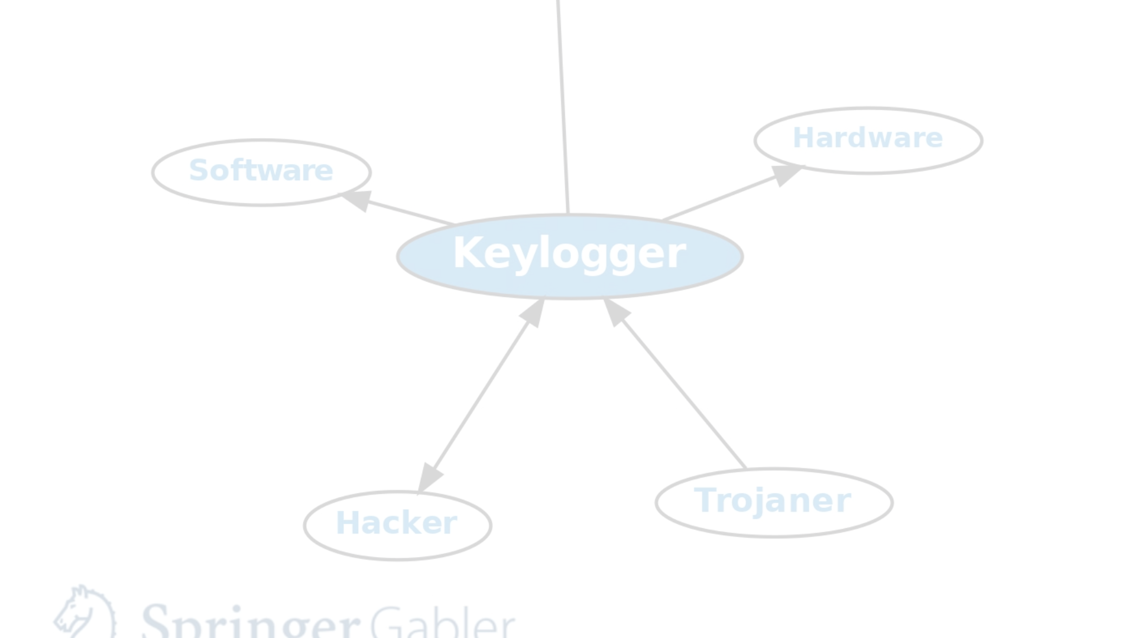
How Keyloggers Work
Capture Keystrokes
1
Keyloggers monitor and record every key pressed on the target computer's keyboard.
2
Store Data
The captured data is then stored locally or transmitted to the attacker remotely.
Access Sensitive Info
3
The attacker can later access the recorded data, exposing passwords, financial details, and other private information.

Slide 3
Types of Keyloggers
Software Keyloggers
Hardware Keyloggers
Wireless Keyloggers
These are programs that are installed on the target computer, often disguised as legitimate applications.
Physical devices that are connected between the keyboard and the computer, capturing keystrokes invisibly.
Transmit recorded data wirelessly, making them harder to detect and remove.

Slide 4
Potential Uses of Keyloggers
1
Corporate Espionage
2
Identity Theft
Stealing trade secrets and sensitive business information.
Capturing login credentials, credit card numbers, and other personal data.
3
Parental Monitoring
4
Employee Monitoring
Tracking children's online activities and computer use.
Monitoring employee productivity and computer usage.

Slide 5
Risks and Dangers of Keyloggers
Privacy Violation
Financial Loss
Keyloggers infringe on personal privacy by capturing sensitive information without consent.
Stolen login credentials and payment details can lead to financial fraud and identity theft.
Data Breaches
Psychological Harm
Sensitive corporate or personal data can be compromised and exploited by cybercriminals.
Victims of keylogger attacks may experience anxiety, distress, and a loss of trust.

Slide 6




Protecting Against Keyloggers
Antivirus Software
Firewall Protection
Data Encryption
Physical Inspection
Install reliable antivirus and anti-malware programs to detect and remove keyloggers.
Implement strong firewall settings to block unauthorized access and data transmission.
Use encryption software to protect sensitive information and prevent keylogger capture.
Regularly check for any suspicious hardware devices connected to the computer.

Slide 7



Legal Considerations with Keyloggers
Workplace Monitoring
Employers may use keyloggers to monitor employee productivity, but must follow local laws and regulations.
Parental Supervision
Parents can use keyloggers to track their children's online activities, but should balance privacy concerns.
Law Enforcement Investigations
Law enforcement agencies may use keyloggers to gather evidence, but must have proper legal authorization.

Slide 8
Conclusion:
Keyloggers pose a serious threat to personal and corporate security. While they have legitimate uses, they can also be misused to violate privacy and enable criminal activities. Educating users and implementing robust security measures are crucial to mitigating the risks of keyloggers.

Slide 9


