Slide 1
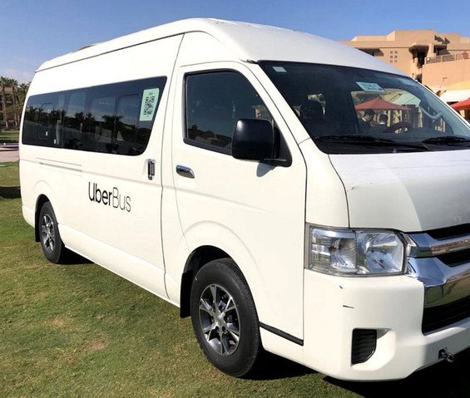
Uber Bus App
- Manasa Vanga & Priyanka Maheshwari

Slide 2
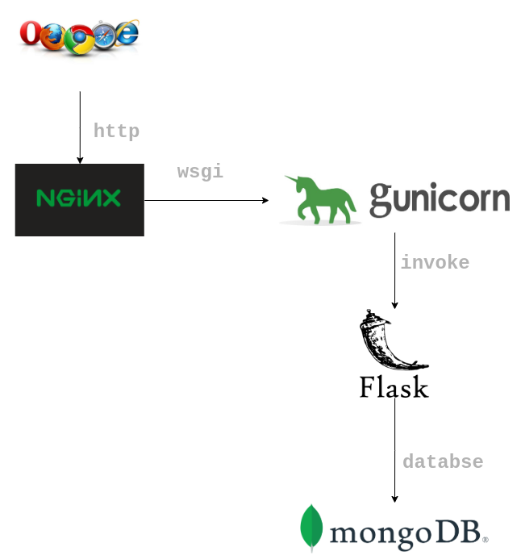
Technology Stack
Frontend: React
Production Server: Nginx
Backend: Python
Production Server: Gunicorn

Slide 3
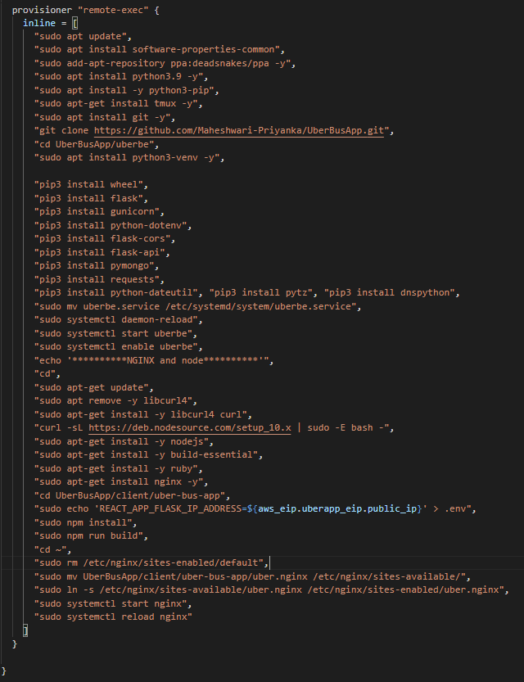
Provisioner
Install Python dependencies
Copied backend service file to gunicorn
Running backend on gunicorn
Install Node dependencies
Copied frontend service file to nginx
Running frontend on nginx

Slide 4





API Calls
Sign In
Sign Up
Sign Out
New Booking
View Bookings

Slide 5
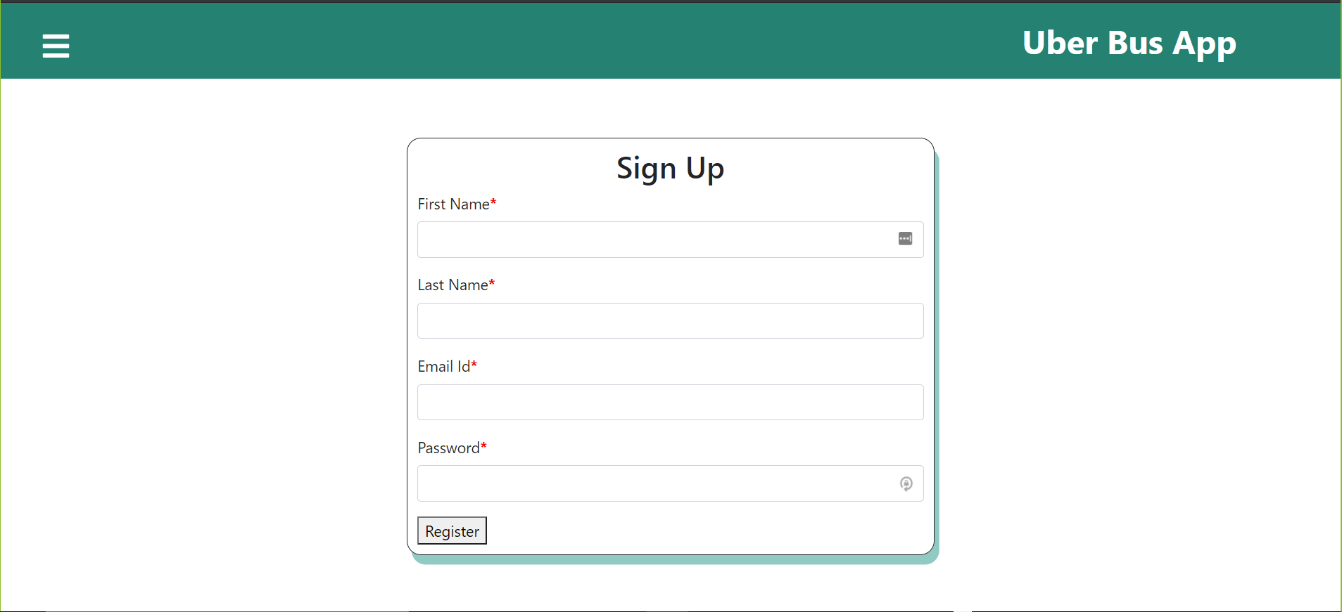
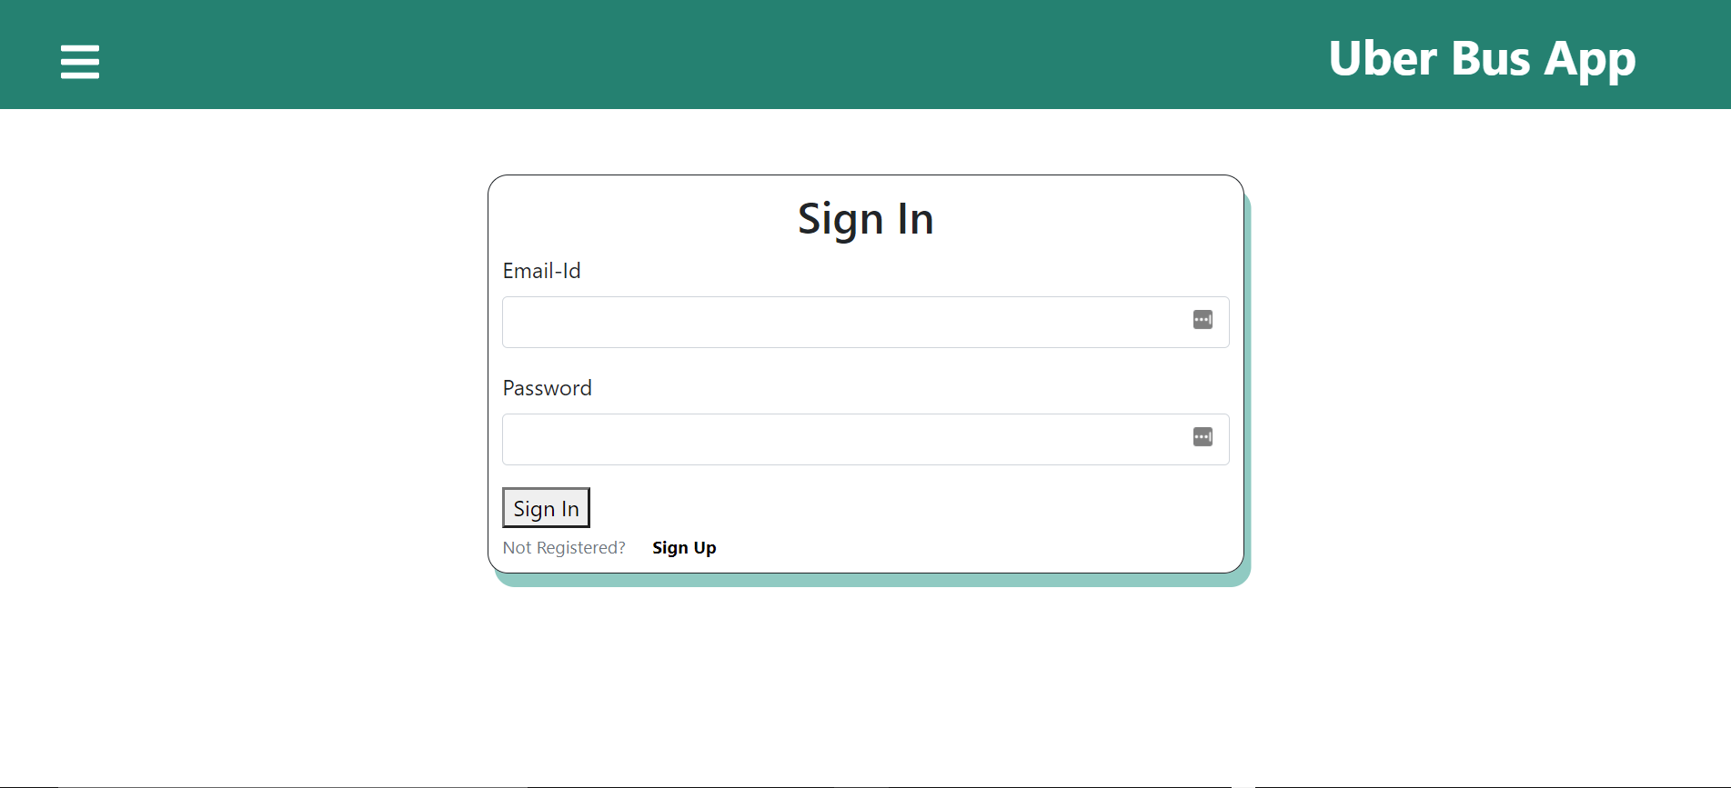
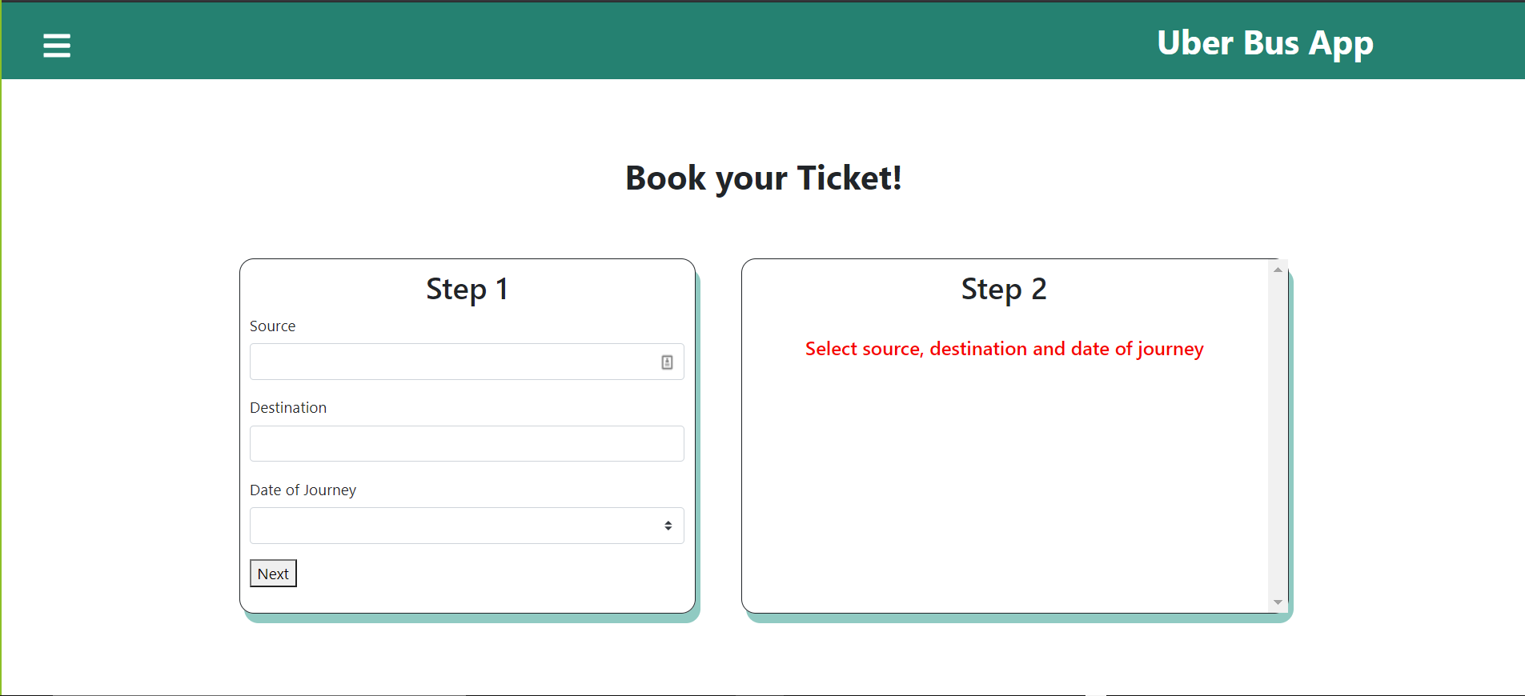
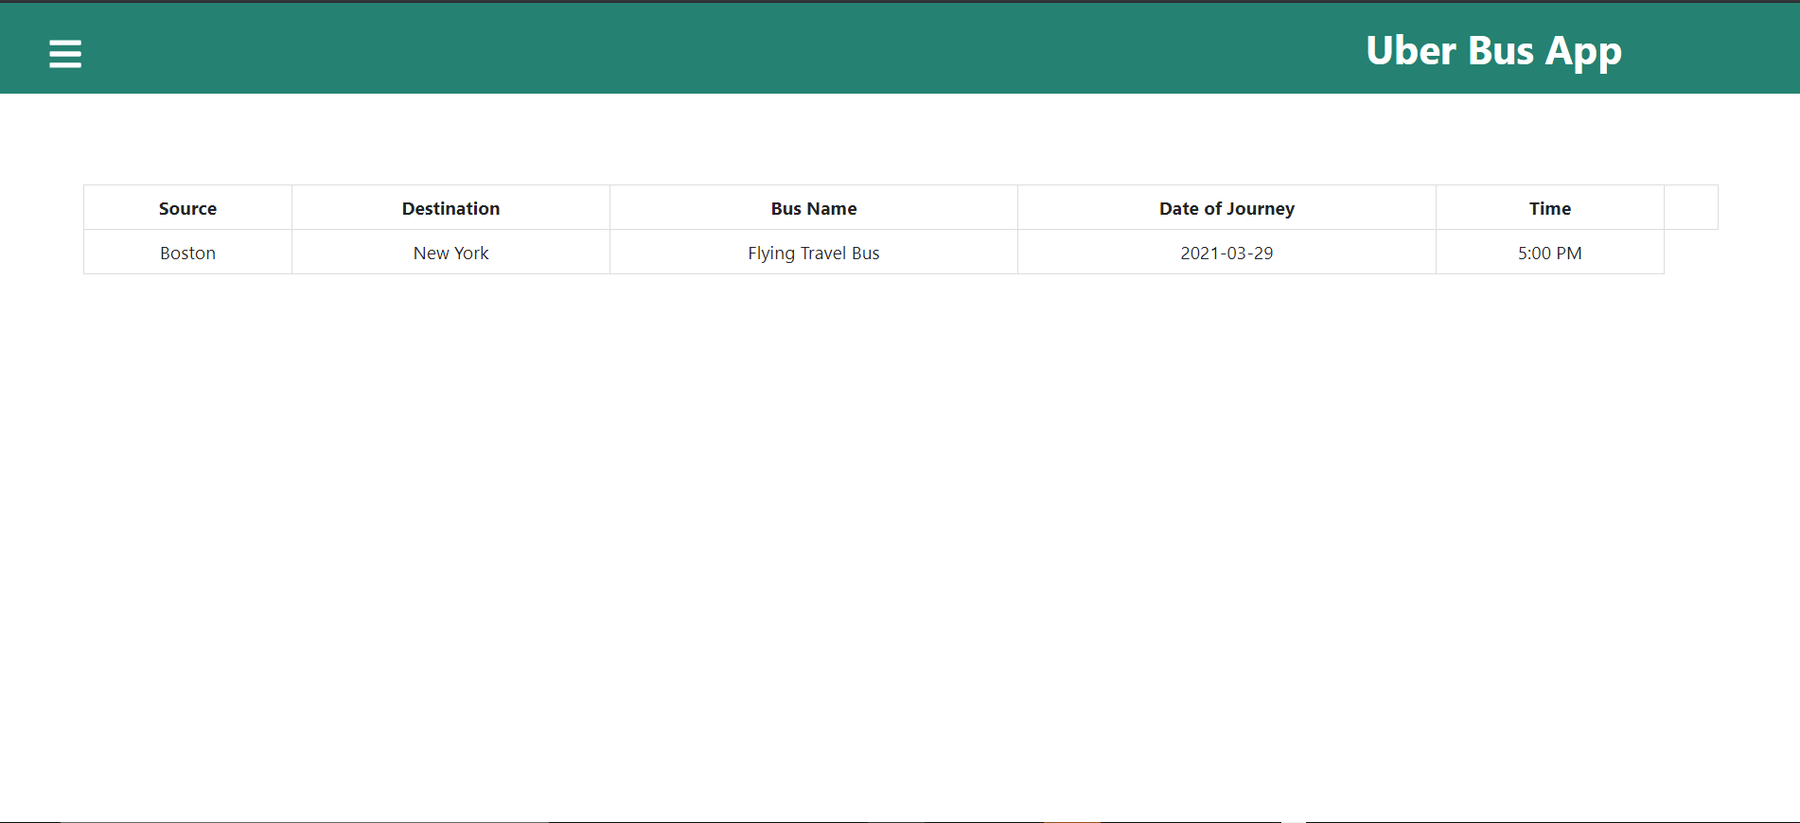
UI Screenshots

