Slide 1


G H RAISONI COLLEGE OF ENGINEERING AND MANAGEMENT
(Approved by AICTE, New Delhi and Recognized by DTE, Maharashtra)
An Autonomous Institute Affiliated to Rashtrasant Tukadoji Maharaj Nagpur University, Nagpur
Accredited by NAAC with A+ Grade
Department of Artificial Intelligence
Second Progressive Seminar
Of Minor Project under Course Category Community Engagement Project (CEP)
On
Sit Smart Coach: Posture Monitoring & Fitness Form Guidance Using Machine Learning
Name of guide : Dr . Smrita Nirkhi Mam
Project In-charge : Shweta Bhelonde Mam
Name of projectees
1. Prachi Hole 2. Maheshwari Rewatkar 3. Pooja Kawle
4. Pratibha Chauhan 5. Pooja Jamunpane
Session:2025-2026

Slide 2
Contents
Introduction
Impact of project on society and the environment
Literature Survey
Problem Statement
Objectives of Project
Flowchart
Description of Project Working
Innovative Work (If any)
Current Progress
Result & Discussion
Conclusion & Future Scope
Work Plan
References

Slide 3
Introduction
In today's digital age, prolonged laptop use is common among professionals and students.
Poor sitting posture can lead to fatigue, neck and back pain, and long-term health issues.
SitSmart Coach addresses this by using computer vision and AI to guide users toward healthier
posture.
Unlike wearables, it works with just a webcam and no extra hardware.
Encourages proactive wellness and improves ergonomic habits.
Helps build healthy posture habits over time using friendly alerts.
Designed for laptop users, especially students and desk workers.

Slide 4
Impact of project on society and the environment
Health: Prevents repetitive stress injuries and promotes ergonomic posture.
Education: Helps students during long study sessions stay physically healthy.
Workplace: Enhances employee well-being in hybrid/remote jobs.
Environmentally Friendly: No new hardware = less e-waste.
Cost-saving: Reduces need for expensive posture devices.
Behavioral Impact: Builds long-term good habits through micro-interventions.

Slide 5
Literature Survey
No. | Sr.Paper Title and its Author | Details of Publication | Findings
1 | Tlili, F. et al., "Machine Learning Algorithms Application For The Proposed Sitting Posture Monitoring System" | Procedia Comput. Sci., 203 (2022) 239– 246 | Achieved 99.03% posture classification using pressure sensors and ML (KNN, SVM, RF); deployed on Raspberry Pi for standalone use.
2 | Jin, H. et al., "SitPose: Real-Time Detection of Sitting Posture and Sedentary Behavior Using Ensemble Learning" | arXiv preprint, arXiv:2412.12216 (2024) | Developed “SitPose” using Kinect and ensemble learning to detect 7 postures with 98.1% F1-score, enabling real-time, non-intrusive monitoring.
3 | Zhao, L. et al., "A Comparative Study on Real-Time Sitting Posture Monitoring Systems Using Pressure Sensors" | J. Electr. Eng., 74(6) (2023) 474–484 | Developed SPRS using pressure sensors to classify 10 sitting postures with up to 99.1% accuracy, comparing multiple ML models for optimal performance.
4 | Tej, K. V. et al., "Intelligent Posture Assessment Using Machine Learning" | J. Comput. Anal. Appl., 33(6) (2024) 722– 726 | Proposed a cost-effective webcam-based system using MediaPipe and Random Forest, achieving 95%+ accuracy in real- time posture assessment.
5 | Matsumoto, Y. et al., "Real-Time Posture Monitoring System Using Wearable Sensors and Machine Learning" | J. Robot. Mechatron., 33(6) (2021) 1202–1210 | Developed a wearable sensor-based system using accelerometer and gyroscope, achieving 97.06% accuracy in detecting medically-relevant postures like "text neck."

Slide 6
Problem Statement
Users often sit for long hours without realizing their poor posture.
Lack of affordable and convenient real-time posture monitoring solutions.
Most available tools require wearables or special posture chairs.
No integrated system to track elbow angle, gaze direction, and screen distance.
Need for a simple, real-time, software-only solution for posture correction.
SitSmart Coach solves this with webcam-based tracking and feedback.

Slide 7
Objectives of the Project
Develop a posture correction tool using AI-based pose estimation.
Analyze user's elbow angle, eye direction, and screen distance from camera.
Provide real-time emoji-based feedback using popups.
Encourage proper sitting behavior without being intrusive.
Design the app to run with minimal CPU usage and no extra setup.
Ensure compatibility with common laptop webcams and OS platforms.

Slide 8
Flowchart
Webcam Input
BlazePose Detector (ROI Extraction)
BlazePose Landmark Model (33 Body Landmark)
Geometric Feature Extraction :
- Elbow Angles
- Back Pose Alignment
- Eye Gaze
- Screen Distance
Posture Classification
Feedback System (Emoji Alerts + Rest Reminders)

Slide 9


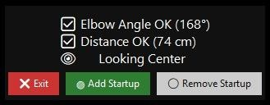
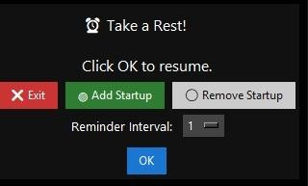
Output Module

Slide 10


Real Life Examples
Example 1: Work From Home Professional
Scenario : A software engineer is attending online
meetings daily
Problem : He sits too close to the laptop → causes eye strain and headaches.
How SitSmart Coach Helps:
Popup : “ Too Close (55 cm)”
User adjusts position → Popup changes to “ Distance OK (75 cm)”.
Result: Reduced eye strain, better ergonomics.

Slide 11
Real Life Examples
Example 2: Student in Online Classes
Scenario: A student bends elbows too much while
typing during online lectures.
Problem: Incorrect elbow angle → causes wrist pain over time.
How SitSmart Coach Helps:
Popup: “ Adjust Elbow Angle (135°)”
Student adjusts → Popup: “ Elbow Angle OK (95°)”.
Result: Student learns to maintain correct desk posture.

Slide 12

Real Life Examples
Example 3: Office Employee Losing Focus.
Scenario: An employee keeps turning head away
during work.
Problem: Lack of focus → decreased productivity. How SitSmart Coach Helps:
Popup shows “ Looking Left” when distracted.
Reminds employee to stay centered (“ Looking Center”)
Result : Reduce back pain of employees

Slide 13


Description of Project Working
Input: Webcam captures upper body of the user.
Pose Detection: MediaPipe identifies body joints like shoulder, elbow, wrist.
Elbow Angle: Angle between shoulder–elbow–wrist is calculated.
Distance Estimation: Measures shoulder width in pixels to estimate user’s distance.
Eye Gaze: Eye landmarks are analyzed for gaze direction.
Popup Alerts: Tkinter floating window shows emoji-based messages.
Looping: Continuous real-time analysis without interrupting the user.
Break Alerts: Timer of 60 minutes is added to take break
Example Alerts:
Good Posture,
Looking Away,
Too Close to Screen.

Slide 14
Innovative Work ( if any)
Does not require any additional hardware – works with laptop webcam.
Combines elbow, eye gaze, and distance analysis for complete posture monitoring.
Uses emojis and color-coded text to keep feedback simple and friendly.
Designed for background operation – unobtrusive but effective.
Lightweight and customizable system with Tkinter.
A new approach that integrates vision AI into everyday wellness routines.

Slide 15


Current Progress
Elbow angle detection with dynamic angle alerts.
Real-time eye gaze detection (left, center, right).
Distance estimation using shoulder width.
Floating popup system with colored emojis.
Break alert notification is added
Cross-platform testing completed.
Features in progress: posture score tracking, head tilt detection.
Plan to add auto-logging and usage analytics.

Slide 16
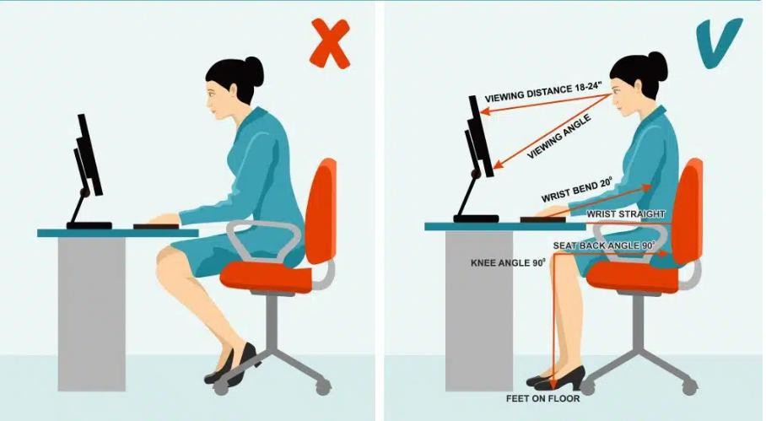
Result & Discussion
Tool runs efficiently on laptops without slowing down other tasks.
Real-time feedback accuracy above 90% in controlled lighting.
User testing shows improved sitting habits within a week.
Positive feedback from testers on simplicity and effectiveness.
Emojis make feedback easy to understand without reading.

Slide 17
Work Plan
Sr. No. | Phase | Timeline | Tasks
1. | Research | Week 1 | Study AI tools like MediaPipe, OpenCV
2. | Design | Week 2 | Plan architecture, popup design, feedback logic
3. | Development | Week 3–4 | Implement detection logic and popup feedback
4. | Testing | Week 5 | User trials, error fixing, UI tweaks
5. | Finalization | Week 6 | Documentation, presentations, packaging

Slide 18
Conclusion & Future Scope
SitSmart Coach is a smart AI solution for improving sitting posture.
Uses real-time computer vision for elbow, eye, and distance analysis.
Designed for students and professionals using laptops for long hours.
No wearables or sensors – just software and webcam.
Visually engaging feedback makes it easy to adopt.
Ready for further enhancements and real-world deployment.

Slide 19
References
List of papers/books/websites etc refer for project
Tlili, F., Haddad, R., Bouallegue, R., Shubair, R., Machine Learning Algorithms Application For The Proposed Sitting Posture
Monitoring System, Procedia Comput. Sci. 203 (2022) 239–246. https://doi.org/10.1016/j.procs.2022.07.031
Jin, H., He, X., Wang, L., Zhu, Y., Jiang, W., Zhou, X., SitPose: Real-Time Detection of Sitting Posture and Sedentary Behavior Using Ensemble Learning, arXiv preprint arXiv:2412.12216 (2024). https://arxiv.org/abs/2412.12216
Zhao, L., Wang, Y., Huang, Z., He, M., Wu, L., A Comparative Study on Real-Time Sitting Posture Monitoring Systems Using
Pressure Sensors, J. Electr. Eng. 74(6) (2023) 474–484. https://sciendo.com/article/10.2478/jee-2023-0055
Tej, K. V., Krishna, M. M., Kumar, K. S., Kumar, T. K., Intelligent Posture Assessment Using Machine Learning, J. Comput. Anal. Appl. 33(6) (2024) 722–726 phhttps://eudoxuspress.com/index.p/pub/article/view/2209
Matsumoto, Y., Ogasawara, K., Mizoguchi, H., Real-Time Posture Monitoring System Using Wearable Sensors and Machine Learning, J. Robot. Mechatron. 33(6) (2021) 1202–1210. https://doi.org/10.20965/jrm.2021.p1202

Slide 20


Thank you !
Nagpur | Pune | Jalgaon | Amravati | Pandhurna | Bhandara

