Slide 1
Introduction
Title: Image Segmentation and Object Analysis
Objective: To Develop a pipeline using transformers or deep learning models that processes an input image to segment, identify, and analyze objects within the image, and outputs a summary table with mapped data for each object.

Slide 2
Approach
Goal: Create a comprehensive pipeline for image segmentation, object identification, and analysis.
Components: Image Segmentation, Object Identification, OCR, Summarization, Data Management
Key Technologies
Segmentation Model: Segment Anything Model (SAM) by Meta for image segmentation.
Identification Model: ResNet-50 model from Hugging Face for object classification.
OCR Technology: EasyOCR for text extraction from segmented objects.
User Interface: Streamlit for interactive visualization and user interaction.

Slide 3
Implementation
Project Structure:
data/ contains input_images/, segmented_objects/, and output/ directories.
models/: Includes a single combined script for segmentation, identification, OCR, and summarization and data mapping.
streamlit_app/: Contains the main Streamlit application.
utils/: Utility scripts for preprocessing of images before being fed into ocr model.
tests/: Tests for individual models and functions.

Slide 4
Key Components
Segmentation:
Model Used: SAM model (sam_vit_h_4b8939.pth)
Functionality: Generates masks for object segmentation in images.
Object Identification:
Model Used: ResNet-50
Functionality: Classifies objects within segmented regions using predefined imagenet labels.
OCR Processing:
Tool Used: EasyOCR
Functionality: Extracts text from segmented objects to provide additional information.
Streamlit Application:
Upload and process single or multiple images.
Display results including segmented images and metadata.
Options to view segmented objects and metadata based on user interaction.

Slide 5
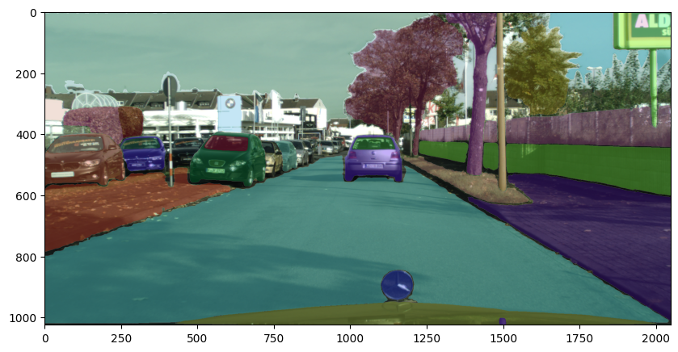
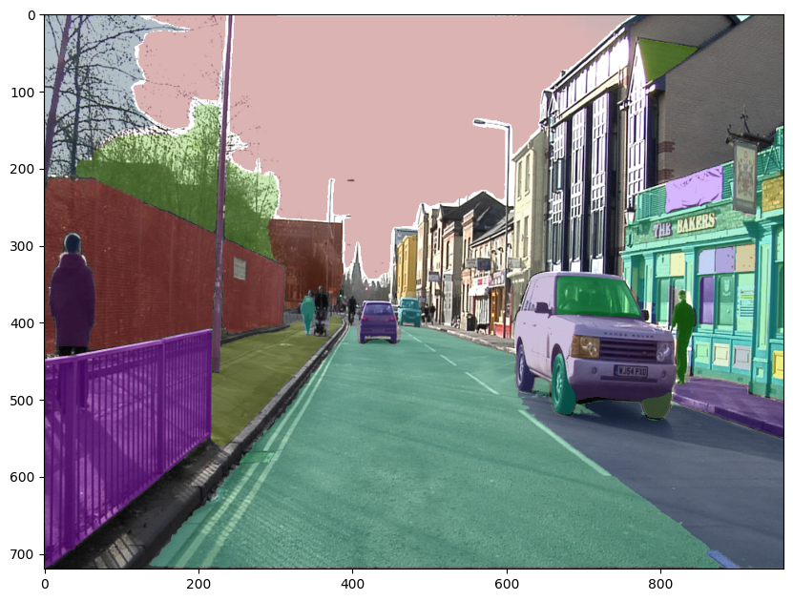
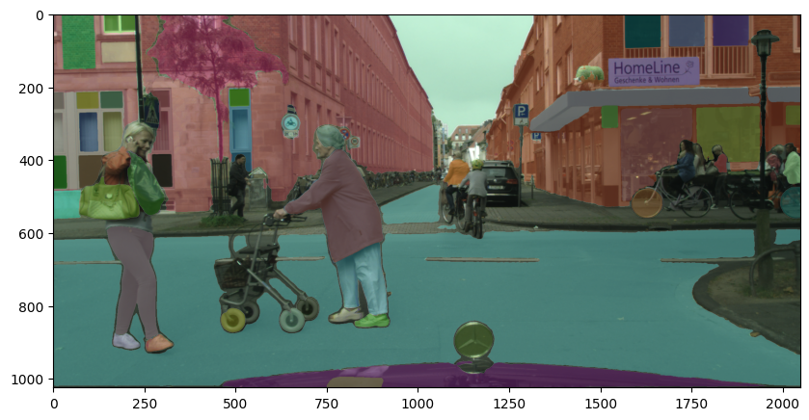
Results
Segmented Images:

Slide 6
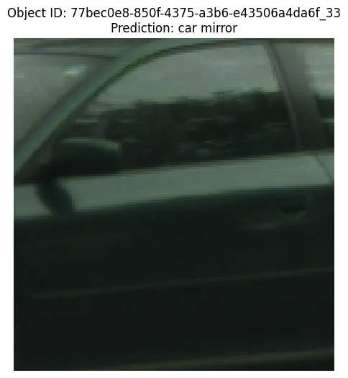
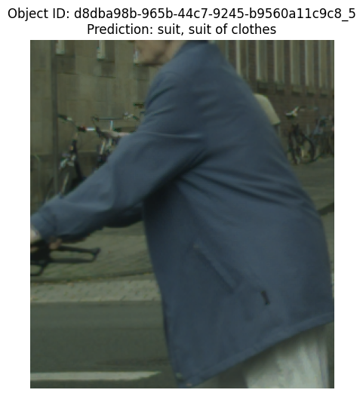
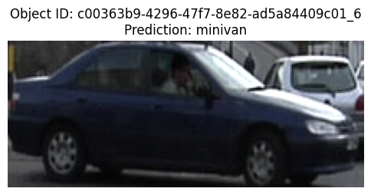
Identification model

Slide 7
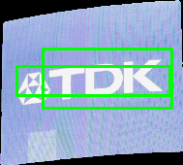

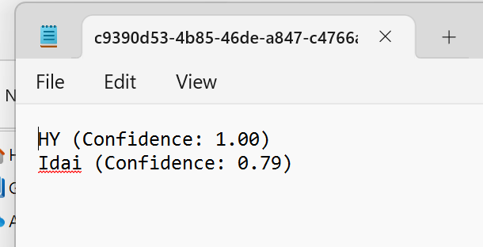
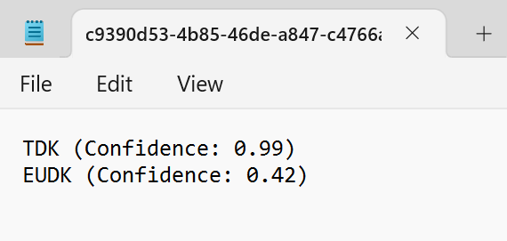
Text extraction

Slide 8
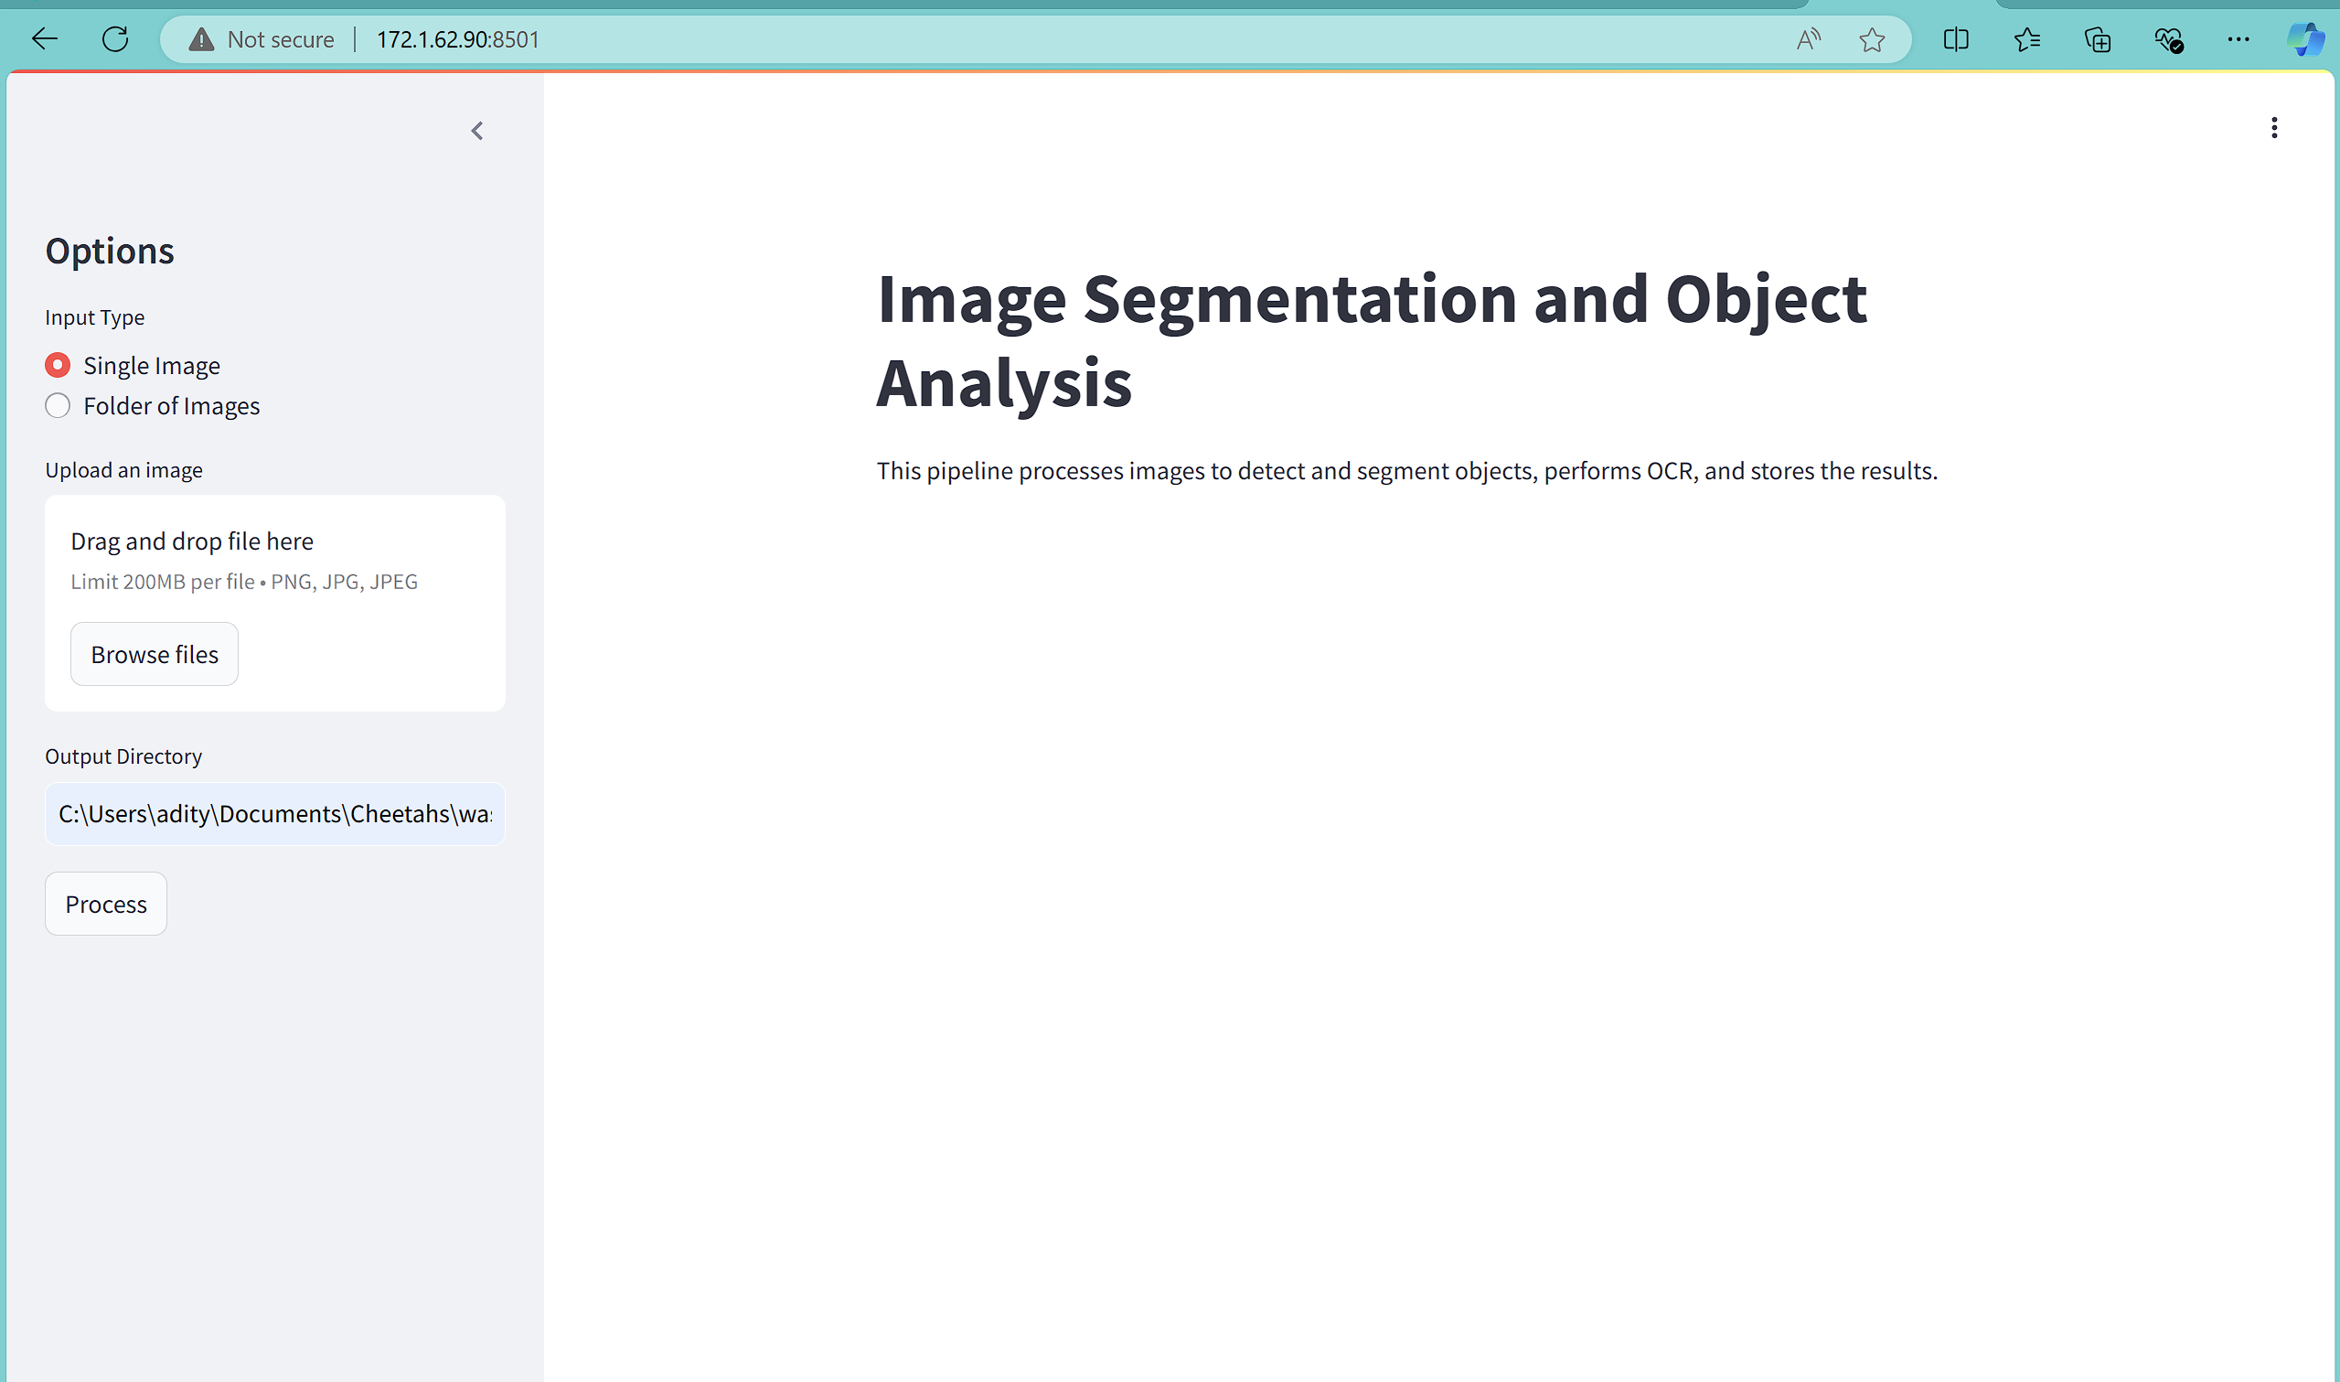
Streamlit UI

Slide 9
Conclusion
Summary: Successfully developed a pipeline that integrates image segmentation, object identification, and text extraction with an interactive user interface.
Future Work: Explore improvements in model accuracy, extend functionality for additional image types, and enhance the user interface.

