Slide 1
Spy Rover with Smart Navigation System and Live Monitoring
Team Number : 10
Students :
1. DHANUSH K – TOC22RA017
2. N P MAHESWAR – TOC22RA035
3. HARIPRASAD ANAND – TOC22RA023
4. HAMEED SUNEER – TOC22RA020
5. PRANAV S S – TOC22RA036
Project Guide : Asst.Prof Mahesh C

Slide 2
Introduction
Developing a spy rover equipped with an intelligent navigation system and real-time video monitoring capabilities for enhanced surveillance and exploration.
Advanced technology is essential for effective monitoring and security in today's world.
It serves as a critical tool in situations where direct human intervention is challenging or risky.
Potential for future enhancements and adaptability to different environments.
Provide real-time video and data to improve situational awareness and decision-making.

Slide 3
Literature Survey
SI NO | Name of the journal | Names of the Title of the Paper Authors | Name of Journal / Conference Proceedings | YEAR | Methodology | Merits | Drawbacks
1. | Design and Development of Spherical Spy Robot for Surveillance Operation | Irfan Rangapura. B.K.Swathi Prasad. R.Suresh. | Third International Conference on Computing and Network Communications (CoCoNet'19), published in Volume 171, 2020 of the journal. | 2020 | Helped in the conceptualization and design Helped with component selection and integration Helped in the control system development | Enhancing the rover's ability to navigate challenging terrains. Inclusion of wireless camera for surveillance | Complex system. High Cost. Higher power consumption.

Slide 4
Sl. No | Name of the Journal | Names of the Title of the Paper Authors | Name of Journal / Conference Proceedings | Year | Methodology | Merits | Drawbacks
2. | Design of a Health Monitoring System for a Planetary Exploration Rover. | 1.Sara Swintn 2. Euan McGookin 3.Douglas Thomson | Accepted for publication in the Proceedings of IEEE ISPARO 2024. | 2024 | Helped us in the better understanding of design requirements of Spy Rover Helped us in component selection and integration of it Helped in the implementation of control system development | Early anomaly detection enhances the spy rover's dependability. Encryption and protocols protect against interception and unauthorized access. The model aligns with the spy rover's espionage needs. | Fault detection may raise costs. High demands may reduce endurance. Specialized tactics may restrict versatility.

Slide 5
SI NO | Name of the journal | Names of the Title of the Paper Authors | Name of Journal / Conference Proceedings | YEAR | Methodology | Merits | Drawbacks
3. | Web Controlled Raspberry Pi Robot Surveillance | V.USHA RANI J.SRIDEVI P.SAI | The International Conference on Computer Science and Information Technology (ICCSIT) in 2021. | 2021 | Utilizes Raspberry Pi as the central controller Helped us in better understanding of web-based system Helped us to learn about the integration of motion software on Raspberry Pi | Remote accessibility Cost-effectiveness Ease of implementation | Stable network connection required Chances of unauthorized access

Slide 6
SI NO | Name of the journal | Names of the Title of the Paper Authors | Name of Journal / Conference Proceedings | YEAR | Methodology | Merits | Drawbacks
4. | Internet Based Real Time Control of Rover Using Live Video Streaming | Madhusudhan Reddy Guggilla K Deepa M Nithya | International Conference on Intelligent Systems and Control (ISCO) | 2022 | Helped in better understanding of Raspberry Pi as central controller Wi-Fi signals used for transmitting commands Helped us in better understanding of real time systems | Real time monitoring which provides valuable intelligence Cost effective with the selection of hardware components Remote operation | Robust measures required for security Limited range due to the use of Wi-Fi Reliant on quantity of internet

Slide 7
SI NO | Name of the journal | Names of the Title of the Paper Authors | Name of Journal / Conference Proceedings | YEAR | Methodology | Merits | Drawbacks
5. | Research on Design and Motion Control of a Considerate Guide Robot. | Hitoshi Hachisuka Hiroshi Matsumoto Takeshi Takashima | 2023 IEEE International Conference on Advanced Robotics and Mechatronics (ARM). | 2023 | Helped us in analyzing the potential environment hazards. Navigate by considering the occupied spaces of surrounding objects. | Obstacle avoidance ensuring safety. Can adjust its movement by considering the dynamic environment. Better agility due to mecanum wheels. | Precise environment data required. In highly dynamic environments system is more complex.

Slide 8
Details of study of existing systems
Robotnik – RB-1 Mecanum Robot
Robotnik’s RB-1 is a mobile robot designed for autonomous navigation with Mecanum wheels, capable of 360-degree movement. It is used for industrial inspections, logistics, and surveillance, where its omnidirectional movement allows it to maneuver in tight spaces.
Features : real-time data transmission and feedback, Can be controlled remotely via wireless communication , Mecanum wheels for omnidirectional movement.
Sensors : Ultrasonic sensors, Cameras
Applications : Industrial automation, security, surveillance, and research.
DJI – RoboMaster S1
The RoboMaster S1 by DJI is a robotics platform that incorporates Mecanum wheels, designed for educational purposes and autonomous navigation. Although not explicitly designed for military or surveillance use, it highlights the potential of Mecanum-wheeled robots in complex environments.
Features : Can be integrated with real-time data streaming, motion detection, and obstacle avoidance, Programmable with a focus on educational robotics, Mecanum wheels for omnidirectional movement
Sensors : Infrared Sensor, FPV Camera, Wi-Fi Module, Audio Sensors
Applications : Educational, research, and hobbyist applications in robotics and AI.

Slide 9
Objectives of the Project
To design and fabricate a spy rover equipped with Mecanum wheels for all-directional mobility.
To integrate advanced sensors and cameras for reconnaissance.
To develop a remote control system with IoT for seamless operation.
To implement secure communication protocols and robust power management.
To establish a server solution for data analytics, processing, and visualization.

Slide 10
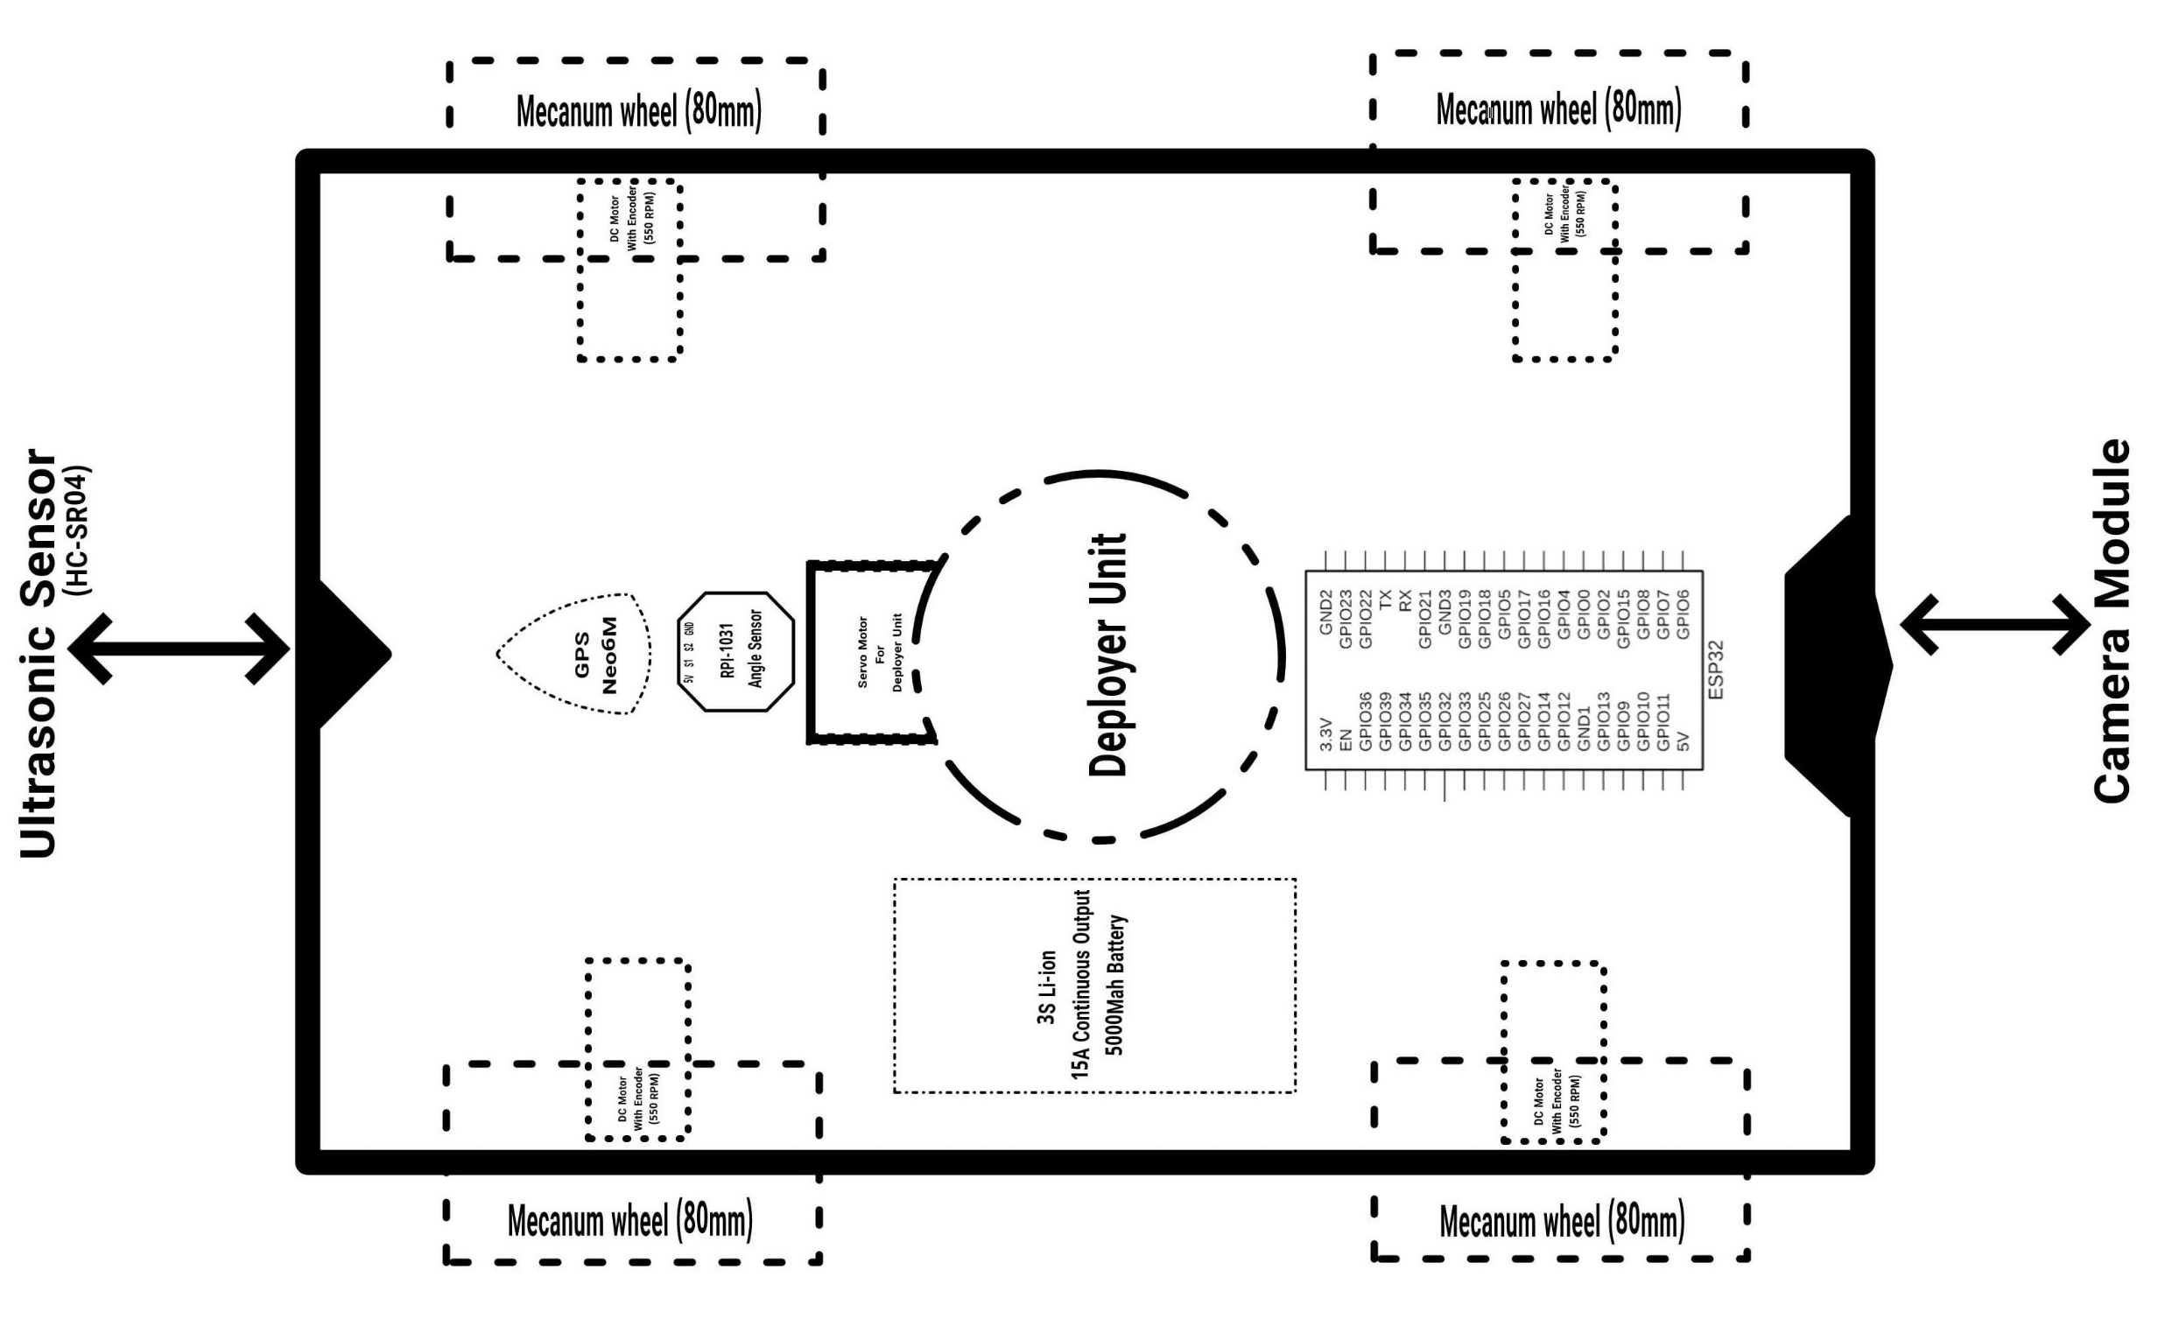
Hardware - Block Diagram

Slide 11
Mechanical Components
Chassis :
Material : Aluminum sheets
Fabrication : Hand cutting using metal shears or a jigsaw for custom shapes. Welding the aluminum sheets to create a robust and secure assembly.
Mecanum Wheels :
Material : Aluminum hubs, rubber tread
Fabrication : Using the pre-fabricated wheels. Hand cutting and shaping any additional mounting parts as needed.

Slide 12
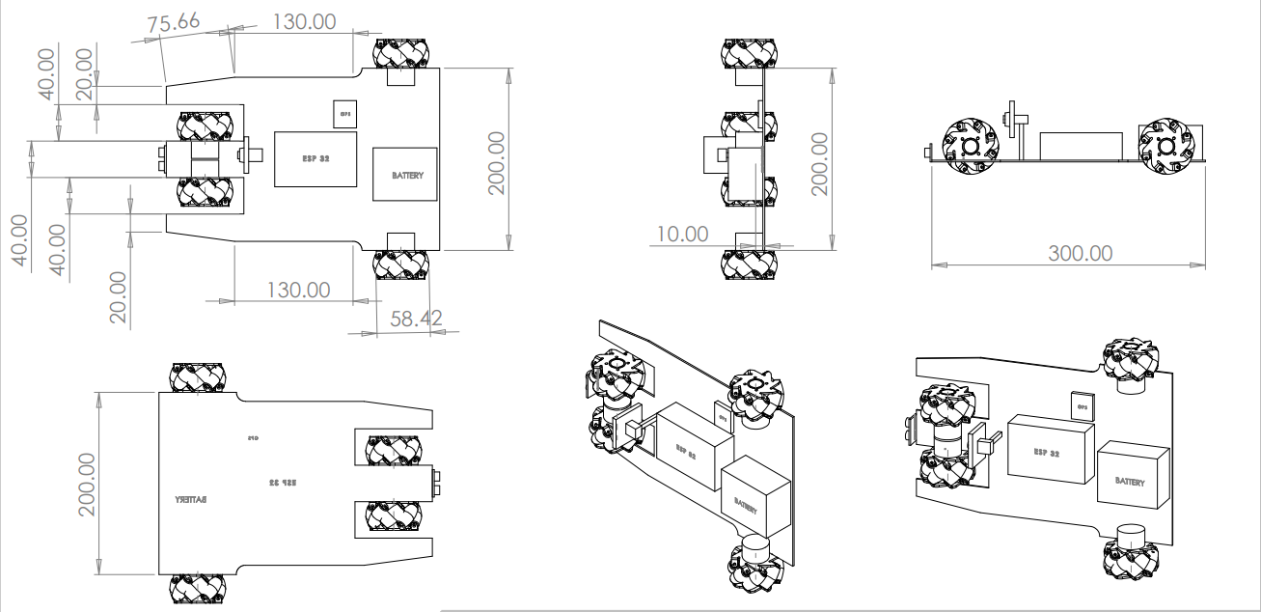
Mechanical Components

Slide 13
Software Requirements
Visual Studio Code
Solidworks
Arduino IDE

Slide 14
Software – Algorithm/Flow Chart

Slide 15
Estimated Cost of Project
S. No. | Item | Unit Rate (Rs) | Quantity | Cost (Rs)
1. | Aluminium Alloy Plate Sheet (300x300x3mm 800g) | 999 | 3 | 2997
2. | Mecanum Wheel (pack of 4) | 783 | 1 | 783
3. | N25 6V 550RPM Metal Gear Motor With Encoder D Type Shaft | 388 | 4 | 1552
4. | CP2102 ESP-32 | 469 | 1 | 469
5. | HC-SR04 Ultrasonic Sensor | 53 | 1 | 53
6. | Neo-6M GPS Module | 242 | 1 | 242
7. | 11.1V 5000mAh 3C 3S2P Li-Ion Battery | 1099 | 1 | 1099

Slide 16
8. | Ov2640 Camera Module | 599 | 1 | 599
9. | Nut and Bolts | 200 | 1 | 200
10. | Welding charge | 400 |  | 400
11. | Miscellaneous expenses |  |  | 1000
Total Cost | 9394

Slide 17
Project Implementation Time Schedule
PERIOD | WORK PLANNED
30/12/2024 to 04/01/2025 | To determine the technical requirements for the rover's hardware and software systems.
06/01/2025 to 11/01/2025 | We developed the initial architecture and created block diagrams for the system. We also shortlisted potential hardware components for the system.
13/01/2025 to 18/01/2025 | Finalized the mechanical components, estimated the project's cost, and planned its timeline. Reviewed journals for further study of papers and existing systems.
20/01/2025 to 25/01/2025 | Outline the architecture and key algorithms for the navigation and monitoring system. Ensure the workspace is organized and equipped for fabrication and assembly, and order all necessary materials and components.

Slide 18
PERIOD | WORK PLANNED
27/01/2025 to 01/02/2025 | Testing of ordered components, machining and fabrication of mechanical parts, and beginning to assemble the chassis, Mecanum wheels, and other mechanical components while also working on the software side.
03/02/2025 to 08/02/2025 | Install and test the sensors and cameras on the rover. Integrate the motors and gearboxes with the mechanical assembly. Set up the battery and power management system.
10/02/2025 to 15/02/2025 | Test firmware for the microcontroller, algorithms for smart navigation, and obstacle avoidance. Implement remote control and monitoring features.
17/02/2025 to 22/02/2025 | Test each component for functionality. Evaluate the rover's performance in various environments. Collect data for analysis to identify areas needing improvement.

Slide 19
PERIOD | WORK PLANNED
24/02/2025 to 01/03/2025 | Enhance the system for improved performance and reliability. Resolve any issues found during testing. Perform a final review and implement necessary adjustments.
03/03/2025 to 08/03/2025 | Perform comprehensive testing of the entire system. Assess all system components thoroughly. Execute an in-depth evaluation of the software algorithms and codebase. Verify the software's connectivity and remote control features systematically.
10/03/2025 to 15/03/2025 | Submit the Rover for final evaluation, documenting the testing results. Provide an overall assessment of the project's success and offer suggestions for potential applications.

Slide 20
References
Rangapur, I., Prasad, B.S. and Suresh, R., 2020. Design and development of spherical spy robot for surveillance operation. Procedia Computer Science, 171, pp.1212-1220.
Swinton, S., McGookin, E. and Thomson, D., 2024, June. Design of a Health Monitoring System for a Planetary Exploration Rover. In 2024 International Conference on Space Robotics (iSpaRo) (pp. 218-223). IEEE.
Rani, V.U., Sridevi, J. and Sai, P.M., 2021, January. Web controlled raspberry pi robot surveillance. In 2021 International Conference on Sustainable Energy and Future Electric Transportation (SEFET) (pp. 1-5). IEEE.
Guggilla, M.R., Deepa, K. and Nithya, M., 2022, August. Internet Based Real Time Control of Rover Using Live Video Streaming. In 2022 International Conference on Innovations in Science and Technology for Sustainable Development (ICISTSD) (pp. 325-329). IEEE.
Zhang, B., Okutsu, M., Ochiai, R., Tayama, M. and Lim, H.O., 2023. Research on Design and Motion Control of a Considerate Guide Mobile Robot for Visually Impaired People. IEEE Access, 11, pp.62820-62828.

