Slide 1
Spy Rover with Smart Navigation System and Live Monitoring
Team Number : 10
Students :
1. DHANUSH K – TOC22RA017
2. N P MAHESWAR – TOC22RA035
3. HARIPRASAD ANAND – TOC22RA023
4. HAMEED SUNEER – TOC22RA020
5. PRANAV S S – TOC22RA036
Project Guide : Asst.Prof Mahesh C

Slide 2
Introduction
Developing a spy rover equipped with an intelligent navigation system and real-time video monitoring capabilities for enhanced surveillance and exploration.
Advanced technology is essential for effective monitoring and security in today's world.
It serves as a critical tool in situations where direct human intervention is challenging or risky.
Potential for future enhancements and adaptability to different environments.
Provide real-time video and data to improve situational awareness and decision-making.

Slide 3
Literature Survey
SI. NO | Name of the journal | Names of the Title of the Paper Authors | Name of Journal / Conference Proceedings | YEAR | Methodology | Merits | Drawbacks
1. | Robust adaptive SINS/CNS integrated navigation algorithm for Mars rovers with experimental verification | 1. Zhihao Li 2. Yinhu Zhan 3. Haijian Du 4. Yang Shen 5. Shaojie Chen 6. Chao Zhang. | Robust adaptive SINS/CNS integrated navigation algorithm for Mars rovers with experimental verification Volume 236, in 2024 (Elsevier) | 2024 | Uses robust estimation and adaptive factors to mitigate errors. Iteratively updates navigation through filtering and corrections. | Effectively handles gross errors. Adapts well to dynamic motion states. Proven effective in real-world field tests. | Sensitive to environmental factors like visibility Relies on precise sensors High algorithm complexity

Slide 4
Sl. No | Name of the Journal | Names of the Title of the Paper Authors | Name of Journal / Conference Proceedings | Year | Methodology | Merits | Drawbacks
2. | Design of a Health Monitoring System for a Planetary Exploration Rover. | 1.Sara Swintn 2. Euan McGookin 3.Douglas Thomson | Accepted for publication in the Proceedings of IEEE ISPARO 2024. | 2024 | The paper introduced the concept of developed planetary exploration rover model with rocker-bogie suspension and differential steering Compared faulty rover outputs with a non-faulty reference to generate heading and velocity residuals Simulated high-risk faults like gyroscope offsets and motor failures to evaluate performance degradation. | Early anomaly detection enhances the spy rover's dependability. Encryption and protocols protect against interception and unauthorized access. The model aligns with the spy rover's espionage needs. | Fault detection may raise costs. High demands may reduce endurance. Specialized tactics may restrict versatility.

Slide 5
SI NO | Name of the journal | Names of the Title of the Paper Authors | Name of Journal / Conference Proceedings | YEAR | Methodology | Merits | Drawbacks
3. | Heliyon | Muhammad Umair Shafiq Abid Imran Sajjad Maznoor Ilyas Khan Abdullah Mohamed Afraz Hussain Majeed Bilal Ahmed | Real-time navigation of mecanum wheel-based mobile robot in a dynamic environment (Elsevier) | 2024 | This robot uses four mecanum wheels for omnidirectional movement Path planning algorithms such as A* algorithm is used Lidar sensor is used for Real-time validations | Omnidirectional Mobility Efficient Path Planning Real-Time Adaptability Lidar provide higher sensor efficiency | Relies heavily on Lidar sensors, hence expensive Higher energy consumption Real-time computation challenges

Slide 6
SI NO | Name of the journal | Names of the Title of the Paper Authors | Name of Journal / Conference Proceedings | YEAR | Methodology | Merits | Drawbacks
4. | Barrier Penetration Routing Against Wireless Spy Sensors | Kazuya Sakai Min-Te Sun Wei-Shinn Ku Jie Wu | IEEE Transactions on Mobile Computing, Volume 23, Issue 5, May 2024 | 2024 | The paper introduces the concept of a barrier penetration routing problem Conducted simulations to compare BPR with existing protocols like MPAR (Multi-Path Avoidance Routing) | Higher Delivery Rate Resistance to Collusion Attacks Flexible Anchor Selection Longer paths are used which increases latency | Longer paths are used which increases latency Careful tuning required for optimal performance.

Slide 7
555555555555555555566666666666
SI NO | Name of the journal | Names of the Title of the Paper Authors | Name of Journal / Conference Proceedings | YEAR | Methodology | Merits | Drawbacks
5. | Research on Design and Motion Control of a Considerate Guide Robot. | Hitoshi Hachisuka Hiroshi Matsumoto Takeshi Takashima | 2023 IEEE International Conference on Advanced Robotics and Mechatronics (ARM). | 2023 | The paper introduces the concept of a guide robot with wheeled mechanism and an easy-to-hold handle. The environment is mapped using SLAM to generate a 2D occupancy grid. The robot can issue warnings in unavoidable interactions. | Obstacle avoidance ensuring safety Can adjust its movement by considering the dynamic environment Better agility due to mecanum wheels | Precise environment data required In highly dynamic environments system is more complex

Slide 8
Details of study of existing systems
Robotnik – RB-1 Mecanum Robot
Robotnik’s RB-1 is a mobile robot designed for autonomous navigation with Mecanum wheels, capable of 360-degree movement. It is used for industrial inspections, logistics, and surveillance, where its omnidirectional movement allows it to maneuver in tight spaces.
Features : real-time data transmission and feedback, Can be controlled remotely via wireless communication , Mecanum wheels for omnidirectional movement.
Sensors : Ultrasonic sensors, Cameras
Applications : Industrial automation, security, surveillance, and research.
DJI – RoboMaster S1
The RoboMaster S1 by DJI is a robotics platform that incorporates Mecanum wheels, designed for educational purposes and autonomous navigation. Although not explicitly designed for military or surveillance use, it highlights the potential of Mecanum-wheeled robots in complex environments.
Features : Can be integrated with real-time data streaming, motion detection, and obstacle avoidance, Programmable with a focus on educational robotics, Mecanum wheels for omnidirectional movement
Sensors : Infrared Sensor, FPV Camera, Wi-Fi Module, Audio Sensors
Applications : Educational, research, and hobbyist applications in robotics and AI.

Slide 9
Objectives of the Project
To design and fabricate a spy rover equipped with Mecanum wheels for all-directional mobility.
To integrate sensors and cameras for reconnaissance.
To develop a remote control system with IoT for seamless operation.
To develop a real-time GPS and location-tracking system that enhances the rover's ability to return to base autonomously.
To establish a system for collecting, storing, and analyzing the data gathered by the rover.

Slide 10
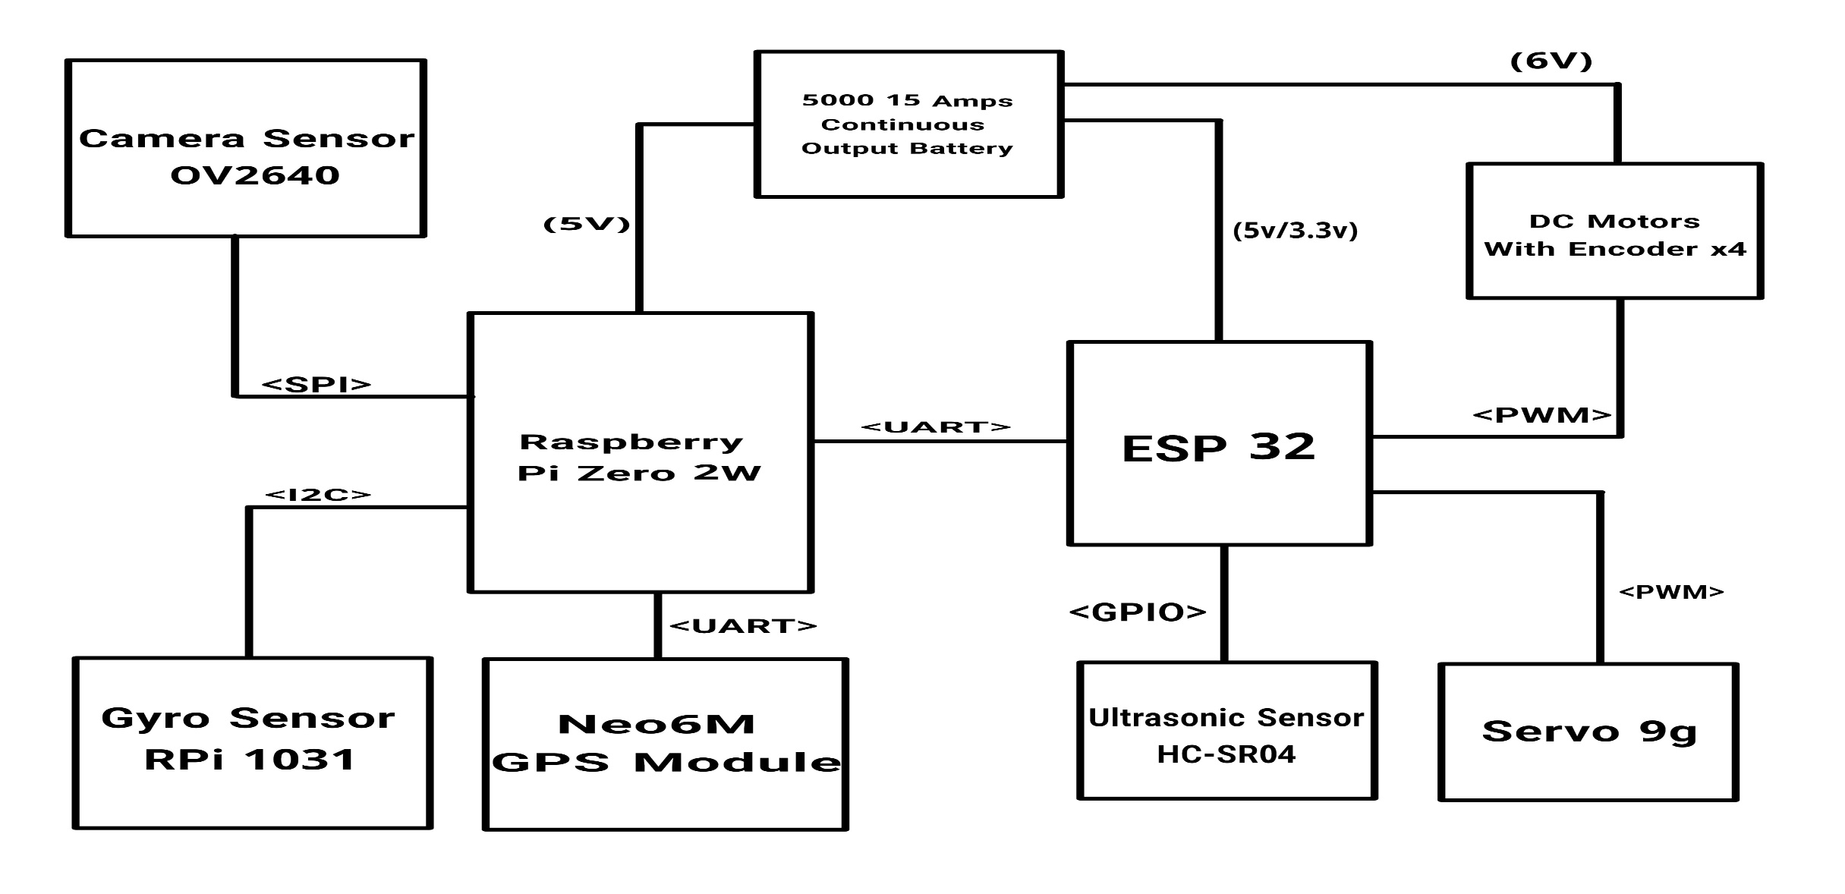
Hardware - Block Diagram

Slide 11
Mechanical Components
Chassis :
Material : Aluminum sheets
Fabrication : Hand cutting using metal shears or a jigsaw for custom shapes. Welding the aluminum sheets to create a robust and secure assembly.
Mecanum Wheels :
Material : Aluminum hubs, rubber tread
Fabrication : Using the pre-fabricated wheels. Hand cutting and shaping any additional mounting parts as needed.

Slide 12
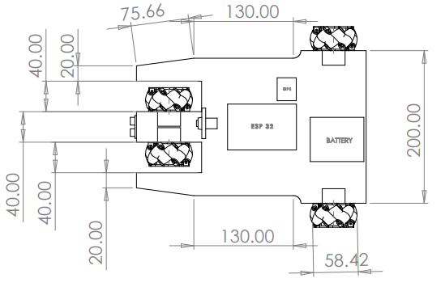
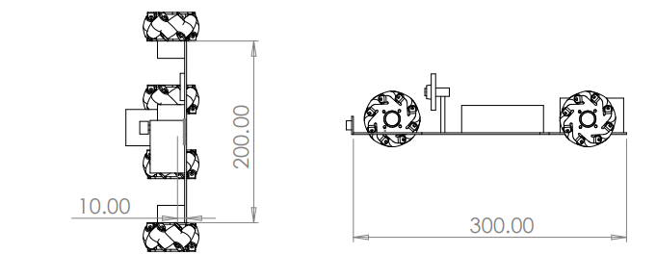
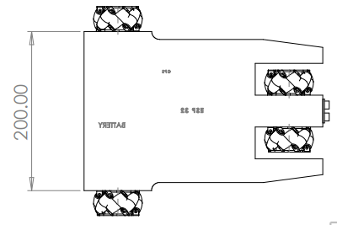
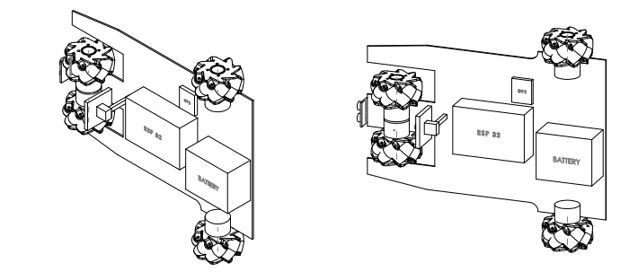
TOP VIEW
BACK VIEW
RIGHT VIEW
BOTTOM VIEW
ISOMETRIC VIEW
DIMETRIC VIEW

Slide 13
Software Requirements
Visual Studio Code
Solidworks
Arduino IDE
Thonny
OpenCV
Python
Automation Components
Raspberry Pi Os
Mission Planner/QgroundControl

Slide 14
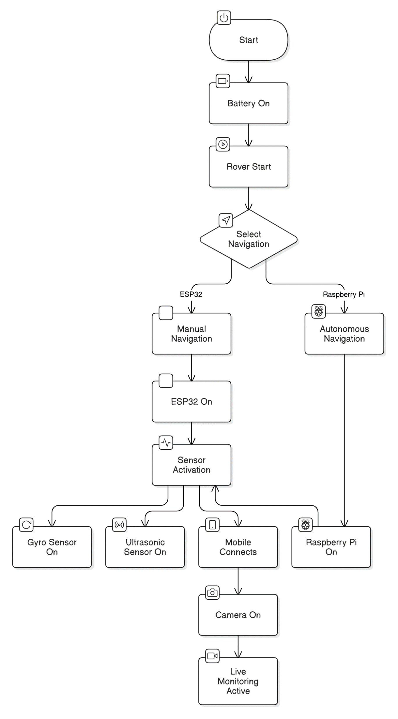
Software – Algorithm/Flow Chart

Slide 15
Estimated Cost of Project
S. No. | Item | Unit Rate (Rs) | Quantity | Cost (Rs)
1. | Aluminium Alloy Plate Sheet (300x300x3mm 800g) | 999 | 3 | 2997
2. | Mecanum Wheel (pack of 4) | 783 | 1 | 783
3. | N25 6V 550RPM Metal Gear Motor With Encoder D Type Shaft | 388 | 4 | 1552
4. | CP2102 ESP-32 | 469 | 1 | 469
5. | HC-SR04 Ultrasonic Sensor | 53 | 1 | 53
6. | Neo-6M GPS Module | 242 | 1 | 242
7. | 11.1V 5000mAh 3C 3S2P Li-Ion Battery | 1099 | 1 | 1099

Slide 16
8. | Ov2640 Camera Module | 599 | 1 | 599
9. | Nut and Bolts | 200 | 1 | 200
10. | Fabrication Cost | 400 |  | 400
12. | RPI -1031 ANGLE SENSOR | 169 | 1 | 169
11. | Miscellaneous expenses |  |  | 1000
Total Cost | 9563

Slide 17
Project Implementation Time Schedule
PERIOD | WORK PLANNED
30/12/2024 to 04/01/2025 | To determine the technical requirements for the rover's hardware and software systems.
06/01/2025 to 11/01/2025 | We developed the initial architecture and created block diagrams for the system. We also shortlisted potential hardware components for the system.
13/01/2025 to 18/01/2025 | Finalized the mechanical components, estimated the project's cost, and planned its timeline. Reviewed journals for further study of papers and existing systems.
20/01/2025 to 25/01/2025 | Outline the architecture and key algorithms for the navigation and monitoring system. Ensure the workspace is organized and equipped for fabrication and assembly, and order all necessary materials and components.

Slide 18
PERIOD | WORK PLANNED
27/01/2025 to 01/02/2025 | Testing of ordered components, machining and fabrication of mechanical parts, and beginning to assemble the chassis, Mecanum wheels, and other mechanical components while also working on the software side.
03/02/2025 to 08/02/2025 | Install and test the sensors and cameras on the rover. Integrate the motors and gearboxes with the mechanical assembly. Set up the battery and power management system.
10/02/2025 to 15/02/2025 | Test firmware for the microcontroller, algorithms for smart navigation, and obstacle avoidance. Implement remote control and monitoring features.
17/02/2025 to 22/02/2025 | Test each component for functionality. Evaluate the rover's performance in various environments. Collect data for analysis to identify areas needing improvement.

Slide 19
PERIOD | WORK PLANNED
24/02/2025 to 01/03/2025 | Enhance the system for improved performance and reliability. Resolve any issues found during testing. Perform a final review and implement necessary adjustments.
03/03/2025 to 08/03/2025 | Perform comprehensive testing of the entire system. Assess all system components thoroughly. Execute an in-depth evaluation of the software algorithms and codebase. Verify the software's connectivity and remote control features systematically.
10/03/2025 to 15/03/2025 | Submit the Rover for final evaluation, documenting the testing results. Provide an overall assessment of the project's success and offer suggestions for potential applications.

Slide 20
References
[ 1 ] Li, Z., Zhan, Y., Du, H., Shen, Y., Chen, S. and Zhang, C., 2024. Robust adaptive SINS/CNS integrated navigation algorithm for Mars rovers with experimental verification. Measurement, p.115087. (Elsevier)
[ 2 ] Swinton, S., McGookin, E. and Thomson, D., 2024, June. Design of a Health Monitoring System for a Planetary Exploration Rover. In 2024 International Conference on Space Robotics (iSpaRo) (pp. 218-223). IEEE.
[ 3 ] Shafiq, M.U., Imran, A., Maznoor, S., Majeed, A.H., Ahmed, B., Khan, I. and Mohamed, A., 2024. Real-time navigation of mecanum wheel-based mobile robot in a dynamic environment. Heliyon, 10(5). (Elsevier)
[ 4 ] Sakai, K., Sun, M.T., Ku, W.S. and Wu, J., 2023. Barrier Penetration Routing Against Wireless Spy Sensors. IEEE Transactions on Mobile Computing.
[ 5 ] Zhang, B., Okutsu, M., Ochiai, R., Tayama, M. and Lim, H.O., 2023. Research on Design and Motion Control of a Considerate Guide Mobile Robot for Visually Impaired People. IEEE Access, 11, pp.62820-62828.

