Slide 1
Identifying a suitable location for opening a Restaurant

Slide 2
Finding suitable location is useful for those who are interested in opening a restaurant in Chennai
Chennai has lots of Restaurant, so doing proper analysis on the location should help the stakeholders
Identifying the location which is not already crowded with Andhra Restaurant will help the user to ensure more opportunity for the business

Slide 3
Data Analysis
Need to know
(i) the locations which are crowded with IT companies
(ii) need to find the center location of the locations having IT companies
(iii) number of Andhra restaurants available in the location
Data Sources:
https://en.wikipedia.org/wiki/List_of_tech_parks_in_Chennai
For location information, Used FourSquare data.

Slide 4
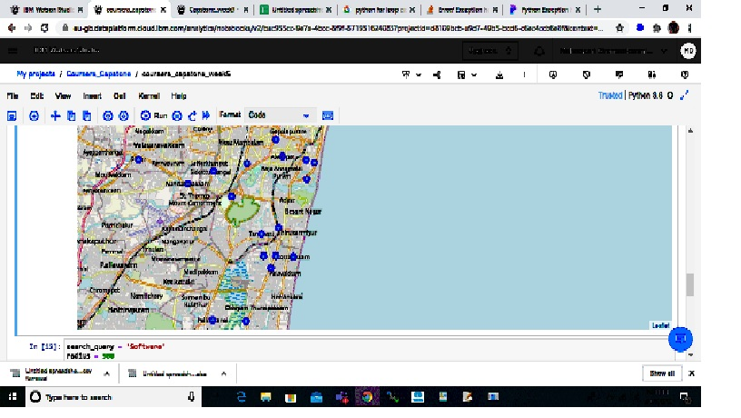
Analysis

Slide 5
Identified the locations having IT companies and stored in data frame
Plotted the locations in the map
Identified Thiruvanmiyur as the center of the locations
Using Foursquare, found the list of restaurants which exists within 5km radius from Thiruvanmiyur

Slide 6
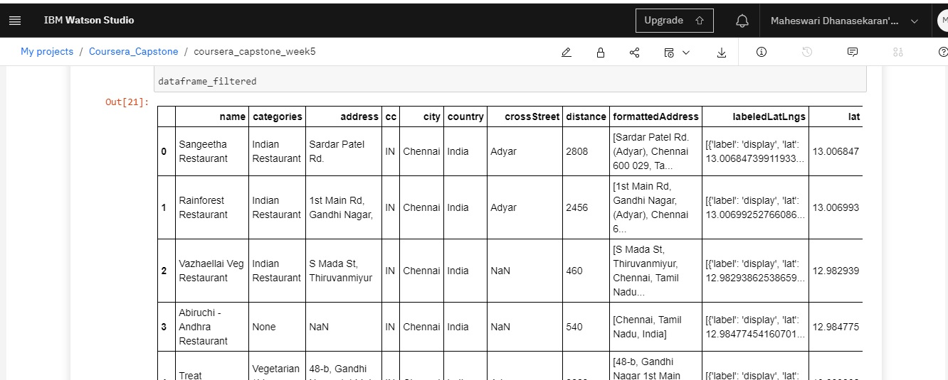
Restaurants within 5 kms radius from Thiruvanmiyur

Slide 7
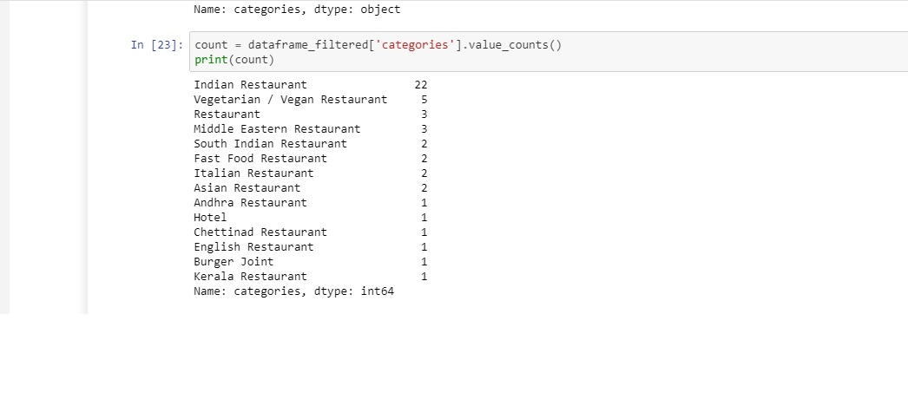
Number of Restaurants category wise

Slide 8
Conclusion
Thiruvanmiyur is the centralized location for IT companies
There is only one Andhra Restaurant within 5 kms radius from Thiruvanmiyur
This would be right location for opening an Andhra Restaurant

