Slide 1
College Selection system
TEAM-10
P. Rajeswari
15JN1A0514
J. Pooja Sri Mani
15JN1A0552
P. Uma Maheswari
15JN1A0572
SK. Gousia Nourien
15JN1A0574
Guided By
K. Guru Kumar

Slide 2
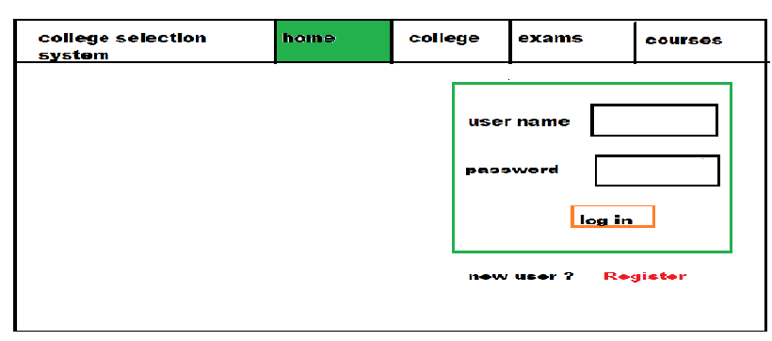
Home Page

Slide 3
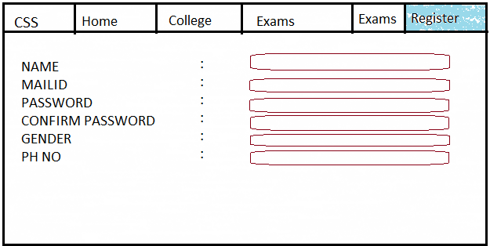
Registration page

Slide 4
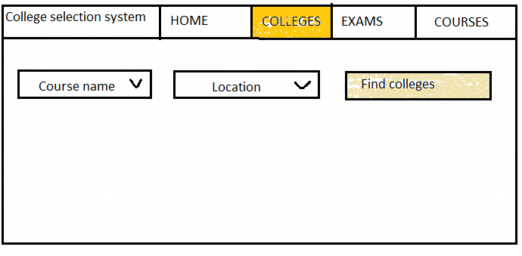
College Page

Slide 5
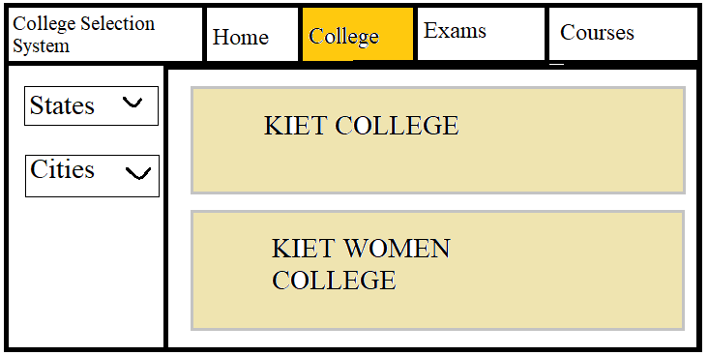
College Page

Slide 6
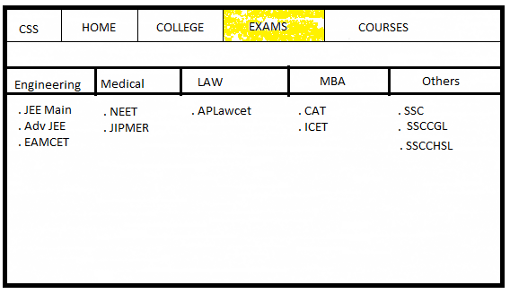
Exam Page

Slide 7
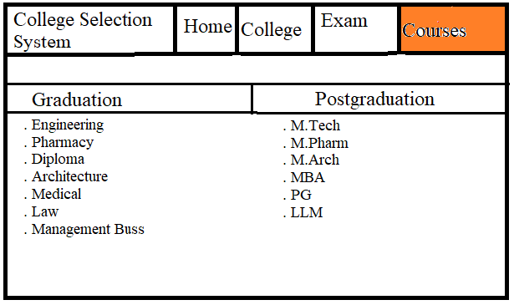
Courses

Slide 8
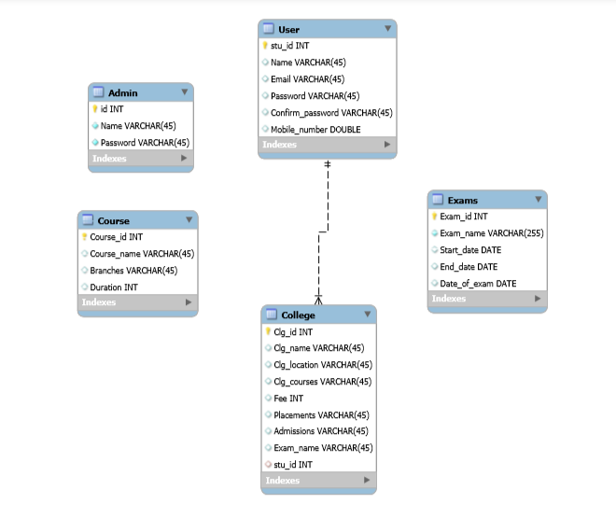
Database Schema

Slide 9
THANK YOU

