Slide 1



TS-WEB TRACK CAPSTONE PROJECT
ONLINE TICKET BOOKING
Presented By:
1. V. Kusuma Kumari
2. P. Preethi
3. I. Kavyasri
4. P. Maheswari
Guided By: Uma Maheswari Madam

Slide 2
OUTLINE
Abstract
Problem Statement
Aims , Objective & Proposed System/Solution
System Design
System Development Approach(Technology Used)
Algorithm & Development
Conclusion
References
Future Scope

Slide 3
Abstract:
Online bus booking is important to the customer because customer can check availability of the bus ticket, buy bus ticket and pay the bus ticket online.
E-ticket is different from traditional paper ticket because e-ticket is safer, faster, reliable and cheaper.
Besides that, this concept can be used by customers will be easier.
The profit the bus will be increased because the online system will attract more customers and no need to stay many staffs at the counter to sell bus ticket because ticket can be hold efficiency online.

Slide 4
Problem Statement:
A bus reservation system is a mobile or web software solution designed to provide customers with a personalized easy-to-utilize user experience for booking and purchasing tickets online. It stores customers' personal data records, scheduled routes, frequent trips, drop points, and other information.
Now a days online ticket booking , customers can book the ticket, buy the ticket, and scheduling the journey over the Internet from their mobiles at any time. But all the 100% customers are not ready to buy ticket online, only 60% of the customers are using the travelling agencies like ( Abhi bus, Red bus) due to highest prices.
So that , we are starting the RADHEYA TRAVELS to reduce this problem.
The main aim of this travels is that all the customers have to utilize this online ticket
booking because it is easier and reliable.

Slide 5
Aim , Objective & Proposed System/Solution:
The main objective of the proposed system” Online ticket booking” is to eliminate the manual reservation system. Making the reservation system, fast, user friendly avoid the unnecessary delay in reservation. The new system needs to develop that can handle lots of records and reports efficiently. Searching information about reservation date etc. will present only on one click.
The systematic approach in running makes the system to work more efficiently. Various types of constraints can be well interoperated to maintain the database consistency. Any report according to the requirements can get easily. Response time is very less comparative to manual system.

Slide 6
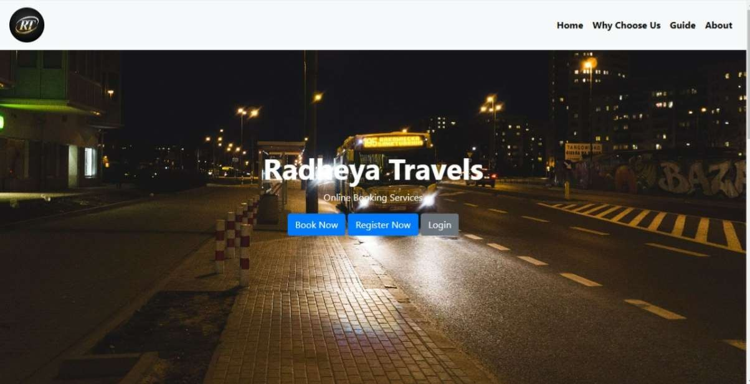
System Design:

Slide 7
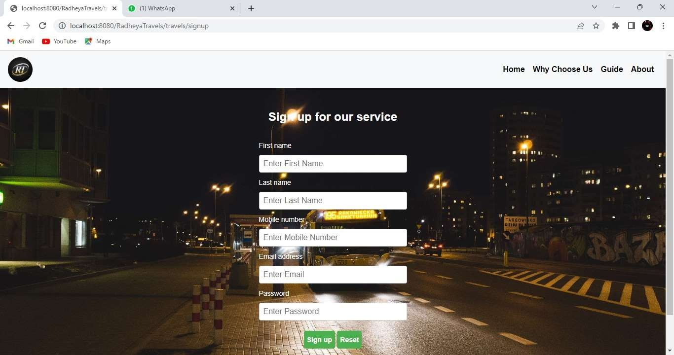

Slide 8
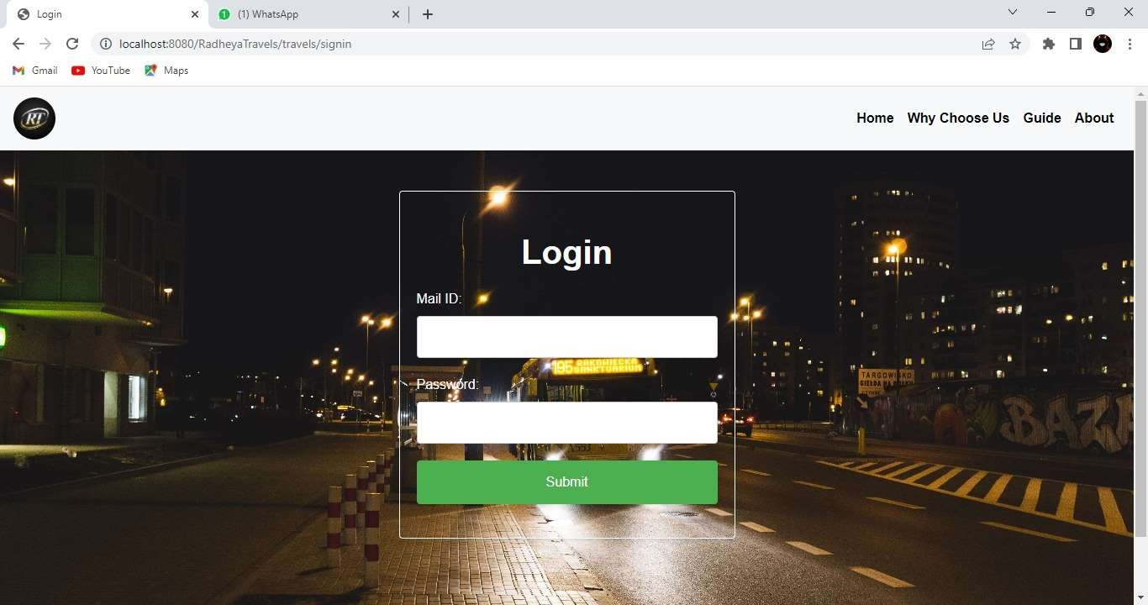

Slide 9
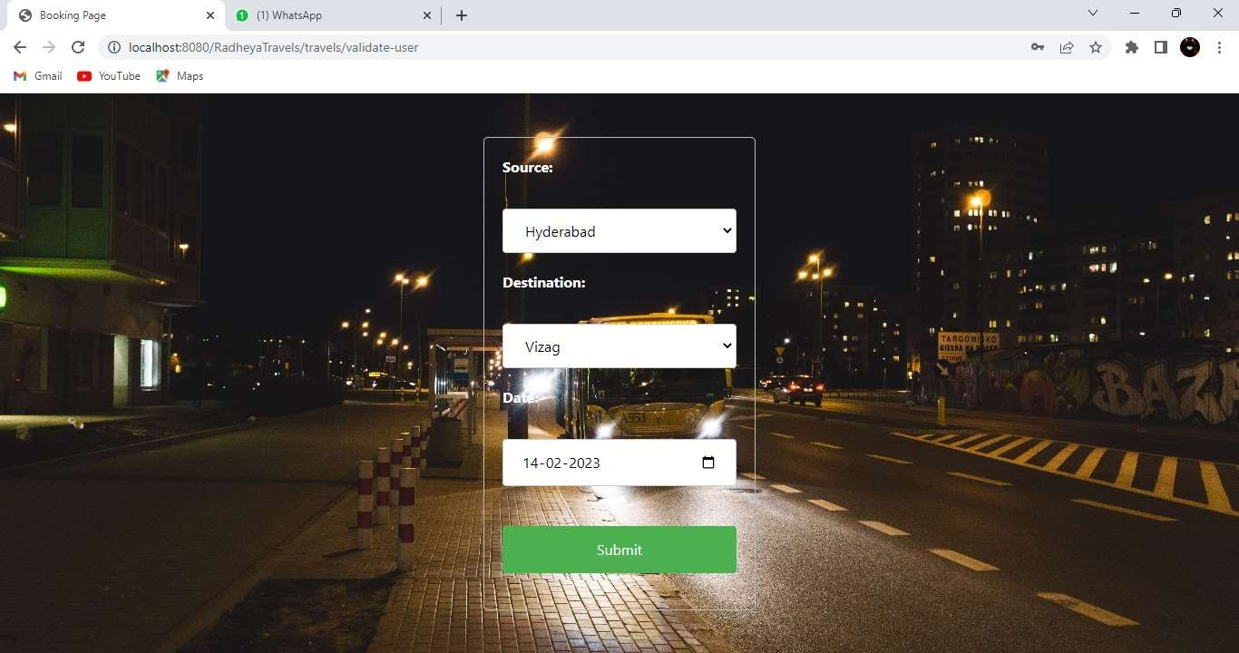

Slide 10
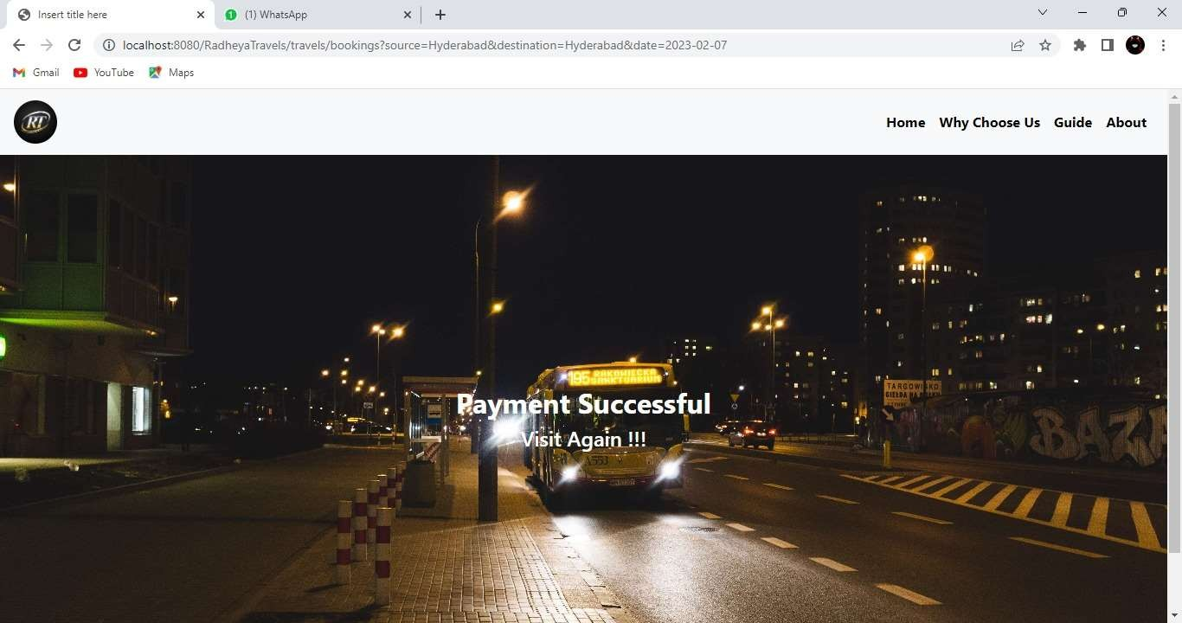

Slide 11
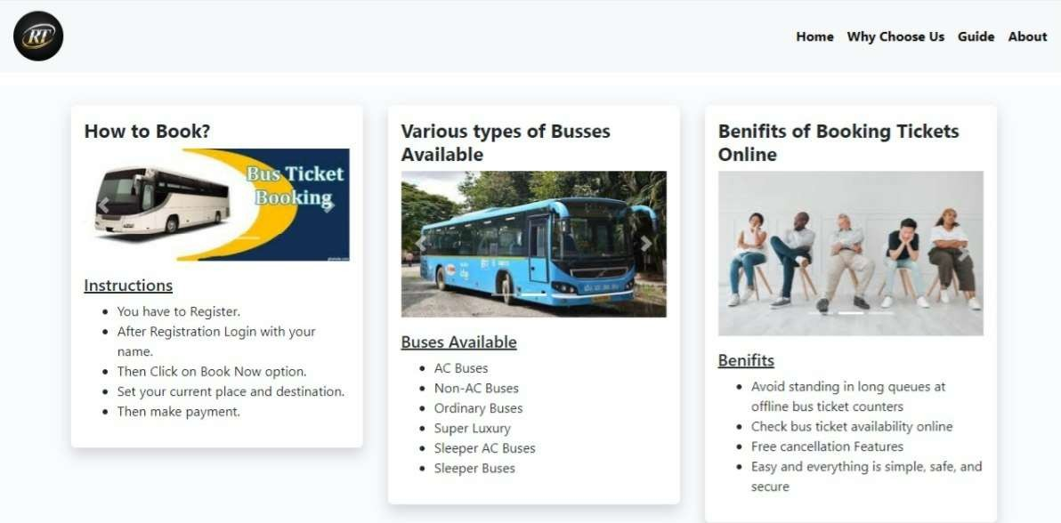

Slide 12
System Development Approach(Technology Used):
For Back end
1. Java web application
2. My SQL ( create tables)
3. Java source files
4. Hibernate : To encrypt the data which is stored in the tables and to retrieve
data I.e., update or delete user info, user mails, user passwords etc.
For Front end
1. Html
2. CSS
3. Bootstrap

Slide 13
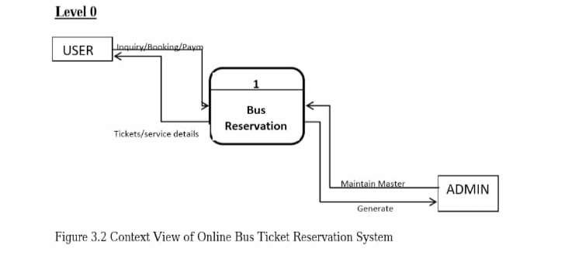
Algorithm:

Slide 14
Conclusion:
Online ticket booking system is an application where the customer can book a ticket online and 24*7 hours a day from anyplace in the world.
Customers can also interact with the ticket booking website to know any other details they want.
Online ticket booking system has been developed successfully. System performance is also found to be satisfactory. This is a user-friendly application. Through this application, the cost can be reduced and efficiency is increased.
There are several procedures that can be selected by customers. With the help of this application customers can book tickets, can know the status of a bus .
Source station and destination can be chosen according to their choice, can select seats, can choose the time, and pay through the portal after reaching the station or airport. Thus online ticket booking system target internal and external audiences.

Slide 15
References:
EASYTOBOOK.COM, 2014. EASY TO BOOK. [Online] Available at: http://www.easytobook.com/?amu=2599051302&utm_nooverride=1 [Accessed 5 December 2014].
Expedia AU, 2014. Expedia AU. [Online] Available at: http://www.expedia.com.au/Hotels [Accessed 19 October 2014].
Hotel Club, 2014. Hotel Club. [Online] Available at: http://www.hotelclub.com/Australia/ [Accessed 19 October 2014].
Hotels.com, n.d. Hotels.com. [Online] Available at: http://www.hotels.com/?PSRC=SEMB&rffrid=sem.hcom.E5.google.003.00.01.s.kwrd=ZzZz.sEaLM1M5C.0.51707353162.10200p829340.d.c&gclid=Cj0KEQjwq52iBRDEvrC12Jnz6coBEiQA2otXAqoAxb7bw_O4y4 24TF_O9XCDcDH_OB46NcdzA14QaAkz58P8HAQ [Accessed 20 October 2014].

Slide 16
Future Scope:
The reservation system has three modules. First module helps the customer to enquire the availability of seats in a particular bus at particular date, the second module helps him to reserve a ticket and with the third module he can cancel a reserved ticket. The current bus booking system relies on buying tickets from the conductor for commuting to and from a location through public transportation. The task can be tedious if the number of commuters is large.
payment in cash can be difficult if the payable denominations are uneven. Online Bus Booking system allows the commuter to either have a specific amount of money on his Android Based mobile, from which the ticket can be charged. Or, the costumer can buy the ticket on the bus

