Slide 1




NEXT GEN EMPLOYABILITY PROGRAM
Creating a future-ready workforce
Team Members
College Name
Student Name :
Maheswari.A
Student ID :au912421104019
SEC

Slide 2

CAPSTONE PROJECT SHOWCASE
Project Title
VOTING APPLICATION USING DJANGO FRAMEWORK
Abstract | Problem Statement | Project Overview | Proposed Solution | Technology Used | Modelling & Results | Conclusion

Slide 3
Abstract
Django is a high-level Python Web framework that encourages rapid development and clean, pragmatic design. Built by experienced developers, it takes care of much of the hassle of Web development, so you can focus on writing your app without needing to reinvent the wheel. It’s free and open source.
Source :

Slide 4
Problem Statement
The problem statement is your opportunity to explain why you care and what you propose to do in the way of researching the problem. A problem statement is an explanation in research that describes the issue that is in need of study. What problem is the research attempting to address?
Source :

Slide 5
Project Overview
A project overview is a detailed description of a project's goals and objectives, the steps to achieve these goals, and the expected outcomes. In addition, a project overview enables you to outline the project schedule, budget, necessary resources, and status.
Source :

Slide 6
Proposed Solution
.
A project overview is a detailed description of a project's goals and objectives, the steps to achieve these goals, and the expected outcomes. In addition, a project overview enables you to outline the project schedule, budget, necessary resources, and status.
Source :

Slide 7
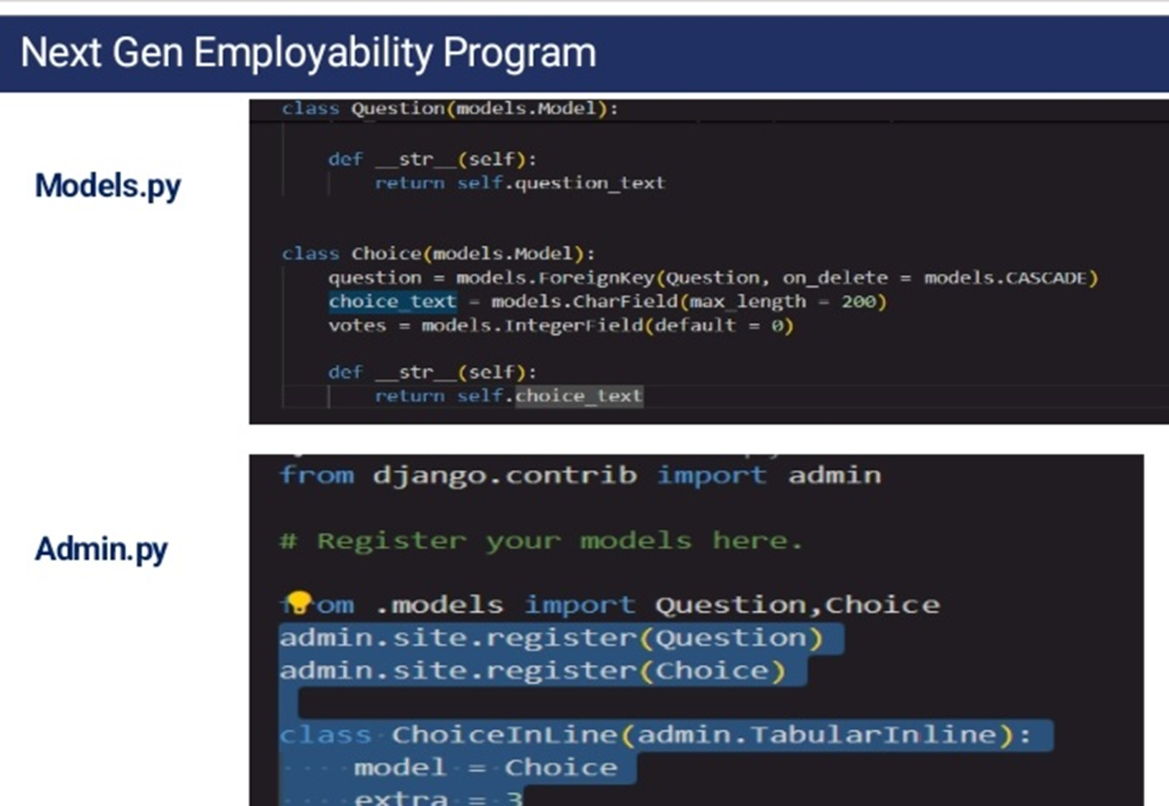
Source :

Slide 8
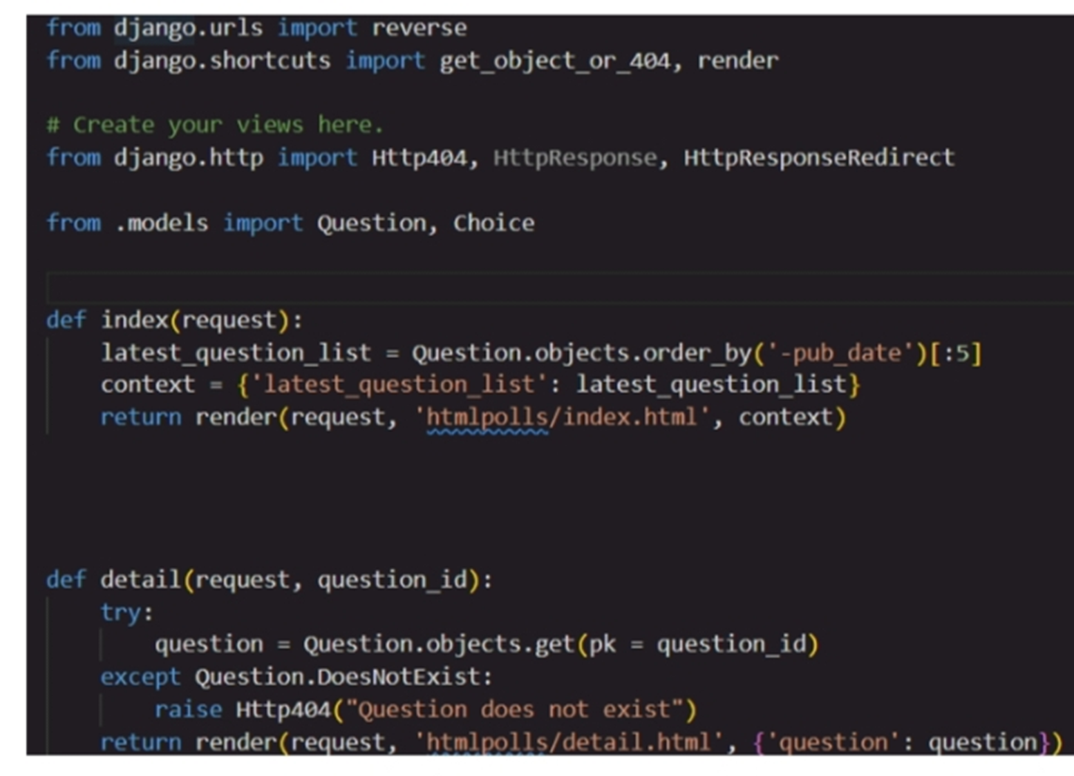

Source :

Slide 9


Technology Used
Front-end
Back-end
Source :

Slide 10
Modelling & Results
Modeling involves making a representation of something. Creating a tiny, functioning volcano is an example of modeling. Teachers use modeling when they have a class election that represents a larger one, like a presidential election.
A result is something that occurs as a consequence of some action. The result of your practical joke is a puddle of water on the floor and a lump on your cousin's head where the bucket hit him.
Source :

Slide 11

Homepage

Slide 12

About-Us-Page
A type of web page commonly seen on websites,containing general information about the person or organization that is responsible for the website in question, usually a description of the site's history and mission or purpose.

Slide 13
Service-Page
Service pages have commercial intent, unlike general webpages like a homepage, about page, or contact page. Most businesses should be able to split their different services into unique pages. Service pages define what you offer, what makes you unique, and why your business is best suited for the job

Slide 14
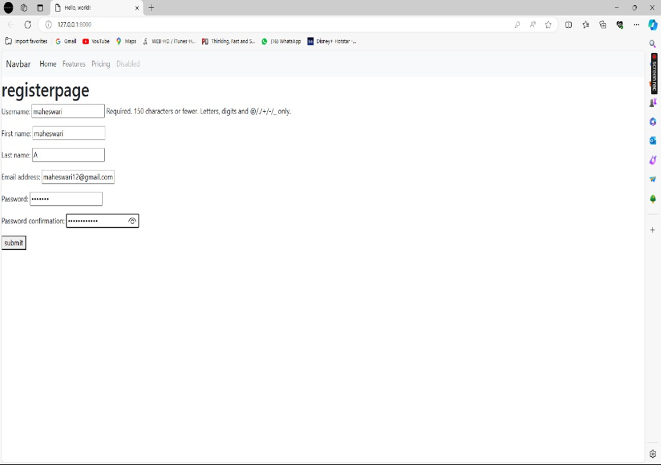
Login-Page

Slide 15
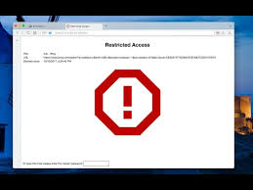
Blog-Page

Slide 16

Future Enhancements:
1 the time yet to come. 2 undetermined events that will occur in that time. 3 the condition of a person or thing at a later date. the future of the school is undecided. 4 likelihood of later improvement or advancement.

Slide 17
Conclusion
Django is a Python-based web application framework that is free and open source. A framework is simply a collection of modules that facilitate development. They're grouped together and allow you to build apps or websites from scratch rather than starting from scratch. Django
Source :

Slide 18
Thank You!
Notes:
Thank You !!

