Slide 1
Overfitting and Underfitting
Most.Kaniz Fatema Isha
Lecturer, CSE,
KUET

Slide 2
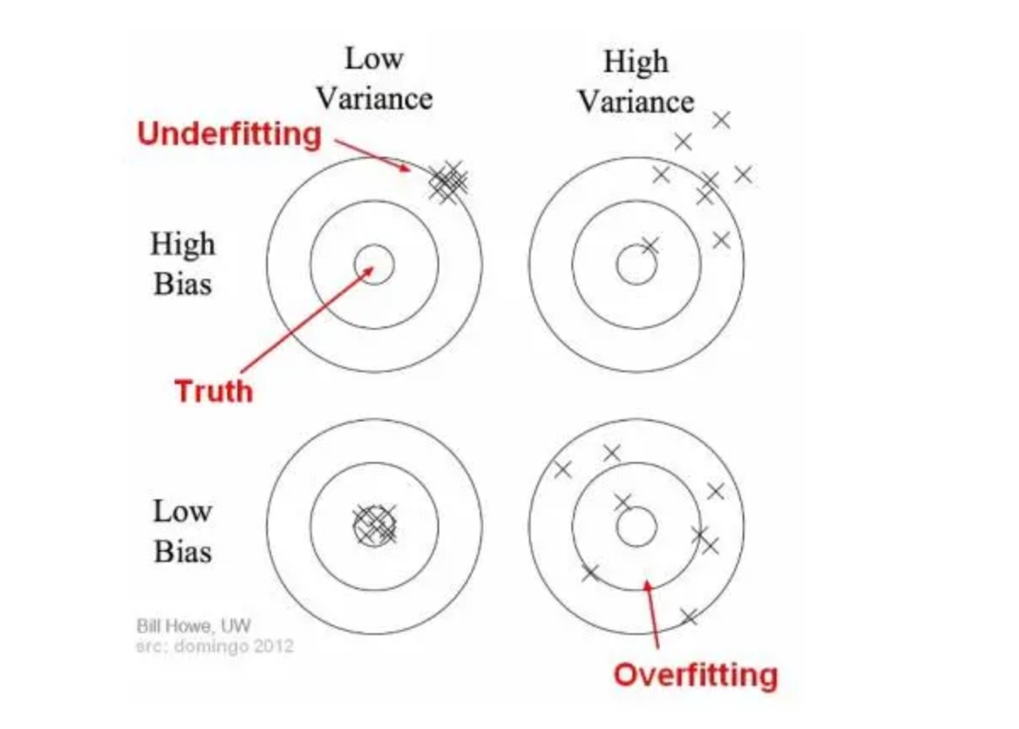
Bias and Variance

Slide 3
Underfitting (High Bias)
If the model is performing poorly over the train set, we call that an underfitting or high-bias model.We check on training data performance.
Symptoms:
Low accuracy on training data and test data.
To Fixes:
Try bigger network
Try getting additional features
Try adding polynomial features
Try different training layers + longer
Try different NN architecture
Better optimization algorithm (Momentum, RMSProp, Adam)

Slide 4
Overfitting (High Variance)
If the model is performing too well on the training set but performs worse over the testing set, we call overfitting or high-variance model.
Symptoms:
High accuracy on training data but poor performance on validation or test data.
To Fixes:
Try more data
Try regularization
Try dropout
Try early stopping etc

Slide 5
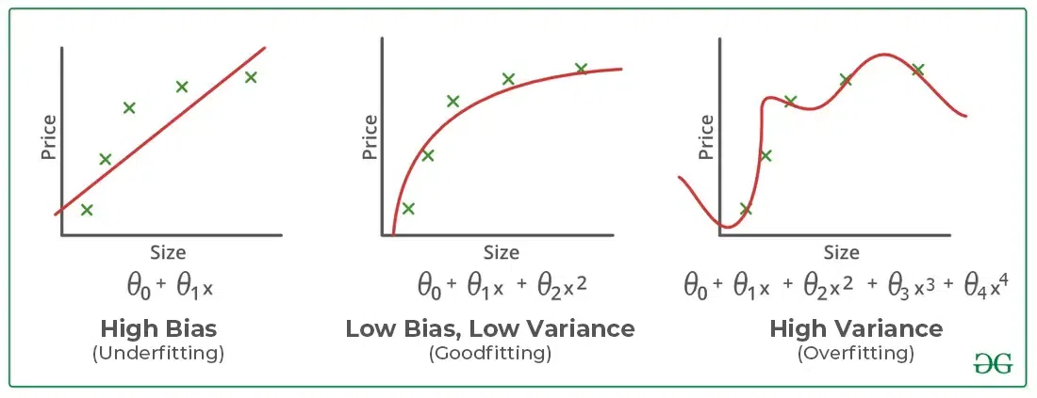

Slide 6
Reducing Network size
It means decreasing the number of layers or neurons in each layer (input and hidden)
We can reduce overfitting by changing the complexity of the network.
Reducing the capacity of the model reduces the likelihood of the model overfitting the training dataset, to a point where it no longer overfits.
We can directly reduce the model’s complexity by removing layers and reduce the size of our model.
We may further reduce complexity by decreasing the number of neurons in the fully-connected layers.

Slide 7
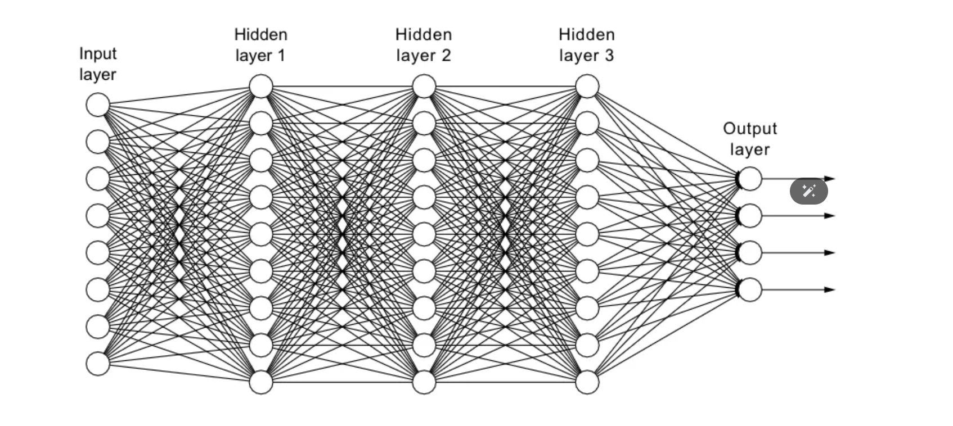
Reducing Network size

Slide 8
Dropout Regularization
This technique is used to prevent overfitting.
It randomly "drops out" a fraction of the neurons during training, which forces the model to learn more robust features.
During training, dropout randomly sets a fraction of the neurons weights to zero (i.e., "drops them out") at each iteration.
For each training batch, a random subset of neurons is selected to be dropped out based on dropout rate.
During the forward pass, only the neurons that are not dropped out are activated and contribute to the output. This creates a different "thinned" network for each training iteration.

Slide 9
Dropout Regularization
The backpropagation process only updates the weights of the neurons that were not dropped out, allowing the model to learn from various configurations.
This reduces the reliance on specific neurons and helps prevent memorization.

Slide 10
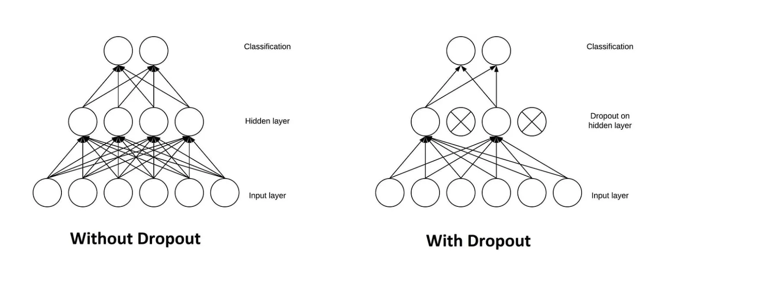
Dropout Regularization

Slide 11
Regularization Techniques
This technique reduces overfitting by adding extra information or adding a penalty to the cost function to push weight toward zero, discouraging overly complex models that fit the training data too closely.
There are 2 types of regularisation techniques that are widely used :
Lasso (L1) Regularization
Ridge (L2) Regularization

Slide 12
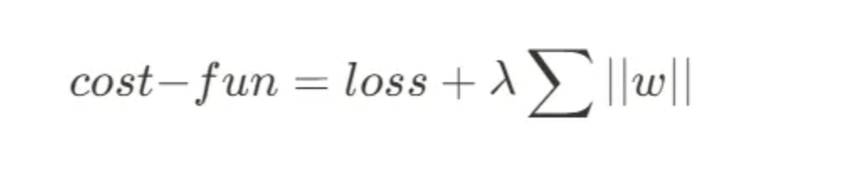
LASSO (L1) Regularization
It adds a penalty term proportional to the absolute values of weights.
As a result, it encourages sparse models, where some feature weights are reduced to zero, leading to feature selection.
The cost function becomes:

Slide 13
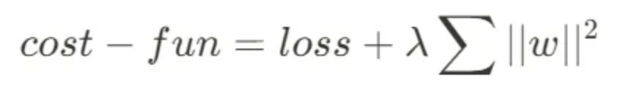
Ridge (L2) Regularization
It adds a penalty term proportional to the square values of weights.
As a result, it prevents the model from assigning too much importance to any one feature, discouraging overly complex models.
The cost function becomes:

Slide 14
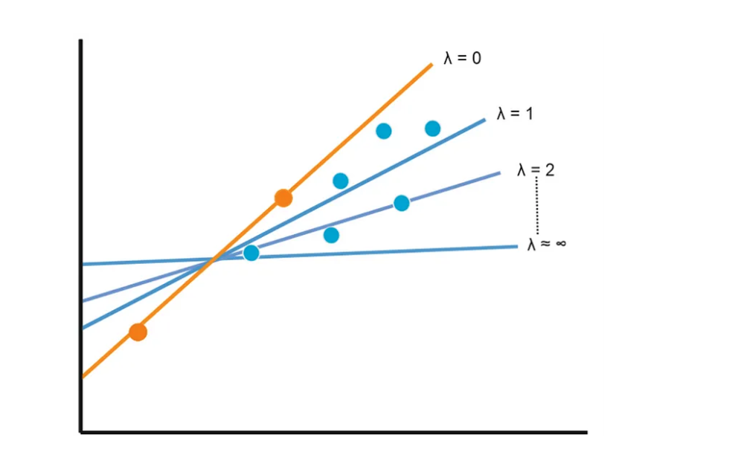
λ represents the strength of the regularization and is a hyperparameter chosen by the user.

Slide 15
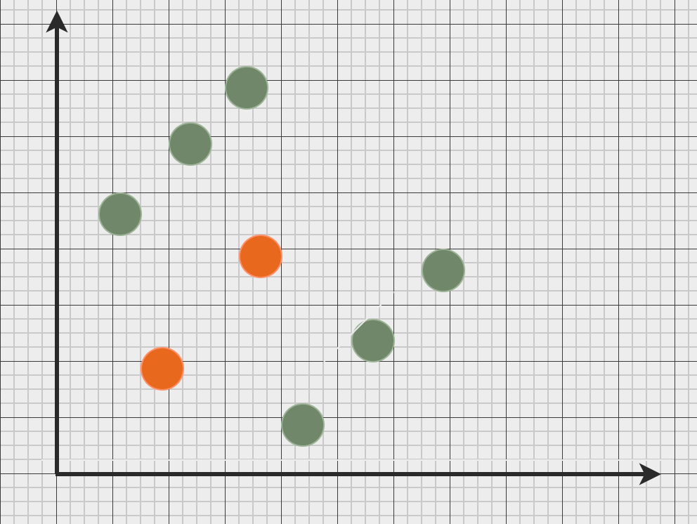

Slide 16
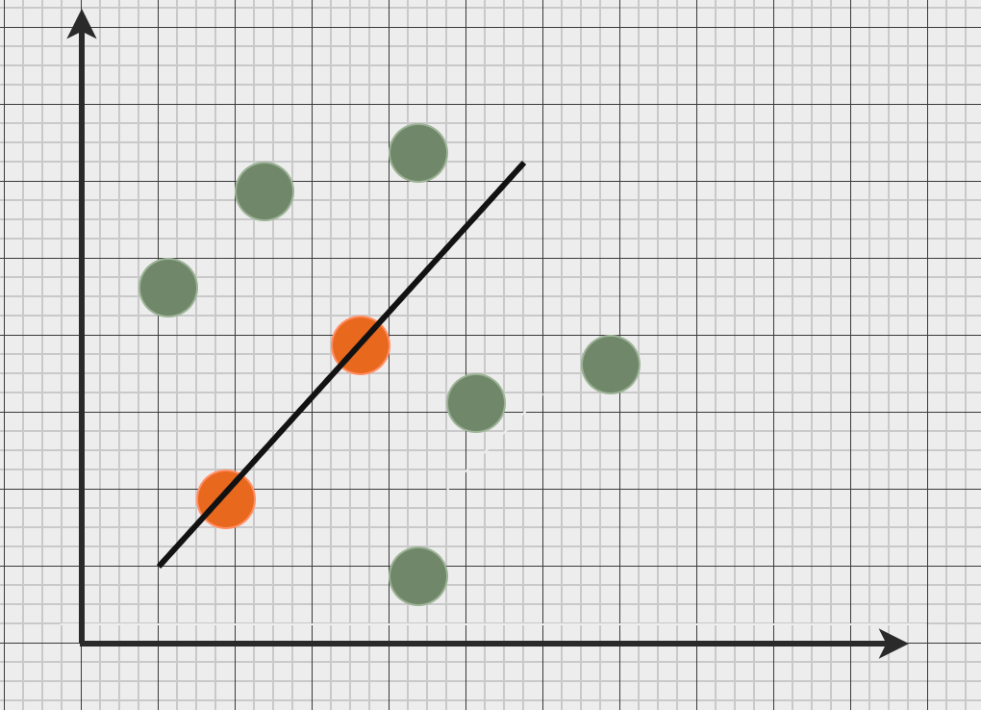

Slide 17
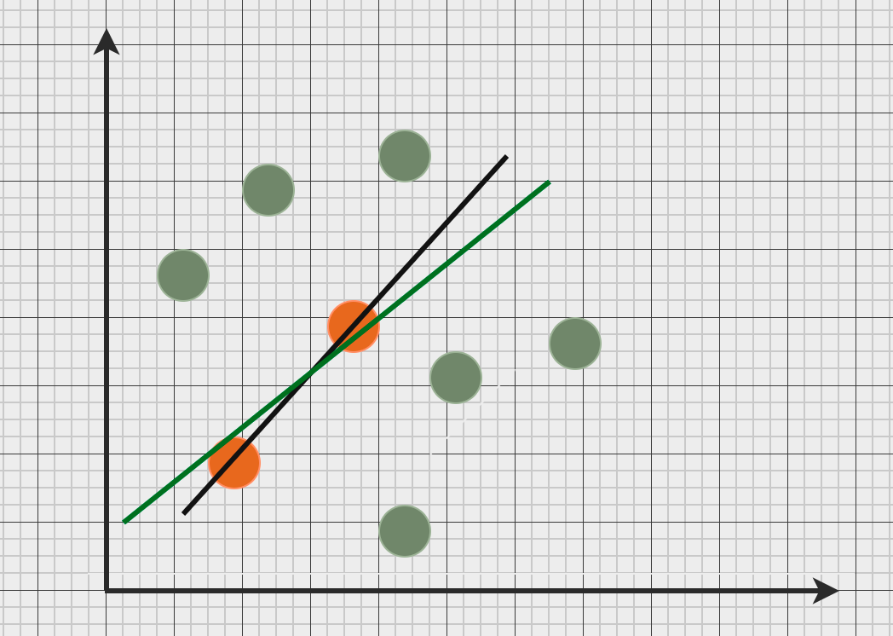

Slide 18
L1 VS L2 Regularization
Both these techniques are used to reduce overfitting of models by introducing a small bias that results in lowering the variance of the model.
However, L1 regularisation can shrink the weight values all the way to 0 thus allowing removing some unrelated features and less sensitive to outliers.
But L2 regularisation retain all weights, thus retaining all features, promoting a more evenly distributed weight. But this also increases its sensitivity towards outliers and noise data.

Slide 19
References
https://medium.com/@alejandro.itoaramendia/l1-and-l2-regularization-part-1-a-complete-guide-51cf45bb4ade
https://medium.com/@alejandro.itoaramendia/l1-and-l2-regularization-part-2-a-complete-guide-0b16b4ab79ce
https://machinelearningmastery.com/introduction-to-regularization-to-reduce-overfitting-and-improve-generalization-error/
https://medium.com/@fraidoonomarzai99/overfitting-and-underfitting-regularization-l1-l2-drop-out-early-stopping-and-data-6139aff3066e
https://www.geeksforgeeks.org/underfitting-and-overfitting-in-machine-learning/

