Slide 1
Dimensionality reduction
PCA, SVD

Slide 2
Why dimensionality reduction?
Some features may be irrelevant
We want to visualize high dimensional data
“Intrinsic” dimensionality may be smaller than the number of features

Slide 3
Supervised feature selection
Scoring features:
    Mutual information between attribute and class
    χ²: independence between attribute and class
    Classification accuracy
Domain specific criteria:
  E.g. Text:
    remove stop-words (and, a, the, …)
    Stemming (going → go, Tom’s → Tom, …)
    Document frequency

Slide 4
Choosing sets of features
Score each feature
Forward/Backward elimination
  Choose the feature with the highest/lowest score
  Re-score other features
  Repeat
If you have lots of features (like in text)
  Just select top K scored features

Slide 5
Unsupervised feature selection
Differs from feature selection in two ways:
  Instead of choosing subset of features,
  Create new features (dimensions) defined as functions over all features
  Don’t consider class labels, just the data points

Slide 6
Unsupervised feature selection
Idea:
  Given data points in d-dimensional space,
  Project into lower dimensional space while preserving as much information as possible
    E.g., find best planar approximation to 3D data
    E.g., find best planar approximation to 104D data
  In particular, choose projection that minimizes the squared error in reconstructing original data

Slide 7
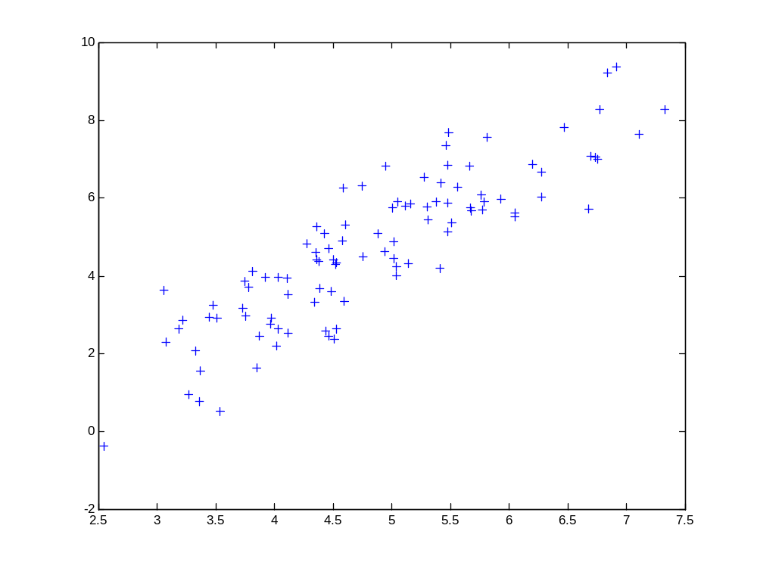
2d Data

Slide 8
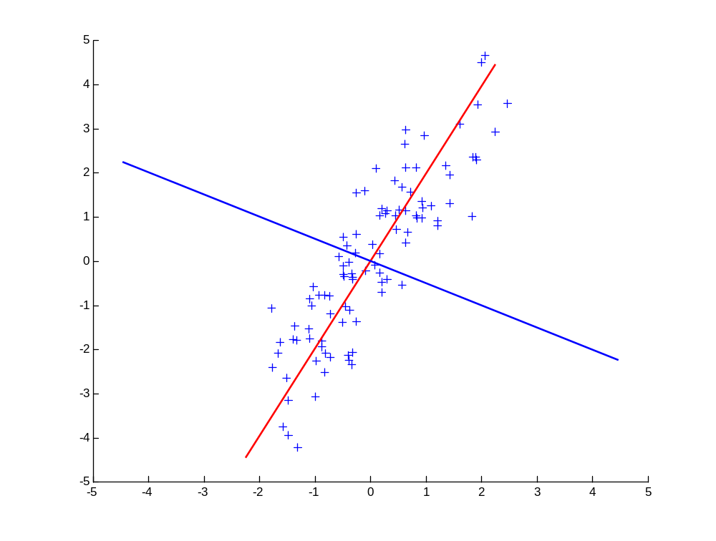
Principal Components
1st principal vector
Gives best axis to project
Minimum RMS error
Principal vectors are orthogonal
2nd principal vector

Slide 9
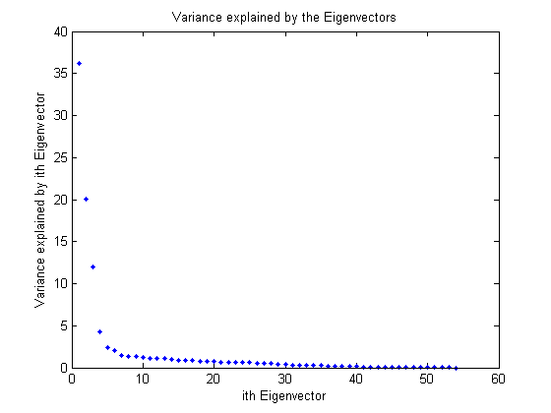
How many components?
Check the distribution of eigen-values
Take enough many eigen-vectors to cover 80-90% of the variance

Slide 10
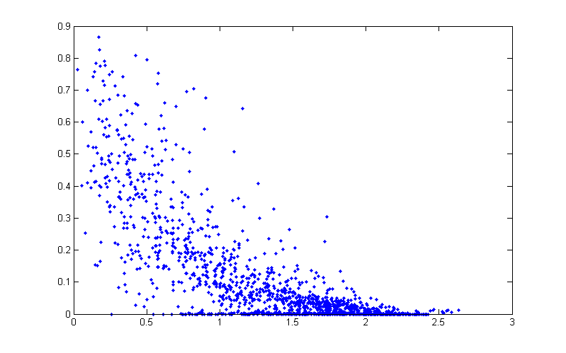
Pairwise link quality vs. distance
Link quality
Distance between a pair of sensors

Slide 11
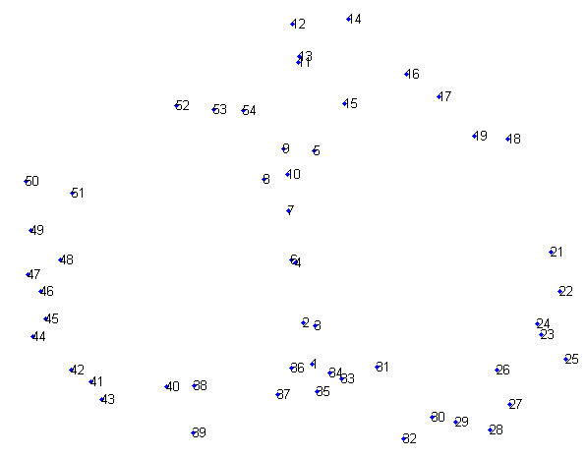
PCA in action
Given a 54x54 matrix of pairwise link qualities
Do PCA
Project down to 2 principal dimensions
PCA discovered the map of the lab

Slide 12
Principal Component Analysis (PCA)
Find a projection that captures the largest amount of variation in data
The original data are projected onto a much smaller space, resulting in dimensionality reduction. We find the eigenvectors of the covariance matrix, and these eigenvectors define the new space
x₂
e
x₁
Dr. Azhar, KUET

Slide 13
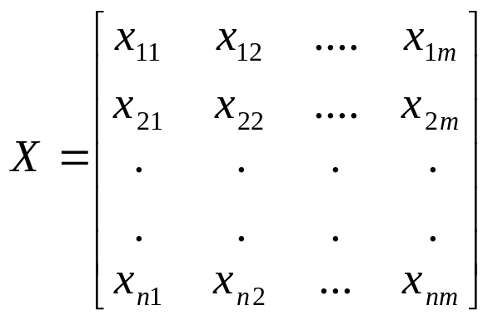
Principal Component Analysis (PCA)
Principal component analysis is typically used to reduce the dimensionality and/or to extract new uncorrelated features from the original data.
Principal component analysis involves an eigen analysis on a covariance matrix. If the input data is represented as a matrix X of ‘n’ rows and ‘m’ columns
Dr. Azhar, KUET

Slide 14
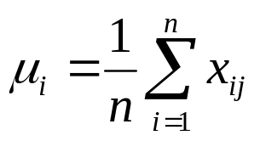
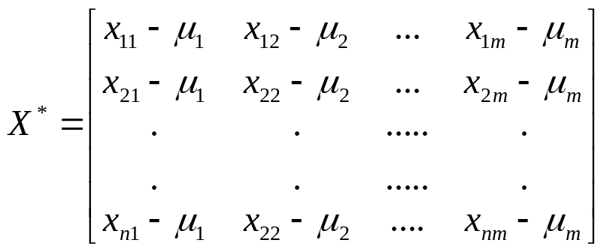
Principal Component Analysis (PCA)
Then, the sample mean μ_{i} is computed for each column, where
Then X can be centered to form X*
for j = 1,2…m.
Dr. Azhar, KUET

Slide 15
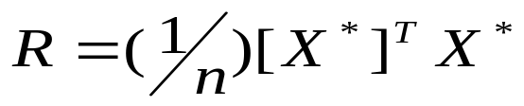



Principal Component Analysis (PCA)
Then covariance matrix is computed.
An eigen analysis on the covariance matrix yields a set of positive eigen values .
If the eigen values are sorted in descending order their corresponding eigen vectors, { }, are the principal components.
Dr. Azhar, KUET

Slide 16
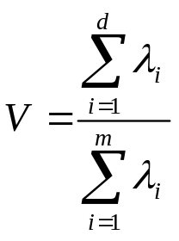
Principal Component Analysis (PCA)
The first principal component retains the most variance, if the feature vectors are projected onto the first principal component.
The second component retain retains the next highest residual variance, and so on
The first few components can retain nearly all of the variance.
If the ‘d’ most significant principal components are selected for projection of the data, then the variance (V) retained by this approximation is.
Dr. Azhar, KUET

Slide 17
Principal Component Analysis (Steps)
Given N data vectors from n-dimensions, find k ≤ n orthogonal vectors (principal components) that can be best used to represent data
  Normalize input data: Each attribute falls within the same range
  Compute k orthonormal (unit) vectors, i.e., principal components
  Each input data (vector) is a linear combination of the k principal component vectors
  The principal components are sorted in order of decreasing “significance” or strength
  Since the components are sorted, the size of the data can be reduced by eliminating the weak components, i.e., those with low variance (i.e., using the strongest principal components, it is possible to reconstruct a good approximation of the original data)
Works for numeric data only
Dr. Azhar, KUET

Slide 18
Problems and limitations
What if very large dimensional data?
  e.g., Images (d ≥ 10⁴)
Problem:
  Covariance matrix Σ is size (d²)
  d=10₄ → |Σ| = 10⁸
Singular Value Decomposition (SVD)!
  efficient algorithms available
  some implementations find just top N eigenvectors

Slide 19
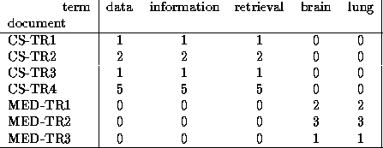
Singular Value Decomposition
Problem:
  #1: Find concepts in text
  #2: Reduce dimensionality

Slide 20
SVD - Definition
A_{[n x m]} = U_{[n x r]} Λ _{[ r x r]} (V_{[m x r]})^{T}
A: n x m matrix (e.g., n documents, m terms)
U: n x r matrix (n documents, r concepts)
Λ: r x r diagonal matrix (strength of each ‘concept’) (r: rank of the matrix)
V: m x r matrix (m terms, r concepts)

Slide 21
SVD - Properties
THEOREM [Press+92]: always possible to decompose matrix A into A = U Λ V^{T} , where
U, Λ, V: unique (*)
U, V: column orthonormal (ie., columns are unit vectors, orthogonal to each other)
  U^{T}U = I; V^{T}V = I (I: identity matrix)
Λ: singular value are positive, and sorted in decreasing order

Slide 22
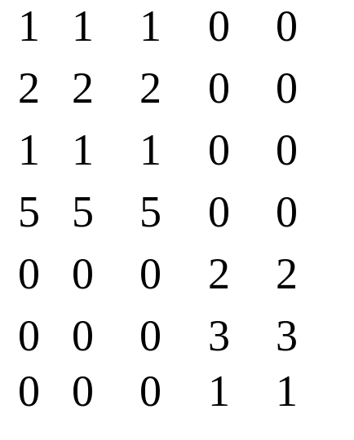
SVD - Properties
‘spectral decomposition’ of the matrix:
λ₁
=
u₁
u₂
x
x
λ₂
v₁
v₂

Slide 23
SVD - Interpretation
‘documents’, ‘terms’ and ‘concepts’:
U: document-to-concept similarity matrix
V: term-to-concept similarity matrix
Λ: its diagonal elements: ‘strength’ of each concept
Projection:
best axis to project on: (‘best’ = min sum of squares of projection errors)

Slide 24
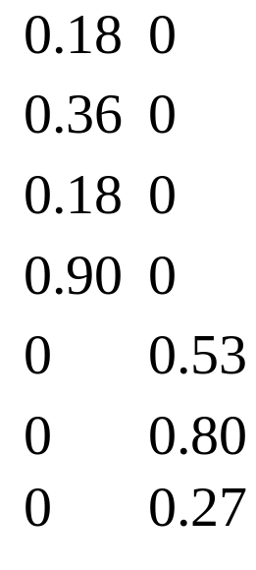
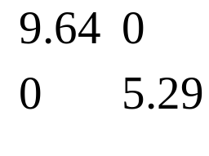
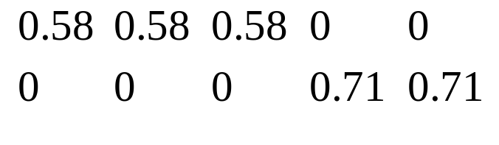
SVD - Example
A = U Λ V^{T} - example:
retrieval
inf.
lung
data
brain
CS
=
x
x
MD

Slide 25
SVD - Example
doc-to-concept
similarity matrix
A = U Λ V^{T} - example:
retrieval
CS-concept
inf.
lung
MD-concept
data
brain
CS
=
x
x
MD

Slide 26
SVD - Example
A = U Λ V^{T} - example:
retrieval
inf.
‘strength’ of CS-concept
lung
data
brain
CS
=
x
x
MD

Slide 27
SVD - Example
A = U Λ V^{T} - example:
term-to-concept
similarity matrix
retrieval
inf.
lung
data
brain
CS-concept
CS
=
x
x
MD

Slide 28
SVD – Dimensionality reduction
Q: how exactly is dim. reduction done?
A: set the smallest singular values to zero:
=
x
x

Slide 29
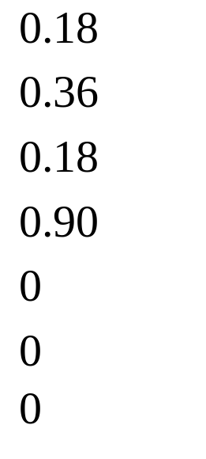
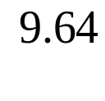
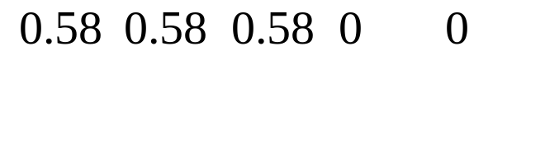
SVD - Dimensionality reduction
~
x
x

Slide 30
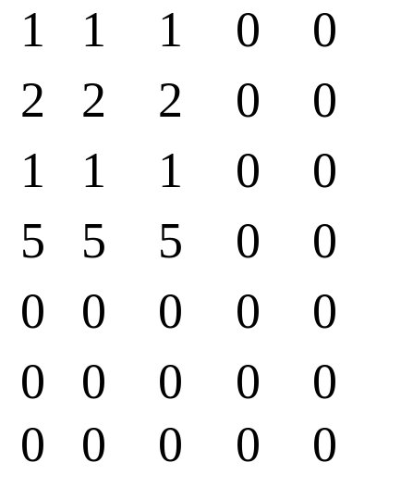
SVD - Dimensionality reduction
~

Slide 31
Acknowledgements
Some of the material is borrowed from lectures of Christos Faloutsos and Tom Mitchell

