Slide 1
Module B: AI and Machine Learning (Lecture:29-30) Text Classification and Naïve Bayes
Kazi Saeed Alam, Assistant Professor, Dept. of CSE, KUET
Email: saeed.alam@cse.kuet.ac.bd

Slide 2
Is this spam?

Slide 3


Positive or negative movie review?
unbelievably disappointing
Full of zany characters and richly applied satire, and some great plot twists
this is the greatest screwball comedy ever filmed
It was pathetic. The worst part about it was the boxing scenes.

Slide 4
What is the subject of this article?
MeSH Subject Category Hierarchy
MEDLINE Article
Antogonists and Inhibitors
Blood Supply
Chemistry
Drug Therapy
Embryology
Epidemiology
…
?

Slide 5
Text Classification
Assigning subject categories, topics, or genres
Spam detection
Authorship identification
Age/gender identification
Language Identification
Sentiment analysis
…

Slide 6
Text Classification: definition
Input:
a document d
a fixed set of classes C = {c₁, c₂,…, c_{k}}
Output: a predicted class c ∈ C

Slide 7
Classification Methods: Hand-coded rules
Rules based on combinations of words or other features
spam: black-list-address OR (“dollars” AND“ have been selected”)
Accuracy can be high
If rules carefully refined by expert
But building and maintaining these rules is expensive

Slide 8
Classification Methods: Supervised Machine Learning
Input:
a document d
a fixed set of classes C = {c₁, c₂,…, c_{J}}
A training set of m hand-labeled documents (d₁,c₁),....,(d_{m},c_{m})
Output:
a learned classifier γ:d → c

Slide 9
Generative vs Discriminative classifier
A probabilistic classifier additionally will tell us the probability of an observation being in the class C.
Two ways of doing classification.
Generative classifiers ( Ex. Naive Bayes)
build a model of each class.
given an observation, they return the class most likely to have generated the observation.
Discriminative classifiers ( EX. logistic regression)
learn what features from the input are most useful to discriminate between the different possible classes.

Slide 10
Classification Methods: Supervised Machine Learning
Any kind of classifier
Naïve Bayes
Logistic regression
Support-vector machines
k-Nearest Neighbors
…

Slide 11
Text Classification and Naïve Bayes

Slide 12
Naïve Bayes Intuition
Simple (“naïve”) classification method based on Bayes rule
Called multinomial naive Bayes classifier
because it is a Bayesian classifier that makes a simplifying (naive) assumption about how the features interact
Relies on very simple representation of document
Bag of words: an unordered set of words with their position ignored, keeping only their frequency in the document

Slide 13
The Bag of Words Representation

Slide 14
Bayes’ Rule Applied to Documents and Classes
Naive Bayes is a probabilistic classifier, meaning that for a document d, out of all classes c ∈C the classifier returns the class c_{MAP} which has the maximum posterior probability for the document.
For a document d and a class c

Slide 15
Naïve Bayes Classifier (I)
MAP is “maximum a posteriori” = most likely class
Bayes Rule
Dropping the denominator
P(d) doesn’t change for each class; we are always asking about the most likely class for the same document d, which must have the same probability P(d); hence P(d) is dropped.

Slide 16
Naïve Bayes Classifier (II)
Posterior probability = highest product of two probabilities: the prior probability of the class P(c) and the likelihood of the document P(d|c):
Document d represented as features f1,f2,…,fn
the probability of every possible combination of features (for example, every possible set of words and positions)

Slide 17
Multinomial Naïve Bayes Independence Assumptions
Naive Bayes classifiers therefore make two simplifying assumptions.
Bag of Words assumption: Assume position doesn’t matter.
Ex. the word “love” has the same effect on classification whether it occurs as the 1st, 20th, or last word in the document
Conditional Independence: Assume the feature probabilities P(x_{i}|c_{j}) are independent given the class c and can be multiplied.

Slide 18
Multinomial Naïve Bayes Classifier
The final equation for the class chosen by a naive Bayes classifier is thus:

Slide 19
Multinomial Naive Bayes Classifier
To apply the naive Bayes classifier to text, we need to consider word positions, by simply walking an index through every word position in the document
positions ← all word positions in test document

Slide 20
Naïve Bayes: Learning

Slide 21
Learning the Multinomial Naïve Bayes Model
How can we learn the probabilities P(c) and P( fi/c)?
first consider the maximum likelihood estimate.
use the frequencies in the data.
For the document prior P(c)
we ask what percentage of the documents in our training set are in each class c.
Let N_{c} be the number of documents in our training data with class c and N_{doc} be the total number of documents.

Slide 22
Learning the Multinomial Naïve Bayes Model
Sec.13.3
To learn the probability P( fi/c), we’ll assume a feature is just the existence of a word in the document’s bag of words
P(wi/c), which we compute as the fraction of times the word w_{i} appears among all words in all documents of topic c.
We first concatenate all documents with category c into one big “category c” text.

Slide 23
Learning the Multinomial Naïve Bayes Model
Then we use the frequency of w_{i} in this concatenated document to give a maximum likelihood estimate of the probability:
Here the vocabulary V consists of the union of all the word types in all classes, not just the words in one class c.

Slide 24
Parameter estimation
fraction of times word w_{i} appears
among all words in documents of topic c_{j}

Slide 25
Problem with Maximum Likelihood
Sec.13.3
What if we have seen no training documents with the word fantastic and classified in the topic positive (thumbs-up)?
since naive Bayes naively multiplies all the feature likelihoods together.
Zero probabilities cannot be conditioned away, no matter the other evidence!

Slide 26
Laplace (add-1) smoothing for Naïve Bayes
The simplest solution is the add-one (Laplace) smoothing

Slide 27
unknown words
What do we do about words that occur in our test data but are not in our vocabulary at all because they did not occur in any training document in any class?
standard solution for such unknown words is to ignore such words—remove them from the test document and not include any probability for them at all.

Slide 28
Stop words
Some systems choose to completely ignore another class of words: stop words, very frequent words like the and a.
Sort the vocabulary by frequency in the training set, and defining the top 10–100 vocabulary entries as stop words, or alternatively by using one of the many pre-defined stop word list
Every instance of stop words are removed from both training and test documents as if they had never occurred.
using a stop word list doesn’t improve performance,
Common to make use of the entire vocabulary and not use a stop word list.

Slide 29
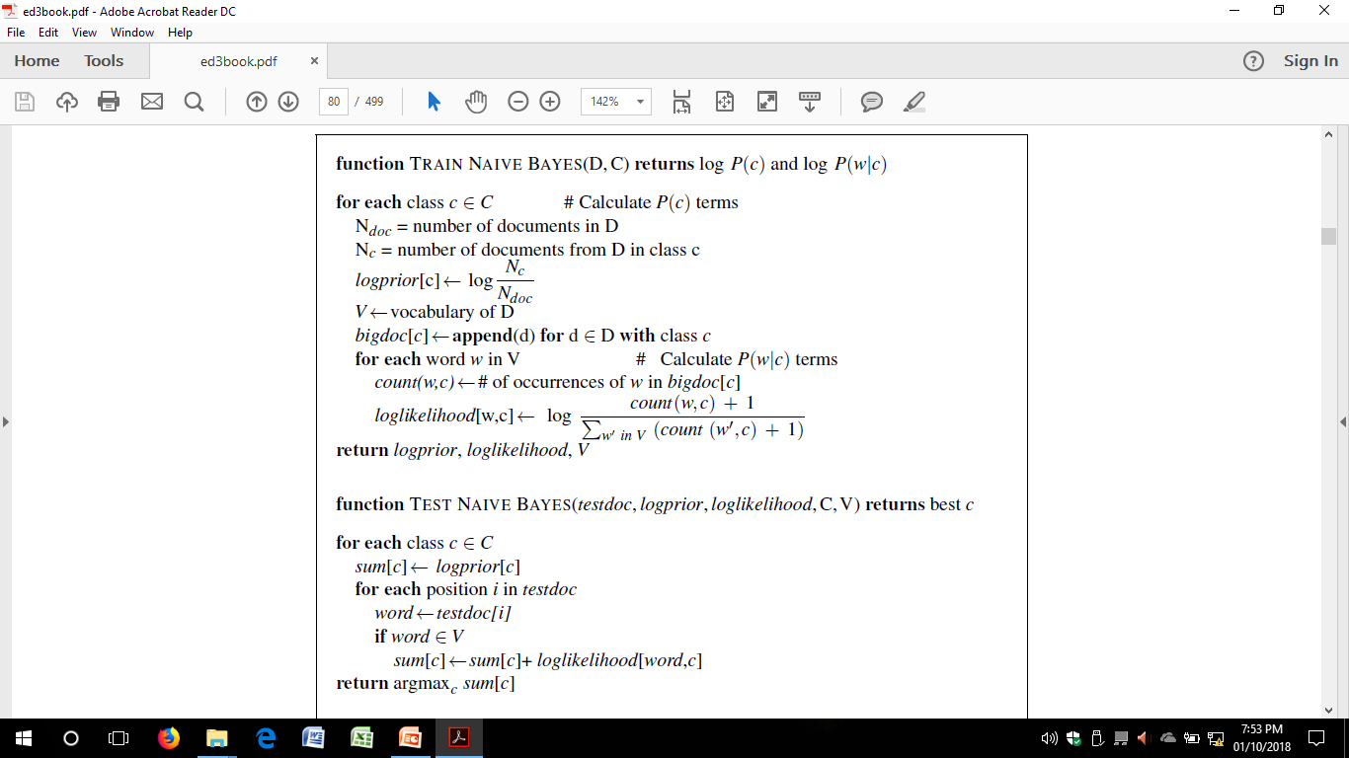
Multinomial Naïve Bayes: Algorithms

Slide 30
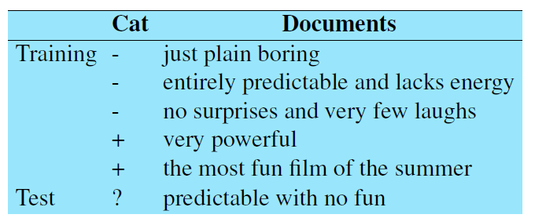
Multinomial Naïve Bayes: A Worked Example
The prior P(c) for the two classes is computed via

Slide 31
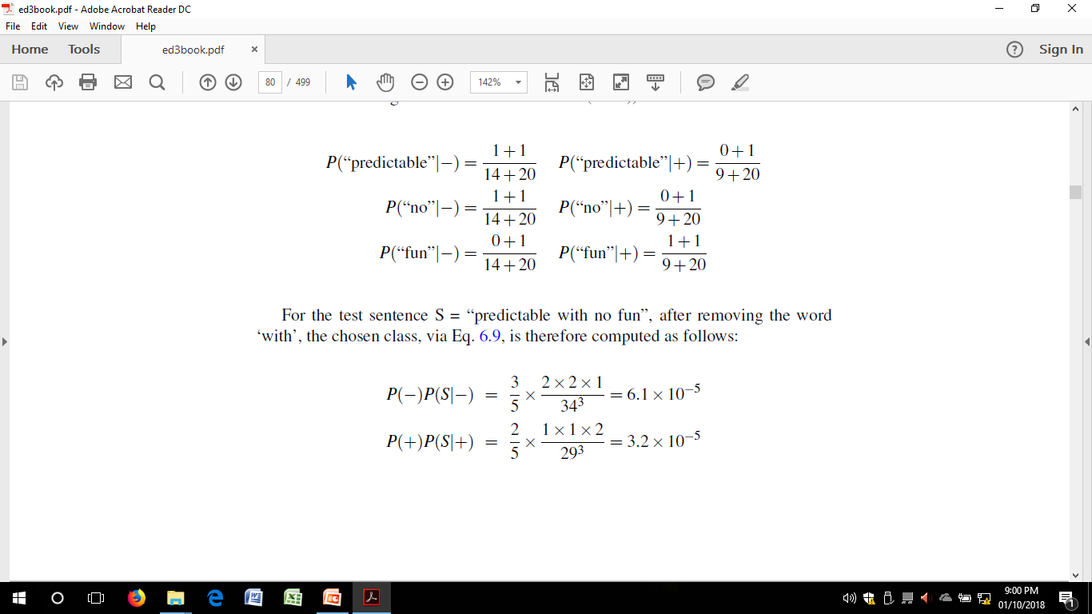
Worked Example
The word ‘with’ doesn’t occur in the training set, so we drop it completely
The likelihoods from the training set for the remaining three words “predictable”, “no”, and “fun”, are as

Slide 32
Worked Example
For the test sentence S = “predictable with no fun”, after removing the word ‘with’, the chosen class
The model thus predicts the class negative for the test sentence.

Slide 33
Another Example
 | Doc | Words | Class
Training | 1 | Chinese Beijing Chinese | c
 | 2 | Chinese Chinese Shanghai | c
 | 3 | Chinese Macao | c
 | 4 | Tokyo Japan Chinese | j
Test | 5 | Chinese Chinese Chinese Tokyo Japan | ?
Priors:
P(c)=
P(j)=
3
4
1
4
Conditional Probabilities:
P(Chinese|c) =
P(Tokyo|c) =
P(Japan|c) =
P(Chinese|j) =
P(Tokyo|j) =
P(Japan|j) =
Choosing a class:
P(c|d5)
P(j|d5)
(5+1) / (8+6) = 6/14 = 3/7
3/4 * (3/7)³ * 1/14 * 1/14
≈ 0.0003
(0+1) / (8+6) = 1/14
(0+1) / (8+6) = 1/14
(1+1) / (3+6) = 2/9
(1+1) / (3+6) = 2/9
1/4 * (2/9)³ * 2/9 * 2/9
≈ 0.0001
(1+1) / (3+6) = 2/9

Slide 34
Deal with negation
Consider the difference between I really like this movie (positive) and I didn’t like this movie (negative).
The negation expressed by didn’t completely alters the inferences we draw from the predicate like
Similarly, negation can modify a negative word to produce a positive review (don’t dismiss this film, doesn’t let us get bored)
prepend the prefix NOT to every word after a token of logical negation (n’t, not, no, never) until the next punctuation mark
“didn't like this movie , but I” => “didn't NOT_like NOT_this NOT_movie , but I”

Slide 35
Precision, Recall, and the F measure
Text Classification: Evaluation

Slide 36
Text Classification: Evaluation
We also need to know whether an email (in spam detection ) is actually spam or not, i.e the human-defined labels for each document that we are trying to match.
We will refer to these human labels as the gold labels.
we need a metric for knowing how well our spam detector is doing.
To evaluate any system for detecting things, we start by building a contingency table

Slide 37
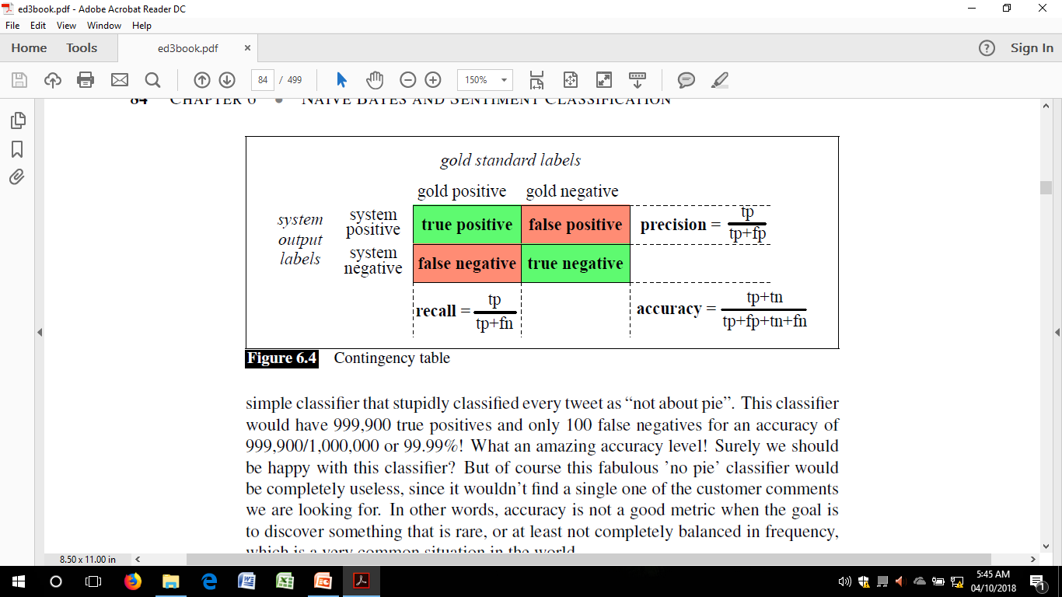
Contigency table

Slide 38
The 2-by-2 contingency table
 | correct | not correct
selected | tp | fp
not selected | fn | tn

Slide 39
Accuracy
Accuracy, which asks what percentage of all the observations our system labeled correctly.
Although accuracy might seem a natural metric, we generally don’t use it.
Accuracy is not a good metric when the goal is to discover something that is rare,
or at least not completely balanced in frequency, which is a very common situation in the world.

Slide 40
Precision and recall
Precision: % of selected items that are correct
Precision P = tp/(tp + fp)
Recall: % of correct items that are selected
Recall R = tp/(tp + fn)
there is typically a trade-off between precision and recall
to get high precision, be very reluctant to make guesses – but then you may have poor recall
to get high recall, be very promiscuous in making guesses – but then you may have poor precision
 | correct | not correct
selected | tp | fp
not selected | fn | tn

Slide 41
A combined measure: F
A combined measure (weighted harmonic mean between precision and recall) that assesses the P/R tradeoff is F measure :
The harmonic mean is a very conservative average;
People usually use balanced F1 measure
i.e., with β = 1 (that is, α = ½): F = 2PR/(P+R)
if P and R are far apart, F tends to be near lower value in order to do well on F1, need to do well on BOTH P and R
can't beat the system by being either too reluctant or too promiscuous

Slide 42
More Than Two Classes
Sec.14.5
Dealing with any-of or multivalued classification
A document can belong to 0, 1, or >1 classes.
For each class c∈C
Build a classifier γ_{c} to distinguish c from all other classes c’ ∈C
Given test doc d,
Evaluate it for membership in each class using each γ_{c}
d belongs to any class for which γ_{c} returns true

Slide 43
More Than Two Classes: Sets of binary classifiers
Sec.14.5
One-of or multinomial classification
Classes are mutually exclusive: each document in exactly one class
For each class c∈C
Build a classifier γ_{c} to distinguish c from all other classes c’ ∈C
Given test doc d,
Evaluate it for membership in each class using each γ_{c}
d belongs to the one class with maximum score

Slide 44
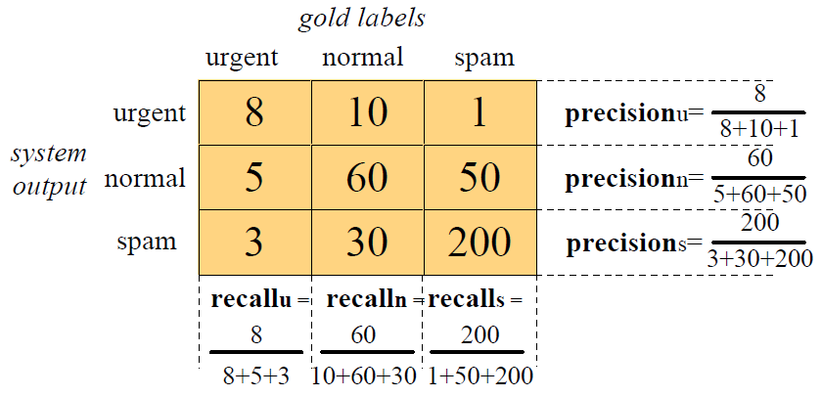
Confusion matrix
For each pair of classes <c₁,c₂> how many documents from c₁ were incorrectly assigned to c₂?

Slide 45
Micro- vs. Macro-Averaging
Sec. 15.2.4
In order to derive a single metric that tells us how well the system is doing, we can combine these values in two ways.
Macroaveraging: Compute performance for each class, then average.
Microaveraging: Collect decisions for all classes, compute contingency table, evaluate.

Slide 46
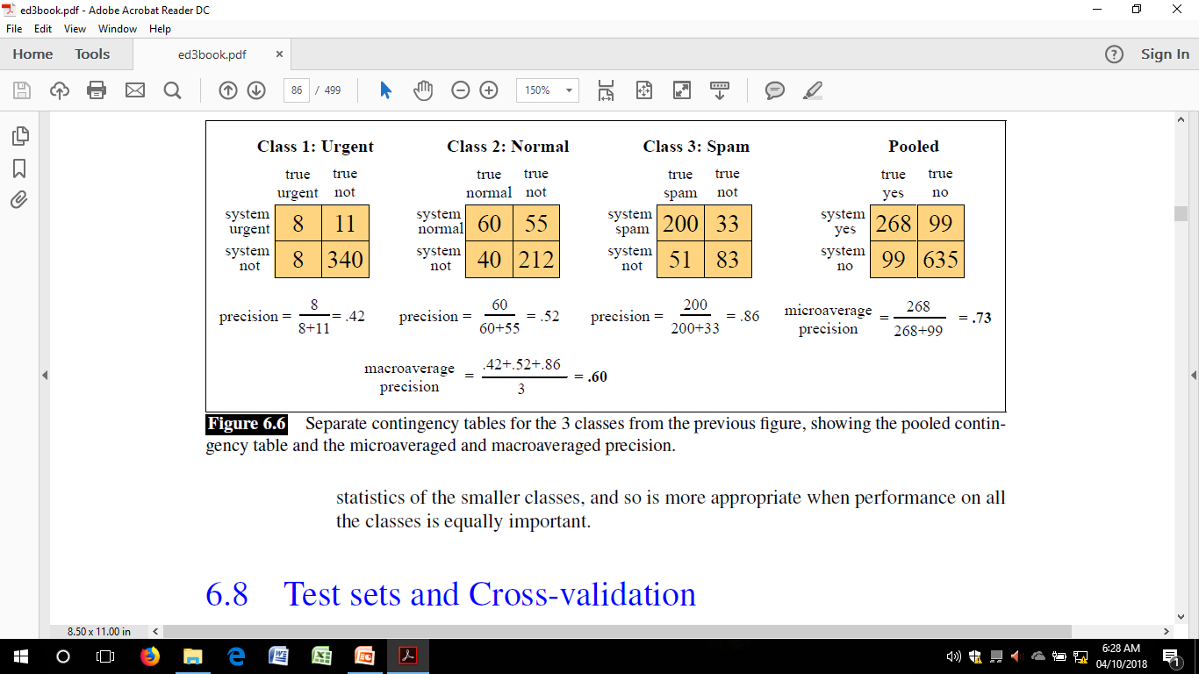
Micro- vs. Macro-Averaging
Microaverage is dominated by the more frequent class
Macroaverage better reflects the statistics of the smaller classes, and so is more appropriate when performance on all the classes is equally important

Slide 47
THANK YOU

