Slide 1
Data Preprocessing
CSE 4239 Data Mining
Specials thanks to
Dr. Azhar sir, KUET
<number>
Notes:
38

Slide 2
Data Preprocessing
Data Preprocessing: Overview
1

Slide 3
Data Preprocessing
How can the data be processed to improve the quality of mining results?
How can the data be processed to improve the efficiency and ease of mining process?

Slide 4
Data Quality: Why Preprocess the Data?
Measures for data quality: A multidimensional view
Accuracy: correct or wrong, accurate or not
Completeness: not recorded, unavailable, …
Consistency: some modified but some not, dangling, …
Timeliness: timely update?
Believability: how trustable the data are correct?
Interpretability: how easily the data can be understood?

Slide 5
Major Tasks in Data Preprocessing
Data cleaning
Fill in missing values, smooth noisy data, identify or remove outliers, and resolve inconsistencies
Data integration
Integration of multiple databases, data cubes, or files
Data reduction
Dimensionality reduction
Numerosity reduction
Data compression
Data transformation and data discretization
Normalization
Concept hierarchy generation

Slide 6
Data Preprocessing
Data Cleaning
5

Slide 7
Data Cleaning
Data in the Real World Is Dirty: Lots of potentially incorrect data, e.g., instrument faulty, human or computer error, transmission error
incomplete: lacking attribute values, lacking certain attributes of interest, or containing only aggregate data
e.g., Occupation = “ ” (missing data)
noisy: containing noise, errors, or outliers
e.g., Salary = “−10” (an error)
inconsistent: containing discrepancies in codes or names, e.g.,
Age = “42”, Birthday = “03/07/2010”
Was rating “1, 2, 3”, now rating “A, B, C”
discrepancy between duplicate records
Intentional (e.g., disguised missing data)
Jan. 1 as everyone’s birthday?

Slide 8
Incomplete (Missing) Data
Data is not always available
E.g., many tuples have no recorded value for several attributes, such as customer income in sales data
Missing data may be due to
equipment malfunction
inconsistent with other recorded data and thus deleted
data not entered due to misunderstanding
certain data may not be considered important at the time of entry
not register history or changes of the data
Missing data may need to be inferred

Slide 9
How to Handle Missing Data?
Ignore the tuple: usually done when class label is missing (when doing classification)—not effective when the % of missing values per attribute varies considerably
Fill in the missing value manually: tedious + infeasible?
Fill in it automatically with
a global constant : e.g., “unknown”, a new class?!
the attribute mean
the attribute mean for all samples belonging to the same class: smarter
the most probable value: inference-based such as Bayesian formula or decision tree

Slide 10
Noisy Data
Noise: random error or variance in a measured variable
Other data problems which require data cleaning
duplicate records
incomplete data
inconsistent data
Notes:
38

Slide 11
How to Handle Noisy Data?
Binning
first sort data and partition into (equal-frequency) bins
then one can smooth by bin means, smooth by bin median, smooth by bin boundaries, etc.
Regression
smooth by fitting the data into regression functions
Clustering
detect and remove outliers
Combined computer and human inspection
detect suspicious values and check by human (e.g., deal with possible outliers)
Notes:
Enrich using data integration research!!

Slide 12
Data Cleaning as a Process
Data discrepancy detection
Use metadata (e.g., domain, range, dependency, distribution)
Check field overloading
Check uniqueness rule, consecutive rule and null rule
Use commercial tools
Data scrubbing: use simple domain knowledge (e.g., postal code, spell-check) to detect errors and make corrections
Data auditing: by analyzing data to discover rules and relationship to detect violators (e.g., correlation and clustering to find outliers)

Slide 13
Data Cleaning as a Process
Data migration and integration
Data migration tools: allow transformations to be specified
ETL (Extraction/Transformation/Loading) tools: allow users to specify transformations through a graphical user interface
Integration of the two processes
Iterative and interactive (e.g., Potter’s Wheels)

Slide 14
Data Preprocessing
Data Integration
9

Slide 15
Data Integration
Data integration:
Combines data from multiple sources into a coherent store
Coherent store is commonly termed data warehouse
Sources may be multiple database, data cube and flat files
Entity identification problem:
How can the equivalent entities of multiple data sources be matched up?
Identify real world entities from multiple data sources, e.g., Bill Clinton = William Clinton Schema integration: e.g., A.cust-id ≡ B.cust-#
Integrate metadata from different sources
Ensure the functional dependency and referential constraints in the target system.
15
Notes:
Should ask students to do some survey on data integration. -JH

Slide 16
Data Integration
Detecting and resolving data value conflicts
For the same real world entity, attribute values from different sources are different
Possible reasons: different representations, different scales, e.g., metric vs. British units

Slide 17
Handling Redundancy in Data Integration
Redundant data occur often when integration of multiple databases
Object identification: The same attribute or object may have different names in different databases
Derivable data: One attribute may be a “derived” attribute in another table, e.g., annual revenue
Redundant attributes may be able to be detected by correlation analysis and covariance analysis
Careful integration of the data from multiple sources may help to reduce/avoid redundancies and inconsistencies and improve mining speed and quality

Slide 18
Correlation Analysis
Redundancies can be detected by Correlation Analysis
Given two attributes (A, B)
Measures how strongly one attribute implies the other based on the available data.
For nominal Data use Χ² (chi-square) test
For numeric data use co relation co efficient and covariance

Slide 19
Correlation Analysis (Nominal Data)
Χ² (chi-square) test: a₁,a₂,…,a_{c} for attribute A and b₁,b₂,…,b_{r} for attribute B
O_{ij} observed (actual) frequency and e_{ij} expected frequency
(r-1)*(c-1) degree of freedom
If the hypothesis is rejected then A and B are correlated.

Slide 20
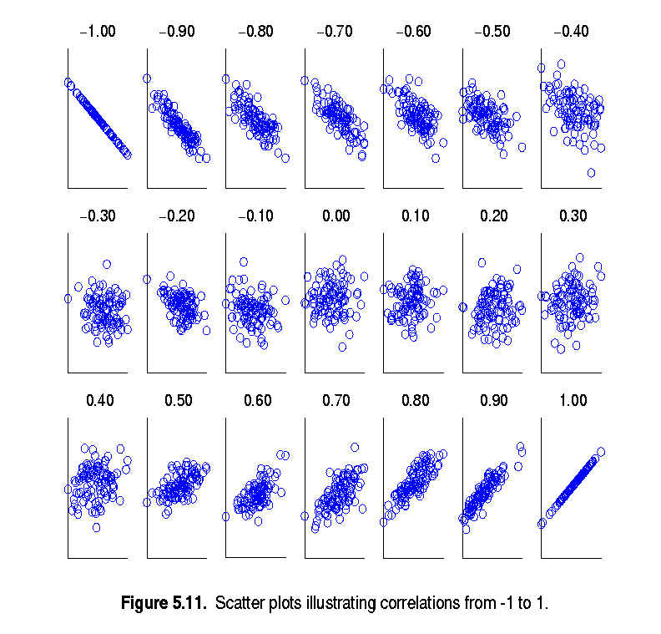
Visually Evaluating Correlation
Scatter plots showing the similarity from –1 to 1.

Slide 21
Data Preprocessing
Data Reduction
Notes:
38

Slide 22
Data Reduction Strategies
Data reduction: Obtain a reduced representation of the data set that is much smaller in volume but yet produces the same (or almost the same) analytical results
Why data reduction? — A database/data warehouse may store terabytes of data. Complex data analysis may take a very long time to run on the complete data set.
Notes:
MK 09/09/05: Wiki has dimensionality reduction as feature extraction (PCA) and feature subset selection. It states both wavelet transforms and PCA as forms of data compression. It does not have any pages for "numerosity reduction". We claim there are many different ways to organize data reduction strategies, which is true, so this presentation below should be OK. Let’s discuss.

Slide 23
Data Reduction Strategies
Data reduction strategies
Dimensionality reduction, e.g., remove unimportant attributes
Wavelet transforms
Principal Components Analysis (PCA)
Feature subset selection, feature creation
Numerosity reduction (some simply call it: Data Reduction)
Regression and Log-Linear Models
Histograms, clustering, sampling
Data cube aggregation
Data compression
Lossy and lossless

Slide 24
Data Reduction (1): Dimensionality Reduction
Curse of dimensionality
When dimensionality increases, data becomes increasingly sparse
Density and distance between points, which is critical to clustering, outlier analysis, becomes less meaningful
The possible combinations of subspaces will grow exponentially
Dimensionality reduction
Avoid the curse of dimensionality
Help eliminate irrelevant features and reduce noise
Reduce time and space required in data mining
Allow easier visualization
Dimensionality reduction techniques
Wavelet transforms
Principal Component Analysis
Supervised and nonlinear techniques (e.g., feature selection)
Notes:
38
JH: put SVD at clustering high-D reduction.

Slide 25
Principal Component Analysis (PCA)
Find a projection that captures the largest amount of variation in data
The original data are projected onto a much smaller space, resulting in dimensionality reduction. We find the eigenvectors of the covariance matrix, and these eigenvectors define the new space
x₂
e
x₁

Slide 26
Attribute Subset Selection
Another way to reduce dimensionality of data
Redundant attributes
Duplicate much or all of the information contained in one or more other attributes
E.g., purchase price of a product and the amount of sales tax paid
Irrelevant attributes
Contain no information that is useful for the data mining task at hand
E.g., students' ID is often irrelevant to the task of predicting students' GPA

Slide 27
Clustering
Partition data set into clusters based on similarity, and store cluster representation (e.g., centroid and diameter) only
Can be very effective if data is clustered but not if data is “smeared”
Can have hierarchical clustering and be stored in multi-dimensional index tree structures
There are many choices of clustering definitions and clustering algorithms

Slide 28
Sampling
Sampling: obtaining a small sample s to represent the whole data set N
Allow a mining algorithm to run in complexity that is potentially sub-linear to the size of the data
Key principle: Choose a representative subset of the data
Simple random sampling may have very poor performance in the presence of skew
Develop adaptive sampling methods, e.g., stratified sampling:

Slide 29
Types of Sampling
Simple random sampling
There is an equal probability of selecting any particular item
Sampling without replacement
Once an object is selected, it is removed from the population
Sampling with replacement
A selected object is not removed from the population
Stratified sampling:
Partition the data set, and draw samples from each partition (proportionally, i.e., approximately the same percentage of the data)
Used in conjunction with skewed data

Slide 30
Sampling: With or without Replacement
SRSWOR
(simple random
sample without
replacement)
SRSWR
Raw Data

Slide 31
Sampling: Cluster or Stratified Sampling
Raw Data
Cluster/Stratified Sample

Slide 32
Data Preprocessing
Data Transformation and Discretization
Notes:
38

Slide 33
Data Transformation
A function that maps the entire set of values of a given attribute to a new set of replacement values s.t. each old value can be identified with one of the new values
Methods
Smoothing: Remove noise from data
Attribute/feature construction
New attributes constructed from the given ones
Aggregation: Summarization, data cube construction
Normalization: Scaled to fall within a smaller, specified range
min-max normalization
z-score normalization
normalization by decimal scaling
Discretization: Concept hierarchy climbing
Notes:
38

Slide 34
Normalization
Min-max normalization: to [new_min_{A}, new_max_{A}]
Ex. Let income range $12,000 to $98,000 normalized to [0.0, 1.0]. Then $73,000 is mapped to
Z-score normalization (μ: mean, σ: standard deviation):
Ex. Let μ = 54,000, σ = 16,000. Then
Normalization by decimal scaling
Where j is the smallest integer such that Max(|ν’|) < 1

Slide 35
Discretization
Three types of attributes
Nominal—values from an unordered set, e.g., color, profession
Ordinal—values from an ordered set, e.g., military or academic rank
Numeric—real numbers, e.g., integer or real numbers
Discretization: Divide the range of a continuous attribute into intervals
Interval labels can then be used to replace actual data values
Reduce data size by discretization
Supervised vs. unsupervised
Split (top-down) vs. merge (bottom-up)
Discretization can be performed recursively on an attribute
Prepare for further analysis, e.g., classification
Notes:
08.09.12 MK: Slide moved here from Ch. 3. Added examples.

Slide 36
Data Discretization Methods
Typical methods: All the methods can be applied recursively
Binning
Top-down split, unsupervised
Histogram analysis
Top-down split, unsupervised
Clustering analysis (unsupervised, top-down split or bottom-up merge)
Decision-tree analysis (supervised, top-down split)
Correlation (e.g., χ²) analysis (unsupervised, bottom-up merge)
35
Notes:
38

Slide 37
Simple Discretization: Binning
Equal-width (distance) partitioning
Divides the range into N intervals of equal size: uniform grid
if A and B are the lowest and highest values of the attribute, the width of intervals will be: W = (B –A)/N.
The most straightforward, but outliers may dominate presentation
Skewed data is not handled well
Equal-depth (frequency) partitioning
Divides the range into N intervals, each containing approximately same number of samples
Good data scaling
Managing categorical attributes can be tricky

Slide 38
Binning Methods for Data Smoothing
Sorted data for price (in dollars): 4, 8, 9, 15, 21, 21, 24, 25, 26, 28, 29, 34
* Partition into equal-frequency (equi-depth) bins:
- Bin 1: 4, 8, 9, 15
- Bin 2: 21, 21, 24, 25
- Bin 3: 26, 28, 29, 34
* Smoothing by bin means:
- Bin 1: 9, 9, 9, 9
- Bin 2: 23, 23, 23, 23
- Bin 3: 29, 29, 29, 29
* Smoothing by bin boundaries:
- Bin 1: 4, 4, 4, 15
- Bin 2: 21, 21, 25, 25
- Bin 3: 26, 26, 26, 34

Slide 39
Thank You

