Slide 1
Basic Text Processing: Regular Expressions and Text Normalization

Slide 2
Regular expressions
A formal language for specifying text strings
particularly useful for searching in texts, when we have a pattern to search.
search through the corpus, returning all texts that match the pattern.
The corpus can be a single document or a collection.
How can we search for any of these?
woodchuck
woodchucks
Woodchuck
Woodchucks

Slide 3
Regular Expressions: Disjunctions
The string of characters inside the braces specifies a disjunction of characters to match.
Ranges [A-Z]
Pattern | Matches
[wW]oodchuck | Woodchuck, woodchuck
[1234567890] | Any digit
Pattern | Matches
[A-Z] | An upper case letter | Drenched Blossoms
[a-z] | A lower case letter | my beans were impatient
[0-9] | A single digit | Chapter 1: Down the Rabbit Hole

Slide 4
Regular Expressions: Negation in Disjunction
The pattern /[2-5]/ specifies any one of the characters
2, 3, 4, or 5. The pattern /[b-g]/ specifies one of the characters b, c, d, e, f, or g.
Negations [^Ss]
Carat means negation only when first in []
Pattern | Matches
[^A-Z] | Not an upper case letter | Oyfn pripetchik
[^Ss] | Neither ‘S’ nor ‘s’ | I have no exquisite reason”
[^e^] | Neither e nor ^ | Look here
a^b | The pattern a carat b | Look up a^b now

Slide 5
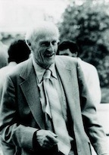
Regular Expressions: ? * + .
Pattern | Matches
colou?r | Optional previous char | color colour
oo*h! | 0 or more of previous char | oh! ooh! oooh! ooooh!
o+h! | 1 or more of previous char | oh! ooh! oooh! ooooh!
baa+ |  | baa baaa baaaa baaaaa
beg.n |  | begin begun begun beg3n
Stephen C Kleene
Kleene *, Kleene +
Pattern | Matches
^[A-Z] | Palo Alto
^[^A-Za-z] | 1 “Hello”
\.$ | The end.
.$ | The end? The end!

Slide 6
Regular Expressions: Anchors ^ $
Anchors are special characters that anchor regular expressions to particular places in a string.
The common anchors are the caret ^ and the dollar sign $.
The caret matches the start of a line. The pattern /^The/ matches the word The only at the start of a line
The caret ^ has three uses:
to match the start of a line,
to indicate a negation inside of square brackets,
and just to mean a caret.

Slide 7
Disjunction, Grouping, and Precedence
The disjunction operator, also called the pipe symbol |. The pattern /cat|dog/ matches either the string cat or the string dog.
To apply disjunction operator only to a specific pattern, use the parenthesis operators ( and ).
the pattern /gupp(y|ies)/ would specify that we meant the disjunction only to apply to the suffixes y and ies.
we could write the expression /(Column [0-9]+ *)*/ to match the word Column, followed by a number and optional spaces, the whole pattern repeated any number of times

Slide 8
operator precedence hierarchy
Parenthesis ()
Counters * + ? {}
Sequences and anchors the ^my end$
Disjunction |
Counters have a higher precedence than sequences,/the*/ matches theeeee but not thethe.
Sequences have a higher precedence than disjunction, /the|any/ matches the or any but not theny.

Slide 9
Greedy pattern
Patterns can be ambiguous in another way.
The expression /[a-z]*/ when matching against the text once upon a time.
Since /[a-z]*/ matches zero or more letters, this expression could match nothing, or just the first letter o, on, onc, or once.
RE always match the largest string they can;
Therefore, we say that “patterns are greedy”, expanding to cover as much of a string as they can.
Ways to make non greedy
*? : Kleenee star ->as little text as possible
+? : Kleenee plus ->as little text as possible

Slide 10
Example 1
Find all instances of the word “the” in a text.
/the/ | Misses capitalized examples
[tT]he | Incorrectly returns other or theology
/\b[tT]he\b/ | some context where it might also have underlines or numbers nearby (the or the25)
/[^a-zA-Z][tT]he[^a-zA-Z]/ | won’t find the word the when it begins a line
/(^|[^a-zA-Z])[tT]he([^a-zA-Z]|$)/

Slide 11
Text Normalization

Slide 12

Text Normalization
Normalizing text means converting it to a more convenient, standard form.
Ex. most of what we are going to do with language relies on first separating out or tokenizing words
Word boundary detection.
English words are often separated from each other by whitespace, but whitespace is not always sufficient.
New York and rock ’n’ roll are sometimes treated as large words despite the fact that they contain spaces,
sometimes we’ll need to separate I’m into the two words I and am.
For processing tweets or texts we need to tokenize emoticons
like :) or hashtags like #nlproc

Slide 13
Lemmatization
Another part of text normalization is lemmatization
The task of determining that two words have the same root, despite their surface differences.
For example, the words sang, sung, and sings are forms of the verb sing
A lemmatizer maps from all of these to sing
sang, sung, and sings->sing

Slide 14
Stemming and Segmentation
Stemming refers to a simpler version of lemmatization in which we mainly just strip suffixes from the end of the word.
Breaking up a text into individual sentences, using cues like periods or exclamation points.

Slide 15
Text Normalization
Every NLP task needs to do text normalization
Segmenting/tokenizing words
Normalizing word formats
Segmenting sentences in running text

Slide 16
Words
What counts as a word?
Look one particular corpus; computer-readable collection of text or speech
Brown corpus is a million-word collection of samples from 500 written English texts from different genres (newspaper, fiction, non-fiction etc.)
How many words are in the following Brown sentence?
“He stepped out into the hall, was delighted to encounter a water brother”.
13 words if we don’t count punctuation marks as words, 15 if we count punctuation.
Whether we treat period (“.”), comma (“,”), and so on as words depends on the task. Punctuation is critical for finding boundaries.

Slide 17
How many words?
Types are the number of distinct words in a corpus;
Tokens are the total number of running words.
They picnicked by the pool, then lay back on the grass and looked at the stars.
How many?
16 tokens and 14 types

Slide 18
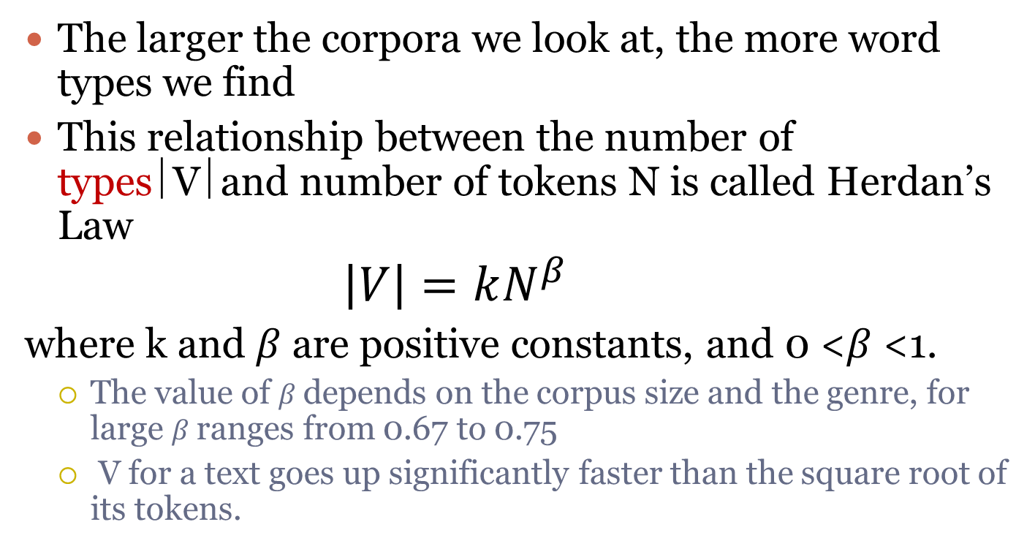
Herdan’s Law/ Heaps’ Law
The larger the corpora we look at, the more word types we find
This relationship between the number of types⎪V⎪and number of tokens N is called Herdan’s Law
$$\left|V\right|=kN^{β}$$
where k and $β$are positive constants, and 0 <$β$<1.
The value of $β$depends on the corpus size and the genre, for large $β$ranges from 0.67 to 0.75
V for a text goes up significantly faster than the square root of its tokens.

Slide 19
How many words?
N = number of tokens
V = vocabulary = set of types
|V| is the size of the vocabulary
Church and Gale (1990): |V| > O(N^{½})
 | Tokens = N | Types = |V|
Switchboard phone conversations | 2.4 million | 20 thousand
Shakespeare | 884,000 | 31 thousand
Google N-grams | 1 trillion | 13 million

Slide 20
Lemma
A lemma is a set of lexical forms having the same stem, the same major part-of-speech, and the same word sense.
Seuss’s cat in the hat is different from other cats!
cat and cats = same lemma
Word form: the full inflected surface form
cat and cats = different word forms

Slide 21
Lemmatization and Stemming
Lemmatization is the task of determining that two words have the same root, despite their surface differences.
The words am, are, and is have the shared lemma be;
The words dinner and dinners both have the lemma dinner.
Representing a word by its lemma is important for web search. This is especially important in morphologically complex languages.
Ex. He is reading detective stories would thus be He be read detective story.

Slide 22
How is lemmatization done?
The most sophisticated methods for lemmatization involve complete morphological parsing of the word.
The way the words constructed
Morphology is the study of morpheme the way words are built up from smaller meaning-bearing units called morphemes.
Two broad classes of morphemes :
Stems : the central morpheme of the word, supplying the main meaning
Affixes : adding “additional” meanings of various kinds

Slide 23
Lemmatization
Reduce inflections or variant forms to base form
am, are, is → be
car, cars, car's, cars' → car
the boy's cars are different colors → the boy car be different color
Lemmatization: have to find correct dictionary headword form

Slide 24
The Porter Stemmer
One of the most widely used stemming algorithms is the simple and efficient Porter (1980) algorithm.
ATIONAL -> ATE (e.g., relational->relate)
ING -> ε if stem contains vowel (e.g., motoring!->motor)
SSES -> SS (e.g., grasses -> grass)

Slide 25
Porter’s algorithm
Step 1a
sses → ss caresses → caress
ies → i ponies → poni
ss → ss caress → caress
s → ø cats → cat
Step 1b
(*v*)ing → ø walking → walk
sing → sing
(*v*)ed → ø plastered → plaster
…
Step 2 (for long stems)
ational→ ate relational→ relate
izer→ ize digitizer → digitize
ator→ ate operator → operate
…
Step 3 (for longer stems)
al → ø revival → reviv
able → ø adjustable → adjust
ate → ø activate → activ
…

Slide 26
Viewing morphology in a corpus Why only strip –ing if there is a vowel?
(*v*)ing → ø walking → walk
sing → sing
1312 King
548 being
541 nothing
388 king
375 bring
358 thing
307 ring
152 something
145 coming
130 morning
548 being
541 nothing
152 something
145 coming
130 morning
122 having
120 living
117 loving
116 Being
102 going

Slide 27
Issues in Tokenization
Some exceptions to handle
Finland’s capital → Finland Finlands Finland’s ?
what’re, I’m, isn’t → What are, I am, is not
Hewlett-Packard → Hewlett Packard ?
state-of-the-art → state of the art ?
Lowercase → lower-case lowercase lower case ?
San Francisco → one token or two?
m.p.h., Ph.D. → ??
$44.55 → prices ?
01/02/06 → dates ?
abc@xyz, www.kuet.ac.bd/cse → Email and urls ?

Slide 28
Case folding
Case folding: Another form of normalization
reduce all letters to lower case
Applications like IR from text
Since users tend to use lower case
Possible exception: upper case in mid-sentence?
e.g., General Motors
US vs. us
SAIL vs. sail
For sentiment analysis, MT, Information extraction
Case is helpful

Slide 29
Sentence Segmentation
!, ? are relatively unambiguous
Period “.” is quite ambiguous
Sentence boundary
Abbreviations like Inc. or Dr.
Numbers like .02% or 4.3
Build a binary classifier
Looks at a “.”
Decides EndOfSentence/NotEndOfSentence
Classifiers: hand-written rules, regular expressions, or machine-learning

Slide 30
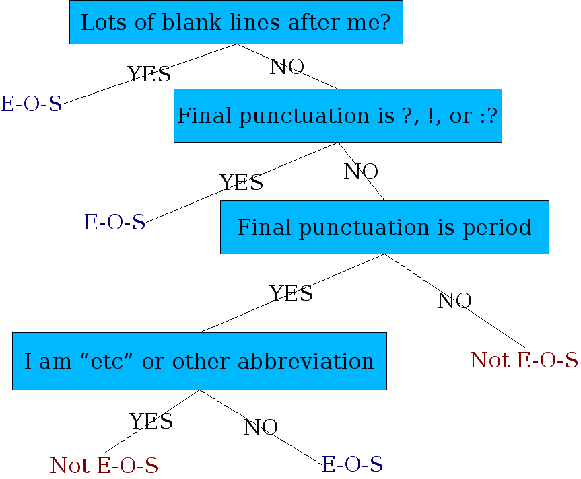
Determining if a word is end-of-sentence: a Decision Tree

Slide 31
THANK YOU

