Slide 1
Linear Algebra, Statistics, and Probability
Abdul Aziz
Assistant Professor, Department of CSE, KUET.

Slide 2
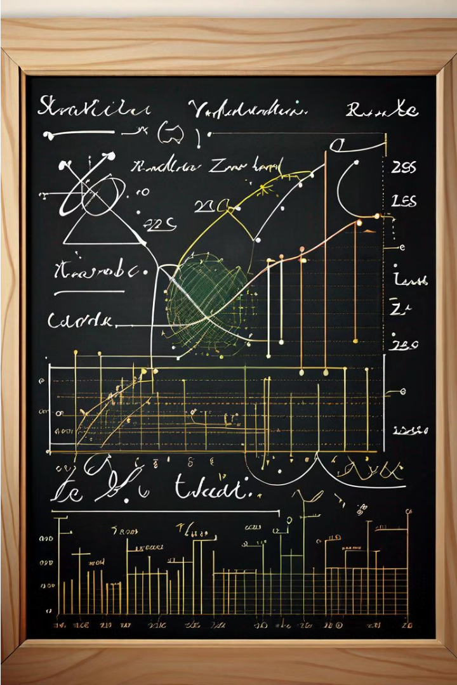
Introduction to Linear Algebra, Statistics, and Probability Theory
Explore the fundamental mathematical disciplines that underpin modern data analysis and scientific discovery. From the principles of vector spaces to the laws of probability, gain a solid foundation in these essential quantitative fields.

Slide 3
Vectors and Vector Spaces
Understanding Vectors
Vector Operations
Vector Spaces
Vectors can be added, subtracted, and multiplied by scalars, enabling the representation of complex relationships and transformations.
A vector space is a collection of vectors that obey certain rules, allowing for the study of abstract mathematical structures.
Vectors are mathematical objects that have both magnitude and direction. They are essential in linear algebra and have numerous applications.

Slide 4
The vector Space R^{n}
Definition 1.
Let be a sequence of n real numbers. The set of all such sequences is called n-space (or n-dimensional. space) and is denoted R^{n}.
u₁ is the first component of .
u₂ is the second component and so on.
Example 1
R² is the collection of all sets of two ordered real numbers.
For example, (0, 0) , (1, 2) and (-2, -3) are elements of R².
R³ is the collection of all sets of three ordered real numbers.
For example, (0,0, 0) and (-1,3, 4) are elements of R³.

Slide 5
Definition 2.
Let be two elements of R^{n}.
We say that u and v are equal if u₁ = v₁, …, u_{n} = v_{n}.
Thus two elements of R^{n} are equal if their corresponding components are equal.
Definition 3.
Let be elements of R^{n}
and let c be a scalar. Addition and scalar multiplication are performed as follows:
Addition:
Scalar multiplication :

Slide 6
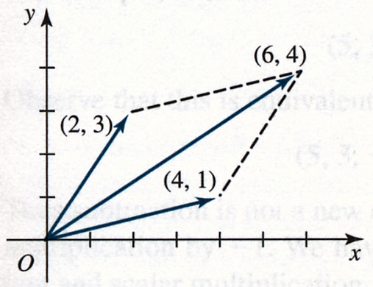
Example 2
Let u = ( –1, 4, 3) and v = ( –2, –3, 1) be elements of R³.
Find u + v and 3u.
Solution:
Example 3
In R² , consider the two elements (4, 1) and (2, 3).
Find their sum and give a geometrical interpretation of this sum.
we get (4, 1) + (2, 3) = (6, 4).
The vector (6, 4), the sum, is the diagonal of the parallelogram.
Figure 4.2

Slide 7
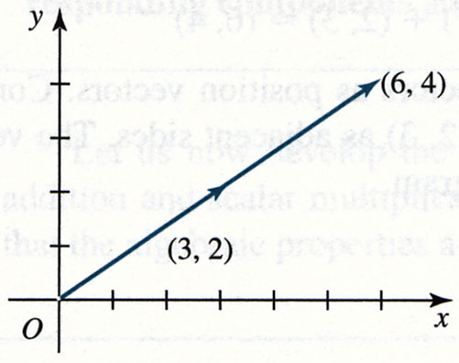
Example 4
Consider the scalar multiple of the vector (3, 2) by 2, we get
2(3, 2) = (6, 4)
Observe in Figure 4.3 that (6, 4) is a vector in the same direction as (3, 2), and 2 times it in length.
Figure 4.3

Slide 8
Zero Vector
The vector (0, 0, …, 0), having n zero components, is called the zero vector of R^{n} and is denoted 0.
Negative Vector
The vector (–1)u is writing –u and is called the negative of u.
It is a vector having the same length (or magnitude) as u, but lies in the opposite direction to u.
u
−u
Subtraction
Subtraction is performed on element of R^{n} by subtracting corresponding components.

Slide 9
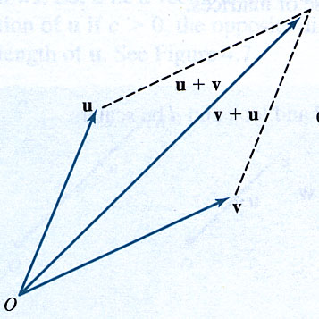
Theorem 4.1
Let u, v, and w be vectors in R^{n} and let c and d be scalars.
u + v = v + u
u + (v + w) = (u + v) + w
u + 0 = 0 + u = u
u + (–u) = 0
c(u + v) = cu + cv
(c + d)u = cu + du
c(du) = (cd)u
1u = u
Figure 4.4
Commutativity of vector addition u + v = v + u

Slide 10
Column Vectors
Row vector:
Column vector:
We defined addition and scalar multiplication of column vectors in R^{n} in a componentwise manner:
and

Slide 11
Dot Product, Norm, Angle, and Distance
Definition
Let be two vectors in R^{n}. The dot product of u and v is denoted u.v and is defined by .
The dot product assigns a real number to each pair of vectors.
Example 1
Find the dot product of
u = (1, –2, 4) and v = (3, 0, 2)
Solution

Slide 12
Properties of the Dot Product
Let u, v, and w be vectors in R^{n} and let c be a scalar. Then
u.v = v.u
(u + v).w = u.w + v.w
cu.v = c(u.v) = u.cv
u.u ≥ 0, and u.u = 0 if and only if u = 0

Slide 13
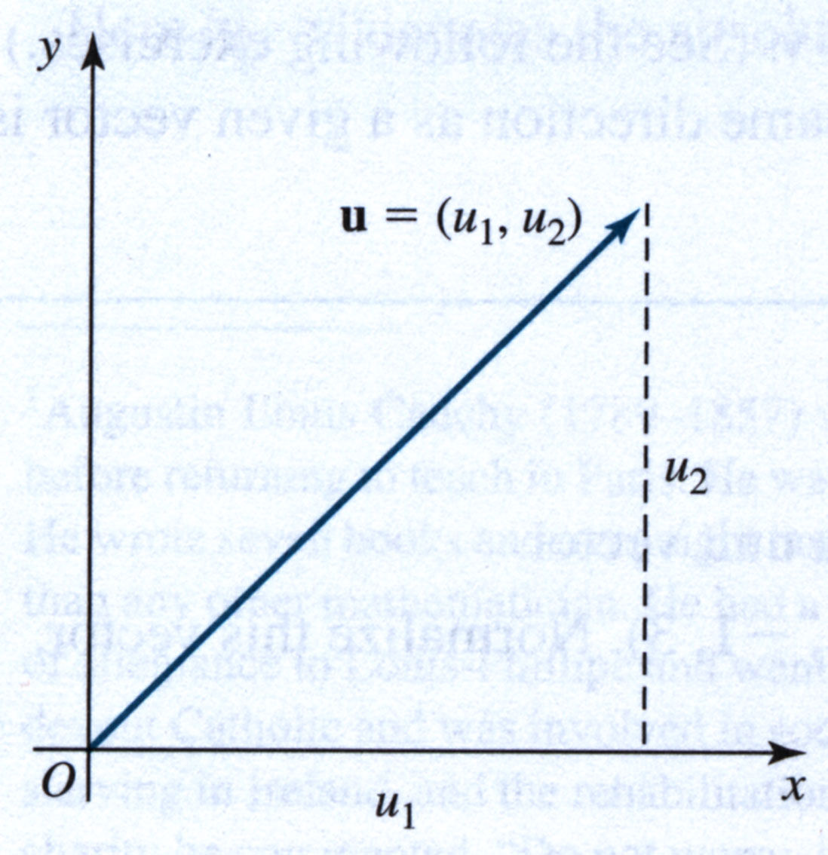
Norm of a Vector in R^{n}
Definition
The norm (length or magnitude) of a vector u = (u₁, …, u_{n}) in R^{n} is denoted ||u|| and defined by
Note: The norm of a vector can also be written in terms of the dot product
Figure 4.5 length of u

Slide 14
Example 2
Find the norm of each of the vectors u = (1, 3, 5) of R³
and v = (3, 0, 1, 4) of R⁴.
Solution
Definition
A unit vector is a vector whose norm is 1.
If v is a nonzero vector, then the vector
is a unit vector in the direction of v.
This procedure of constructing a unit vector in the same direction as a given vector is called normalizing the vector.

Slide 15
Example 3
Show that the vector (1, 0) is a unit vector.
Find the norm of the vector (2, –1, 3). Normalize this vector.
Solution

Slide 16
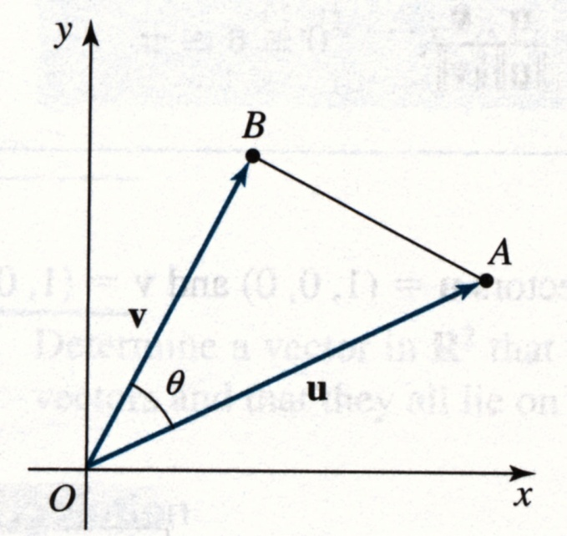
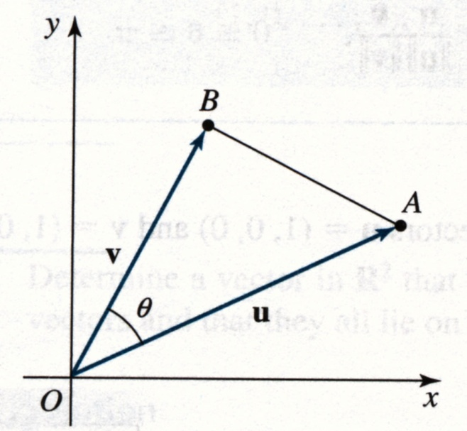
Angle between Vectors ( in R²)
The law of cosines gives:
← Figure

Slide 17
Angle between Vectors (in R ^{n})
Definition
Let u and v be two nonzero vectors in R^{n}.
The cosine of the angle θ between these vectors is
Example 4
Determine the angle between the vectors u = (1, 0, 0) and v = (1, 0, 1) in R³.
Solution

Slide 18
Operations with Matrices
Matrix representations:
An uppercase case: A, B, C, …
A representative element enclosed in brackets: [a_{ij}], [b_{ij}]
A rectangular array of numbers:
Vector (column/row matrix): boldface lowercase a₁, a₂, …, a_{n}

Slide 19
Definitions
Equality of Matrices Two matrices A = [a_{ij}] and B = [b_{ij}] are equal if they have the same size (m×n) and a_{ij} = b_{ij} for 1 ≤ i ≤ m and 1 ≤ j ≤ n.
Matrix Addition If A = [a_{ij}] and B = [b_{ij}] are matrices of size m×n, then their sum is the m×n matrix given by A+B = [a_{ij} + b_{ij}]. The sum of two matrices of different sizes is undefined.
Scalar Multiplication If A = [a_{ij}] is an m×n matrix and c is a scalar, then the scalar multiplication of A by c is the m×n matrix given by cA = [ca_{ij}]

Slide 20
Example 1
Consider the four matrices
Matrices A and B are not equal because they are of different sizes.
Similarly, B and C are not equal.
Matrices A and D are equal if and only if (iff) x = 3

Slide 21
Subtraction of Matrices
If A and B are of the same size, A−B represents the sum of A and (−B). That is, A−B = A+(−1)B = [a_{ij} − b_{ij}].
cA − dB = [ca_{ij} − db_{ij}].
Example 3:

Slide 22
Matrix Multiplication
If A = [a_{ij}] is an m×n matrix and B = [b_{ij}] is an n×p matrix, then the product AB is an m×p matrix AB = [c_{ij}], where

Slide 23
Example 4
Find the product AB, where and

Slide 24
Example 5
Matrix multiplication is not, in general, commutative.

Slide 25
Systems of Linear Equations
Matrix Equation: Ax = b
A: coefficient matrix; x and b: column matrix (vector)
Example 6: Solve the matrix equation Ax = 0

Slide 26
Diagonal Matrix & Trace
A square matrix is called a diagonal matrix if all entries that not on the main diagonal are zero.
The trace of an n×n matrix A is the sum of the main diagonal entries. That is,

Slide 27
2.2 Properties of Matrix Operations
Theorem 2.1 Properties of Matrix Addition and Scalar Multiplication
If A, B, and C are m×n matrices and c and d are scalars, then the following properties are true.
1. A+B = B+A Commutative property of addition
2. A+(B+C) = (A+B)+C Associative property of addition
3. (cd)A = c(dA) Associative property of multiplication
4. 1A = A Multiplication identity
5. c(A+B) = cA + cB Distributive property
6. (c+d)A = cA + dA Distributive property

Slide 28
Zero Matrix & Additive Identity
If A is an m×n matrix and O_{mn} is the m×n matrix consisting entirely of zeros, then A + O_{mn} = A.
The matrix O_{mn} is called a zero matrix, and it serves as the additive identity for the set of all m×n matrices.
Theorem 2.2: Properties of Zero Matrix If A is an m×n matrix and c is a scalar, then the following properties are true. 1. A + O_{mn} = A. 2. A + (−A) = O_{mn}. ⇒ −A is the additive inverse of A. 3. If cA = O_{mn}, then c = 0 or A = O_{mn}.

Slide 29
Matrix Equation
Section 2-2
Real Numbers m × n Matrices
Ex. 2: Solve for X in the equation 3X+A = B, where

Slide 30
Theorem 2.3
Properties of Matrix Multiplication
If A, B, and C are matrices (with sizes such that the given matrix products are defined) and c is a scalar, then the following properties are true. 1. A(BC) = (AB)C Associative property 2. A(B+C) = AB + AC Distribution property 3. (A+B)C = AC + BC Distribution property 4. c(AB) = (cA)B = A(cB)

Slide 31
Noncommutativity
Section 2-2
A commutative property for matrix multiplication was NOT listed in Theorem 2.3.
If A is of size 2×3 and B is of size 3×3, then the product AB is defined, but the product BA is not.
Example 4: Show that AB and BA are not equal for the matrices and

Slide 32
Cancellation Property
It does NOT have a general cancellation property for matrix multiplication.
If AC = BC, it is NOT necessary true that A = B.
Example 5: Show that AC = BC.

Slide 33
Identity Matrix & Theorem 4
Section 2-2
A square matrix that has 1’s on the main diagonal and 0’s elsewhere.
The identity matrix of order n:
Theorem 2.4: Properties of the Identity Matrix If A is a matrix of size m×n, then the following properties are true. 1. AI_{n} = A. 2. I_{m}A = A.
If A is a square matrix of order n, then AI_{n} = I_{n}A = A.

Slide 34
Repeated Multiplication
Section 2-2
Repeated multiplication of a square matrix: For a positive integer k, A^{k} is
A⁰ = I_{n}, where A is a square matrix of order n.
Example 3: Find A³ for the matrix .
k factors
j and k are nonnegative integer.

Slide 35
The Transpose of a Matrix
Section 2-2
The transpose of a matrix is formed by writing its columns as rows.
A matrix A is symmetric if A = A^{T}. ⇔ a_{ij} = a_{ji}, ∀ i ≠ j. ⇒ a symmetric matrix must be square.

Slide 36
Theorem 2.6
Section 2-2
Properties of Transpose
If A and B are matrices (with sizes such that the given matrix products are defined) and c is a scalar, then the following properties are true. 1. Transpose of a transpose 2. Transpose of a sum 3. Transpose of a scalar multiplication 4. Transpose of a product
For any matrix A, the matrix is symmetric.

Slide 37
Example 9
Show that are equal.
Sol:

Slide 38
2.3 The Inverse of a Matrix
Definition of an Inverse of a Matrix An n×n matrix A is invertible if there exists an n×n matrix B such that AB = BA = I_{n}
I_{n} is the identity matrix of order n.
The matrix B is called the (multiplicative) inverse of A.
A matrix that does NOT have an inverse is called noninvertible.
Nonsquare matrices do NOT have inverse.
Theorem 2.7: Uniqueness of an Inverse Matrix If A is an invertible matrix, then its inverse is unique. The inverse of A is denoted by .

Slide 39
Example 2
Find the inverse of the matrix
Sol: To find the inverse of A, try to solve the matrix equation AX = I for X.
Using matrix multiplication to check the result.

Slide 40
Example 6
Compute A⁻² in two different ways and show that the results are equal.
1. (A²)⁻¹:
2. (A⁻¹)²:
the same result

Slide 41
Example 7
Find (AB)⁻¹ for the matrices and
using the fact that A⁻¹ and B⁻¹ are given by
Sol:

Slide 42
Theorem 2.11
Systems of Equations with Unique Solutions
If A is an invertible matrix, then the system of linear equations Ax = b has a unique solution given by x = A⁻¹b.
pf: Ax = b ⇒ A⁻¹(Ax) = A⁻¹(b) ⇒ A⁻¹Ax = A⁻¹b ⇒ x = A⁻¹b
Example 8: Use an inverse matrix to solve each system

Slide 43
Eigenvalues and Eigenvectors

Slide 44
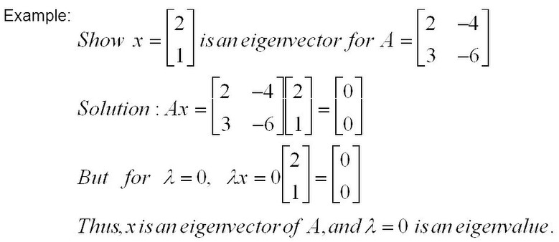
6.1 Definitions
Definition 1: A nonzero vector x is an eigenvector (or characteristic vector) of a square matrix A if there exists a scalar λ such that Ax = λx. Then λ is an eigenvalue (or characteristic value) of A.
Note: The zero vector can not be an eigenvector even though A0 = λ0. But λ = 0 can be an eigenvalue.

Slide 45
Geometric interpretation of Eigenvalues and Eigenvectors
An n×n matrix A multiplied by n×1 vector x results in another n×1 vector y=Ax. Thus, A can be considered as a transformation matrix.
In general, a matrix acts on a vector by changing both its magnitude and its direction. However, a matrix may act on certain vectors by changing only their magnitude, and leaving their direction unchanged (or possibly reversing it). These vectors are the eigenvectors of the matrix.
A matrix acts on an eigenvector by multiplying its magnitude by a factor, which is positive if its direction is unchanged and negative if its direction is reversed. This factor is the eigenvalue associated with that eigenvector.

Slide 46
6.2 Eigenvalues
Let x be an eigenvector of the matrix A. Then there must exist an eigenvalue λ such that Ax = λx or, equivalently,
Ax - λx = 0 or
(A – λI)x = 0
If we define a new matrix B = A – λI, then
Bx = 0
If B has an inverse, then x = B⁻¹0 = 0. But an eigenvector cannot be zero.
Thus, it follows that x will be an eigenvector of A if and only if B does not have an inverse, or equivalently det(B)=0, or
det(A – λI) = 0
This is called the characteristic equation of A. Its roots determine the eigenvalues of A.

Slide 47
6.2 Eigenvalues: examples
Example 1: Find the eigenvalues of
two eigenvalues: −1, − 2
Note: The roots of the characteristic equation can be repeated. That is, λ₁ = λ₂ =…= λ_{k}. If that happens, the eigenvalue is said to be of multiplicity k.
Example 2: Find the eigenvalues of
λ = 2 is an eigenvector of multiplicity 3.

Slide 48
6.3 Eigenvectors
To each distinct eigenvalue of a matrix A there will correspond at least one eigenvector which can be found by solving the appropriate set of homogenous equations. If λ_{i} is an eigenvalue then the corresponding eigenvector x_{i} is the solution of (A – λ_{i}I)x_{i} = 0
Example 1 (cont.):

Slide 49
6.3 Eigenvectors
Example 2 (cont.): Find the eigenvectors of
Recall that λ = 2 is an eigenvector of multiplicity 3.
Solve the homogeneous linear system represented by
Let . The eigenvectors of λ = 2 are of the form
s and t not both zero.

Slide 50
6.4 Properties of Eigenvalues and Eigenvectors
Definition: The trace of a matrix A, designated by tr(A), is the sum of the elements on the main diagonal.
Property 1: The sum of the eigenvalues of a matrix equals the trace of the matrix.
Property 2: A matrix is singular if and only if it has a zero eigenvalue.
Property 3: The eigenvalues of an upper (or lower) triangular matrix are the elements on the main diagonal.
Property 4: If λ is an eigenvalue of A and A is invertible, then 1/λ is an eigenvalue of matrix A⁻¹.

Slide 51
6.4 Properties of Eigenvalues and Eigenvectors
Property 5: If λ is an eigenvalue of A then kλ is an eigenvalue of kA where k is any arbitrary scalar.
Property 6: If λ is an eigenvalue of A then λ^{k} is an eigenvalue of A^{k} for any positive integer k.
Property 8: If λ is an eigenvalue of A then λ is an eigenvalue of A^{T}.
Property 9: The product of the eigenvalues (counting multiplicity) of a matrix equals the determinant of the matrix.

Slide 52
6.5 Linearly independent eigenvectors
Theorem: Eigenvectors corresponding to distinct (that is, different) eigenvalues are linearly independent.
Theorem: If λ is an eigenvalue of multiplicity k of an n × n matrix A then the number of linearly independent eigenvectors of A associated with λ is given by m = n - r(A- λI). Furthermore, 1 ≤ m ≤ k.
Example 2 (cont.): The eigenvectors of λ = 2 are of the form
s and t not both zero.
λ = 2 has two linearly independent eigenvectors

Slide 53
Probability Axioms and Formulas

Slide 54
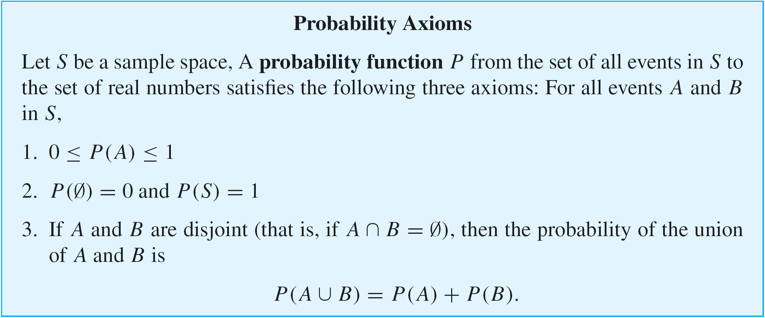
Probability Axioms and Formulas
We have known that a sample space is a set of all outcomes of a random process or experiment and that an event is a subset of a sample space.

Slide 55
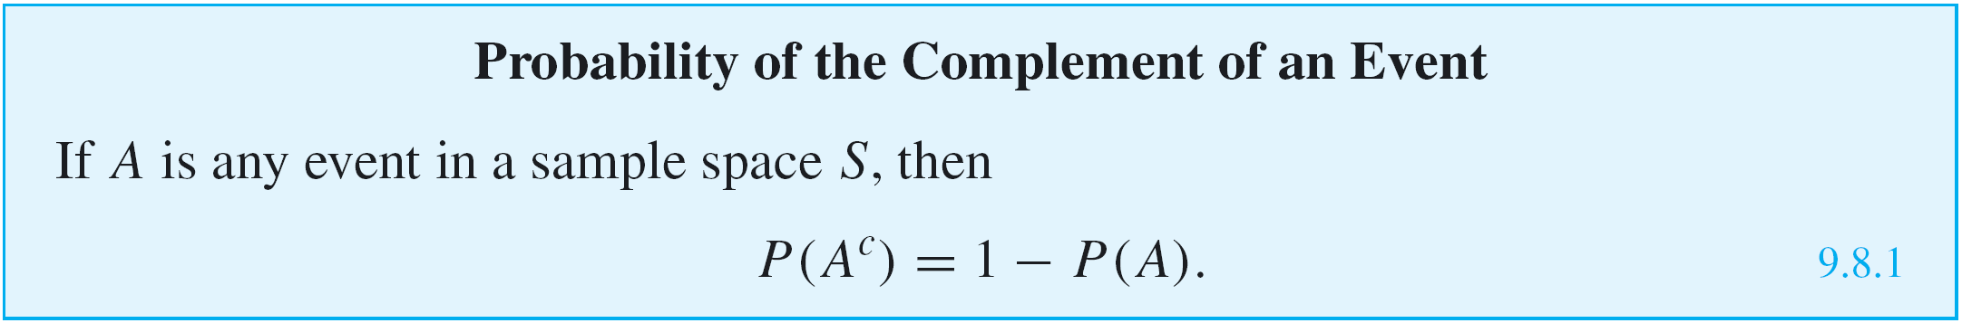
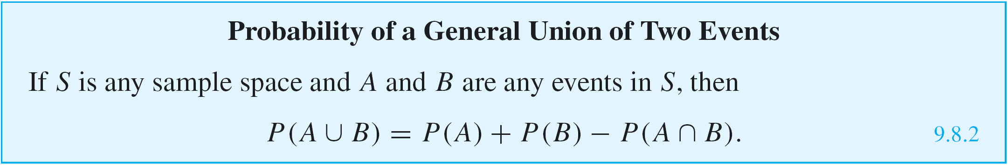
Probability Axioms and Formulas

Slide 56
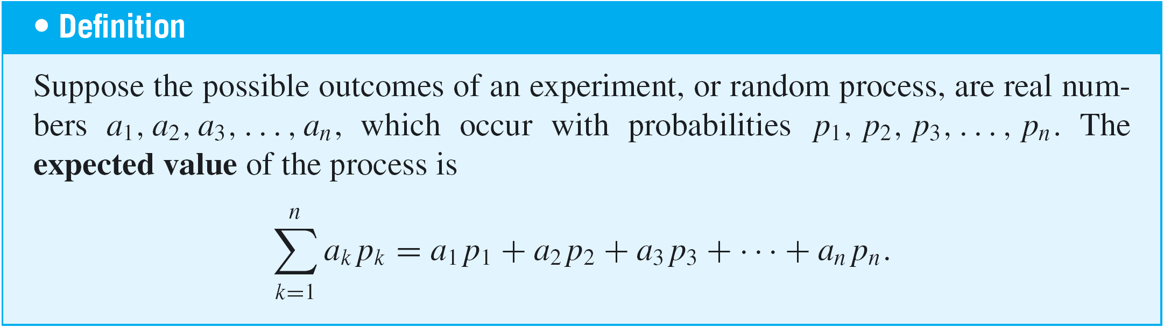
Expected Value

Slide 57
Expected Value of a Lottery
Suppose that 100 people pay $1 each to play a lottery game with a single prize of $98 for exact one winner.
What is the expected value of a ticket?

Slide 58
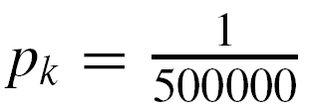
Example 5 – Expected Value of a Lottery
Suppose that 500,000 people pay $5 each to play a lottery game with the following prizes:
a grand prize of $1,000,000, 10 second prizes of $1,000 each, 1,000 third prizes of $500 each, and 10,000 fourth prizes of $10 each.
What is the expected value of a ticket?
Solution:
Each of the 500,000 lottery tickets has the same chance as any other of containing a winning lottery number, and so for all k = 1, 2, 3, . . . , 500000.

Slide 59
Example 5 – Solution
cont’d
Let a₁, a₂, a₃, . . . , a₅₀₀₀₀₀ be the net gain for an individual ticket, where a₁ = 999995 (the net gain for the grand prize ticket, which is one million dollars minus the $5 cost of the winning ticket),
a₂ = a₃ = ・・・ = a₁₁ = 995 (the net gain for each of the 10 second prize tickets),
a₁₂ = a₁₃ = ・・・ = a₁₀₁₁ = 495 (the net gain for each of the 1,000 third prize tickets), and
a₁₀₁₂ = a₁₀₁₃ = ・・・ = a₁₁₀₁₁ = 5 (the net gain for each of the 10,000 fourth prize tickets).

Slide 60
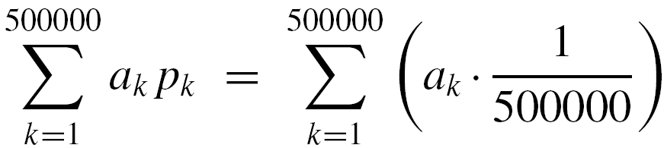

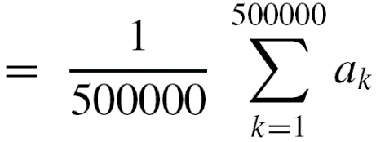

Example 5 – Solution
cont’d
Since the remaining 488,989 tickets just lose $5, a₁₁₀₁₂ = a₁₁₀₁₃ = ・・・ = a₅₀₀₀₀₀ = –5.
The expected value of a ticket is therefore

Slide 61
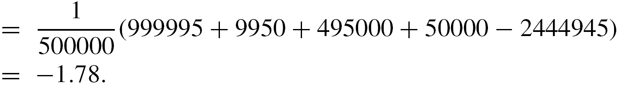
Example 5 – Solution
cont’d
In other words, a person who continues to play this lottery for a very long time will probably win some money occasionally but on average will lose $1.78 per ticket.

Slide 62
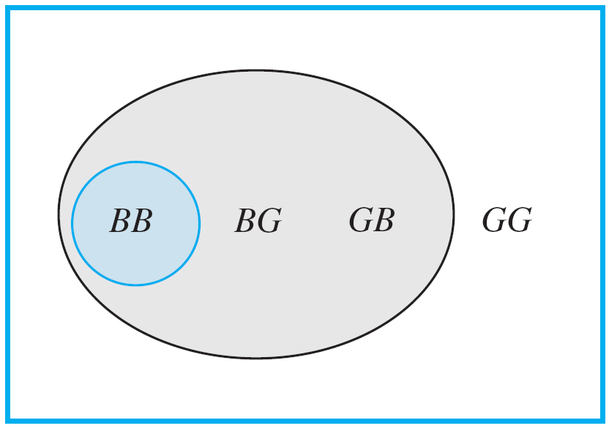
Conditional Probability
Imagine a couple with two children, each of whom is equally likely to be a boy or a girl. Now suppose you are given the information that one is a boy. What is the probability that the other child is a boy?
Figure 9.9.1 shows the four equally likely combinations of gender for the children.
Figure 9.9.1

Slide 63
Conditional Probability
You can imagine that the first letter refers to the older child and the second letter to the younger.
Thus the combination BG indicates that the older child is a boy and the younger is a girl.
The combinations where one of the children is a boy are shaded gray, and the combination where the other child is also a boy is shaded blue-gray.
Given that you know one child is a boy, only the three combinations in the gray region could be the case, so you can think of the set of those outcomes as a new sample space with three elements, all of which are equally likely.

Slide 64
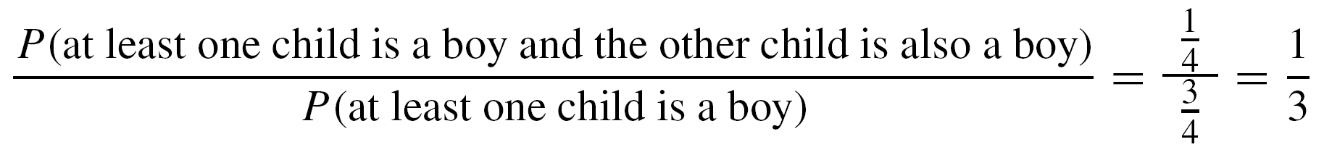
Conditional Probability
Within the new sample space, there is one combination where the other child is a boy (in the region shaded blue-gray).
Thus it would be reasonable to say that the likelihood that the other child is a boy, given that at least one is a boy, is
1/3 = 33 %.
Note that because the original sample space contained four outcomes,
also.

Slide 65
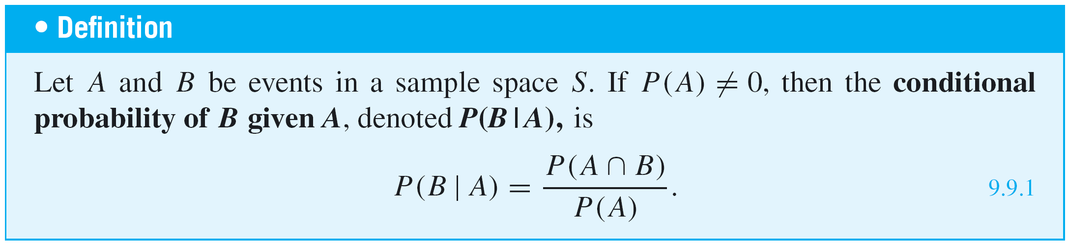
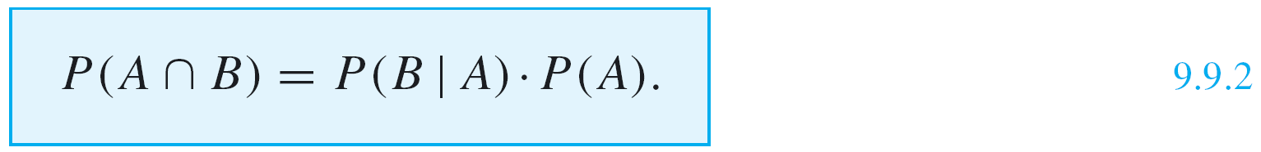
Conditional Probability
A generalization of this observation forms the basis for the following definition.
Note that when both sides of the formula for conditional probability (formula 9.9.1) are multiplied by P(A), a formula for P(A ∩ B) is obtained:

Slide 66
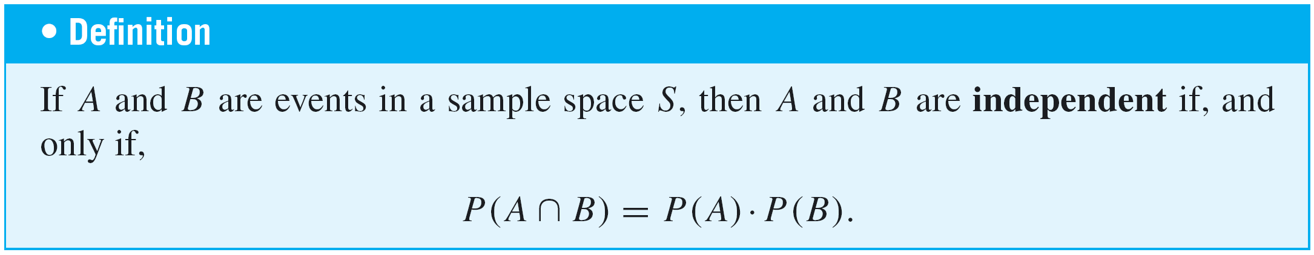
Independent Events
Informally, two events are independent: the probability of one event to happen does not depend on whether the other happens or not.
Formally, events A and B can be independent in the sense that P(A | B) = P(A) and P(B | A) = P(B).

Slide 67
Bayes’ Theorem
Suppose that one urn contains 3 blue and 4 gray balls and a second urn contains 5 blue and 3 gray balls. A ball is selected by choosing one of the urns at random and then picking a ball at random from that urn. If the chosen ball is blue, what is the probability that it came from the first urn?
This problem can be solved by carefully interpreting all the information that is known and putting it together in just the right way.
Let A be the event that the chosen ball is blue, B₁ the event that the ball came from the first urn, and B₂ the event that the ball came from the second urn.

Slide 68
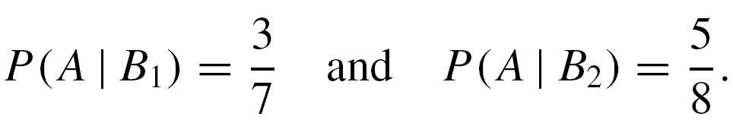
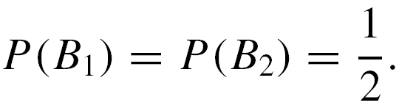
Bayes’ Theorem
Because 3 of the 7 balls in urn one are blue, and 5 of the 8 balls in urn two are blue,
And because the urns are equally likely to be chosen,

Slide 69
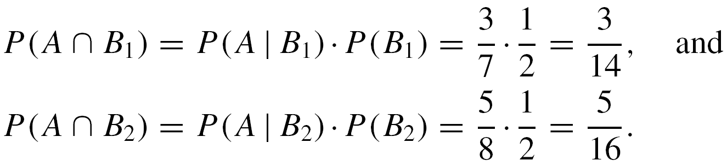
Bayes’ Theorem
Moreover, by formula (9.9.2),
But A is the disjoint union of (A ∩ B₁) and (A ∩ B₂), so by probability axiom 3,

Slide 70
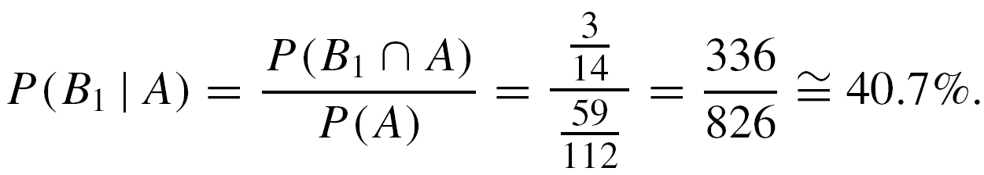
Bayes’ Theorem
Finally, by definition of conditional probability,
Thus, if the chosen ball is blue, the probability is approximately 40.7% that it came from the first urn.
The steps used to derive the answer in the previous example can be generalized to prove Bayes’ Theorem.

Slide 71
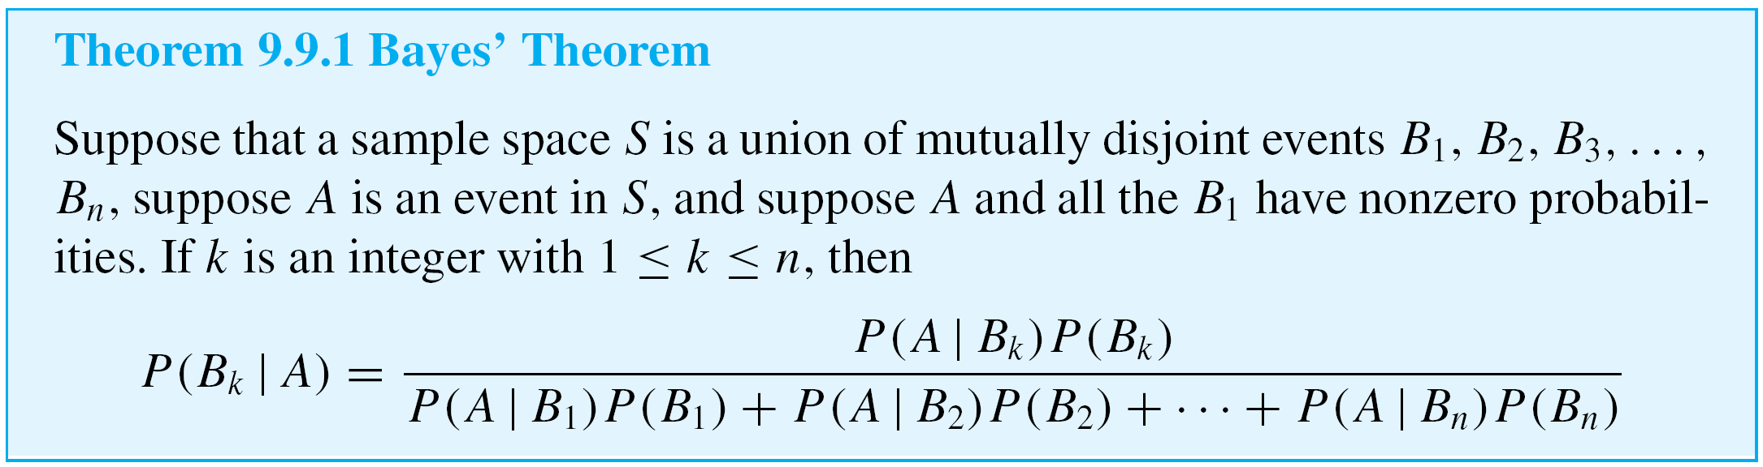
Bayes’ Theorem

Slide 72
Example 3 – Applying Bayes’ Theorem
Most medical tests occasionally produce incorrect results, called false positives and false negatives.
When a test is designed to determine whether a patient has a certain disease, a false positive result indicates that a patient has the disease when the patient does not have it.
A false negative result indicates that a patient does not have the disease when the patient does have it.

Slide 73
Basic Statistical Concepts

Slide 74
Properties of distributions: Center
There are three main measures of center
Mean (M): the arithmetic average
Add up all of the scores and divide by the total number
Most used measure of center
Median (Mdn): the middle score in terms of location
The score that cuts off the top 50% of the from the bottom 50%
Mode: the most frequent score
Good for nominal scales (e.g. eye color)

Slide 75
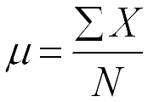
The Mean
The most commonly used measure of center
The arithmetic average
Computing the mean
Divide by the total number in the population
The formula for the population mean is (a parameter):
Add up all of the X’s

Slide 76
Spread (Variability)
How similar are the scores?
Range: the maximum value - minimum value
Only takes two scores from the distribution into account
Influenced by extreme values (outliers)
Standard deviation (SD): (essentially) the average amount that the scores in the distribution deviate from the mean
Takes all of the scores into account
Also influenced by extreme values (but not as much as the range)
Variance: standard deviation squared

Slide 77
Variability
Low variability
The scores are fairly similar
High variability
The scores are fairly dissimilar
mean
mean

Slide 78
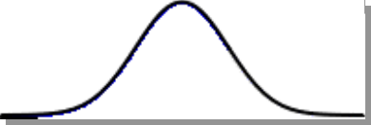
Standard deviation
The standard deviation is the most popular and most important measure of variability.
The standard deviation measures how far off all of the individuals in the distribution are from a standard, where that standard is the mean of the distribution.
Essentially, the average of the deviations.
μ

Slide 79

An Example: Computing the Mean
Our population
2, 4, 6, 8
1 2 3 4 5 6 7 8 9 10
μ

Slide 80
An Example: Computing Standard Deviation (population)
Our population
Step 1: To get a measure of the deviation we need to subtract the population mean from every individual in our distribution.
2, 4, 6, 8
-3
1 2 3 4 5 6 7 8 9 10
μ
X - μ = deviation scores
2 - 5 = -3

Slide 81
An Example: Computing Standard Deviation (population)
Our population
Step 1: To get a measure of the deviation we need to subtract the population mean from every individual in our distribution.
2, 4, 6, 8
-1
1 2 3 4 5 6 7 8 9 10
μ
X - μ = deviation scores
2 - 5 = -3
4 - 5 = -1

Slide 82
An Example: Computing Standard Deviation (population)
Our population
Step 1: To get a measure of the deviation we need to subtract the population mean from every individual in our distribution.
2, 4, 6, 8
1
1 2 3 4 5 6 7 8 9 10
μ
X - μ = deviation scores
2 - 5 = -3
6 - 5 = +1
4 - 5 = -1

Slide 83
An Example: Computing Standard Deviation (population)
Our population
Step 1: To get a measure of the deviation we need to subtract the population mean from every individual in our distribution.
2, 4, 6, 8
3
1 2 3 4 5 6 7 8 9 10
μ
X - μ = deviation scores
2 - 5 = -3
6 - 5 = +1
Notice that if you add up all of the deviations they must equal 0.
4 - 5 = -1
8 - 5 = +3

Slide 84
An Example: Computing Standard Deviation (population)
Step 2: So what we have to do is get rid of the negative signs. We do this by squaring the deviations and then taking the square root of the sum of the squared deviations (SS).
X - μ = deviation scores
SS = ∑ (X - μ)²
2 - 5 = -3
6 - 5 = +1
= (-3)²
+ (-1)²
+ (+1)²
+ (+3)²
4 - 5 = -1
8 - 5 = +3
= 9 + 1 + 1 + 9 = 20

Slide 85
An Example: Computing Standard Deviation (population)
Step 3: ComputeVariance (which is simply the average of the squared deviations (SS))
So to get the mean, we need to divide by the number of individuals in the population.
variance = σ² = SS/N
SS = 20, N = 4
σ² = 20/4 = 5.0

Slide 86


An Example: Computing Standard Deviation (population)
Step 4: Compute Standard Deviation
To get this we need to take the square root of the population variance.
standard deviation = σ =

Slide 87
An Example: Computing Standard Deviation (population)
To review:
Step 1: Compute deviation scores
Step 2: Compute the SS
Step 3: Determine the variance
Take the average of the squared deviations
Divide the SS by the N
Step 4: Determine the standard deviation
Take the square root of the variance

Slide 88
An Example: Computing Standard Deviation (SAMPLE)
To review:
Step 1: Compute deviation scores
Step 2: Compute the SS
Step 3: Determine the variance
Take the average of the squared deviations
Divide the SS by (n-1)
Step 4: Determine the standard deviation
Take the square root of the variance

Slide 89
Relationships between variables
Example: Suppose that you notice that the more you study for an exam, the better your score typically is.
This suggests that there is a relationship between study time and test performance.
We call this relationship a correlation.

Slide 90
Relationships between variables
Properties of a correlation
Form (linear or non-linear)
Direction (positive or negative)
Strength (none, weak, strong, perfect)
To examine this relationship you should:
Make a scatterplot
Compute the Correlation Coefficient

Slide 91
Scatterplot
Plots one variable against the other
Useful for “seeing” the relationship
Form, Direction, and Strength
Each point corresponds to a different individual
Imagine a line through the data points

Slide 92
Scatterplot
Y
Hours study X | Exam perf. Y
6 | 6
1 | 2
5 | 6
3 | 4
3 | 2
6
5
4
3
2
1
1
2
3
4
5
6
X

Slide 93
Correlation Coefficient
A numerical description of the relationship between two variables
For relationship between two continuous variables we use Pearson’s r
It basically tells us how much our two variables vary together
As X goes up, what does Y typically do
X↑, Y↑
X↑, Y↓
X↑, Y

Slide 94
Form
Linear
Non-linear

Slide 95
Direction
Positive
Negative
Y
Y
X
X
As X goes up, Y goes up
X & Y vary in the same direction
positive Pearson’s r
As X goes up, Y goes down
X & Y vary in opposite directions
negative Pearson’s r

Slide 96
Strength
Zero means “no relationship”.
The farther the r is from zero, the stronger the relationship
The strength of the relationship
Spread around the line (note the axis scales)

Slide 97
Strength
r = -1.0
“perfect negative corr.”
r = 0.0
“no relationship”
r = 1.0
“perfect positive corr.”
-1.0
0.0
+1.0
The farther from zero, the stronger the relationship

Slide 98
Strength
Rel A
Rel B
r = -0.8
r = 0.5
-.8
.5
-1.0
0.0
+1.0
Which relationship is stronger?
Rel A, -0.8 is stronger than +0.5

Slide 99
Regression
Compute the equation for the line that best fits the data points
Y
Y = (X)(slope) + (intercept)
6
5
4
0.5
2.0
3
2
Change in Y
Change in X
1
= slope
1
2
3
4
5
6
X

Slide 100
Regression
Can make specific predictions about Y based on X
X = 5
Y = ?
Y = (X)(.5) + (2.0)
Y
Y = (5)(.5) + (2.0)
Y = 2.5 + 2 = 4.5
6
4.5
5
4
3
2
1
1
2
3
4
5
6
X

