Slide 1


Slide 2
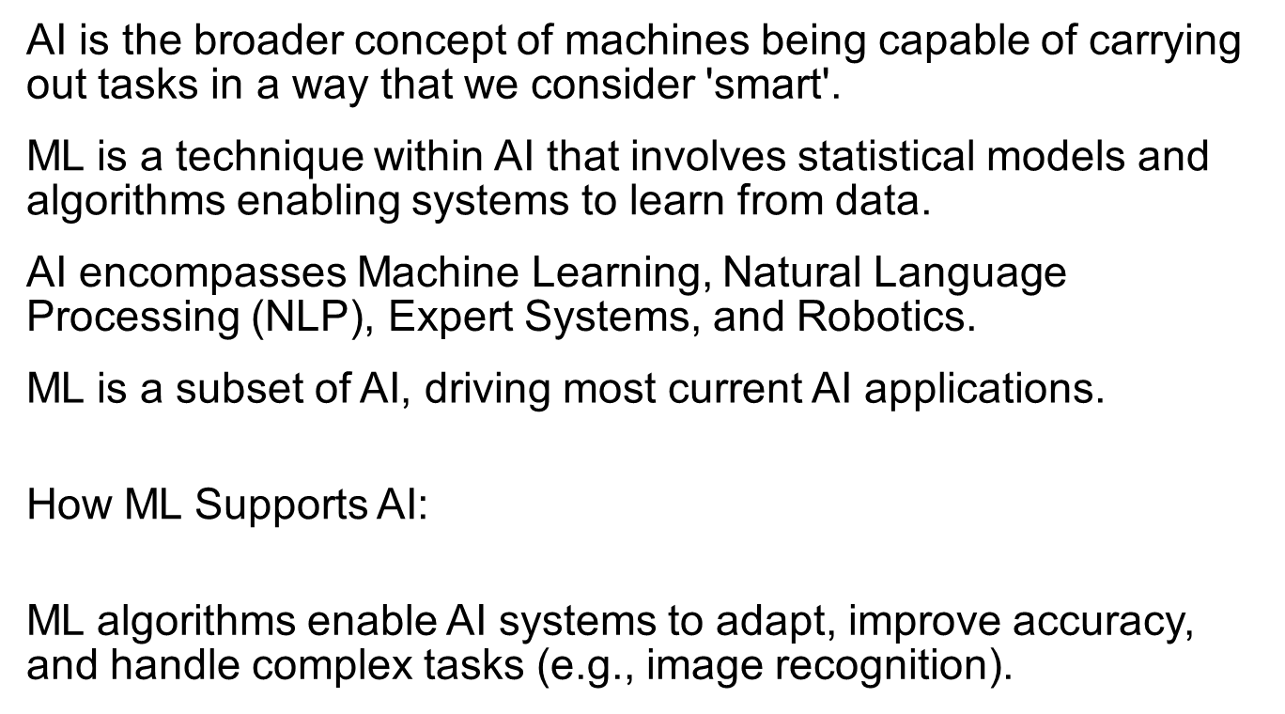
Relationship Between AI and ML

Slide 3
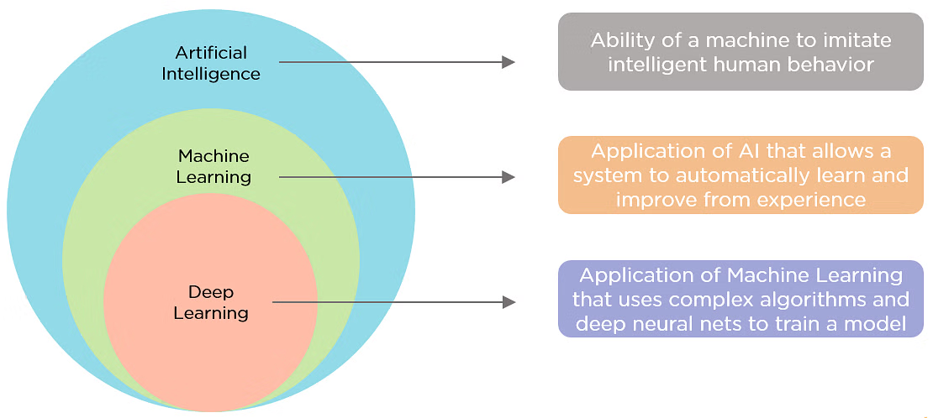

Slide 4
Key Differences Between AI and ML
Aspect | Artificial Intelligence (AI) | Machine Learning (ML)
Definition | Broad concept of machines mimicking human intelligence | Subset of AI enabling machines to learn from data
Goal | To perform tasks intelligently, like a human | To learn from data and improve over time
Types | Narrow AI, General AI | Supervised, Unsupervised, Reinforcement Learning
Scope | Includes multiple fields (ML, NLP, robotics) | Focused on data-driven learning techniques
Examples | Self-driving cars, smart assistants | Spam filtering, recommendation systems
Application | Wide-ranging, including symbolic reasoning | Primarily data-driven and statistically based

Slide 5
Why Machine Learning?
No human experts
industrial/manufacturing control
mass spectrometer analysis, drug design, astronomic discovery
Black-box human expertise
face/handwriting/speech recognition
driving a car, flying a plane
Rapidly changing phenomena
credit scoring, financial modeling
diagnosis, fraud detection
Need for customization/personalization
personalized news reader
movie/book recommendation

Slide 6
Related Fields
data
mining
control theory
statistics
machine
learning
decision theory
information theory
cognitive science
databases
psychological models
evolutionary
models
neuroscience
Machine learning is primarily concerned with the accuracy and effectiveness of the computer system.

Slide 7
Machine Learning Paradigms
learning by being told (advice-taking)
learning from examples (induction)
learning by analogy
speed-up learning
concept learning
clustering
discovery
…

Slide 8
Architecture of a Learning System
critic
feedback
performance standard
percepts
ENVIRONMENT
learning
element
changes
performance
element
actions
knowledge
learning goals
problem
generator

Slide 9
Learning Element
Design affected by:
performance element used
e.g., utility-based agent, reactive agent, logical agent
functional component to be learned
e.g., classifier, evaluation function, perception-action function,
representation of functional component
e.g., weighted linear function, logical theory, HMM
feedback available
e.g., correct action, reward, relative preferences

Slide 10
Dimensions of Learning Systems
type of feedback
supervised (labeled examples)
unsupervised (unlabeled examples)
reinforcement (reward)
representation
attribute-based (feature vector)
relational (first-order logic)
use of knowledge
empirical (knowledge-free)
analytical (knowledge-guided)

Slide 11
Outline
Supervised learning
empirical learning (knowledge-free)
attribute-value representation
logical representation
analytical learning (knowledge-guided)
Reinforcement learning
Unsupervised learning
Performance evaluation
Computational learning theory

Slide 12
Inductive (Supervised) Learning
Basic Problem: Induce a representation of a function (a systematic relationship between inputs and outputs) from examples.
target function f: X → Y
example (x,f(x))
hypothesis g: X → Y such that g(x) = f(x)
x = set of attribute values (attribute-value representation)
x = set of logical sentences (first-order representation)
Y = set of discrete labels (classification)
Y = ℜ (regression)

Slide 13
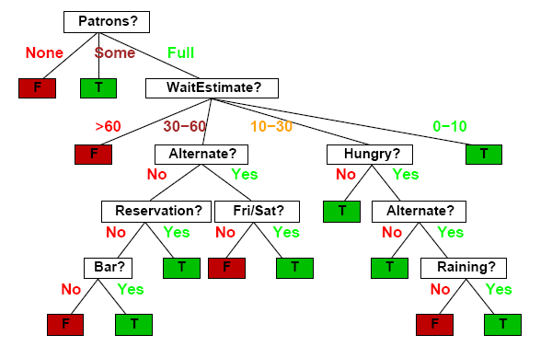
Decision Trees
Should I wait at this restaurant?

Slide 14
Decision Tree Induction
(Recursively) partition examples according to the most important attribute.
Key Concepts
entropy
impurity of a set of examples (entropy = 0 if perfectly homogeneous)
(#bits needed to encode class of an arbitrary example)
information gain
expected reduction in entropy caused by partitioning

Slide 15
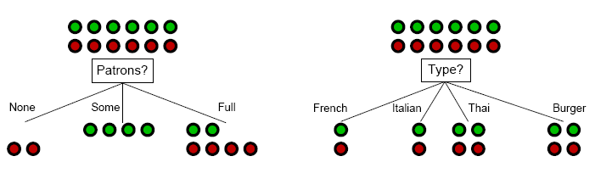
Decision Tree Induction: Attribute Selection
Intuitively: A good attribute splits the examples into subsets that are (ideally) all positive or all negative.

Slide 16
Decision Tree Induction: Attribute Selection
Intuitively: A good attribute splits the examples into subsets that are (ideally) all positive or all negative.

Slide 17
Decision Tree Induction: Decision Boundary

Slide 18
Decision Tree Induction: Decision Boundary

Slide 19
Decision Tree Induction: Decision Boundary

Slide 20
Decision Tree Induction: Decision Boundary

Slide 21
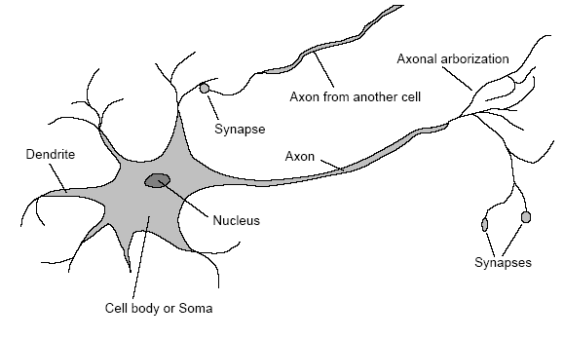
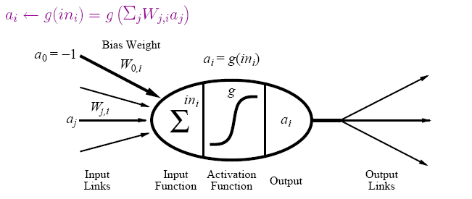
(Artificial) Neural Networks
Motivation: human brain
massively parallel (10¹¹ neurons, ~20 types)
small computational units with simple low-bandwidth communication (10¹⁴ synapses, 1-10ms cycle time)
Realization: neural network
units (≈ neurons) connected by directed weighted links
activation function from inputs to output

Slide 22
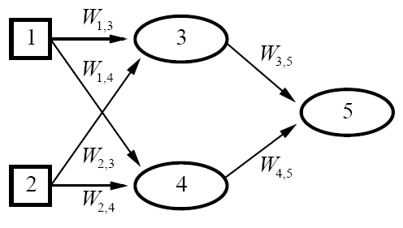

Neural Networks (continued)
neural network = parameterized family of nonlinear functions
types
feed-forward (acyclic): single-layer perceptrons, multi-layer networks
recurrent (cyclic): Hopfield networks, Boltzmann machines
[ connectionism, parallel distributed processing]

Slide 23
Neural Network Learning
Key Idea: Adjusting the weights changes the function represented by the neural network (learning = optimization in weight space).
Iteratively adjust weights to reduce error (difference between network output and target output).
Weight Update
perceptron training rule
linear programming
delta rule
backpropagation

Slide 24
Neural Network Learning: Decision Boundary
single-layer perceptron
multi-layer network

Slide 25
Support Vector Machines
Kernel Trick: Map data to higher-dimensional space where they will be linearly separable.
Learning a Classifier
optimal linear separator is one that has the largest margin between positive examples on one side and negative examples on the other
= quadratic programming optimization

Slide 26
Support Vector Machines (continued)
Key Concept: Training data enters optimization problem in the form of dot products of pairs of points.
support vectors
weights associated with data points are zero except for those points nearest the separator (i.e., the support vectors)
kernel function K(x_{i},x_{j})
function that can be applied to pairs of points to evaluate dot products in the corresponding (higher-dimensional) feature space F (without having to directly compute F(x) first)
efficient training and complex functions!

Slide 27
Support Vector Machines: Decision Boundary
Ф

Slide 28
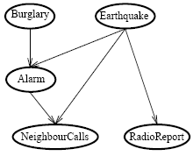
Bayesian Networks
Network topology reflects direct causal influence
Basic Task: Compute probability distribution for unknown variables given observed values of other variables.
[belief networks, causal networks]
 | A B | A ¬B | ¬A B | ¬A ¬B
C | 0.9 | 0.3 | 0.5 | 0.1
¬C | 0.1 | 0.7 | 0.5 | 0.9
conditional probability table
for NeighbourCalls

Slide 29
Bayesian Network Learning
Key Concepts
nodes (attributes) = random variables
conditional independence
an attribute is conditionally independent of its non-descendants, given its parents
conditional probability table
conditional probability distribution of an attribute given its parents
Bayes Theorem
P(h|D) = P(D|h)P(h) / P(D)

Slide 30
Bayesian Network Learning (continued)
Find most probable hypothesis given the data.
In theory: Use posterior probabilities to weight hypotheses. (Bayes optimal classifier)
In practice: Use single, maximum a posteriori (most probable) hypothesis.
Settings
known structure, fully observable (parameter learning)
unknown structure, fully observable (structural learning)
known structure, hidden variables (EM algorithm)
unknown structure, hidden variables (?)

Slide 31
Nearest Neighbor Models
Key Idea: Properties of an input x are likely to be similar to those of points in the neighborhood of x.
Basic Idea: Find (k) nearest neighbor(s) of x and infer target attribute value(s) of x based on corresponding attribute value(s).
Form of non-parametric learning where hypothesis complexity grows with data (learned model ≈ all examples seen so far)
[instance-based learning, case-based reasoning, analogical reasoning]

Slide 32
Nearest Neighbor Model: Decision Boundary

Slide 33
Explanation-Based Learning
Amazed crowd of cavemen observe Zog roasting a lizard on the end of a pointed stick (“Look what Zog do!”) and thereafter abandon roasting with their bare hands.
Basic Idea: Generalize by explaining observed instance.
form of speedup learning
doesn’t learn anything factually new from the observation
instead converts first-principles theories into useful special-purpose knowledge
utility problem
cost of determining if learned knowledge is applicable may outweight benefits from its application

Slide 34
Relevance-Based Learning
Mary travels to Brazil and meets her first Brazilian (Fernando), who speaks Portuguese. She concludes that all Brazilians speak Portuguese but not that all Brazilians are named Fernando.
Basic Idea: Use knowledge of what is relevant to infer new properties about a new instance.
form of deductive learning
learns a new general rule that explains observations
does not create knowledge outside logical content of prior knowledge and observations

Slide 35
Knowledge-Based Inductive Learning
Medical student observes consulting session between doctor and patient at the end of which the doctor prescribes a particular medication. Student concludes that the medication is effective treatment for a particular type of infection.
Basic Idea: Use prior knowledge to guide hypothesis generation.
benefits in inductive logic programming
only hypotheses consistent with prior knowledge and observations are considered
prior knowledge supports smaller (simpler) hypotheses

Slide 36
Reinforcement Learning
k-armed bandit problem:
Agent is in a room with k gambling machines (one-armed bandits). When an arm is pulled, the machine pays off 1 or 0, according to some unknown probability distribution. Given a fixed number of pulls, what is the agent’s (optimal) strategy?
Basic Task: Find a policy π, mapping states to actions, that maximizes (long-term) reward.
Model (Markov Decision Process)
set of states S
set of actions A
reward function R : S × A → ℜ
state transition function T : S × A → Π(S)
T(s,a,s') = probability of reaching s' when a is executed in s

Slide 37
Reinforcement Learning (continued)
Settings
fully vs. partially observable environment
deterministic vs. stochastic environment
model-based vs. model-free
rewards in goal state only or in any state
value of a state: expected infinite discounted sum of reward the agent will gain if it starts from that state and executes the optimal policy
Solving MDP when the model is known
value iteration: find optimal value function (derive optimal policy)
policy iteration: find optimal policy directly (derive value function)

Slide 38
Reinforcement Learning (continued)
Reinforcement learning is concerned with finding an optimal policy for an MDP when the model (transition, reward) is unknown.
exploration/exploitation tradeoff
model-free reinforcement learning
learn a controller without learning a model first
e.g., adaptive heuristic critic (TD(λ)), Q-learning
model-based reinforcement learning
learn a model first
e.g., Dyna, prioritized sweeping, RTDP

Slide 39
Unsupervised Learning
Learn patterns from (unlabeled) data.
Approaches
clustering (similarity-based)
density estimation (e.g., EM algorithm)
Performance Tasks
understanding and visualization
anomaly detection
information retrieval
data compression

Slide 40
Performance Evaluation
Randomly split examples into training set U and test set V.
Use training set to learn a hypothesis H.
Measure % of V correctly classified by H.
Repeat for different random splits and average results.

Slide 41
Performance Evaluation: Learning Curves
classification accuracy
classification error
#training examples

Slide 42
Performance Evaluation: ROC Curves
false negatives
false positives

Slide 43
Performance Evaluation: Accuracy/Coverage
classification accuracy
coverage

Slide 44
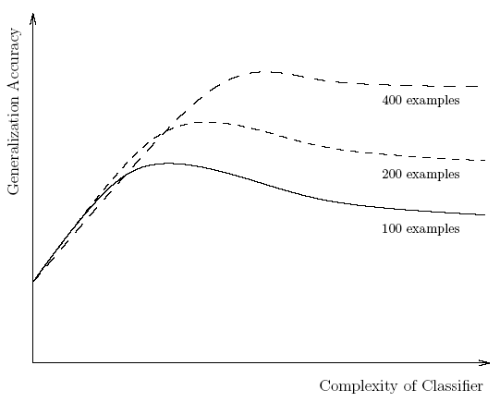
Triple Tradeoff in Empirical Learning
size/complexity of learned classifier
amount of training data
generalization accuracy
bias-variance tradeoff

Slide 45
Current Machine Learning Research
Representation
data sequences
spatial/temporal data
probabilistic relational models
…
Approaches
ensemble methods
cost-sensitive learning
active learning
semi-supervised learning
collective classification
…

