Slide 1
INDUSTRY 4.0
WHAT’S IT ALL ABOUT?

Slide 2
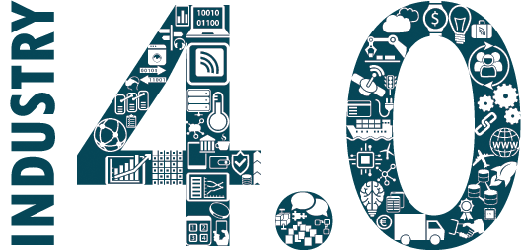
What is Industry 4.0?
“
”
Industry 4.0 is more than just a flashy catchphrase. A confluence of trends and technologies promises to reshape the way things are made.
— Cornelius Baur and Dominik Wee, McKinsey & Company

Slide 3
Transformation: Industry 0 to Industry 4.0
Industry 0
Hand Crafted
Industry 1.0
Mechanical production via water & stream
Industry 2.0
Mass Production and Division of Labour
Industry 3.0
Advanced Automation of Production Processes with Electronics and Logic
A Digital Supply Chain and Smart Manufacturing. Cyber-physical systems.
Industry 4.0

Slide 4
Principles of the 4th industrial revolution
Interoperability
Information transparency
4th industrial revolution
Technical assistance
Decentralized decisions

Slide 5
What’s Inside?
RPA
Machine Learning
IoT
Artificial Intelligence
Industry 4.0
Additive Manufacturing
Big Data
Cloud Computing
Augmented Reality

Slide 6
Robotic Process Automation - RPA
RPA is the transformation and automation of business processes. RPA changes the approach to the performance of repetitive tasks related to manual data entry and processing.
Optimization of the existing infrastructure
Uses existing applications
RPA
Your virtual employee
No Physical robot

Slide 7

Robotic Process Automation - RPA
Benefits of RPA for Business
Increases scalability and flexibility of business processes
RPA tools can work 24/7
One software robot can do the work of 3-5 FTE
RPA allows achieving 40-80% cost savings
Fact box
Solution providers report that implementation of RPA yields to 40 – 80% of business process costs’ reduction.
! RPA has become one of the most efficient ways towards process optimization.

Slide 8
Internet of Things - IoT
IoT is usually defined as the connection between wireless technologies, microcontrollers, services and the Internet. It collects, transforms, and transmits real-time data from any device or machine – anywhere.
Any Device Anything
Anytime Any Context
Anybody Anyone
IoT
Any Place Anywhere
Any Service Any Business
Any Path Any Network

Slide 9
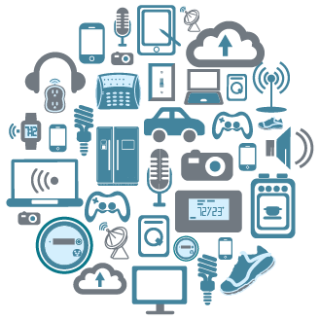
Internet of Things - IoT
Fact box
$1.4 TRILLION by 2021 ! IDC: Expects worldwide spending on IoT hardware, software, services, and connectivity to reach $1.4 trillion by 2021.
$11.1 TRILLION by 2025
! McKinsey: Predicts the IoT will have an $11.1 trillion per year impact by 2025

Slide 10
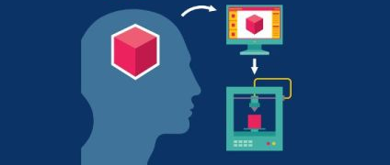
Additive Manufacturing
Often referred to by its far more sensational-sounding description of 3D printing, additive manufacturing is, in fact, a technology which has been around for at least three decades.

Slide 11
Additive Manufacturing
3D printing
Benefits of Additive Manufacturing for Business
Efficient use of resources
Small-lot production
Rapid manufacturing
Agile manufacturing
Reverse engineering
Components of Additive Manufacturing
Rapid Prototyping
Selective Laser Sintering

Slide 12

Cloud Computing
Instant computing infrastructure, provisioned and managed over the Internet.
Infrastructure-as-a-
Service
Cloud computing is the delivery of on-demand computing services -- from applications to storage and processing power -- typically over the internet and on a pay-as-you-go basis.
Delivery of hardware and software tools -- usually those needed for application development -- to users over the internet
Platform-as-a-Service
Delivery of applications-as-a-service.
Software-as-a-Service

Slide 13
Cloud Computing
Fact box
Benefits of Additive Manufacturing for Business
Reduced IT costs
Scalability
Business continuity
Collaboration efficiency
Flexibility of work practices
Access to automatic updates
Studies predict that more than 50% of all information technology will be in the cloud within the next 5 to 10 years.
In the next five years, hybrid clouds are expected to represent 43% of the market – higher than both public and private.

Slide 14
Augmented Reality - AR
AR is the technology that expands our physical world by adding layers of digital information onto it. AR appears in direct view of an existing environment and adds sounds, videos, graphics to it.
Navigation & the Travel Industry
Retail & E-commerce
Education & Science
Medicine
Architecture
Creative Industry
Next Generation Instructions

Slide 15
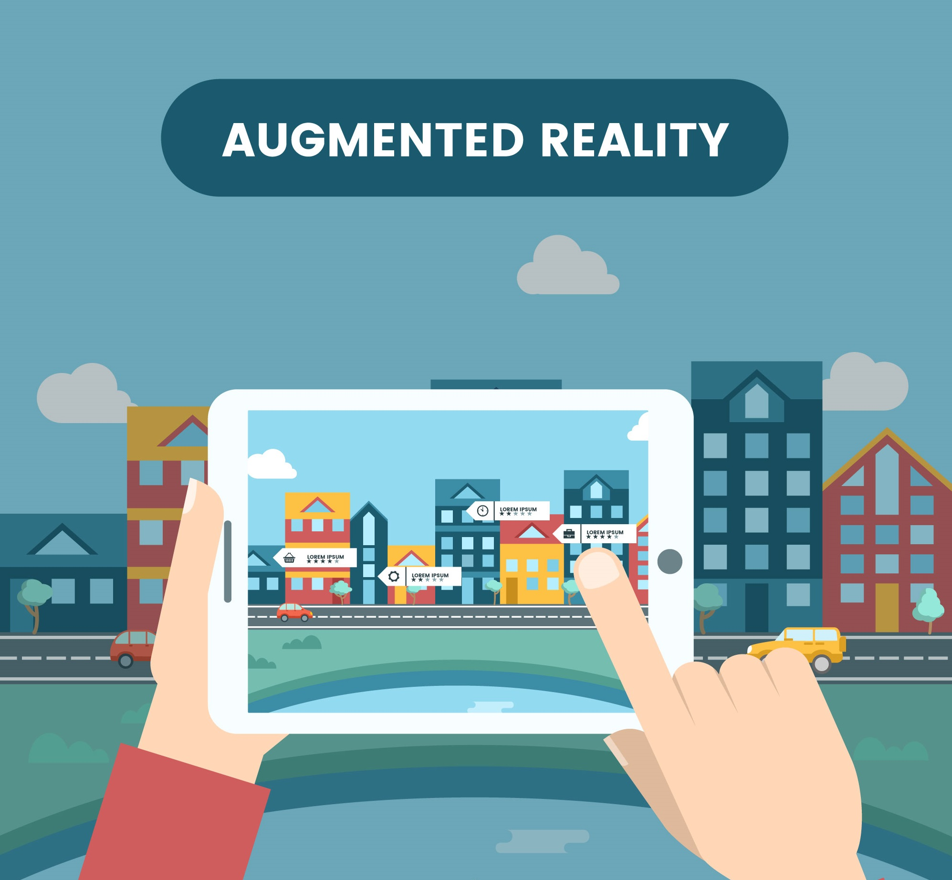
Augmented Reality
Fact box
30% of smartphone users use an AR app at least once a week. That’s over 60 million people in the US.
By 2020 the revenue for AR is expected to reach $120 billion.
69% of US respondents believe that using AR in workplace training could make their jobs easier to do.

Slide 16
Big Data
Big data is an evolving term that describes any voluminous amount of structured, semi structured and unstructured data that has the potential to be mined for information.
Big Data is used for
Understanding and Targeting Customers
Understanding and Optimizing Business Processes
Personal Quantification and Performance Optimization
Improving Healthcare and Public Health
Improving Sports Performance
Improving Science and Research
Optimizing Machine and Device Performance
Improving Security and Law Enforcement
Improving and Optimizing Cities and Countries
Financial Trading

Slide 17

Practical Big Data Benefits
Better dialogue with consumers
Opportunity for product re-development
Efficient risk analysis
High level of data safety
New revenue streams
Real time website customization
Acquiring enterprise-wise insights
Making cities smarter

Slide 18
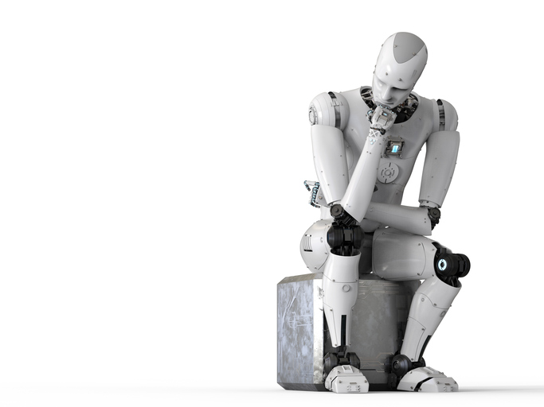
Artificial Intelligence & Machine Learning
AI is the simulation of human intelligence processes by machines.
This includes learning (the acquisition of information and rules for using the information), reasoning (using the rules to reach approximate or definite conclusions) and self-correction
! Machine learning is a way to make AI possible.

Slide 19
Artificial Intelligence & Machine Learning
Fact box
Top uses for AI and machine learning
Respondents who have experience with AI and machine learning:
49% have heard or read about it
28% have personal experience working with it
15% have colleagues who have worked with it
Research
Office automation
Security monitoring
Consumer Behavior Analysis
Fraud Detection
Market projection/sales forecasting

Slide 20

Benefits of Industry 4.0
More precise control over production lines
Improve consistency of production
Increase efficiency and revenue
Predictive maintenance
Less waste
Enables higher growth levels
Sustainable Manufacturing
Increase customer satisfaction

