Slide 1
Cluster Analysis
Notes:
1

Slide 2
Data Mining: Confluence of Multiple Disciplines
Machine
Learning
Pattern
Recognition
Statistics
Applications
Data Mining
Visualization
Algorithm
Database
Technology
High-Performance
Computing

Slide 3
Cluster Analysis: Basic Concepts and Methods
3
Notes:
3

Slide 4
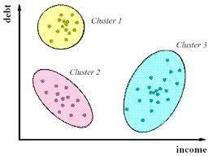
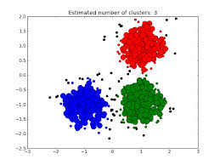
Cluster Analysis: Basic Concepts and Methods

Slide 5
What is Cluster Analysis?
Cluster: A collection of data objects
similar (or related) to one another within the same group
dissimilar (or unrelated) to the objects in other groups
Cluster analysis (or clustering, data segmentation, …)
Finding similarities between data according to the characteristics found in the data and grouping similar data objects into clusters
Unsupervised learning: no predefined classes (i.e., learning by observations vs. learning by examples: supervised)
Typical applications
As a stand-alone tool to get insight into data distribution
As a preprocessing step for other algorithms

Slide 6
Applications of Cluster Analysis
Data reduction
Summarization: Preprocessing for regression, PCA, classification, and association analysis
Compression: Image processing: vector quantization
Hypothesis generation and testing
Prediction based on groups
Cluster & find characteristics/patterns for each group
Finding K-nearest Neighbors
Localizing search to one or a small number of clusters
Outlier detection: Outliers are often viewed as those “far away” from any cluster

Slide 7
Clustering Application : Examples
Biology: taxonomy of living things: kingdom, class, order, family, genus and species
Information retrieval: document clustering
Land use: Identification of areas of similar land use in an earth observation database
Marketing: Help marketers discover distinct groups in their customer bases, and then use this knowledge to develop targeted marketing programs

Slide 8
Clustering Application : Examples
City-planning: Identifying groups of houses according to their house type, value, and geographical location
Earth-quake studies: Observed earth quake epicenters should be clustered along continent faults
Climate: understanding earth climate, find patterns of atmospheric and ocean
Economic Science: market resarch

Slide 9
Considerations for Cluster Analysis
Partitioning criteria
Single level vs. hierarchical partitioning (often, multi-level hierarchical partitioning is desirable)
Separation of clusters
Mutually exclusive (e.g., one customer belongs to only one region) vs. non-exclusive (e.g., one document may belong to more than one class)
Similarity measure
Distance-based (e.g., Euclidian, road network, vector) vs. connectivity-based (e.g., density or contiguity)
Clustering space
Full space (often when low dimensional) vs. subspaces (often in high-dimensional clustering)

Slide 10
Measure the Quality of Clustering
Dissimilarity/Similarity metric
Similarity is expressed in terms of a distance function, typically metric: d(i, j)
The definitions of distance functions are usually rather different for interval-scaled, boolean, categorical, ordinal ratio, and vector variables
Weights should be associated with different variables based on applications and data semantics

Slide 11
Measure the Quality of Clustering
Quality of clustering
There is usually a separate “quality” function that measures the “goodness” of a cluster.
It is hard to define “similar enough” or “good enough”
The answer is typically highly subjective

Slide 12
Major Clustering Approaches
Partitioning approach:
Construct various partitions and then evaluate them by some criterion, e.g., minimizing the sum of square errors
Finds mutually exclusive clusters of spherical shape
Typical methods: k-means, k-medoids, CLARANS
Hierarchical approach:
Create a hierarchical decomposition of the set of data (or objects) using some criterion
Typical methods: Diana, Agnes, BIRCH, CAMELEON

Slide 13
The K-Means Clustering Method
Given k, the k-means algorithm is implemented in four steps:
1. Partition objects into k nonempty subsets
2. Compute seed points as the centroids of the clusters of the current partitioning (the centroid is the center, i.e., mean point, of the cluster)
3. Assign each object to the cluster with the nearest seed point
4. Go back to Step 2, stop when the assignment does not change

Slide 14
The K-means Algorithm
Input
k: the number of clusters
D: a dataset containing n elements
Output: a set of k clusters
Method
(1) arbitrarily choose k elements from D as the initial cluster center
(2) repeat
(3) (re) assign each element to the cluster to which the object is similar based on mean value (closest to)
(4) once all of the elements are assigned to clusters, calculate the actual cluster means
(5) until there is no change between the new and old cluster means

Slide 15
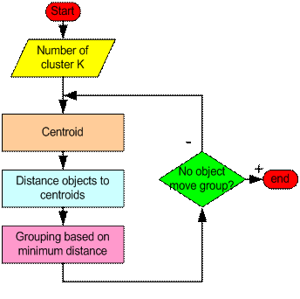
How the K-Mean Clustering algorithm works

Slide 16
Example: k-means algorithm (K=2)

Slide 17
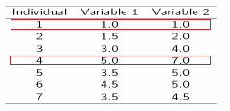
Example: k-means algorithm (K=2)
Initialization: Randomly we choose following two centroids (k=2) for two clusters.
In this case the 2 centroid are: m1=(1.0,1.0) and m2=(5.0,7.0).

Slide 18



Example: k-means algorithm (K=2)
Thus, we obtain two clusters containing:
{1,2,3} and {4,5,6,7}.
Their new centroids are:

Slide 19
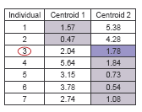
Example: k-means algorithm (K=2)
Now using these centroids we compute the Euclidean distance of each object, as shown in table.
Therefore, the new clusters are:
{1,2} and {3,4,5,6,7}
Next centroids are: m1=(1.25,1.5) and m2 = (3.9,5.1)

Slide 20
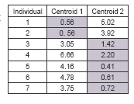
Example: k-means algorithm (K=2)
The clusters obtained are:
{1,2} and {3,4,5,6,7}
Therefore, there is no change in the cluster.
Thus, the algorithm comes to a halt here and final result consist of 2 clusters {1,2} and {3,4,5,6,7}.

Slide 21
Example: k-means algorithm (K=2)

Slide 22
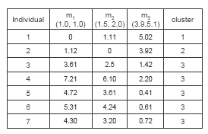
Example: k-means algorithm (K=3)
Step 1
Step 2

Slide 23
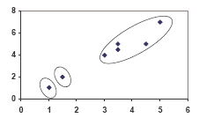
PLOT

Slide 24
An Example of K-Means Clustering
K=2
Arbitrarily partition objects into k groups
Update the cluster centroids
The initial data set
Loop if needed
Reassign objects
Partition objects into k nonempty subsets
Repeat
Compute centroid (i.e., mean point) for each partition
Assign each object to the cluster of its nearest centroid
Until no change
Update the cluster centroids

