Slide 1
ADVANCED DATA STORAGE TECHNIQUE IN PYTHON: LIST AND DICTIONARY
Farhan Sadaf
Lecturer,
CSE, KUET

Slide 2
Objectives
Create, index, and slice a list
Add and delete elements from a list
Use list methods to append, sort, and reverse a list
Use nested sequences to represent even more complex information
Use dictionaries to work with pairs of data
Add and delete dictionary items

Slide 3
Lists
Lists
Sequences of any type
Like tuples, but mutable (can be modified)
Essentially can do everything tuples can, plus more

Slide 4
Creating a List
List: A mutable sequence of any type
Creating an Empty List
inventory = []
Creating a List with Elements
inventory = ["sword", "armor", "shield",
"healing potion"]

Slide 5
Using len() and in with Lists
The len() function with lists
Just as with tuples, returns number of elements
print "You have", len(inventory), "items."
The in operator with lists
Just as with tuples, tests for element membership
if "healing potion" in inventory:
print "You will live to fight another day."

Slide 6
Indexing and Slicing Lists
Indexing lists
Just as with tuples, supply the position number of the element in brackets
print "At index", index, "is",inventory[index]
Slicing lists
Just as with tuples, supply the two end points, separated by a colon, in brackets
print inventory[begin:end]

Slide 7
Concatenating Lists
>>> inventory = ["sword", "armor", "shield",
"healing potion"]
>>> chest = ["gold", "gems"]
>>> inventory += chest
>>> print inventory
['sword', 'armor', 'shield', 'healing potion', 'gold', 'gems']
Just as with tuples, concatenation operator, +, works with lists

Slide 8
Understanding List Mutability
Mutable: Changeable
Lists are mutable
Elements (or slices) can be added
Elements (or slices) can be removed

Slide 9
Assigning a New List Element by Index
>>> inventory = ["sword", "armor", "shield",
"healing potion“, "gold", "gems"]
>>> inventory[0] = "crossbow”
>>> print inventory
[' crossbow', 'armor', 'shield', 'healing potion', 'gold', 'gems']
Just as with tuples, you can assign a value to an existing list element

Slide 10
Assigning a New List Slice
>>> inventory = ["crossbow", "armor", "shield",
"healing potion“, "gold", "gems"]
>>> inventory[4:6] = ["orb of future telling"]
>>> print inventory
['crossbow', 'armor', 'shield', 'healing potion', 'orb of future telling’]
Assignment statement replaces elements in slice with new element
Replaces the two elements inventory[4] and inventory[5] with
"orb of future telling"

Slide 11
Deleting a List Element
>>> inventory = ["crossbow", "armor", "shield",
"healing potion”, "orb of future telling"]
>>> del inventory[2]
>>> print inventory
['crossbow', 'armor', 'healing potion', 'orb of future telling’]
Designate element to delete after del

Slide 12
Deleting a List Slice
>>> inventory = ["crossbow", "armor", "shield",
"healing potion”, "orb of future telling"]
>>> del inventory[:2]
>>> print inventory
['healing potion', 'orb of future telling’]
Designate slice to delete after del

Slide 13
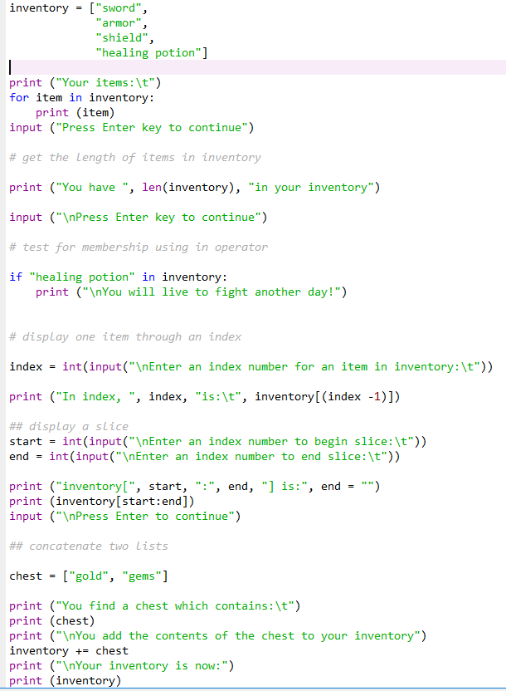
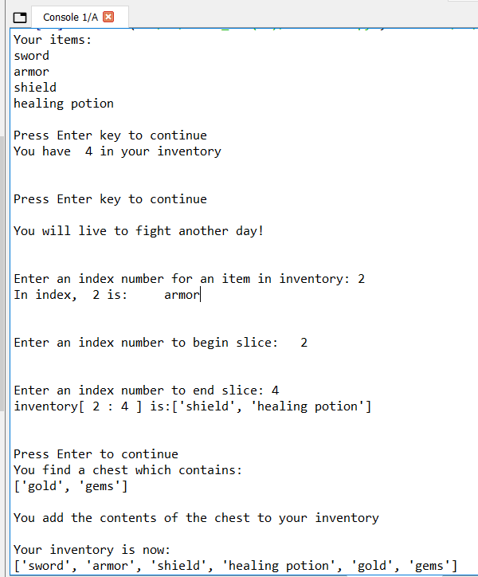
Inventory Program

Slide 14
Inventory Program

Slide 15
Inventory Program

Slide 16
Inventory Program

Slide 17
Inventory Program

Slide 18
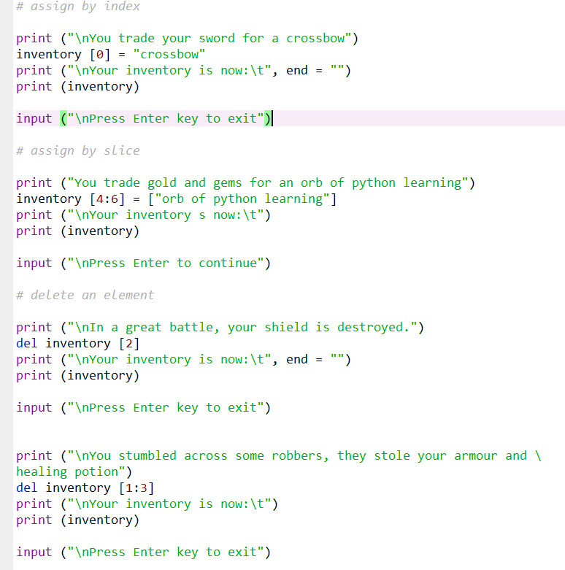
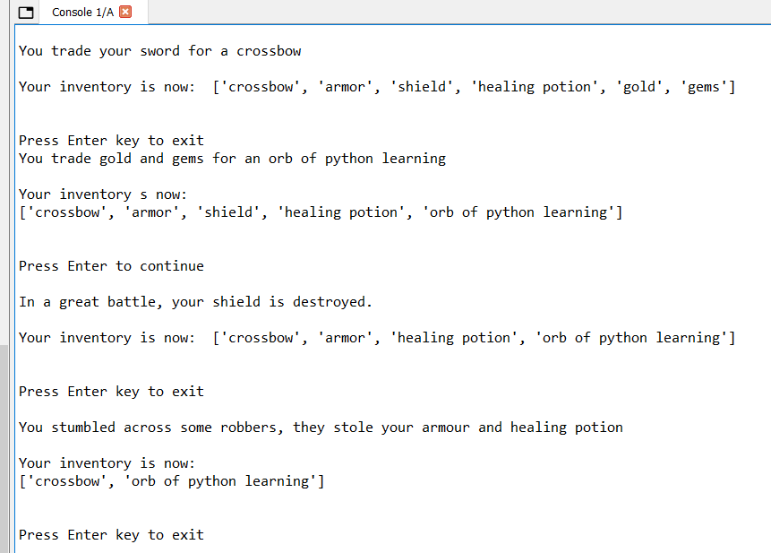
Inventory Program

Slide 19
Inventory Program

Slide 20
Inventory Program

Slide 21
Inventory Program

Slide 22
Using List Methods
List methods manipulate lists
Through list methods, you can:
Add an element
Remove an element
Sort a list
Reverse a list

Slide 23
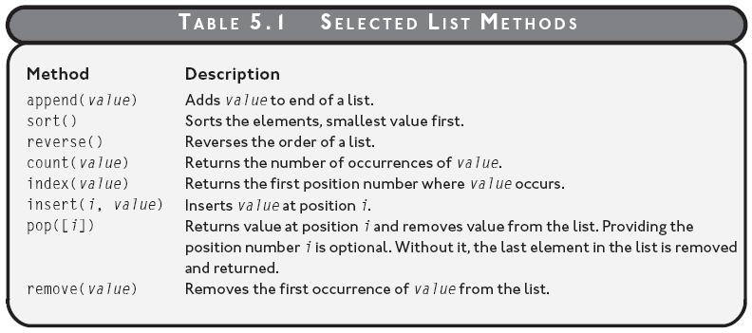
Selected List Methods

Slide 24
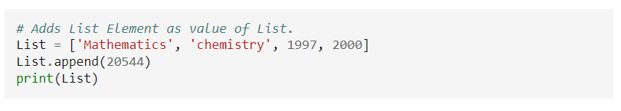
The List append() Method

Slide 25
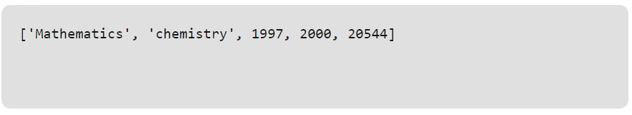
The List append() Method

Slide 26
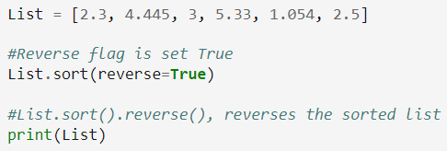
The List sort() Method

Slide 27
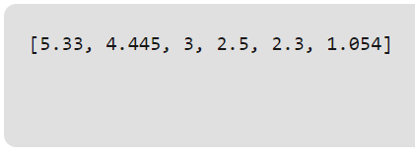
The List sort() Method

Slide 28
Using Nested Sequences
Nested Sequence: A sequence inside another sequence
A list can contain lists or tuples
A tuple can contain tuples or lists

Slide 29
Creating Nested Sequences
>>> scores = [("Moe", 1000), ("Larry", 1500),
("Curly", 3000)]
>>> print scores
[('Moe', 1000), ('Larry', 1500), ('Curly', 3000)]
scores is a nested sequence
scores is a list of tuples
scores has three elements, each of which is a tuple

Slide 30
Accessing Nested Elements
>>> scores = [("Moe", 1000), ("Larry", 1500),
("Curly", 3000)]
>>> print scores[2]
('Curly', 3000)
>>> print scores[2][0]
Curly
scores[2] is the element of the list at position 2
scores[2][0] is the element at position 0 of scores[2]

Slide 31
Unpacking a Sequence
>>> name, score = ("Shemp", 175)
>>> print name
Shemp
>>> print score
175
Sequence unpacking: Automatically accessing each element of a sequence
The tuple is unpacked as result of assignment statement

Slide 32
Accessing Elements of a Nested Sequence
for entry in scores:
score, name = entry
print name, "\t", score
entry is an element of scores
Assignment statement unpacks entry
score is assigned first element of entry
name is assigned second element of entry

Slide 33
Appending Elements to a Nested Sequence
entry = (score, name)
scores.append(entry)
append() method works for any list, including a list of sequences
New tuple entry is created
entry is appended to list scores as last element

Slide 34
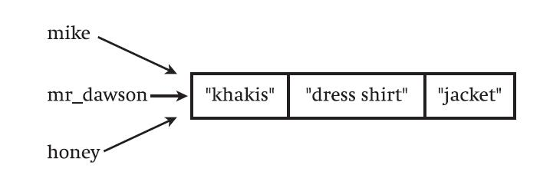
Shared References
Figure 5.9: A single object has three references to it.
Mike, mr_dawson and honey all refer to same single list.

Slide 35
Shared References
>>> mike = ["khakis", "dress shirt", "jacket"]
>>> mr_dawson = mike
>>> honey = mike
>>> print mike
['khakis', 'dress shirt', 'jacket']
>>> print mr_dawson
['khakis', 'dress shirt', 'jacket']
>>> print honey
['khakis', 'dress shirt', 'jacket’]
All variables refer to same single list

Slide 36
Shared References
>>> honey[2] = "red sweater"
>>> print honey
['khakis', 'dress shirt', 'red sweater']
>>> print mike
['khakis', 'dress shirt', 'red sweater']
>>> print mr_dawson
['khakis', 'dress shirt', 'red sweater’]
Change to list through one variable reflects change for all variables because there is only one list

Slide 37
Shared References
>>> mike = ["khakis", "dress shirt", "jacket"]
>>> honey = mike[:]
>>> honey[2] = "red sweater"
>>> print honey
['khakis', 'dress shirt', 'red sweater']
>>> print mike
['khakis', 'dress shirt', 'jacket']
List slicing can create a new copy of a list and avoid shared references

Slide 38
Using Dictionaries
Dictionary: A mutable collection of key-value pairs
Like tuple and list, dictionary is another built-in type
Unlike tuples and lists, dictionaries don’t organize data into sequences, but pairs
Works like actual dictionary; look up one thing to get another
Look up a key to get a value

Slide 39
Creating Dictionaries
geek = {"404" : "clueless.",
"Uninstalled" : "being fired."}
Creates new dictionary called geek
geek has two entries or items (or elements)
Each item is made up of a key and a value
404 is a key of one item; use it to look up value "clueless."
Create dictionary by pairing values with colon, separated by commas, surrounded by curly braces

Slide 40
Using a Key to Retrieve a Value
>>> geek["404"]
'clueless.'
>>> geek["Uninstalled"]
'being fired.'
Use key as index to get value
Cannot use value as index to get key
Using non-existent key as index produces error
Dictionaries don't have position numbers – no order

Slide 41
Testing for a Key with the in Operator
>>> if "Dancing Baloney" in geek:
print "I know what Dancing Baloney is."
else:
print "I have no idea what Dancing Baloney is."
I have no idea what Dancing Baloney is.
Use the in operator to test for key
Condition is True if key exists in dictionary, False otherwise
in operator can't be used to test for dictionary values

Slide 42
The Dictionary get() Method
>>> geek.get("404")
'clueless.'
>>> geek.get("Dancing Baloney")
None
>>> geek.get("Dancing Baloney", "I have no idea.")
'I have no idea.’
Used for retrieving value based on key
Has built-in safety net for handling non-existent key
If key exists, returns associated value
If key doesn’t exist, returns a default, program-provided value (or None if no default is provided)

Slide 43
Adding a Key-Value Pair
geek["Link Rot"] = "process by which web page links become obsolete."
Dictionaries are mutable
Add item by assigning value to dictionary indexed by key
Overwrites current entry if key already exists in dictionary

Slide 44
Deleting a Key-Value Pair
del geek["404"]
Removes key-value pair if key exists
Generates error if key doesn’t exist

Slide 45
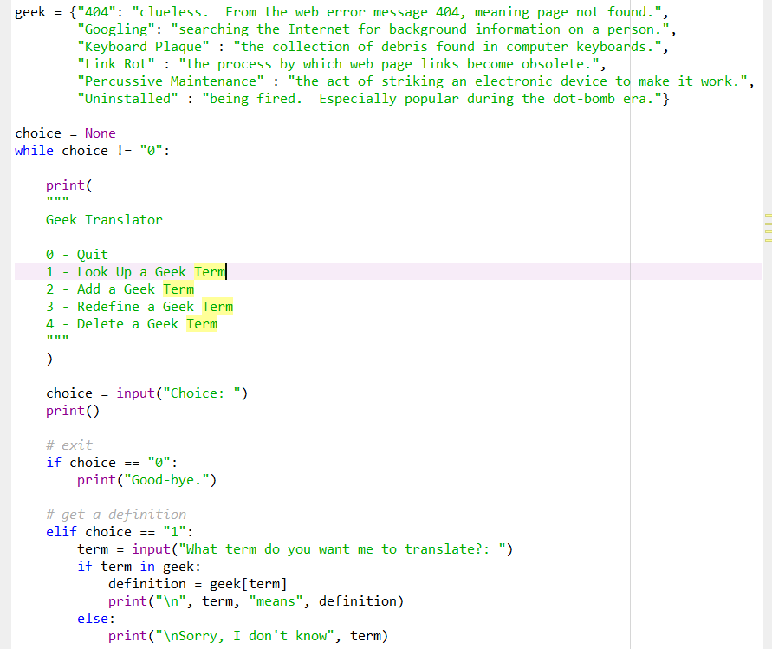
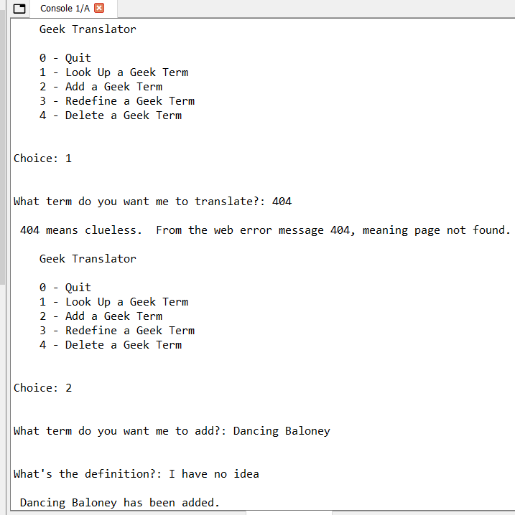
Geek Translator Program

Slide 46
Geek Translator Program

Slide 47
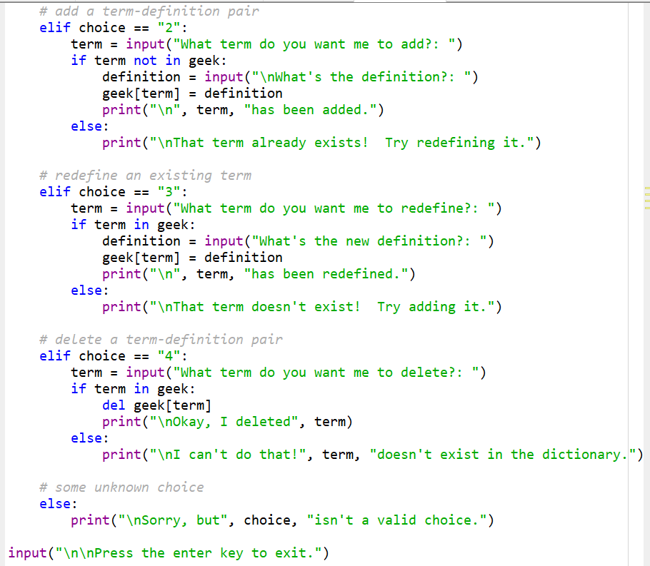
Geek Translator Program

Slide 48
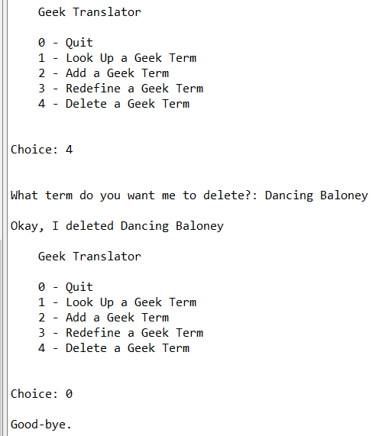
Geek Translator Program

Slide 49
Dictionary Requirements
Keys
Must be unique
Must be immutable
Values
Can be mutable or immutable
Doesn’t have to be unique

Slide 50
Built-in Dictionary Functions:
SN | Function with Description
1 | cmp(dict1, dict2)
 | Compares elements of both dict.
2 | len(dict)
 | Gives the total length of the dictionary. This would be equal to the number of items in the dictionary.
3 | str(dict)
 | Produces a printable string representation of a dictionary
4 | type(variable)
 | Returns the type of the passed variable. If passed variable is dictionary then it would return a dictionary type.

Slide 51
Built-in Dictionary Methods:
SN | Methods with Description
1 | dict.clear()
 | Removes all elements of dictionary dict
2 | dict.copy()
 | Returns a shallow copy of dictionary dict
2 | dict.fromkeys()
 | Create a new dictionary with keys from seq and values set to value.
3 | dict.get(key, default=None)
 | For key key, returns value or default if key not in dictionary
4 | dict.has_key(key)
 | Returns true if key in dictionary dict, false otherwise
5 | dict.items()
 | Returns a list of dict's (key, value) tuple pairs
6 | dict.keys()
 | Returns list of dictionary dict's keys
7 | dict.setdefault(key, default=None)
 | Similar to get(), but will set dict[key]=default if key is not already in dict
8 | dict.update(dict2)
 | Adds dictionary dict2's key-values pairs to dict
9 | dict.values()
 | Returns list of dictionary dict2's values

Slide 52
REFERENCES
https://www.geeksforgeeks.org/python-list/
https://www.tnstate.edu/faculty/fyao/COMP3050/Py-Slides-5.ppt

