Slide 1
Python Programming and Basic Data Science
EDGE
Lecture-3: Setting up the Environment (cont.)
Prof. Dr. G M Atiqur Rahaman
Computer Science and Engineering Discipline

Slide 2
Contents (Lec-1)
Jupyter Notebook
Setup Numpy
Setup Pandas

Slide 3
IPython and Shell Commands
Any command that works at the command-line can be used in IPython by prefixing it with the % character.
Get a list of the files in the required directory.
In [ ]: %ls
In [ ]: %ls {'C:\\Users\\csepc2022\sample1’}
Get the current working directory
In []: %pwd
Print texts in the shell
In [3]: %echo "printing from the shell

Slide 4
IPython and Shell Commands
Shell commands can not only be called from IPython, but can also be made to interact with the IPython namespace.
For example, save the output of any shell command to a Python list using the assignment operator:
In [4]: contents = !ls
In [5]: print(contents)
In [6]: directory = !pwd
In [7]: print(directory)

Slide 5
IPython and Shell Commands
Note that these results are not returned as lists, but as a special shell return type defined in IPython:
In [8]: type(directory)
IPython.utils.text.Slist
This looks and acts a lot like a Python list, but has additional functionality, such as the grep and fields methods and the s, n, and p properties that allow you to search, filter, and display the results in convenient ways.
For more information on these, you can use IPython's built-in help features.

Slide 6
IPython and Shell Commands
Communication in the other direction–passing Python variables into the shell–is possible using the {varname} syntax:
In [9]: message = "hello from Python"
In [10]: !echo {message}
The curly braces contain the variable name, which is replaced by the variable's contents in the shell command.

Slide 7
Shell-Related Magic Commands
Change the working directory
In[ ]: %cd C:\Users
In[ ]: cd C:\Users
Besides %cd, other available shell-like magic functions are %cat, %cp, %env, %ls, %man, %mkdir, %more, %mv, %pwd, %rm, and %rmdir, any of which can be used without the % sign if automagic is on.

Slide 8
Shell-Related Magic Commands
Create a new directory
In [16]: mkdir tmp
List the files and directories
In [17]: ls
Copy file to the new directory
In [18]: copy myproject.txt tmp/
In [19]: ls tmp
A list of available magic commands and their usage:
https://ipython.readthedocs.io/en/stable/interactive/magics.html

Slide 9
Errors and Debugging
Code development and data analysis always require a bit of trial and error, and IPython contains tools to streamline this process.
This section covers some options for controlling Python's exception reporting, followed by exploring tools for debugging errors in code.

Slide 10
Controlling Exceptions: %xmode
Most of the time when a Python script fails, it will raise an Exception. When the interpreter hits one of these exceptions, information about the cause of the error can be found in the traceback, which can be accessed from within Python.
With the %xmode magic function, IPython allows you to control the amount of information printed when the exception is raised. Consider the following code

Slide 11
Controlling Exceptions: %xmode
Consider the following code:
def func1(a, b):
return a / b
def func2(x):
a = x
b = x - 1
return func1(a, b)

Slide 12
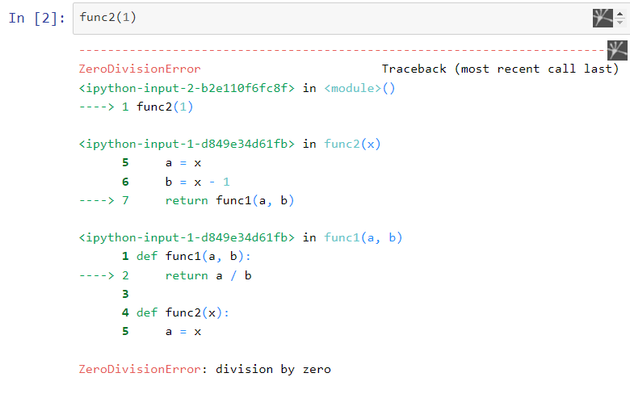
Controlling Exceptions: %xmode

Slide 13
Controlling Exceptions: %xmode
Using the %xmode magic function (short for Exception mode), we can change what information is printed.
%xmode takes a single argument, the mode, and there are three possibilities: Plain, Context, and Verbose.
The default is Context, and gives output like that just shown before.
Plain is more compact and gives less information:

Slide 14
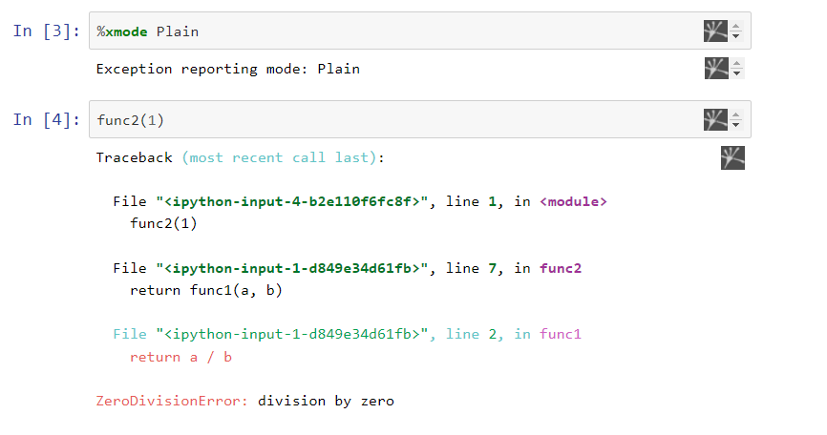
Controlling Exceptions: %xmode

Slide 15
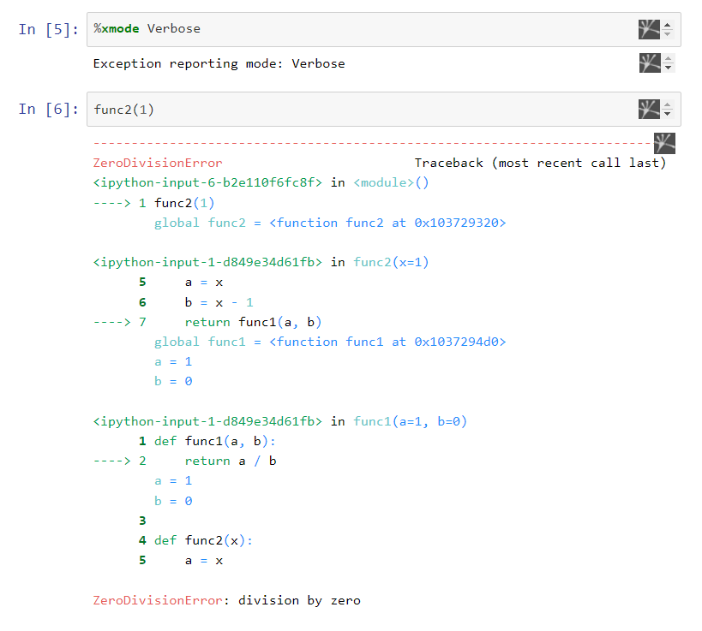
Controlling Exceptions: %xmode
The Verbose mode adds some extra information, including the arguments to any functions that are called:

Slide 16
Controlling Exceptions: %xmode
This extra information can help narrow-in on why the exception is being raised. So why not use the Verbose mode all the time?
As code gets complicated, this kind of traceback can get extremely long.
Depending on the context, sometimes the brevity of Default mode is easier to work with.

Slide 17
Debugging: When Reading Tracebacks Is Not Enough
There are many ways to launch and use the debuggers.
In IPython, the most convenient interface to debugging is the %debug magic command.
If you call it after hitting an exception, it will automatically open an interactive debugging prompt at the point of the exception.
The ipdb prompt lets you explore the current state of the stack, explore the available variables, and even run Python commands!

Slide 18
Debugging: When Reading Tracebacks Is Not Enough
Let's look at the most recent exception, then do some basic tasks–print the values of a and b, and type quit to quit the debugging session:
import pdb; pdb.set_trace()

Slide 19
TRY IT YOURSELF!!

