Slide 1
FILES
Md. Ariful Islam Khandaker
Assistant Professor
IICT, KUET

Slide 2
Introduction
A file is place on the disk where a group of related data is stored.
File Operations:
Naming a file
Opening a file
Reading data from a file
Writing data to a file
Closing a file

Slide 3
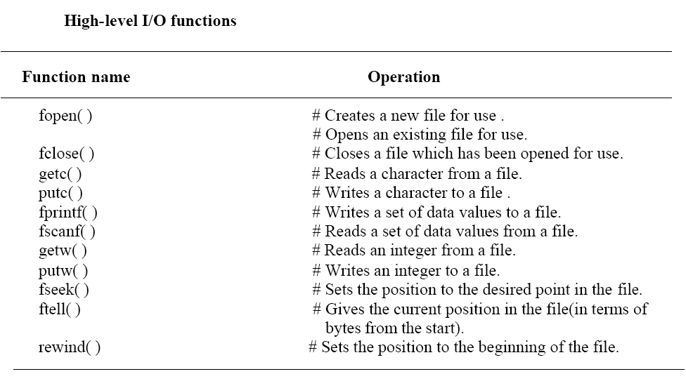
File Operation Functions

Slide 4
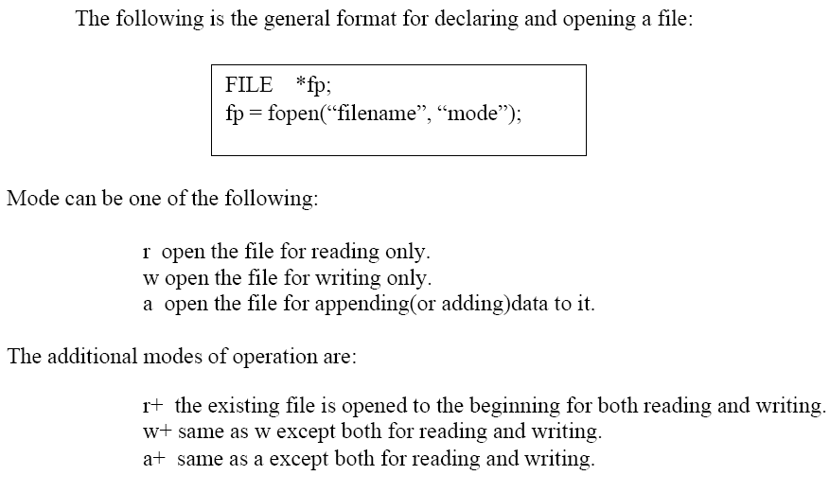
DEFINING AND OPENING A FILE
Filename is a string of characters that make up a valid filename for the operating
System. It may contain two parts, a primary name and an optional period with
the extension. Examples
Input.data, Store.txt,Data.dat etc

Slide 5
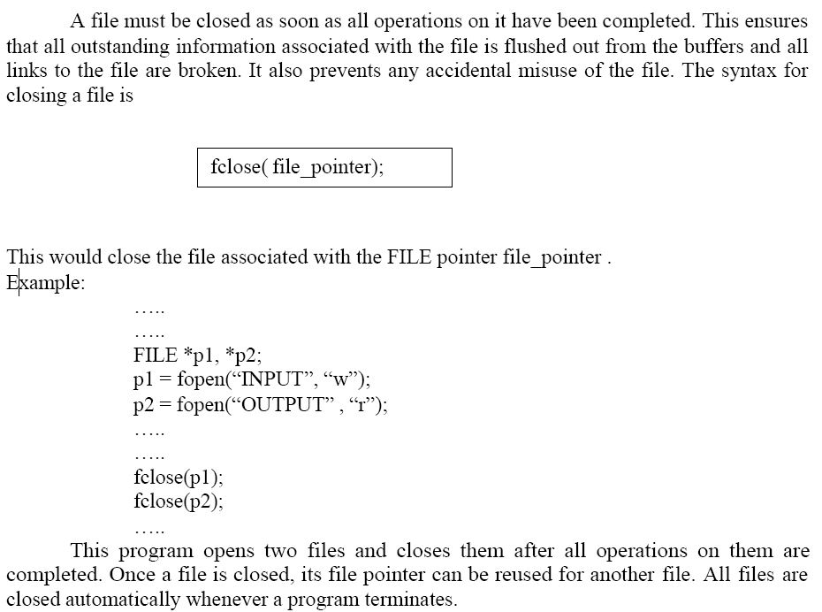
CLOSING A FILE

Slide 6
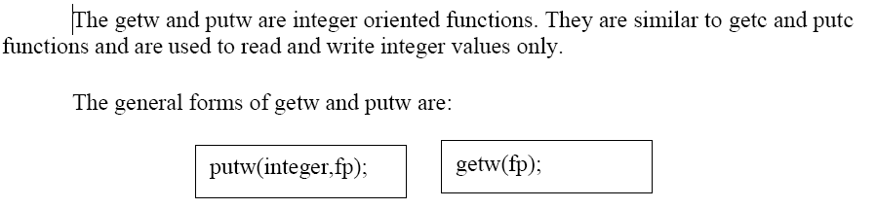
INPUT/OUTPUT OPERATIONS ON FILES
The getc and putc functions
The file i/o functions getc and putc are similar to getchar and putchar functions and handle one character at a time. The statement
putc(c, fp1);
writes the character contained in the character variable c to the file associated with FILE pointer fp1. Similarly, getc is used to read a character from a file that has been opened in the read mode. For example, the statement
c = getc(fp2);
would read a character from the file whose file pointer is fp2.
The getw and putw functions

Slide 7
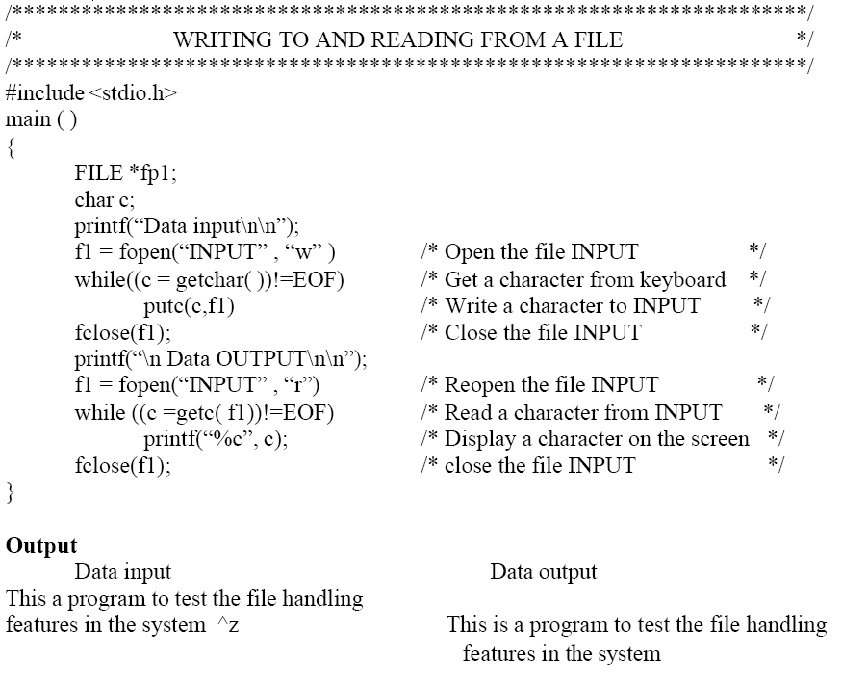
Program

Slide 8
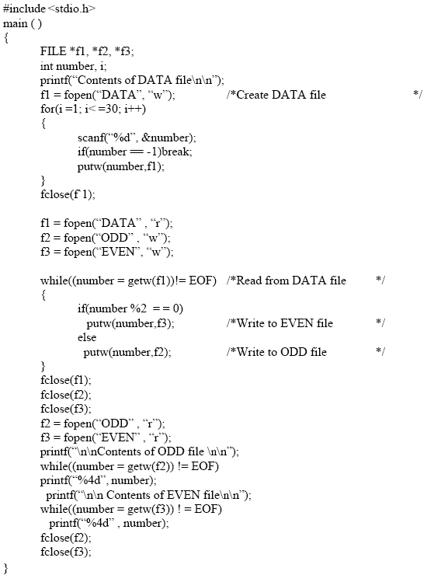
Another Example for Integer VALUES

Slide 9
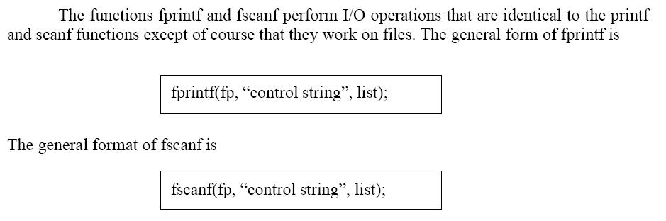
The fprintf and fscanf functions

Slide 10
Example using fprintf and fscanf functions
#include<stdio.h>
int main( ){
int i,n,m,p;
FILE *fp;
fp=fopen(“c:\\input.txt”,”a”);
printf(“How many data you want to store?”);
scanf(“%d”,&n);
for(i=0;i<n;i++) {
scanf(“%d”,&m);
fprintf(fp,”%d\n”,m);}
fclose(fp);
fp=fopen(“c:\\input.txt”,”r”);
while(1) {
fscanf(fp,”%d”,&p);
if(feof(fp))
break;
printf(“%d”, p);
}
fclose(fp);
return 0; }
For float and string data you need to change only %f and %s

Slide 11
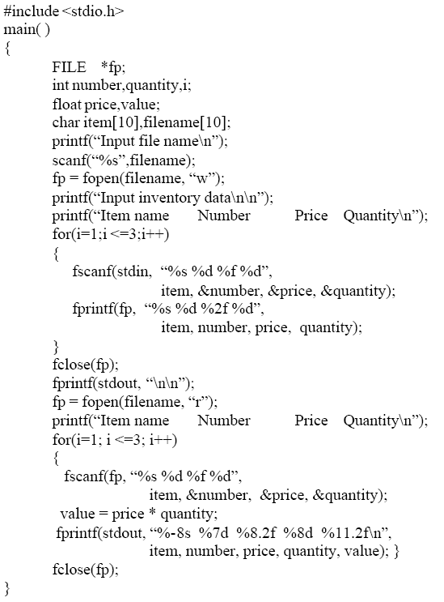
Program HANDLING OF FILES WITH MIXED DATA TYPES
(fscanf and fprintf )

Slide 12
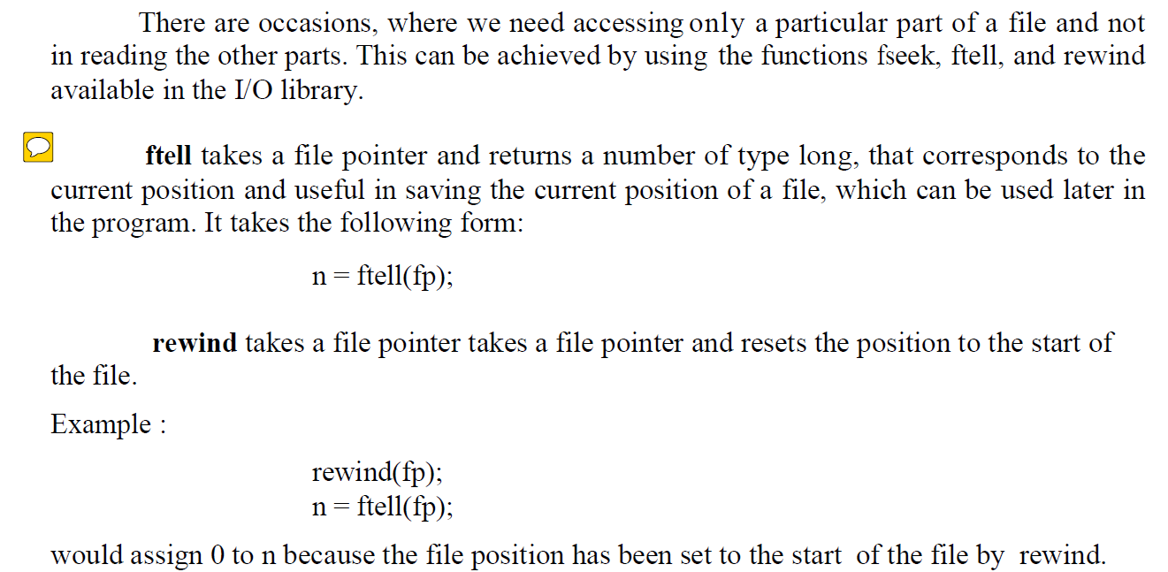
Random Access to File

Slide 13
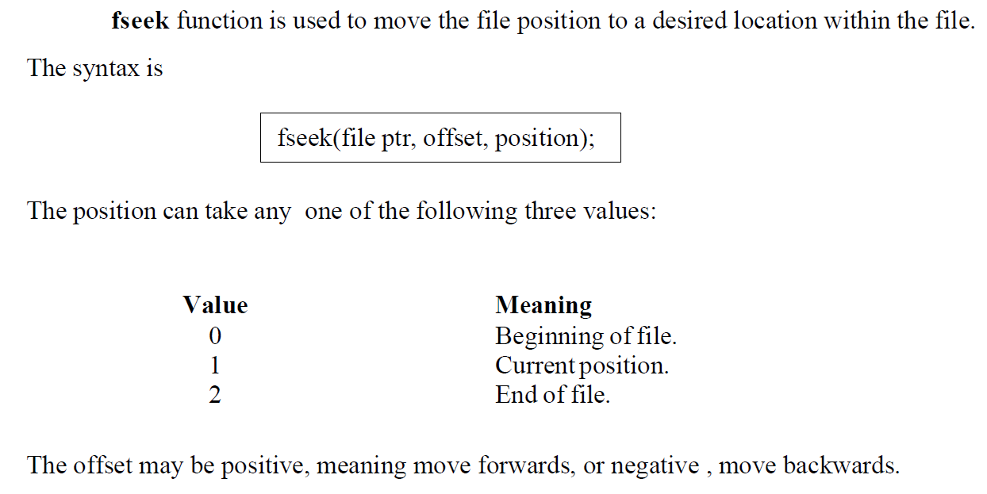
Random Access to File

Slide 14
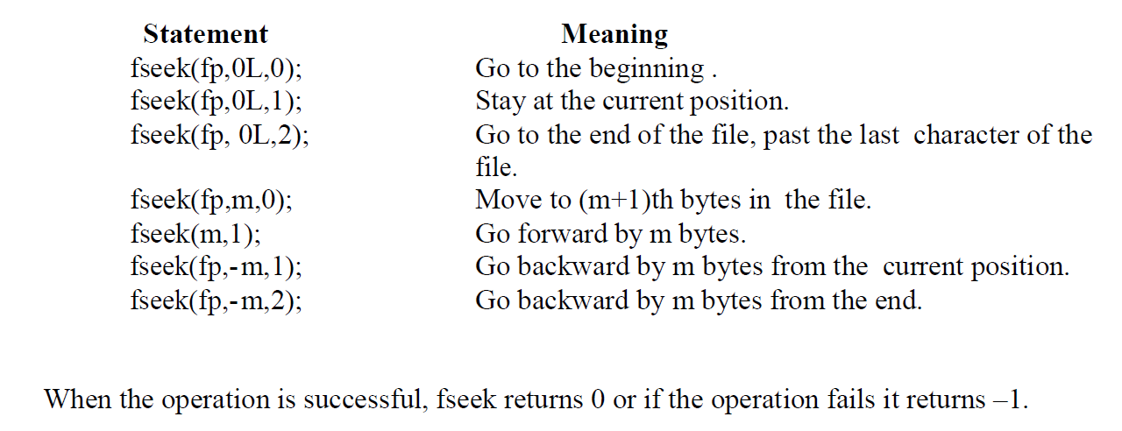
Random Access to File

Slide 15
THANK YOU

