Slide 1

Solutions
Prof. Dr. Md. Hafezur Rahaman
Dept. of Applied Chemistry and Chemical Engineering
Islamic University, Kushtia 7003, Bangladesh

Slide 2
Colligative Properties of Solutions
Solution- a homogenous mixture of two or more substances.
Solubility- the maximum amount of a solute that will dissolve in a given quantity of solvent at a specific temperature.
When solute is introduced into the volume of solvent, the solvent properties change
Colligative properties are properties of solutions that depend solely on the number of particles dissolved in the solution
Four types of colligative properties of solutions:
1. Vapor-Pressure Lowering
2. Boiling-Point Elevation
3. Freezing-Point Depression
4. Osmotic Pressure

Slide 3

Vapor-Pressure Lowering
Occurs with non-volatile, non-ionizing solutes at low solute concentrations.
~0 vapor pressure
does not dissociate
Larger entropy increase
Smaller entropy increase
disordered
disordered
strong driving force
Gas
weaker driving force
“Ordered”
Liquid
less “Ordered”
Solute molecule
The vapor pressure of a pure solvent drops whenever non-volatile solute is added

Slide 4
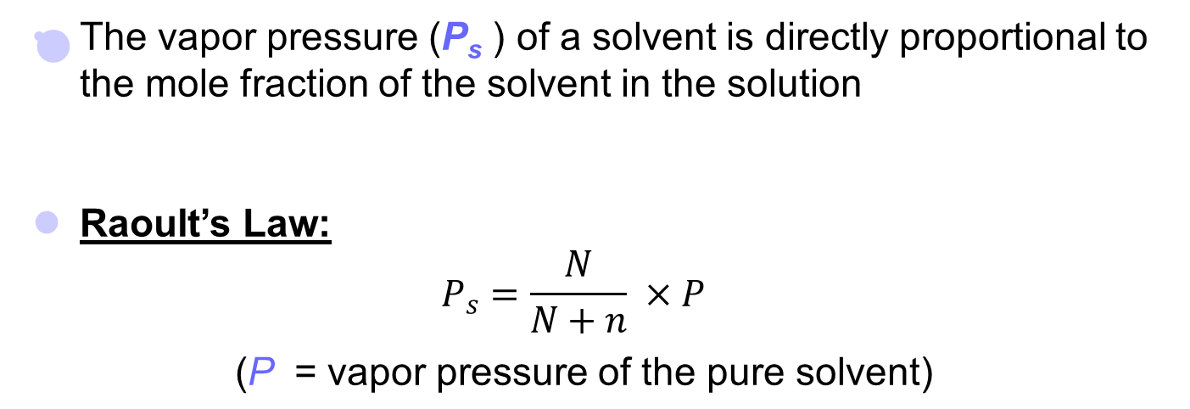
Raoult’s Law (Vapor Pressure Lowering)
vapor pressure (P_{s}) ∝ mole fraction of solvent
Where, N = moles of solvent
n = moles of solute
  P_{s} = P
For pure solvent
moles of solute
X₁
P
As solute is added, the vapor pressure drops.

Slide 5
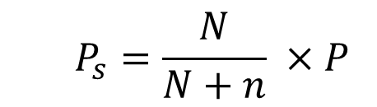
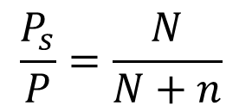
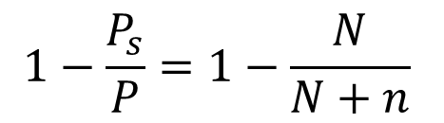
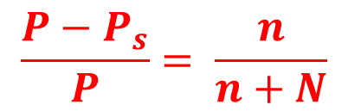
Raoult’s Law (Vapor Pressure Lowering)
P – the vapor pressure of the pure solvent
P_{s} – the vapor pressure of the solution with solute
The relative lowering of vapour pressure of a dilute solution is equals to the mole fraction of the solute present in the dilute solution.

Slide 6
Determination of molecular weight from Vapor Pressure Lowering
  From Raoult’s Law
  (P- P_{s} )/P= n/(n+N)
Considering
w gms of solute;
W gms of solvent;
Moles of solute (n) = w/m
Moles of solvent (N) = W/M
Where m= molecular weight of solute
And M= molecular weight of solvent
  (P- P_{s} )/P = n/(n+N)
  P- P_{s} )/P = (w/m)/ (w/m+W/M)
  P- P_{s} )/P = wM/mW

Slide 7
Limitations of Raoult’s Law
At higher conc.; solute gain intermolecular forces
It does not applies to volatile solutes.
Dissociate or associate

Slide 8
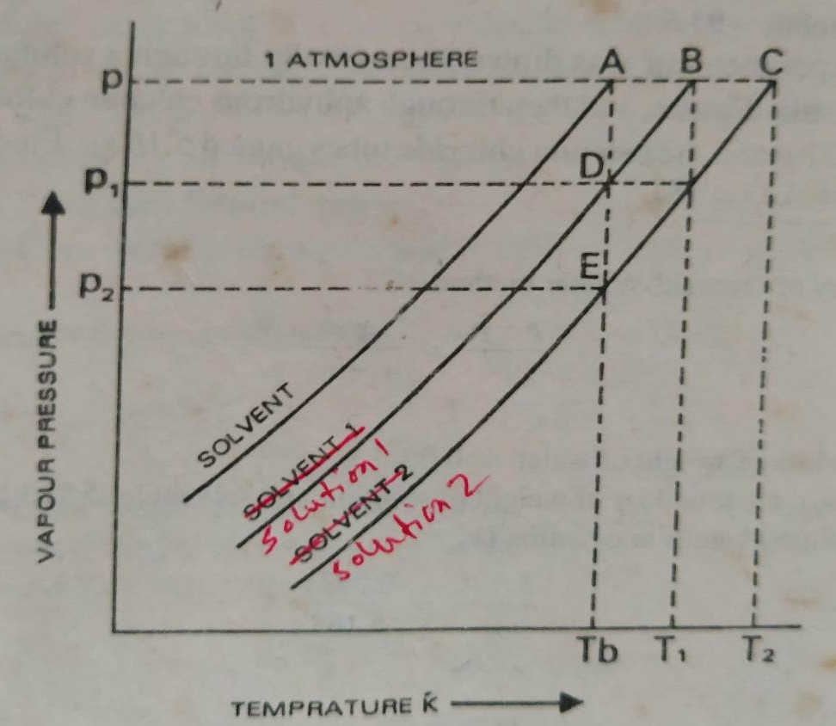
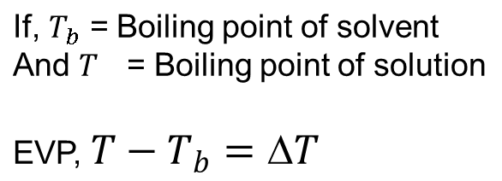
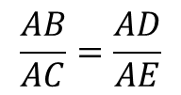
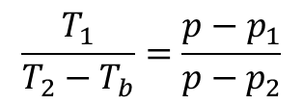
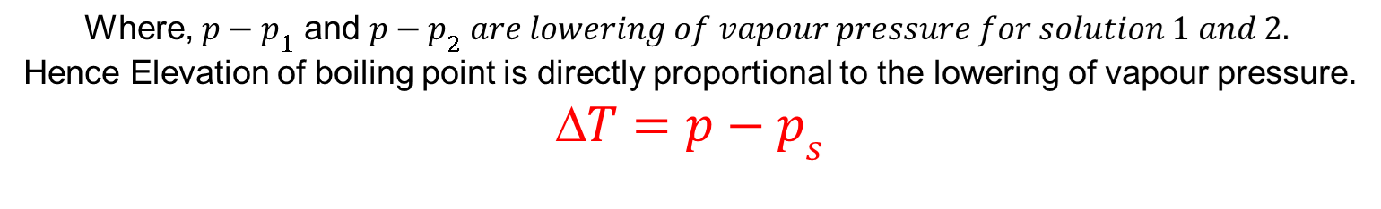
Boiling Point Elevation
(Relation between Boiling Point Elevation and Vapor Pressure Lowering)
When a liquid is heated, its vapour pressure rises and when it equals to atmospheric
Pressure, the liquid boils.
For dilute solution, the curves BD and CE
are parallel and straight lines approximately.
Therefore, ACE and ABD are similar triangles

Slide 9
Determination of molecular weight from Boiling Point Elevation

Slide 10
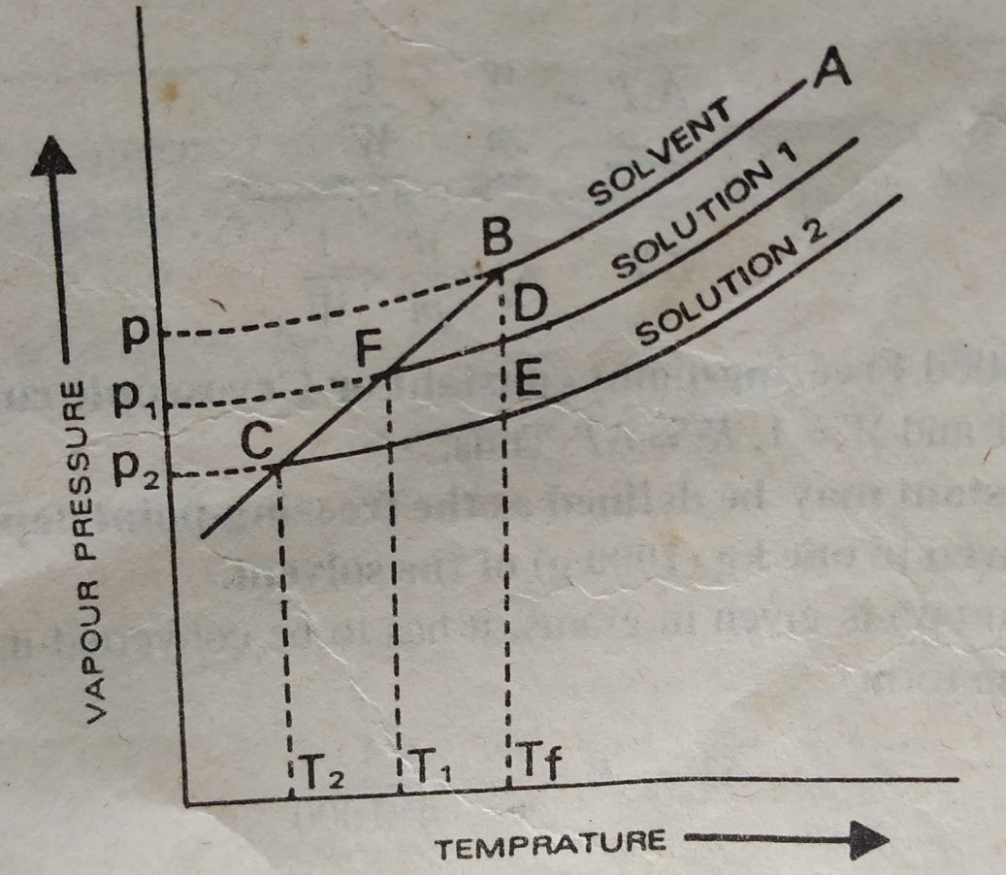
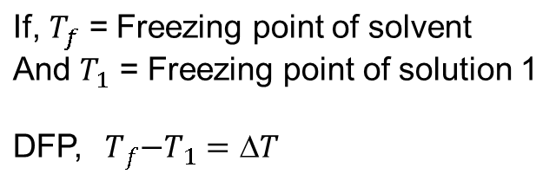
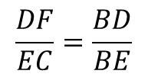
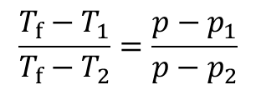
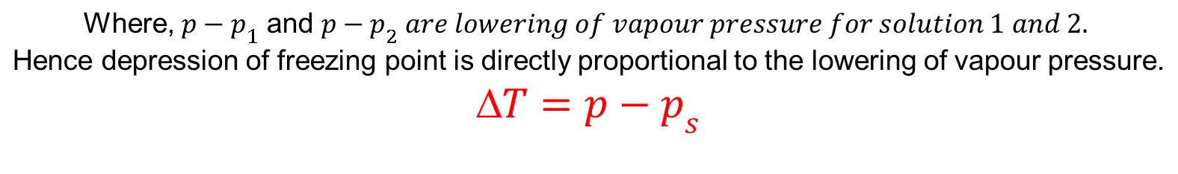
Freezing-Point Depression
For dilute solution, the curves FD and CE
are parallel and straight lines approximately.
Therefore, BDFand BEC are similar triangles

Slide 11
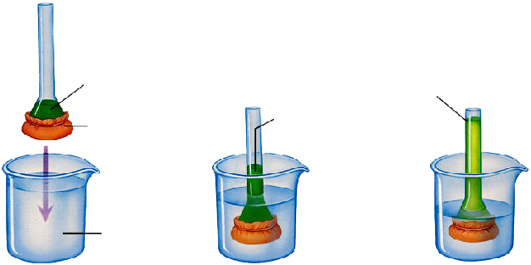
Osmosis
Osmosis is the selective passage of solvent molecules through a porous membrane from a dilute solution to a more concentrated one.
A semipermeable membrane allows the passage of solvent molecules but blocks the passage of solute molecules.
solution stops rising when weight of column equals osmotic pressure
3% salt solution
salt solution rising
selectively permeable membrane
distilled water

Slide 12
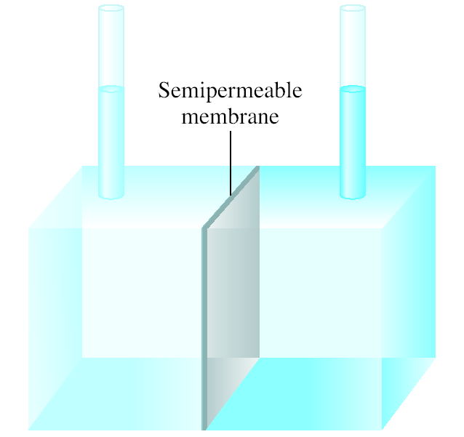
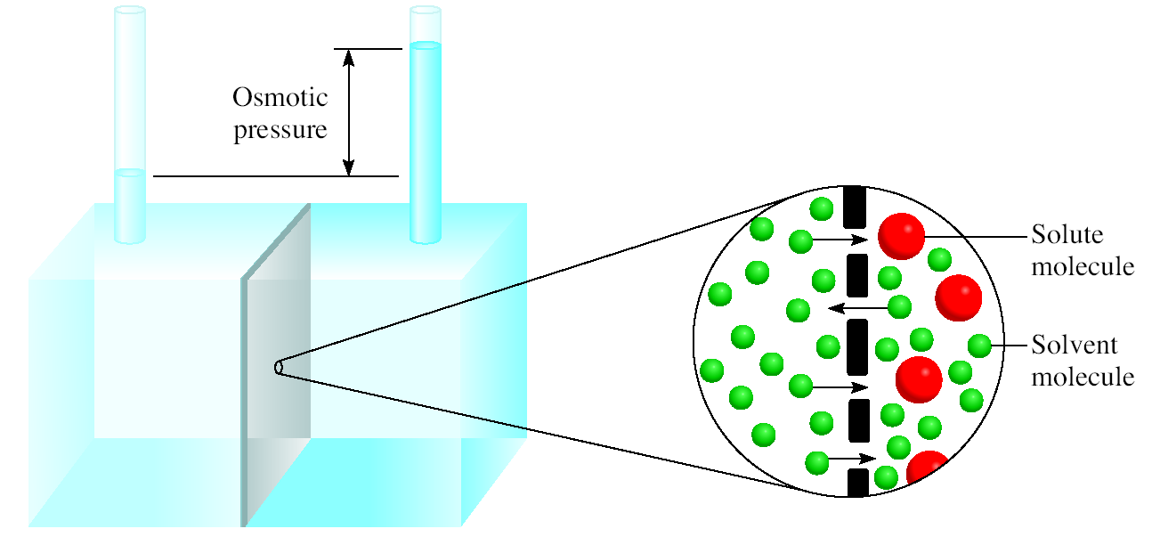
Osmosis
Osmosis is the selective passage of solvent molecules through a porous membrane from a dilute solution to a more concentrated one.
A semipermeable membrane allows the passage of solvent molecules but blocks the passage of solute molecules.
“Higher vapor pressure”
“Lower vapor pressure”
Pure Solvent
Solution
Osmotic pressure (π) is the pressure required to stop osmosis.

Slide 13
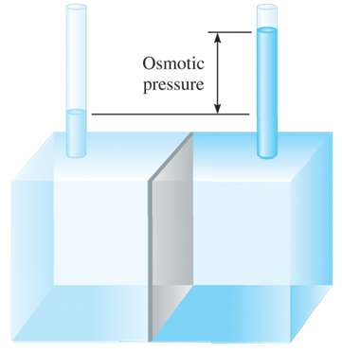
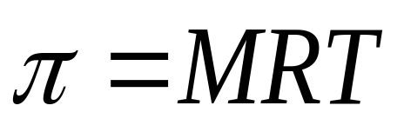
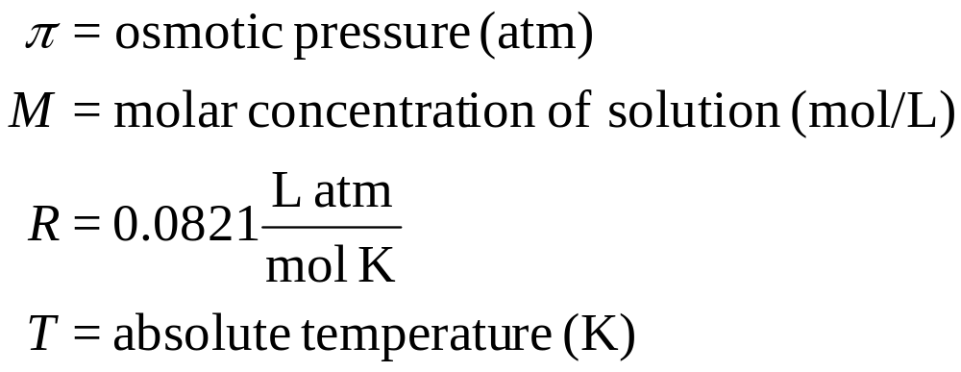
Osmotic Pressure
Osmosis is a rate controlled phenomenon.
  The solvent is passing from the dilute solution into the concentrated solution at a faster rate than in opposite direction, i.e. establishing an equilibrium.
The osmotic pressure

Slide 14
Abnormal Colligative Properties of Solutions

