Slide 1

Thermodynamics
  Prof. Dr. Md. Hafezur Rahaman
  Dept. of Applied Chemistry & Chemical Engineering
  Islamic University, Kushtia

Slide 2

The Nature of Energy
What is thermodynamics?
Thermochemistry -
It is the study of energy and
its transformations
Studies the relationships between chemical reactions and energy changes

Slide 3

Units of Energy
Energy is measured in two units
  Joule --> is the SI unit for energy
  1 J = 1 kg•m²/s²
  a joule is not a large amount of energy..so we generally use kJ or kiloJoules
    1000 Joules = 1 kiloJoule
Calorie - another unit of energy
1 cal = 4.184 J 1000 cal = 1 kcal

Slide 4
Analyzing energy of a system
Internal Energy – is the sum of all kinetic and potential energy of all components of the system.

Slide 5
Analyzing energy of a system
ΔE = E_{final} - E_{initial}
A positive value of ΔE results when
E_{final} > E_{initial}, indicating the system gained energy
A negative value of ΔE results when
E_{final} < E_{initial}, indicating the system lost energy

Slide 6
Analyzing energy of a system
In a chemical reaction, the initial state of the system refers to the reactants and the final state to the products
We can analyze the ΔE gained or lost in a system by examining the processes that cause the changes to the system
…heat and work

Slide 7
Relating ΔE to Heat and Work
The internal energy of a system can changes in two general ways
  As heat or as work
When a system undergoes any chemical or physical change, the accompanying change in internal energy is given by:
ΔE = q + w

Slide 8
Conventions of q and w
q > 0: Heat is transferred from the surrounding to the system
q < 0: Heat is transferred from the system to the surrounding
w > 0: Work is done by the surroundings on the system
w < 0: Work is done by the system on the surroundings

Slide 9
Practice Problem
Calculate the change in the internal energy of the system for a process in which the system absorbs 140 J of heat from the surroundings and does 85 J of work on the surroundings
E = q + W = 140J – 85J = 55J

Slide 10
Endothermic and Exothermic Reaction/ Processes
Endothermic – when the system/reaction absorbs heat from the surroundings
Exothermic – when heat flow out of the system/reaction to the surroundings

Slide 11
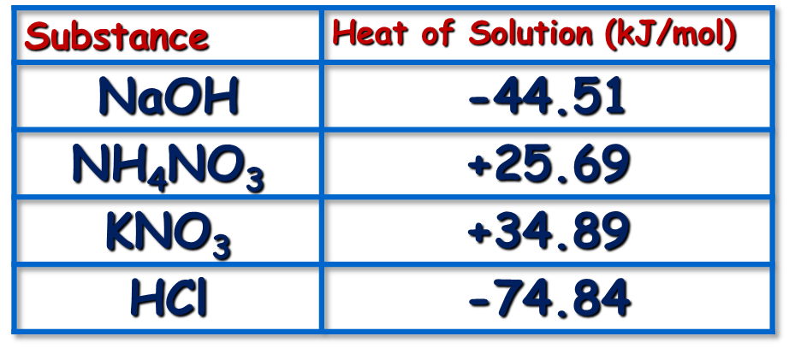
Heat of Solution
The Heat of Solution is the amount of heat energy absorbed (endothermic) or released (exothermic) when a specific amount of solute dissolves in a solvent. Molar heat of solution is the amount of energy absorbed or released per one mole of the solute.

Slide 12
Heat of Neutralization
The Heat of neutralization is the amount of heat energy absorbed (endothermic) or released (exothermic) when one gram equivalent of an acid is neutralized by one gram equivalent of a base or vice-versa in dilute solution.

Slide 13
Heat of Vaporization
Heat of Vaporization- amount of heat needed to be absorbed to convert a unit mass of a substance from its liquid phase to gas phase.
  Since vaporizing and condensing are opposite changes, the amount of energy absorbed to boil a liquid is equal to the amount of energy removed to condense a gas of equal mass

Slide 14
Heat of combustion
The change in heat content in a system when one mole of substance is completely burnt in access of air

Slide 15
Heat of formation
The change in heat content that takes place when one mole of the compound is formed from its elements.

Slide 16
State Function
The internal energy of a system is a state function
A state function is a property of a system that is determined by specifying its condition

Slide 17
Enthalpy
The majority of physical and chemical changes take place under the essentially constant pressure of the Earth’s atmosphere
Result → only tiny amounts of work are performed as the system expands and contracts against the force of the atmosphere
  Thus..most of the energy gained or lost is in the form of heat

Slide 18
Enthalpy
Most of our discussions will focus on the transfer of heat under these conditions
Enthalpy (meaning to warm): is the heat that is transferred under constant pressure
  Denoted by the symbol ΔH
ΔH = H_{final} - H_{initial} = q_{p}
Q_{p} = heat gained or lost by the system when the process occurs under constant pressure

Slide 19
Enthalpy cont…
Surroundings
Surroundings
System
System
Heat
Heat
ΔH > 0
Endothermic
ΔH < 0
Exothermic

Slide 20
Enthalpies of Reaction
Since ΔH = H_{final} – H_{initial}
ΔH = H(products) - H(reactants)
The enthalpy change that accompanies a reaction is called the enthalpy of reaction or the heat of reaction ΔH_{rxn}

Slide 21
Example
Combustion of Hydrogen
2H_{2(g)} + O_{2(g)} → 2H₂O_{(g)} ΔH = -483.6 kJ
The reaction occurs under constant pressure and
the negative sign tells us its exothermic
Balanced chemical equations of this sort are
Called thermo-chemical equations

Slide 22
Guidelines for using Thermo-chemical Reactions
1) Enthalpy is an extensive property → the magnitude of ΔH is directly proportional to the amount of reactant consumed
Example
2H_{2(g)} + O_{2(g)} → 2H₂O_{(g)} ΔH = -483.6 kJ
Twice reactants will result in 2 x ΔH

Slide 23
Guidelines cont…
2) The enthalpy change for a reaction is equal in magnitude but opposite in sign to ΔH for the reverse reaction
2H₂O_{(g)} → 2H_{2(g)} + O_{2(g)} ΔH = 483.6 kJ

Slide 24
Guidelines cont…
3) The enthalpy change for a reaction depends on the state of the reactants and products
Example
    2H₂O_{(l)} → 2H₂O_{(g)} ΔH = +88 kJ
    Energy has to be put in (endothermic) to change
    water in liquid form to gas

Slide 25
Example
Hydrogen Peroxide can decompose to water and oxygen by the reaction:
2H₂O_{2(l)} → 2H₂O_{(l)} + O_{2(g)} ΔH = -196 kJ
Calculate the value of q when 5.00 g of H₂O_{2(l)} decomposes
at constant pressure
Heat = (5.00 g H₂O₂) (1 mol H₂O₂ / 34 g) (-196 kJ / 2 mol H₂O₂)
Q = Heat = -14.4 kJ

Slide 26
HESS’S LAW
In going from a particular set of reactants to a particular set of products, the change in enthalpy is the same whether the reaction takes place in one step or in a series of steps.
Copyright © Cengage Learning. All rights reserved

Slide 27
N₂(g) + 2O₂(g) → 2NO₂(g) ΔH₁ = 68 kJ
This reaction also can be carried out in two distinct steps, with enthalpy changes designated by ΔH₂ and ΔH₃.
N₂(g) + O₂(g) → 2NO(g) ΔH₂ = 180 kJ
2NO(g) + O₂(g) → 2NO₂(g) ΔH₃ = – 112 kJ
N₂(g) + 2O₂(g) → 2NO₂(g) ΔH₂ + ΔH₃ = 68 kJ
ΔH₁ = ΔH₂ + ΔH₃ = 68 kJ

Slide 28
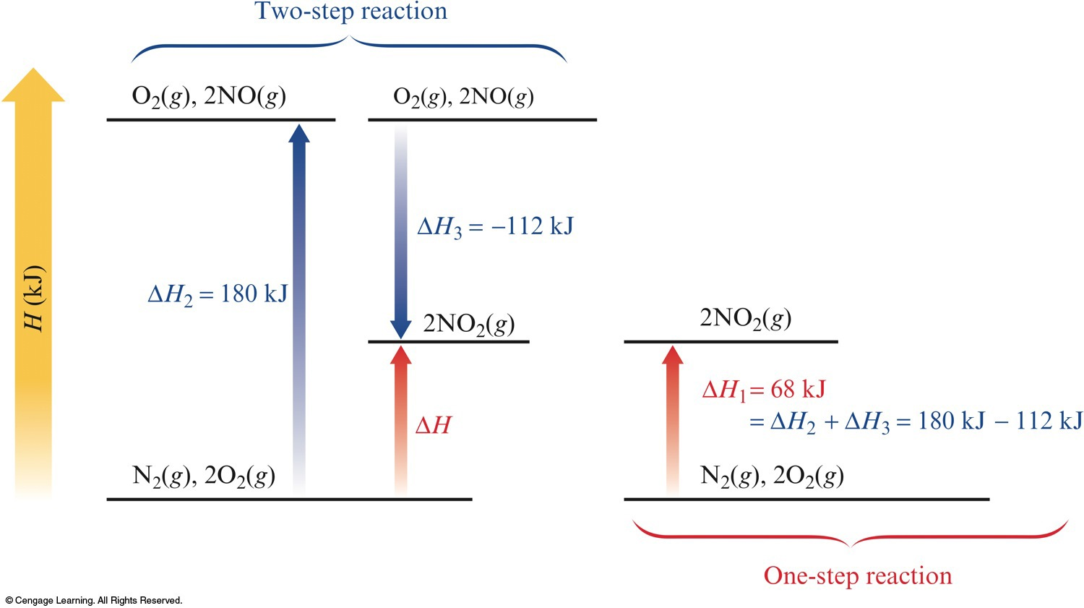
The Principle of Hess’s Law

Slide 29
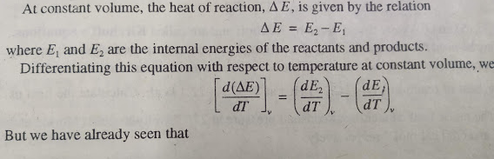
Kirchoff’s Equations

Slide 30
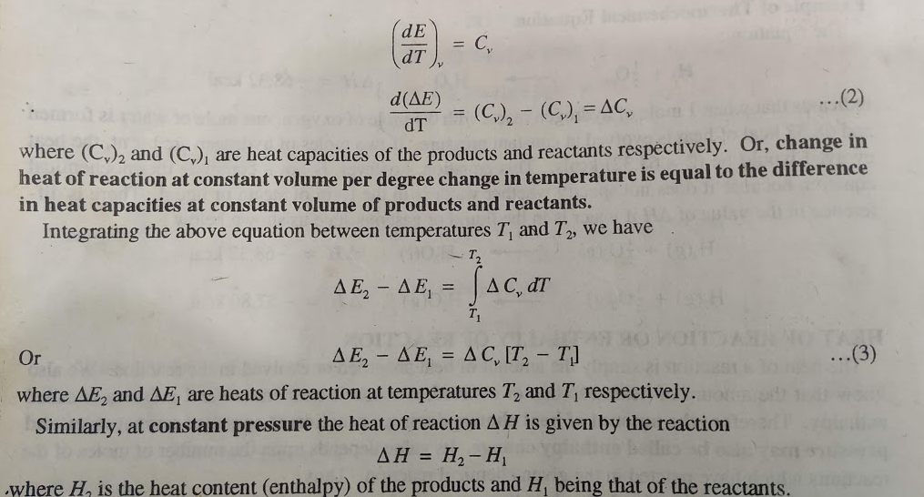
Kirchoff’s Equations

Slide 31
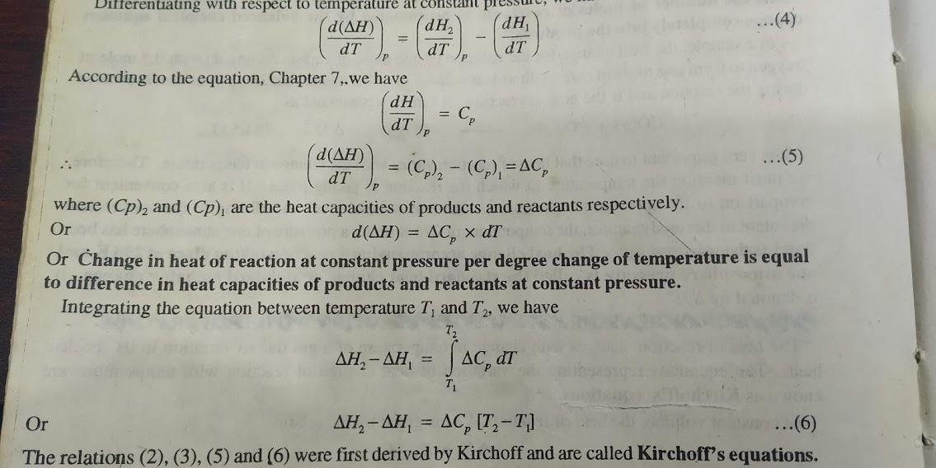
Kirchoff’s Equations

