Slide 1
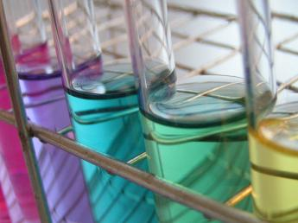
Solutions
Prof. Dr. Md. Hafezur Rahaman
Dept. of Applied Chemistry and Chemical Engineering
Islamic University, Kushtia 7003, Bangladesh

Slide 2
Solution: A homogeneous mixture of two or more substances on molecular level.
  A solution can be physically separated
  All portions of the solution have the same properties
Examples: salt water, blood, sugar water, gasoline

Slide 3
Solutes and Solvents
Solute: a substance that is dissolved to make a solution.
  when dissolved it separates into individual particles
Solvent: is a substance that dissolves a solute.
  when the solute is dissolved into the solvent it is not possible to identify the solvent and solute as individual parts

Slide 4
The solvent is the largest part of the solution and the solute is the smallest part of the solution
S | O | L | V | E | N | T
S | O | L | U | T | E

Slide 5

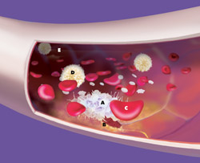
Examples of Solutes and Solvents
Saltwater
salt=solute
water=solvent
Blood
calcium ions, sugars=solutes
water =solvent
saltwaterfishing365.com
ucdavismagazine.ucdavis.edu

Slide 6
TYPES AND EXAMPLES OF SOLUTIONS
TYPES | Example
Solid/Solid | Alloys (brass, etc.)
Solid/Liquid | Ocean water
Solid/Gas | Smoke, Sulfur vapor in air
Liquid/Solid | Jelly, Butter, Cheese, Mercury in copper
Liquid/Liquid | Alcohol in water
Liquid/Gas | Fog
Gas/Solid | Hydrogen gas absorbed on surface of platinum
Gas/Liquid | Softdrinks
Gas/gas | Air

Slide 7
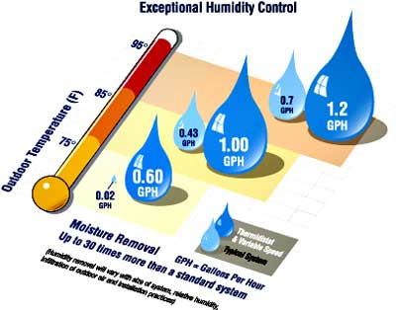
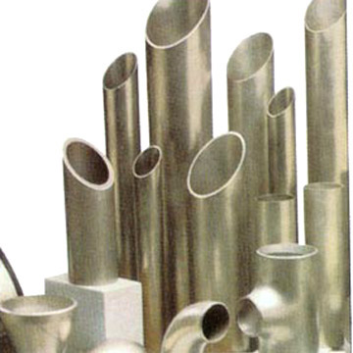
Examples of Solutions
askville.amazon.com
Solutions can be made from solids, liquids, and gases
Air: solute=oxygen, solvent=nitrogen (oxygen is dissolved in nitrogen)
Humidity: solute=liquid, solvent=gas (water is dissolved into air)
Stainless steel: solute=chromium metal, solvent=iron (chromium metal is dissolved in iron to form a shiny steel)
www.germes-online.com

Slide 8
Properties of Solvents change in Solutions
A solution’s physical properties are different from the physical properties of the pure solvent.
The amount of solute in the solution determines how much the physical properties of the solvent are changed

Slide 9
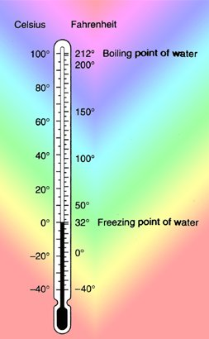
Lowering the freezing point
Freezing point: temperature at which a liquid becomes a solid
The freezing point of a liquid solvent decreases when a solute is dissolved in it.
Example
  Water, pure = 0 degrees C.
  Water + salt = a freezing point lower than 0 degrees C.
coolcosmos.ipac.caltech.edu

Slide 10
Lowering the freezing point
Making Ice Cream
  Depends on lowering the freezing point of a solvent
  Canister hold liquid ice cream ingredients
  Put in a larger container containing ice and salt
    Salt lowers the freezing point of the mixture
    Causes ice to melt (absorbing heat from surroundings)
    Ice cream mix is chilled when its contents are constantly stirred
    Tiny ice crystals form all at once instead of gradually
    Causing the ice cream to be smooth and creamy

Slide 11
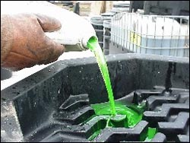
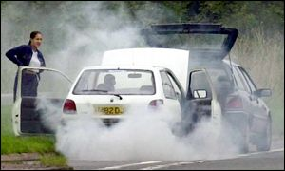
Raising the boiling point
Boiling point: temperature when a liquid turns into a gas
A solution’s boiling point can be raised by the amount of solute in the solvent.
Example:
  Antifreeze added to cars prevent it from overheating or having the liquid’s reach their boiling point
www.state.tn.us
www.classic-car-magazine.co.uk

Slide 12
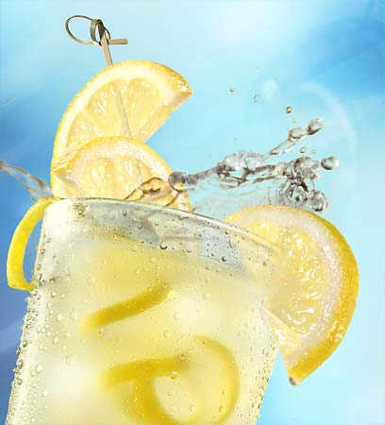
Concentration: The amount of solute dissolved in a solvent at a given temperature.
Examples:
  Hot chocolate…the more powdered mix you add the higher the concentration of chocolate
  Lemonade…the more frozen lemon concentrate or powdered mix you add the more tart the drink becomes
www.thesunblog.com

Slide 13
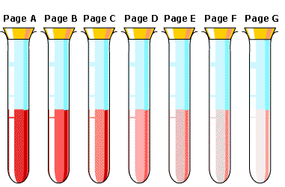
Degrees of Concentration
www.seroundtable.com
Dilute: a solution has a low concentration of solute
Saturated: a solution that contains the maximum amount of solute that can be dissolved into the solvent at a given temperature.
Supersaturated: a solution can contain more solute than normal by raising the temperature of the solvent.

Slide 14
Ways to Express Concentrations
Mass percentage
Mole fraction
Molarity
Molality
Normality

Slide 15
Mass Percent
Solutions can also be represented as percent of solute in a specific mass of solution.
For a solid dissolved in water, you use percent by mass which is Mass Percent.
% by mass = mass solute x 100
mass of solution
**Mass of solution = solute mass + solvent mass

Slide 16
Molarity
Molarity is the concentration of a solution expressed in moles of solute per Liter of solution.
Molarity is a conversion factor for calculations
  Molarity (M) = moles of solute
  Liters of solution

Slide 17
Molarity
  M = mol (solute)
  L (solution)
Example 1: What is the molarity of a solution that has 2.3 moles of sodium chloride in 0.45 liters of solution?
2.3 moles NaCl = 5.1M NaCl
0.45 L

Slide 18
Molarity
  M = mol (solute)
  L (solution)
Example 2: How many grams of NaCl are needed to make 3.0 L of 1.5 M solution?
3.0 L 1.5 mol NaCl 58.44 g NaCl
1 1 L 1 mol NaCl
= 260 g NaCl

Slide 19
Solubility
Solubility: the amount of the substance that will dissolve in a certain amount of solvent at a given temperature.
The solubility of a solute can be changed
  by raising the temperature
  If solute is a gas…then you can change the pressure…higher pressure of gas in a liquid increases the amount of gas that can be dissolved

Slide 20
Solubility and Temperature
Solute | Increased Temperature | Decreased Temperature
Solid | Increase in solubility | Decrease in solubility
Liquid | Increase in solubility | Decrease in solubility
Gas | Decrease in solubility | Increase in solubility

Slide 21
Solubility and Pressure
Solute | Increased Pressure | Decreased Pressure
Solid | No effect on solubility | No effect on solubility
Gas | Increase in solubility | Decrease in solubility

Slide 22
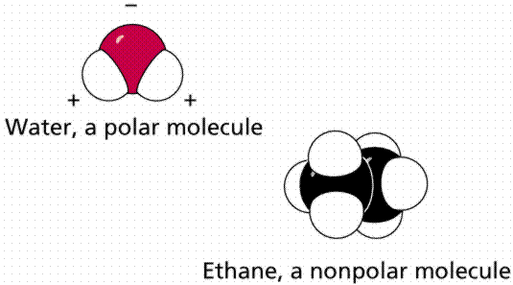
Solubility depends on Molecular Structure
When a substance dissolves, its molecules (covalent bonds) or ions (ionic bonds) separate from one another and become evenly mixed with molecules of the solvent
Water contains polar covalent bonds.
  Negative region (O)
  Positive region (H)
www.emc.maricopa.edu

Slide 23
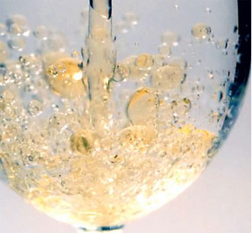
Polar and Nonpolar
Water and oil do not mix
  Water is polar…negative and positive regions
  Oil is nonpolar...no charge
  Molecules are not attracted to each other (opposite charges attract each other) so they do not mix
Water and sugar or salt mix
  Water is polar
  Salt and sugar are also polar
  Opposite charged molecules are attracted to each other
www.historyforkids.org

Slide 24
Solutions can be acidic, basic, or neutral
Acid | Base
Donate H⁺ ion (proton…atomic number is 1=1 proton) | Can accept a H⁺ ion...usually release an OH⁻ ion than can accept a H⁺ ion.
Taste sour | Taste bitter
Produce burning or prickling sensation on skin | Feel slippery
React with most metals

Slide 25
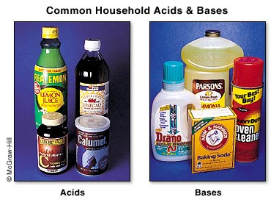
www.mhhe.com

Slide 26
pH scale
pH scale: potential of Hydrogen
Higher H⁺ lower number (Acid)
Lower H⁺ higher number (Base)
Range is 0-14, 7 is neutral
Common Acids and Bases
  Base: Soap pH 10
  Acid: lemon juice pH 2
Acids and Bases neutralize each other

Slide 27
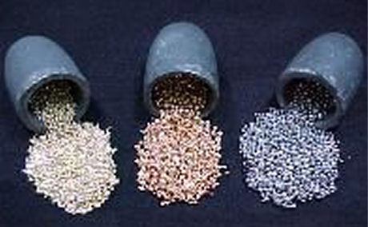
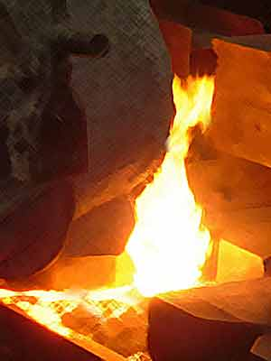
Metal alloys are solid mixtures
Alloy: a mixture of one or more metals and one or more other elements…made from melting and mixing
Examples:
  Brass: zinc and copper
  Bronze: tin and copper
  Stainless steel: chromium and iron
www.kengem.com
art-foundry.com

Slide 28
Liquid-Liquid Solutions
Phenol-water
Methanol-cyclohexane
Carbondisulphide-methanol
Hexane aniline

Slide 29
Azeotropic Mixture

Slide 30
Distribution Law

