Slide 1

Solutions
Prof. Dr. Md. Hafezur Rahaman
Dept. of Applied Chemistry and Chemical Engineering
Islamic University, Kushtia 7003, Bangladesh

Slide 2
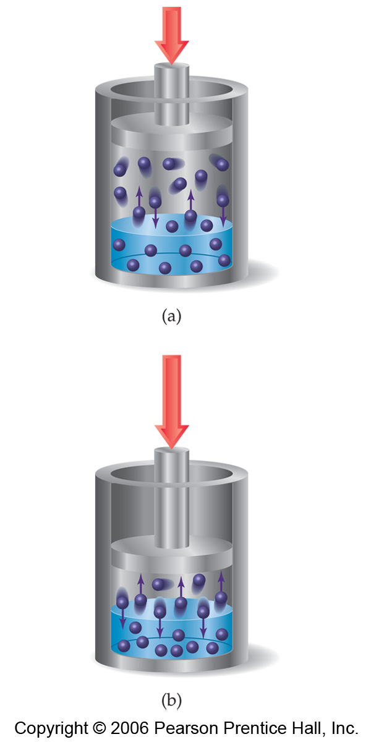
Effect of Pressure on Gas Solubility
The solubilities of solids and liquids are not affected appreciably by pressure.
When the pressure of a gas is increased, as in (b), the rate at which gas molecules enter the solution increases.
The concentration of solute molecules at equilibrium increases in proportion to the pressure.
So the solubility of a gas increases with pressure.

Slide 3
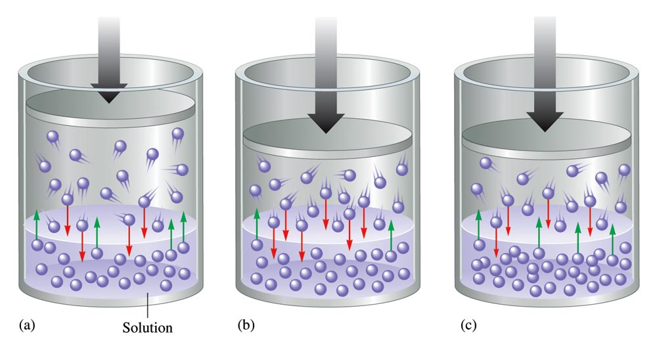
Pressure and Solubility of Gases
Solubility of a gas in a solvent depends on pressure and temperature
The solubility of a gas in a liquid is proportional to the pressure of the gas over the solution at constant temperature (Henry’s law).
c = kP
c is the concentration (M) of the dissolved gas
P is the pressure of the gas over the solution
k is a constant (mol/L•atm) that depends only on temperature
13.5

Slide 4
Limitations:
At moderate temperature and Pressure
Solubility in solvent is low
Gas react with solvent
Associate or Dissociate the molecules

Slide 5

SAMPLE EXERCISE A Henry’s Law Calculation
Calculate the concentration of CO₂ in a soft drink that is bottled with a partial pressure of CO₂ of 4.0 atm over the liquid at 25°C. The Henry’s law constant for CO₂ in water at this temperature is 3.1 × 10^{–2} mol/L-atm.
Solution
Analyze: We are given the partial pressure of CO₂, and the Henry’s law constant, k, and asked to calculate the concentration of CO₂ in the solution.
Plan: With the information given, we can use Henry’s law to calculate the solubility.
Solve:
Check: The units are correct for solubility, and the answer has two significant figures consistent with both the partial pressure of CO₂ and the value of Henry’s constant.
₂
PRACTICE EXERCISE
Calculate the concentration of CO₂ in a soft drink after the bottle is opened and equilibrates at 25°C under a CO₂ partial pressure of 3.0 × 10^{–4} atm.

Slide 6
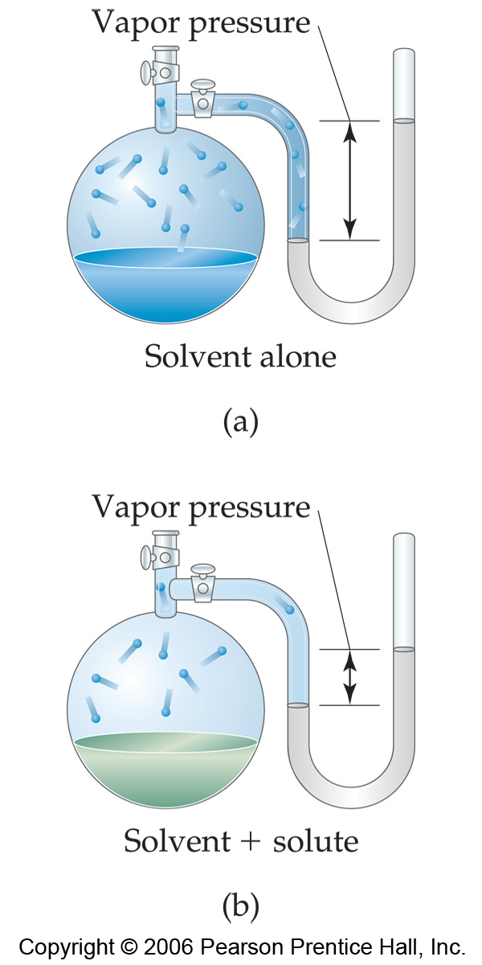
Vapor Pressure
When a liquid is heated, its molecules obtain sufficient kinetic energy to overcome the forces holding them in the liquid and they escape into the gaseous phase.
Pressure exerted by this vapor at a fixed temperature is call Vapor Pressure.
Because of solute-solvent intermolecular attraction, higher concentrations of nonvolatile solutes make it harder for solvent to escape to the vapor phase.

Slide 7
Colligative Properties
Changes in colligative properties depend only on the number of solute particles present, not on the identity of the solute particles.
Among colligative properties are
  Vapor pressure lowering
  Boiling point elevation
  Melting point depression
  Osmotic pressure

Slide 8

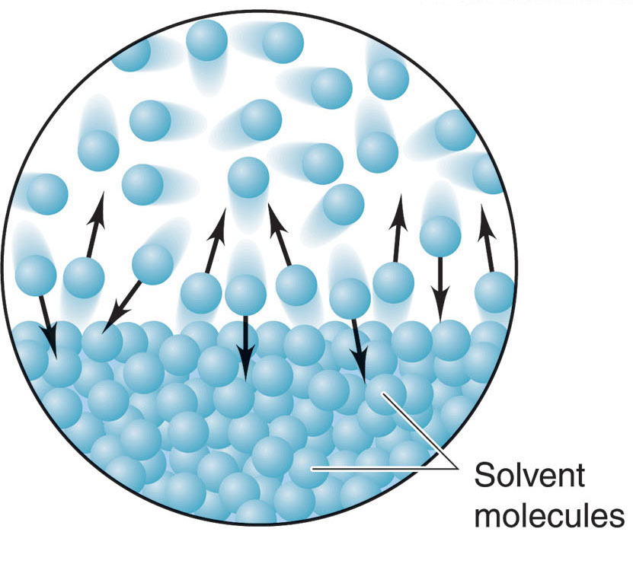
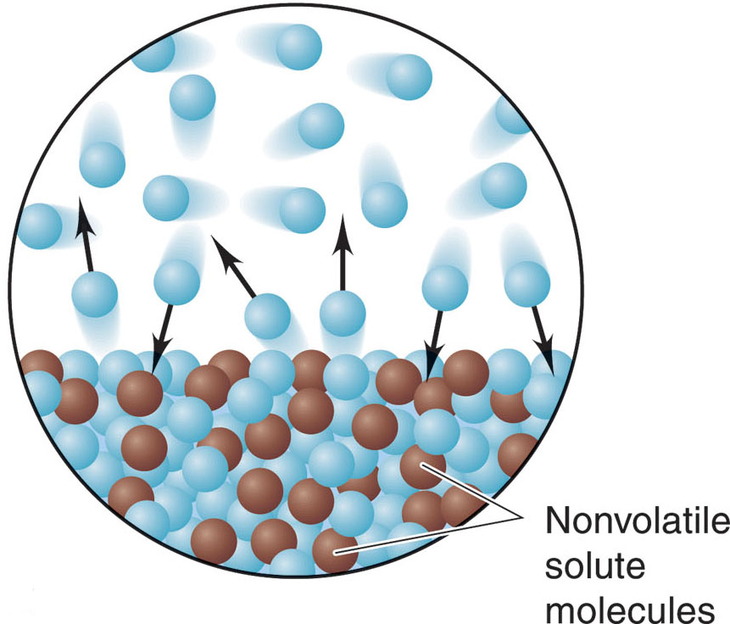
Vapor Pressure Lowering
The vapor pressure of a solution of a nonvolatile nonelectrolyte
is always lower than the vapor pressure of the pure solvent.
An entropy argument!

Slide 9


Boiling Point Elevation
A solution boils at a higher temperature than the pure solvent.
This effect is explained by differences between the VP of
the solution and VP of the pure solvent at a given temperature.

Slide 10
Depression of Freezing Point
Freezing point: temperature at which a liquid becomes a solid
The freezing point of a liquid solvent decreases when a solute is dissolved in it.
Example
  Water, pure = 0 degrees C.
  Water + salt = a freezing point lower than 0 degrees C.

Slide 11
Osmotic Pressure
Two solutions of different concentrations are separated by a semi-permeable membrane (allows water/solvent but notsolute to pass through)

Slide 12
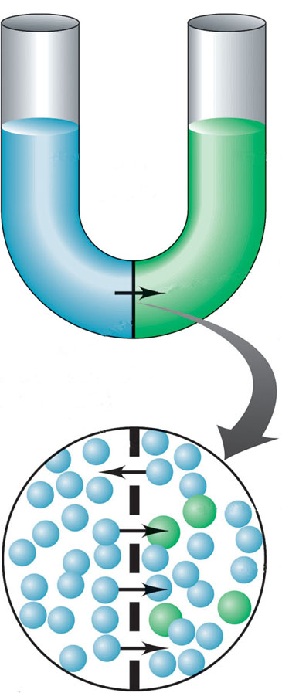
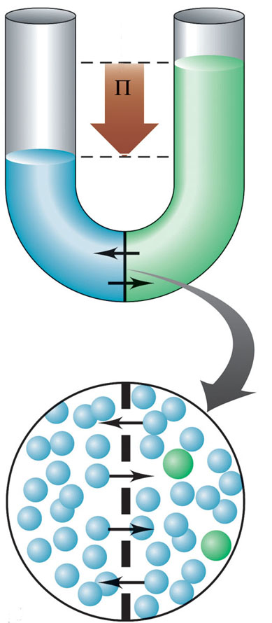
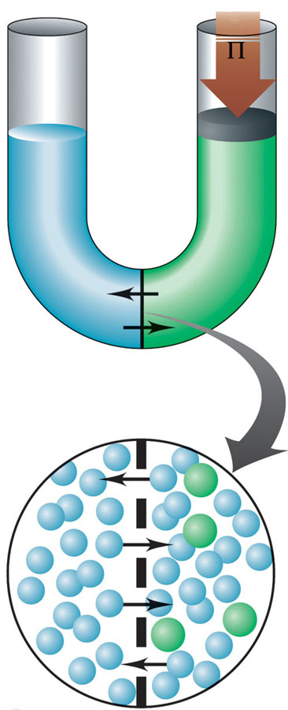
The development of osmotic pressure
osmotic
pressure
applied pressure needed to prevent volume increase; equal to the osmotic pressure
pure solvent
solution
semipermeable
membrane
Figure 13.17

