Slide 1
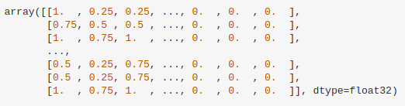
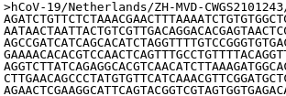
4800 data samples
Data Cleaning &
Preprocessing
Model
Output
2 Conv1D &
2 Maxpooling
Alpha
Beta
Delta
Gamma

