Slide 1
Spring MVC
Zubayer Ahamed

Slide 2
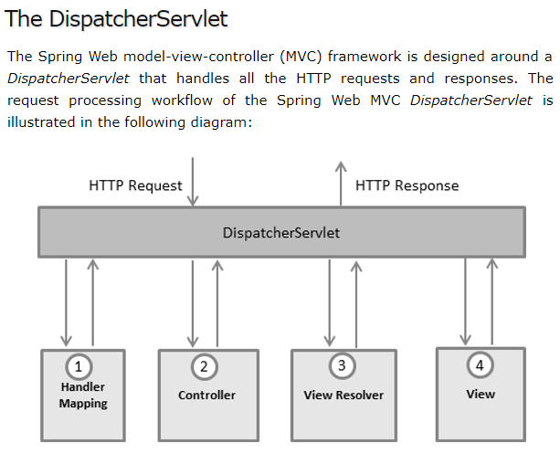

Slide 3
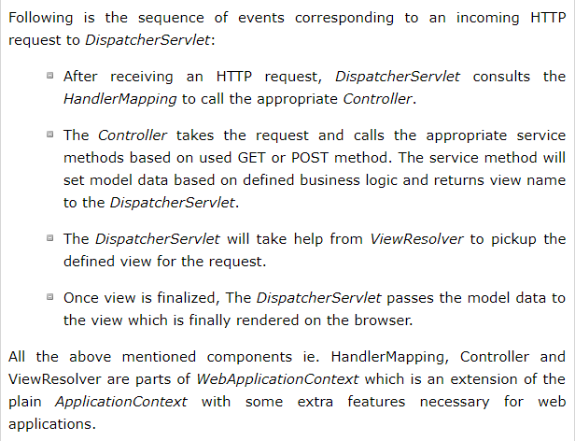

Slide 4
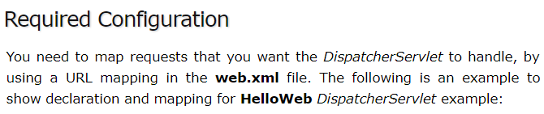
<web-app id="WebApp_ID" version="2.4" xmlns="http://java.sun.com/xml/ns/j2ee"
xmlns:xsi="http://www.w3.org/2001/XMLSchema-instance"
xsi:schemaLocation="http://java.sun.com/xml/ns/j2ee http://java.sun.com/xml/ns/j2ee/web-app_2_4.xsd">
<display-name>Spring MVC Application</display-name>
<servlet>
<servlet-name>HelloWeb</servlet-name>
<servlet-class> org.springframework.web.servlet.DispatcherServlet </servlet-class>
<load-on-startup>1</load-on-startup>
</servlet>
<servlet-mapping>
<servlet-name>HelloWeb</servlet-name>
<url-pattern>*.jsp</url-pattern>
</servlet-mapping>
</web-app>

Slide 5
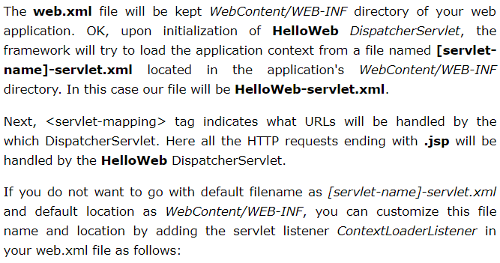
<web-app...>
<!-------- DispatcherServlet definition goes here-----> ....
<context-param>
<param-name>contextConfigLocation</param-name>
<param-value>/WEB-INF/HelloWeb-servlet.xml</param-value>
</context-param>
<listener>
<listener-class> org.springframework.web.context.ContextLoaderListener </listener-class>
</listener>
</web-app>

Slide 6
<beans xmlns="http://www.springframework.org/schema/beans"
xmlns:xsi="http://www.w3.org/2001/XMLSchema-instance"
xmlns:p="http://www.springframework.org/schema/p"
xmlns:context="http://www.springframework.org/schema/context"
xmlns:mvc="http://www.springframework.org/schema/mvc"
xsi:schemaLocation="http://www.springframework.org/schema/beans
http://www.springframework.org/schema/beans/spring-beans-3.0.xsd
http://www.springframework.org/schema/context
http://www.springframework.org/schema/context/spring-context-3.0.xsd
http://www.springframework.org/schema/mvc
http://www.springframework.org/schema/mvc/spring-mvc-3.0.xsd">
<context:annotation-config></context:annotation-config>
<context:component-scan base-package="com.tutorialspoint" />
<bean id=“viewResolver"
class="org.springframework.web.servlet.view.InternalResourceViewResolver">
<property name="prefix" value="/WEB-INF/jsp/" />
<property name="suffix" value=".jsp" />
</bean>
</beans>

Slide 7
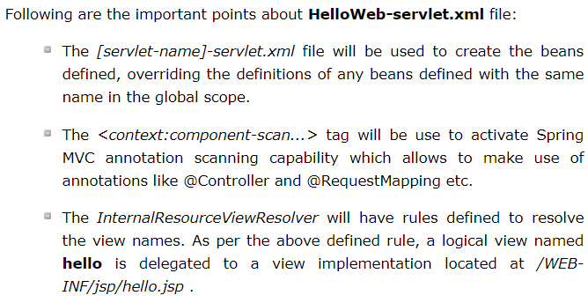

Slide 8
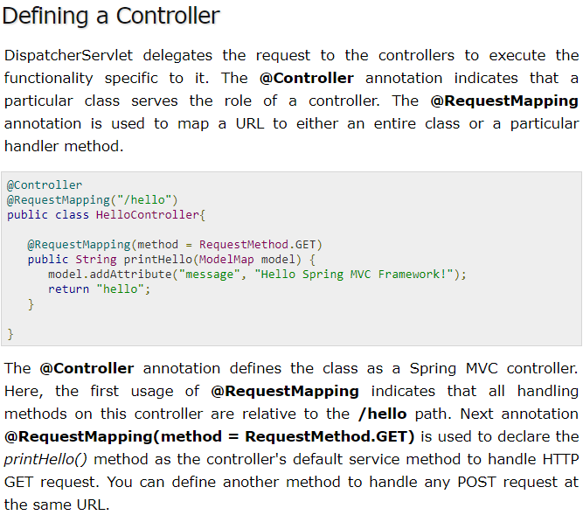

Slide 9
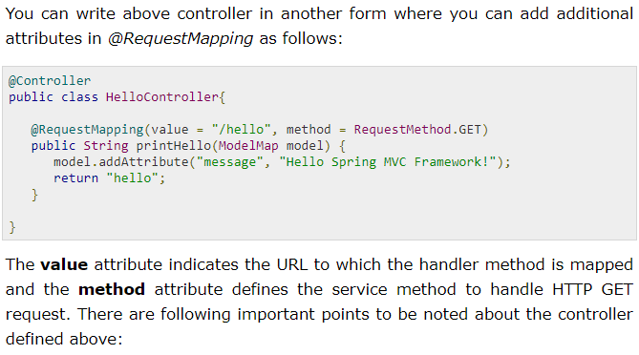
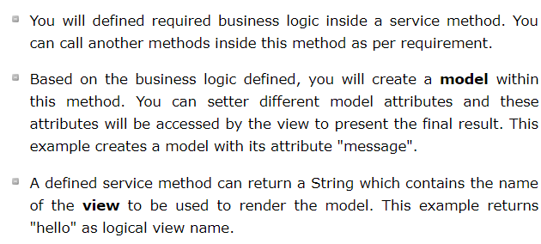

Slide 10
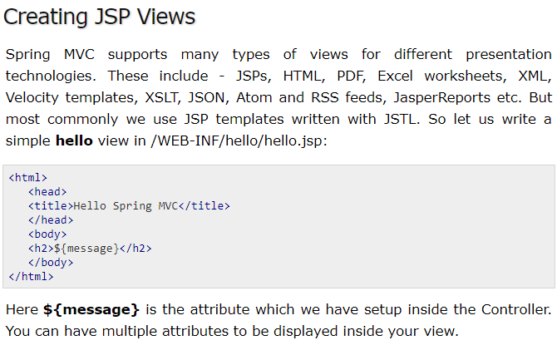

Slide 11
