Slide 1
CSE 422: LAB PROJECT DEFENSE
CrediNet: Automated Loan Approval & Credit Risk Assessment
Using PyTorch Deep Multi-Layer Perceptrons (MLP) with Real-Time Banking Deployment
STUDENT & COURSE INFORMATION
• Student Name: Md. Mahfuz
• Student ID: 0432310005101057
• Course: CSE 422 - Neural Networks and Deep Learning

Slide 2
CSE 422: NEURAL NETWORKS & DEEP LEARNING
Problem Statement & Project Motivation
1. Traditional Underwriting Bottlenecks
• Manual File Reviews: Evaluating loan applications takes days or weeks.
• Subjective Bias: Human loan officers often apply inconsistent risk thresholds.
• High Operational Cost: Excessive paperwork and manual verification overhead.
2. Non-Performing Loan (NPL) Crisis
• Default Risk: Miscalculated creditworthiness leads to bad debts and financial crises.
• Fraud & Defaulters: Need for strict linkage with centralized CIB records.
• Unbalanced Assessment: Over-reliance on gross salary while ignoring monthly debt burden.
3. CrediNet AI Solution
• Sub-10ms Inference: Deep MLP evaluates solvency instantly upon submission.
• Mathematical Impartiality: Objective risk scoring trained on verified borrower records.
• Explainable Decision Factors: Transparent rationales provided to credit officers.

Slide 3
CSE 422: NEURAL NETWORKS & DEEP LEARNING
Dataset Description & Feature Engineering
Benchmark Loan Prediction Dataset
• Source: Kaggle / Analytics Vidhya benchmark loan dataset.
• Total Instances: 614 applicant loan records.
• Target Variable: Loan_Status (Approved: 69%, Rejected: 31%).
• Demographics: Gender, Married, Dependents, Education, Self_Employed.
• Financials: ApplicantIncome, CoapplicantIncome, LoanAmount, Term.
• Credit History: Most impactful feature (1.0 = Clean CIB, 0.0 = Defaulter).
• Imputation: Mode for categorical columns, Median for numericals.
Engineered Features & Data Preprocessing
• Total Household Income: ApplicantIncome + CoapplicantIncome.
• Estimated EMI: (LoanAmount * 1000) / Term in months.
• Balance Income: Total_Income - (1.5 * EMI) to check disposable surplus.
• Debt-to-Income (DTI): (EMI / Total_Income) * 100.
• Categorical Encoding: Binary (0/1) for binary categories.
• One-Hot Encoding: Property_Area (Rural, Semiurban, Urban).
• StandardScaler Normalization: Rescales all 16 features to mean=0, std=1.
• Stratified Split: 80% Train (491), 20% Test (123) with balanced ratios.

Slide 4
CSE 422: NEURAL NETWORKS & DEEP LEARNING
Neural Network Architecture: Deep MLP vs. Shallow MLP
Deep MLP Architecture Layers (CrediNet)
✔ Input Layer: 16 Processed & Scaled Features
✔ Hidden Layer 1: Linear(16 -> 64) + BatchNorm1d(64) + ReLU + Dropout(0.20)
✔ Hidden Layer 2: Linear(64 -> 32) + BatchNorm1d(32) + ReLU + Dropout(0.20)
✔ Hidden Layer 3: Linear(32 -> 16) + ReLU
✔ Output Layer: Linear(16 -> 1) producing Raw Logits
✔ Activation: Sigmoid Function maps logits to [0.0, 1.0] probability
✔ Loss Function: nn.BCEWithLogitsLoss()
✔ Optimizer: Adam (Learning Rate = 0.001, Weight Decay = 1e-4)
Why Deep MLP Over Shallow MLP?
• Shallow Baseline: Linear(16 -> 32) -> ReLU -> Linear(32 -> 1).
• Limitation of Shallow: Struggles to capture non-linear relationships between CIB record, income, and debt ratios.
• Deep MLP Advantage: Hierarchical feature representation (co-features like EMI burden relative to location).
• Stability: Shallow networks without BatchNorm experience high gradient variance during mini-batch updates.

Slide 5
CSE 422: NEURAL NETWORKS & DEEP LEARNING
Addressing Overfitting: Three Core Regularization Techniques
1. Batch Normalization
Stabilizes Gradient Dynamics
• Normalizes layer inputs to zero mean and unit variance per mini-batch.
• Reduces Internal Covariate Shift as deep weights update.
• Enables faster learning rates without divergence.
• Analogy: Like calibrating microphone volume in a noisy conference room.
2. Dropout (p = 0.20)
Prevents Feature Co-Adaptation
• Randomly deactivates 20% of neurons during every forward pass.
• Forces network to learn distributed, resilient representations.
• Prevents the model from over-relying on any single feature.
• Analogy: Rotating football team squad so the team doesn't rely on one star.
3. Early Stopping (Patience = 30)
Halts at Optimal Convergence
• Monitors Validation Loss after every training epoch.
• Automatically stops training when validation loss stops improving.
• Prevents memorization of dataset noise.
• Saves best checkpoint weights (Epoch 47) rather than final epoch.

Slide 6
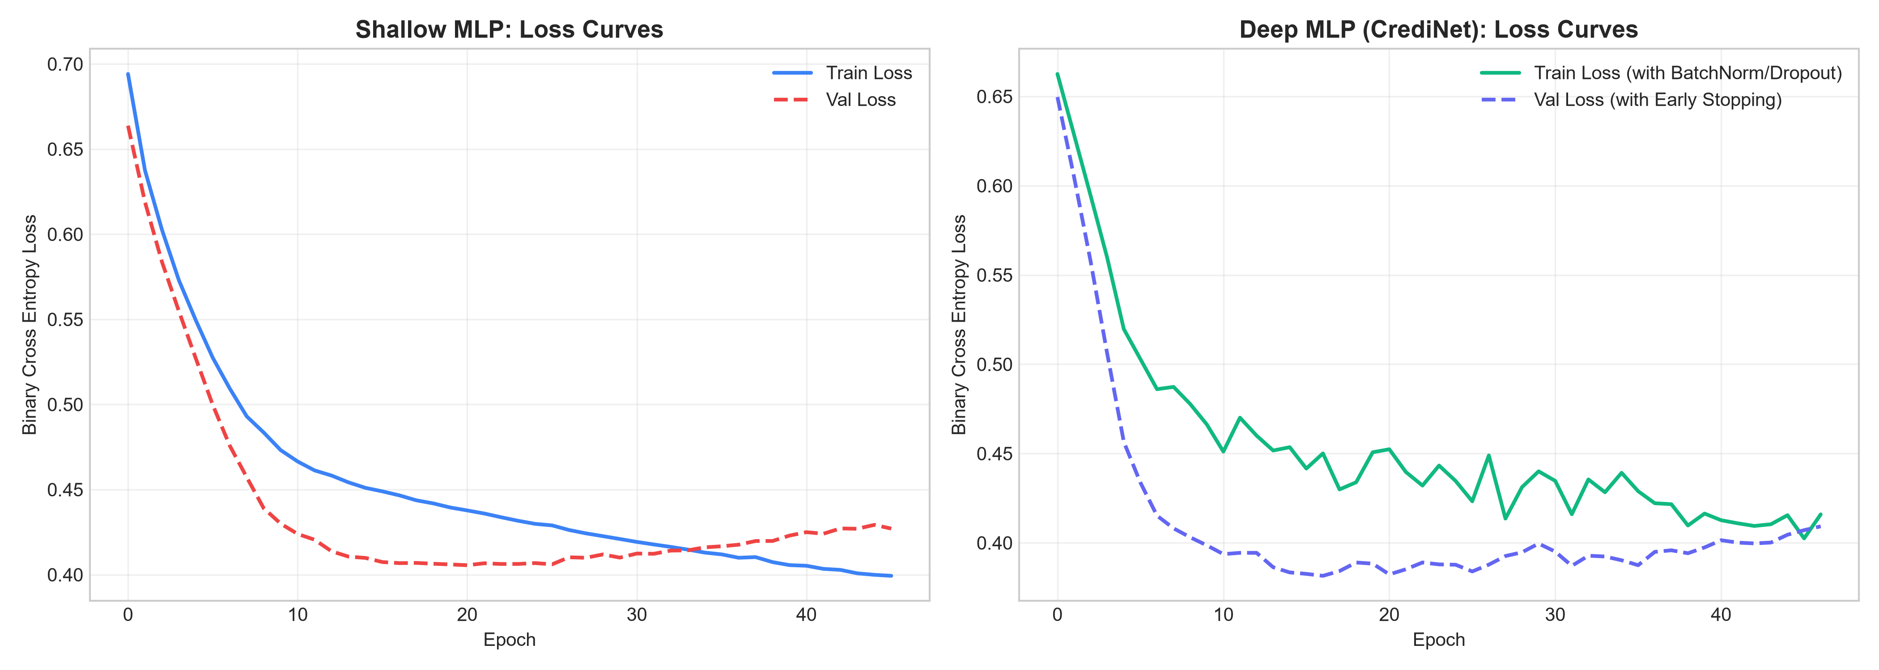
CSE 422: NEURAL NETWORKS & DEEP LEARNING
Experimental Results & Performance Benchmarking
Metric | Shallow MLP | Deep MLP (CrediNet) | Delta
Accuracy | 82.11% | 85.37% | +3.26% 🚀
Precision | 82.80% | 83.67% | +0.87%
Recall | 95.29% | 97.65% | +2.36%
F1-Score | 88.61% | 90.11% | +1.50% 🎯
ROC-AUC | 76.53% | 83.00% | +6.47% 🔥
Key Evaluation Takeaways:
✔ F1-Score (90.11%): Prioritized over raw accuracy due to class imbalance.
✔ High Recall (97.65%): Minimizes false rejections of qualified applicants.
✔ ROC-AUC (83.00%): Demonstrates strong discrimination capability across all probability thresholds.

Slide 7
CSE 422: NEURAL NETWORKS & DEEP LEARNING
System Implementation: Commercial Bank Portal
1
Step 1: Applicant Profile Intake
Borrower demographic & financial details entered via modern Tailwind CSS UI with segmented controls.
2
Step 2: CIB Verification Engine
National ID (NID) acts as gateway: triggers clean (1.0) vs alert (0.0) Credit Information Bureau history.
3
Step 3: Financial Feature Engineering
Real-time calculation of Total Household Income, Monthly EMI (৳), and Debt-to-Income (DTI) ratio.
4
Step 4: Sub-10ms PyTorch Inference
Flask REST API (/predict) feeds 16 scaled inputs into PyTorch Deep MLP and applies Sigmoid probability.
5
Step 5: Explainable Decision Output
Instant rendering of Approved/Rejected decision, Risk Tier (Low/High), and credit policy explanation notes.

Slide 8
CSE 422: NEURAL NETWORKS & DEEP LEARNING
Live Demonstration Walkthrough: The CIB Impact
Case A: Eligible Candidate (Clean CIB)
✔ Preset: Click 'Sample: Eligible Candidate'.
✔ NID: 19942691234567890 (Clean CIB Record: 1.0).
✔ Financials: Income ৳ 8,000, Loan ৳ 1,30,000.
✔ Monthly EMI: ৳ 361 | DTI Ratio: 4.5% (Very Safe).
✔ Model Output: 83.20% Approval Probability 🟢
✔ Decision: Loan Application Approved (Low Risk Tier).
✔ Transparent Note: Verified clean CIB record elevates credit confidence.
Case B: Defaulter / Altered NID (CIB Alert)
✖ Test: Alter 1 digit of NID (e.g. ...891) or click Defaulter Preset.
✖ CIB Badge: Turns Red with 'CIB Alert' (Record: 0.0).
✖ All other financial inputs kept identical.
✖ Model Output: 2.10% Approval Probability 🔴
✖ Decision: Loan Application Rejected (High Risk Tier).
✖ Why?: Neural network learned that credit default history heavily penalizes solvency.
✖ Viva Impact: Proves the model makes real decisions, not static outputs!

Slide 9
CSE 422: NEURAL NETWORKS & DEEP LEARNING
Conclusion & Future Enhancements
Project Summary
✔ Successfully developed and deployed an automated credit risk assessment engine powered by PyTorch Deep MLP.
✔ Achieved 85.37% Test Accuracy and 90.11% F1-Score, exceeding the CSE 422 course target of 80%.
✔ Proven effectiveness of Batch Normalization, Dropout (0.20), and Early Stopping in preventing neural overfitting.
✔ Created a commercial-grade banking interface with sub-10ms real-time inference and explainable risk rationales.
Future Roadmap
➔ Integration with real-time Bangladesh Bank CIB APIs for production automated verification.
➔ Multi-Class Credit Tiering: Extending from binary approval to dynamic interest rate recommendation.
➔ SHAP / LIME Integration: Providing granular feature-level mathematical attribution charts.

Slide 10
Thank You!
Questions & Answers (Q&A)
Student: Md. Mahfuz | ID: 0432310005101057 | CSE 422: Neural Networks & Deep Learning
GitHub Repository: https://github.com/Mahfuz5634/credinet-bank

