Slide 1
CHAPTER 3
RECORD
Or
STRUCTURE
Delivered By
Md Shamsur Rahim
Slides are adopted from Prof. Dr. Md. Rafiqul Islam

Slide 2
Definition of a record
  It is a collection of non-homogenous (different types of) related data items.
  Each item of a record is called a field or attribute.
  Related data items of a person may constitute a record.

Slide 3
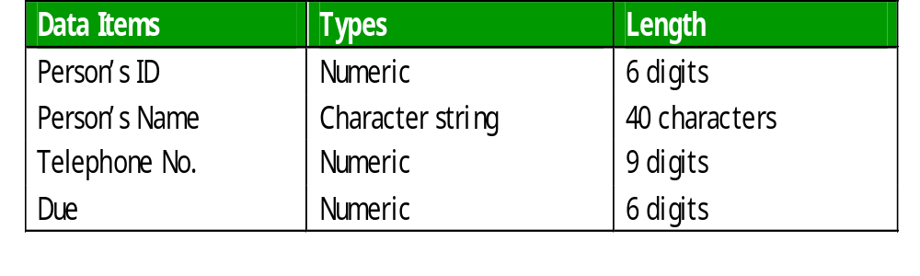
Items of record
The following data items may constitute a record.

Slide 4
Record in C/C++
Record in C/C++ is called structure.
A structure can be defined as follows:
  struct
  { keyword
  int rollno;
  char name[35];
  int marks; An array
  }student;
  structure variable
Here, “name” is an array of 35 characters.
An array may be a member (field) of a structure (record).

Slide 5
Memory requirement for a record
  struct
  {
  int rollno;
  char name[35];
  int marks;
  }stud;
Name of field | Type of field | Required space in byte
rollno | int | 2
name | char | 1 X 35= 35
marks | int | 2
Total = 39 bytes

Slide 6
Record in C/C++
We can assign value to the members of the structure (stud) as follows:
  stud.rollno = 5011;
  stud.name[ ] = “H.M. Mehedi Hasan”;
  stud.marks = 50;
  In other way we can use scanf() to store (assign) data to members
  of a structure as follows.
  scanf (“%d”, &stud.rollno);
  gets (name);
  scanf(“%d”, &stud.marks);

Slide 7
Array of structures
Example:
  struct
  {
  int rollno;
  char name[40];
  int marks;
  }stud [30];
    Here, stud is an array of structures where
    members are roll_no, name[ ] and marks, here
    Name[ ] is an array.
    Question:
    Calculate the space (memory) required for the above code.

Slide 8
RECORD
If there is an array of structures, we can assign the members of the structure (stud) as follows:
  stud [2].rollno = 5011;
  stud [2].name[ ] = “H.M. Mehedi Hasan”;
  stud [2].marks = 50;
  In other way we can use scanf() and gets() to store data:
  scans (“%d”, &stud[2].rollno);
  gets(stud[2].name);
  scanf(“%d”, stud[2].marks);

Slide 9
RECORD
If we want to store data to a record (structure) for more than one person or student, then we need array of structures.
But disadvantage is that, for these types of array a huge amount of memory space may be misused or wasted.

Slide 10
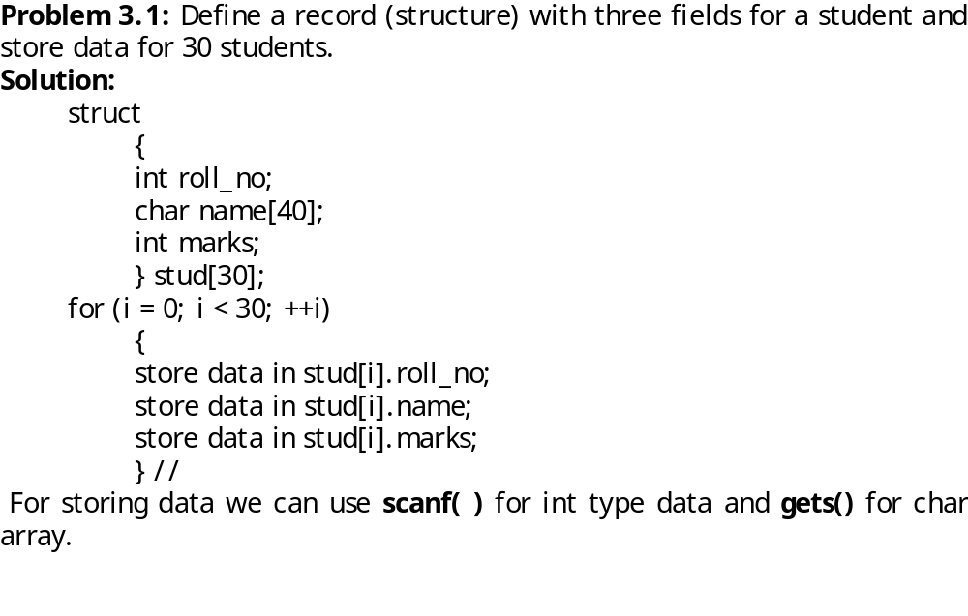
Algorithm for record operation
.

Slide 11
Code for storing data using C/C++
struct
{
int rollno;
char name[40];
int marks;
}stud[30];
for(i=0; i<30; ++i) loop for array, stud.
{
scanf(“%d”,&stud[i].rollno);
fflush(stdin);
gets(stud[i].name);
scanf (“%d”,&stud[i].marks);
}

Slide 12
Code for printing the data
for(i=0; i<30; ++i)
{
cout>>stud[i].rollno;
cout>>stud[i].name;
cout>>stud[i].marks;
}

Slide 13
Pointer to structure
struct stud
{
int roll:
int marks;
} sptr
struct stud *sptr; //sptr is a pointer to stud structure.
sptr=new(stud); //Allocation memory space for the structure.
cin>>sptr->roll; //for input
cin>>sptr->marks;
cout<<sptr->roll;
cout<<sptr->marks;
roll marks

Slide 14
Difference between an array and a record
  An array is a finite set of same type of data elements.In other words, it is a collection of homogeneous data items (elements).
  Whereas a record is a collection of non-homogenous (different types of) related data items.
  The data items of an array are of same type.
  But in a record, data elements are usually of different types.

Slide 15
Problem on structure
Problem 3.1:
There are 40 students in a class. Each student record contains student ID, Name, Marks of four class tests of a course. Write a program to print the ID, name and average marks of best three tests for each student.

Slide 16
This is the end
of
record

