Slide 1
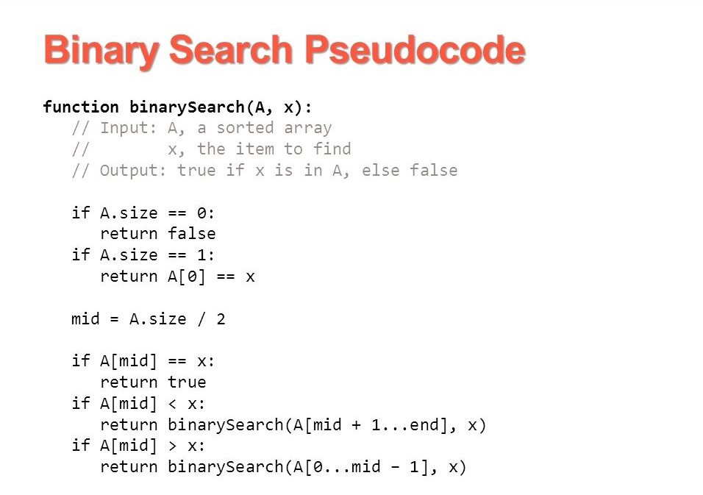
Binary Search

Slide 2
Binary Search
Binary search. Given value and sorted array a[], find index i
such that a[i] = value, or report that no such index exists.
Invariant. Algorithm maintains a[lo] ≤ value ≤ a[hi].
Ex. Binary search for 33.
6
13
14
25
33
43
51
53
64
72
84
93
95
96
97
0
1
2
3
4
5
6
7
8
9
10
11
12
13
14
lo
hi

Slide 3
Binary Search
Binary search. Given value and sorted array a[], find index i
such that a[i] = value, or report that no such index exists.
Invariant. Algorithm maintains a[lo] ≤ value ≤ a[hi].
Ex. Binary search for 33.
6
13
14
25
33
43
51
53
64
72
84
93
95
96
97
0
1
2
3
4
5
6
7
8
9
10
11
12
13
14
lo
mid
hi

Slide 4
Binary Search
Binary search. Given value and sorted array a[], find index i
such that a[i] = value, or report that no such index exists.
Invariant. Algorithm maintains a[lo] ≤ value ≤ a[hi].
Ex. Binary search for 33.
6
13
14
25
33
43
51
53
64
72
84
93
95
96
97
0
1
2
3
4
5
6
7
8
9
10
11
12
13
14
lo
hi

Slide 5
Binary Search
Binary search. Given value and sorted array a[], find index i
such that a[i] = value, or report that no such index exists.
Invariant. Algorithm maintains a[lo] ≤ value ≤ a[hi].
Ex. Binary search for 33.
6
13
14
25
33
43
51
53
64
72
84
93
95
96
97
0
1
2
3
4
5
6
7
8
9
10
11
12
13
14
lo
mid
hi

Slide 6
Binary Search
Binary search. Given value and sorted array a[], find index i
such that a[i] = value, or report that no such index exists.
Invariant. Algorithm maintains a[lo] ≤ value ≤ a[hi].
Ex. Binary search for 33.
6
13
14
25
33
43
51
53
64
72
84
93
95
96
97
0
1
2
3
4
5
6
7
8
9
10
11
12
13
14
lo
hi

Slide 7
Binary Search
Binary search. Given value and sorted array a[], find index i
such that a[i] = value, or report that no such index exists.
Invariant. Algorithm maintains a[lo] ≤ value ≤ a[hi].
Ex. Binary search for 33.
6
13
14
25
33
43
51
53
64
72
84
93
95
96
97
0
1
2
3
4
5
6
7
8
9
10
11
12
13
14
lo
mid
hi

Slide 8
Binary Search
Binary search. Given value and sorted array a[], find index i
such that a[i] = value, or report that no such index exists.
Invariant. Algorithm maintains a[lo] ≤ value ≤ a[hi].
Ex. Binary search for 33.
6
13
14
25
33
43
51
53
64
72
84
93
95
96
97
0
1
2
3
4
5
6
7
8
9
10
11
12
13
14
lo
hi

Slide 9
Binary Search
Binary search. Given value and sorted array a[], find index i
such that a[i] = value, or report that no such index exists.
Invariant. Algorithm maintains a[lo] ≤ value ≤ a[hi].
Ex. Binary search for 33.
6
13
14
25
33
43
51
53
64
72
84
93
95
96
97
0
1
2
3
4
5
6
7
8
9
10
11
12
13
14
lo
hi
mid

Slide 10
Binary Search
Binary search. Given value and sorted array a[], find index i
such that a[i] = value, or report that no such index exists.
Invariant. Algorithm maintains a[lo] ≤ value ≤ a[hi].
Ex. Binary search for 33.
6
13
14
25
33
43
51
53
64
72
84
93
95
96
97
0
1
2
3
4
5
6
7
8
9
10
11
12
13
14
lo
hi
mid

