Slide 1
Object-Oriented Programming with Java
Spring 2007
Michael Zheng
Associate Professor
Software School
Yunnan University

Slide 2
My Background
Education
  Master in Software Engineering/Metallurgy and Materials, Bachelor in Computer and Information Science, Bachelor in Metal Processing
6 Years work experience in IBM Australia
  Work involved:
    Developing middleware applications using C++/Corba/MQ, Web applications using Websphere/VAJ.
    PM - Manage 5 major applications (as Project Manager) for Telstra.
    Cutover manager
    IT Consultant, Architect
  Certifications
    IBM advanced Websphere (RAD) certificate, IBM MQ Series, Rational Rose, IBM Advanced JAVA using Visual Age Java, Rational OOAD, Advanced C++ ， IBM Louts Domino， IBM DB2 fundamental and admin, IBM Project Management

Slide 3
My Contact
  Mobile: 13987629933
  Email: zhengqian@hotmail.com; MichaelZheng@edu.ynu.cn

Slide 4


Textbook
Core Java Volume 1 - Fundamentals 7th edition by Horstmann and Cornell
Core Java 2 Volume II - Advanced Features,7E

Slide 5
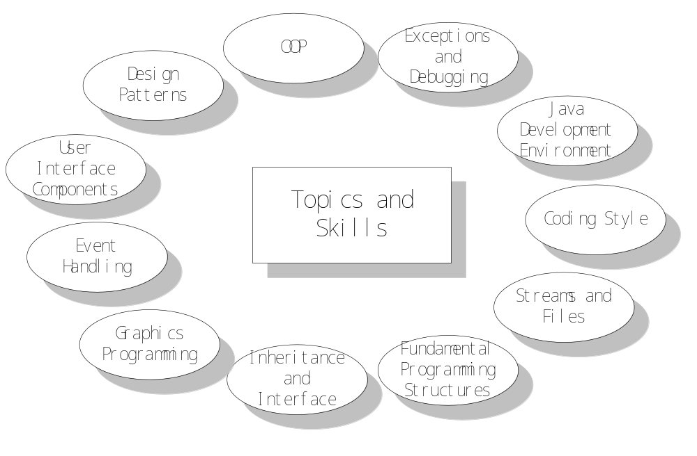
What will be covered – Java Fundamentals

Slide 6
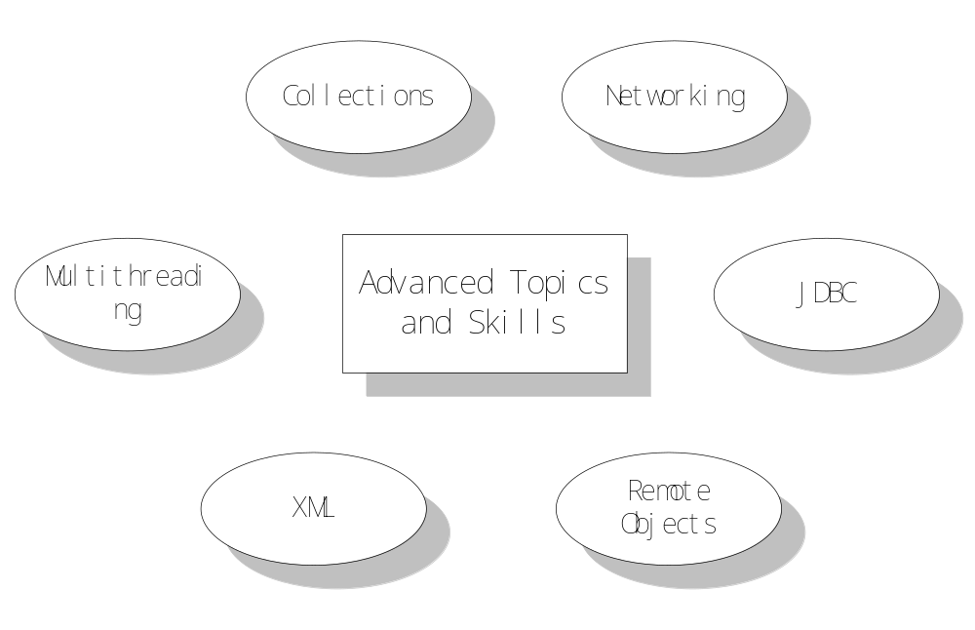
What will be covered – Advanced Java Features

Slide 7
Object-oriented programming
The three pillars of object orientation:
  Encapsulation
  Inheritance
  Polymorphism
Some other features are necessary to make an object-oriented language suitable for real software engineering:
  Reflection
  Dynamic loading
  Serialization

Slide 8
Object-Oriented Programming (OOP) vs. Top-Down (Procedural) Programming
OO approach
  System is defined as a collection of objects that work together to accomplish tasks
    Objects carry out actions when asked
    Each object maintains its own data
Procedural approach
  System is defined as a set of procedures that interact with data
    Data is maintained separately from procedures

Slide 9
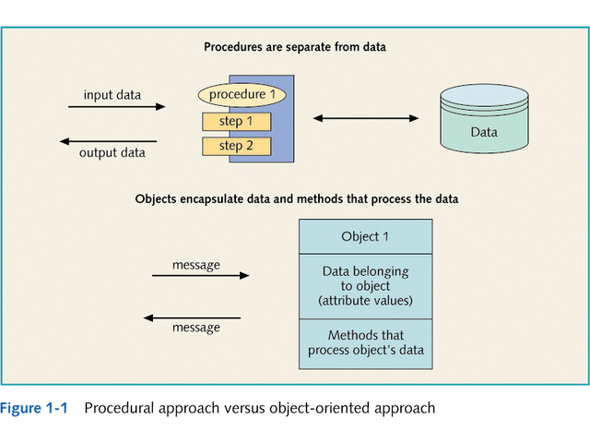

Slide 10
Advantages of Object-Oriented System Development
Objects are more natural
Reuse
  Classes and objects can be invented once and used many times during analysis, design, and programming
  Do not need source code for reused class, simply need to know interface

Slide 11
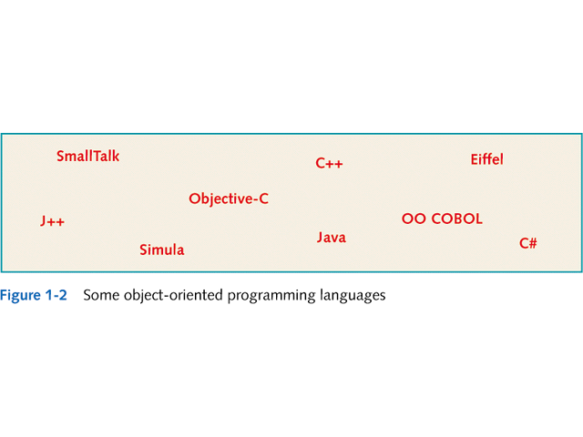

Slide 12
Java

Slide 13
Java
Created by Sun in the early 90s
Originally called “Oak”
Released in 1995 with tons of hype
“Write once, run anywhere!” — portable ‘object’ code
Initial client-side usefulness compromised by poor implementations in browsers
Sun now provides Java plug-ins for common browsers

Slide 14
Advantages of Java
A runtime environment that provides platform independence
  you can use the same code on Windows, Solaris, Linux, Macintosh, and so on
Object-oriented
  Everything in Java, except for a few basic types like numbers, is an object.
Based loosely on C++ (syntax similar to that of C++)

Slide 15
Advantages of Java
No manual memory allocation and deallocation - Automatic memory management
  Memory in Java is automatically garbage collected. You never have to worry about memory corruption.
Safe arrays and no pointers.
  You never have to worry about overwriting an area of memory because of an off-by-one error when working with a pointer.
No confuse of testing for equality in a conditional statement.
  if (ntries = 3) // wrong
No multiple inheritance
  replacing it with a new notion of interface.
  Interfaces give you most of what you want from multiple inheritance, without the complexity of managing multiple inheritance hierarchies.
Only call-by-value
Immutable strings
Well-defined datatypes

Slide 16
The Big Advantage of Java
Portability
  Programs can be written and compiled once, then run on different platforms
    Important for internet applications (applets)
  Achieved by using:
    Bytecode
      Produced when a Java program is compiled
    Interpreter (Java Virtual Machine – JVM)
      Execution environment for bytecode on each platform

Slide 17
Java buzzwords
Simple
Portable
Object-oriented
Interpreted
Distributed
High performance
Robust
Multithreaded
Secure
Dynamic
Architecture Neutral

Slide 18
Java buzzwords
Simple
  A cleaned-up version of the syntax for C++.
  No header files, pointers, structures, unions, operator overloading, virtual base classes
Object-oriented
  A technique for programming that focuses on the data (objects) and on the interfaces to that object
Distributed
  The networking capabilities of Java is strong and easy to use
Robust
  emphasis on early checking, later dynamic (run-time) checking, and eliminating possible problems and no pointers

Slide 19
Java buzzwords
Secure
  Sample of Java's security features
    Overrunning the runtime stack, like the infamous Internet worm did;
    Corrupting memory outside its own process space;
    Reading or writing local files when invoked through a security-conscious class loader
Architecture Neutral
  The compiler generates an architecture-neutral Bytecode which is executable on many processors, given the presence of the Java run time system.
Portable
  The sizes of the primitive data types are specified
  The libraries define portable interfaces

Slide 20
Java buzzwords
Interpreted
  The Java interpreter can execute Java bytecodes directly on any machine to which the interpreter has been ported
High performance
  The bytecodes can be translated at run time into machine code for the particular CPU the application is running on.
Multithreaded
  Better interactive responsiveness and real-time behavior
Dynamic
  Libraries can freely add new methods and instance variables without any effect on their clients.
  In Java, finding out run time type information is straightforward.

Slide 21
The Java class libraries
Java includes a huge set of classes for:
  Graphical user interfaces
  Collections
  Networking
  Introspection
  …and lots more
3,000+ classes
32,000+ methods

Slide 22
The Java Virtual Machine (JVM)
Interprets bytecodes generated by the compiler.
Designed to enhance security and robustness of code.
Tightly defined:
  Datatypes
  Operations
  Exceptions
  etc…
Intended to promote cross-platform code — bytecode (.class) files are portable.

Slide 23
Java 2 is PAH (Pure Acronym Heaven)
“Java 2” is version 1.4 of the Java language and runtime.
JVM == Java Virtual Machine
JRE == Java Runtime Environment
J2SE == Java 2 Standard Edition
J2EE == Java 2 Enterprise Edition
J2ME == Java 2 Micro Edition
JDK == Java Development Kit
SDK == Software Development Kit
JCP == Java Community Process
API == Application Programming Interface
IDE == Integrated Development Environment

Slide 24
Java Development

Slide 25
Steps to developing a Java program
Classical edit-compile-run cycle.
Create source file(s) with *.java extension.
Use the javac compiler to compile the source files to bytecode class files (*.class).
Run the application using the java interpreter.
Document your application using javadoc.

Slide 26
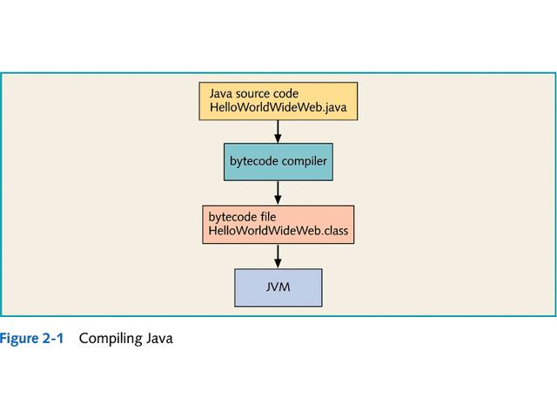

Slide 27
Development environments
Development environments
  Java Development Kit
    Available free from Sun Web site: java.sun.com
    Includes: compiler JVM and prewritten classes
  Integrated Development Environments (IDEs)
    Sophisticated editors
    Debugging tools
    Graphical development tools
  Ex. JBuilder, VAJ, Eclipse
In this course, we will use an IDE – JCreator 4.0

Slide 28
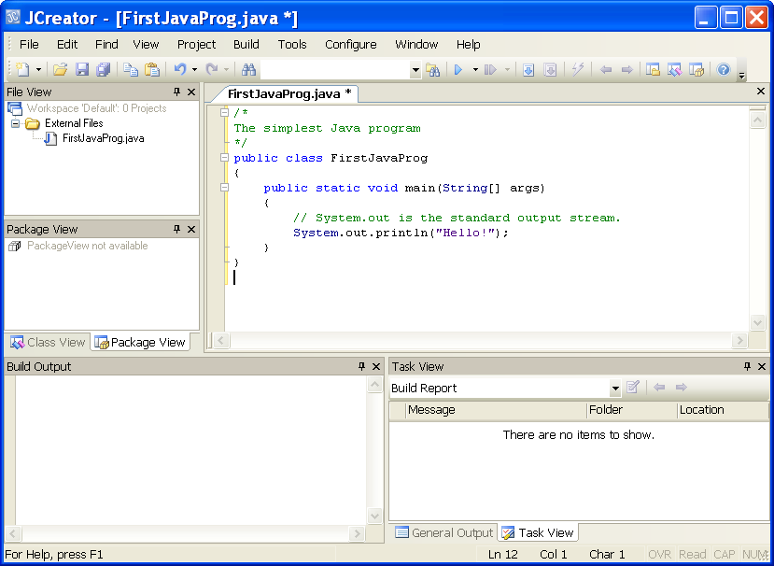
The Java Development Tool Used in This Course

Slide 29
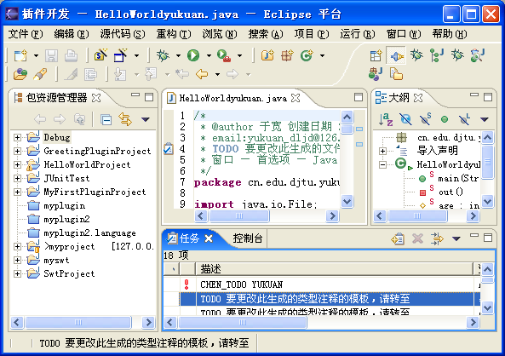
Alternative IDE

Slide 30
Building a Java Class
Applets vs. Applications vs. Servlets
  Applets run on the client in a browser
  Applications run on the client on their own
  Servlets run on the server
Each source code file defines a class
  Class
    HelloWorldWideWeb
  File
    HelloWorldWideWeb.java

